Slide 1
Introduction to Physical Science
What is Science?
Presented by Robert Wagner

Slide 2
What Is Physics?
Physics can explain a wide variety of phenomena
Flight of birds
Color of flowers
Falling objects
Subatomic particles
Structure of galaxies
And More!

Slide 3
What is Physics?
Physics can explain a wide variety of phenomena
Flight of birds
Color of flowers
Falling objects
Subatomic particles
Structure of galaxies
And More!
Image Credit: A.Savin (Wikimedia Commons · WikiPhotoSpace), FAL, via Wikimedia Commons

Slide 4
What is Physics?
Physics can explain a wide variety of phenomena
Flight of birds
Color of flowers
Falling objects
Subatomic particles
Structure of galaxies
And More!
Image Credit: Ibrahim Husain Meraj, CC BY-SA 4.0 <https://creativecommons.org/licenses/by-sa/4.0>, via Wikimedia Commons

Slide 5
What is Physics?
Physics can explain a wide variety of phenomena
Flight of birds
Color of flowers
Falling objects
Subatomic particles
Structure of galaxies
And More!
Image Credit: Zátonyi Sándor, (ifj.) Fizped, CC BY 3.0 <https://creativecommons.org/licenses/by/3.0>, via Wikimedia Commons

Slide 6
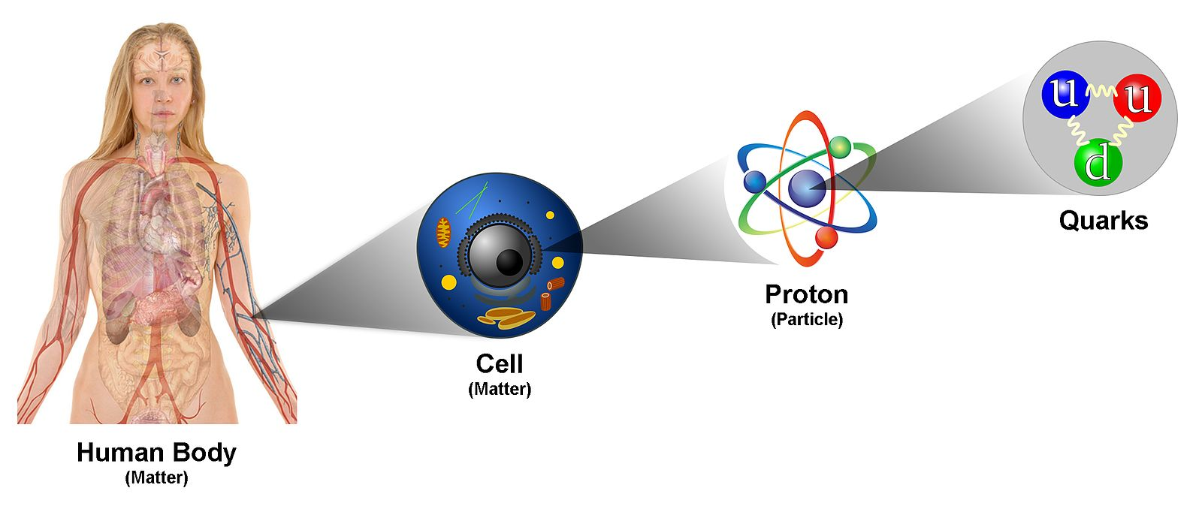
What is Physics?
Physics can explain a wide variety of phenomena
Flight of birds
Color of flowers
Falling objects
Subatomic particles
Structure of galaxies
And More!
Image Credit: Finches&quarks, CC BY-SA 4.0 <https://creativecommons.org/licenses/by-sa/4.0>, via Wikimedia Commons

Slide 7
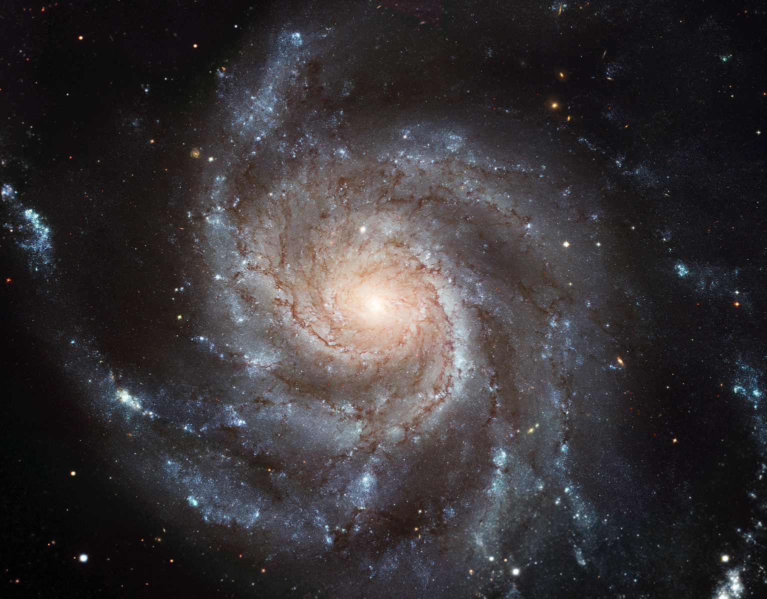
What is Physics?
Physics can explain a wide variety of phenomena
Flight of birds
Color of flowers
Falling objects
Subatomic particles
Structure of galaxies
And More!
Image Credit: ESA/Hubble, CC BY 4.0 <https://creativecommons.org/licenses/by/4.0>, via Wikimedia Commons

Slide 8
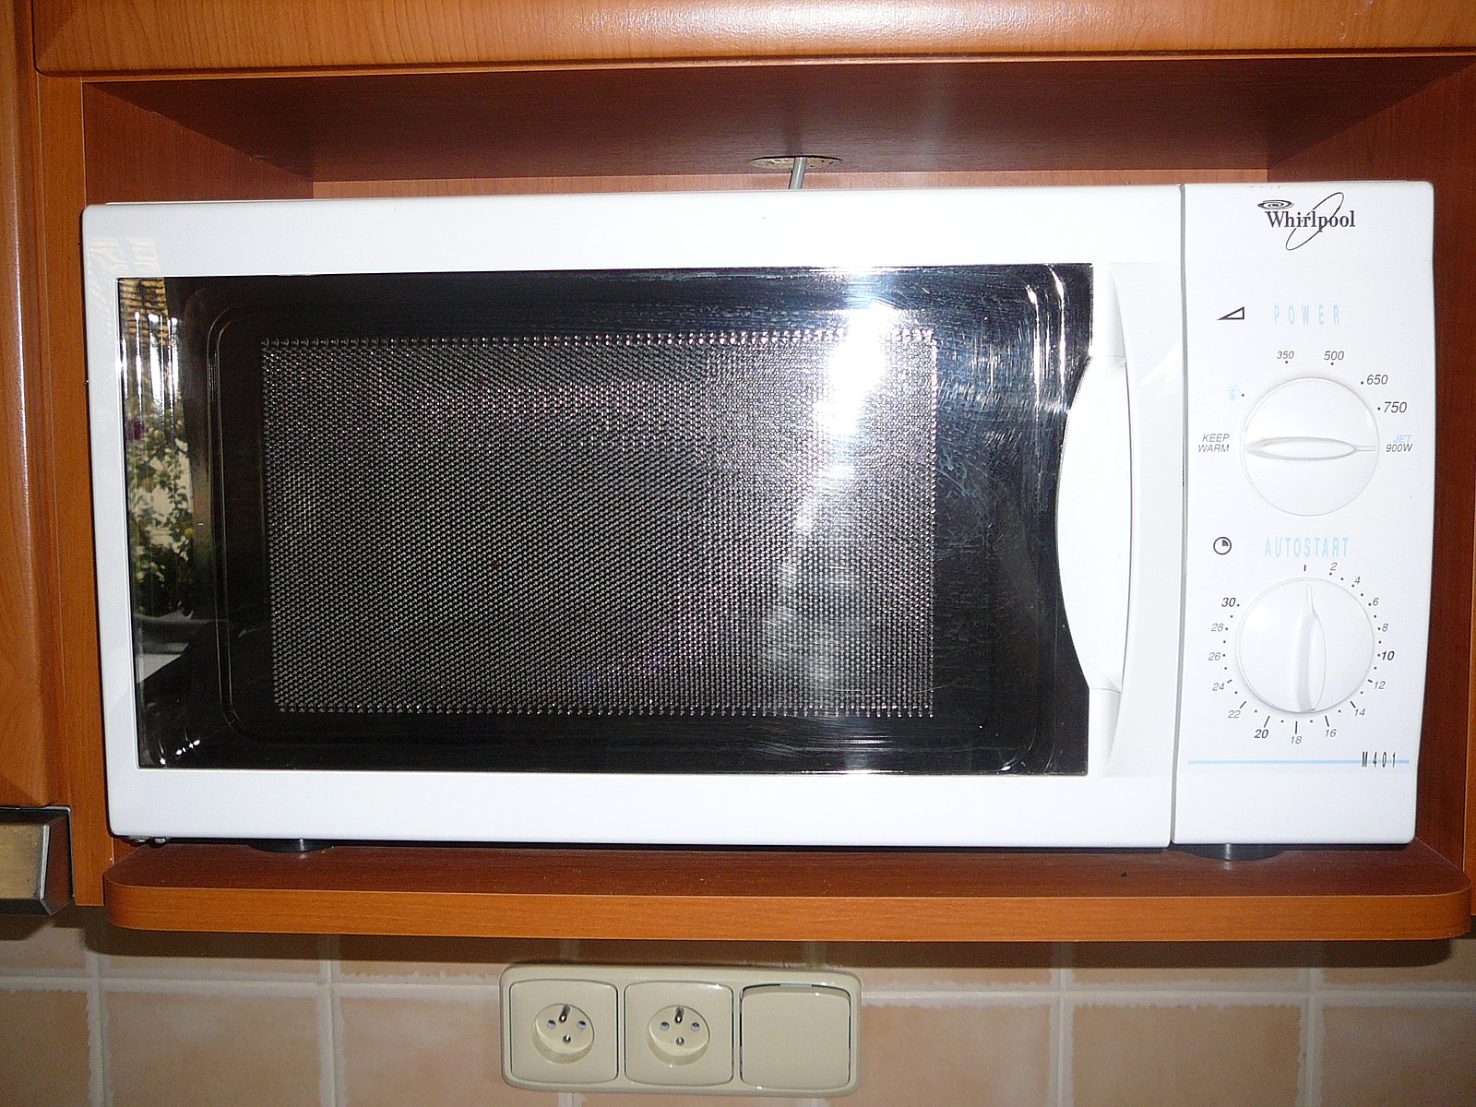
Applications of Physics
Used in everyday life
Microwave ovens
MRI
Electrical Circuits
Earthquakes
Musical instruments
Black Holes
And More!
Image Credit: Pavel Ševela, CC BY-SA 3.0 <https://creativecommons.org/licenses/by-sa/3.0>, via Wikimedia Commons

Slide 9
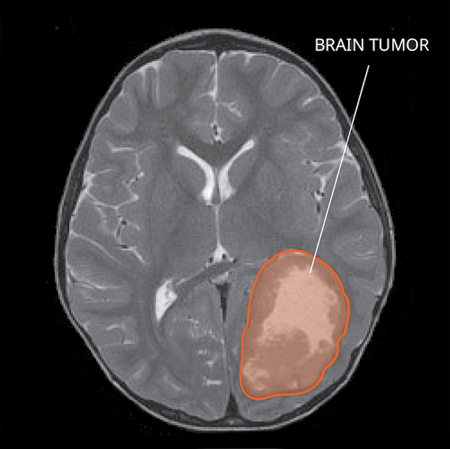
Applications of Physics
Used in everyday life
Microwave ovens
MRI
Electrical Circuits
Earthquakes
Musical Instruments
Black Holes
And More!
Image Credit: NCI-CONNECT Staff, Public domain, via Wikimedia Commons

Slide 10
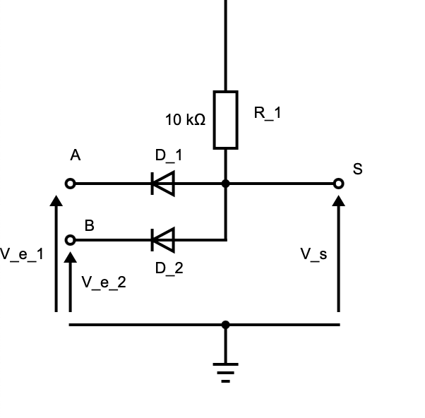
Applications of Physics
Used in everyday life
Microwave ovens
MRI
Electrical Circuits
Earthquakes
Musical instruments
Black Holes
And More!
Image Credit: Pradana Aumars, Public domain, via Wikimedia Commons

Slide 11
Applications of Physics
Used in everyday life
Microwave ovens
MRI
Electrical Circuits
Earthquakes
Musical Instruments
Black Holes
And More!
Image Credit: Chadwick, H. D, Public domain, via Wikimedia Commons

Slide 12
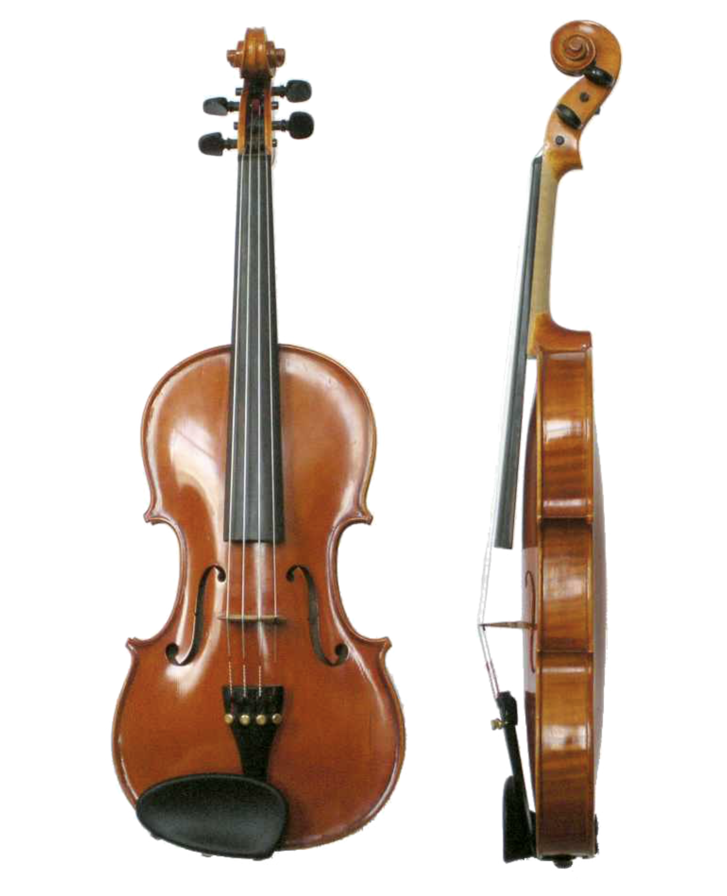
Applications of Physics
Used in everyday life
Microwave ovens
MRI
Electrical Circuits
Earthquakes
Musical Instruments
Black Holes
And More!
Image Credit: Just plain Bill, CC0, via Wikimedia Commons

Slide 13
Applications of Physics
Used in everyday life
Microwave ovens
MRI
Electrical Circuits
Earthquakes
Musical Instruments
Black Holes
And More!
Image Credit: Event Horizon Telescope, CC BY 4.0 <https://creativecommons.org/licenses/by/4.0>, via Wikimedia Commons

Slide 14
Models, Theories, and Laws
Theory/Law
Must be testable – “The Moon is made of Green Cheese!”
Based on observations and study
Model
Simplified representation of how things work
Make assumptions for simplification

Slide 15
The Scientific Method
Starts with an observation – but never ends!
Come up with an hypothesis to explain the observation
Must make a testable prediction
Test the predictions made – make more observations
Predictions found to be correct
Great! Make more predictions and continue testing
Predictions found to be incorrect
Oops! Modify or reject your hypothesis

Slide 16
The Scientific Method
The scientific method as an ongoing process:
By ArchonMagnus - Own work, CC BY-SA 4.0, https://commons.wikimedia.org/w/index.php?curid=42164616

Slide 17
Summary
Physics can help us to find the explanations for a variety of phenomena in nature
We study physics to learn about the world around us
The scientific method is a never ending process that allows scientists to continually modify, refine and improve their theories and models

