Slide 1
Introduction to Physical Science
Physical Quantities and Units
Presented by Robert Wagner

Slide 2
Numbers in Physics
Physics deals with scales of both the very large and very small
Scientific Notation - based on powers of 10
Systems of Units
SI Units - Used in science worldwide
English Units - Used primarily in the US, outside of science

Slide 3
SI Units
Fundamental and derived units
Fundamental units - defined only in terms of the procedure used to measure them
Derived units - expressed as combinations of fundamental units (velocity = distance/time)
Image Credit: OpenStax College Physics Table 1.1 CC BY 4.0

Slide 4
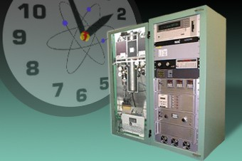
Fundamental Units
For now, we look at three fundamental units
Second - 9,192,631,770 vibrations os a cesium atom
Meter - Distance traveled by light in 1/299,792,458 second
Kilogram - Mass of a platinum-iridium cylinder kept near Paris. (Now defined using the Meter, Second and Planck’s Constant.)
Image Credit: NASA, Public Domain, via Wikimedia Commons

Slide 5
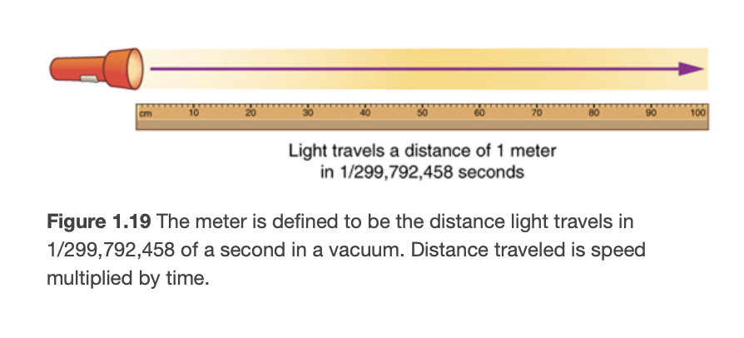
Fundamental Units
For now, we look at three fundamental units
Second - 9,192,631,770 vibrations os a cesium atom
Meter - Distance traveled by light in 1/299,792,458 second
Kilogram - Mass of a platinum-iridium cylinder kept near Paris. (Now defined using the Meter, Second and Planck’s Constant.)
Image Credit: OpenStax College Physics Figure 1.19 CC BY 4.0

Slide 6
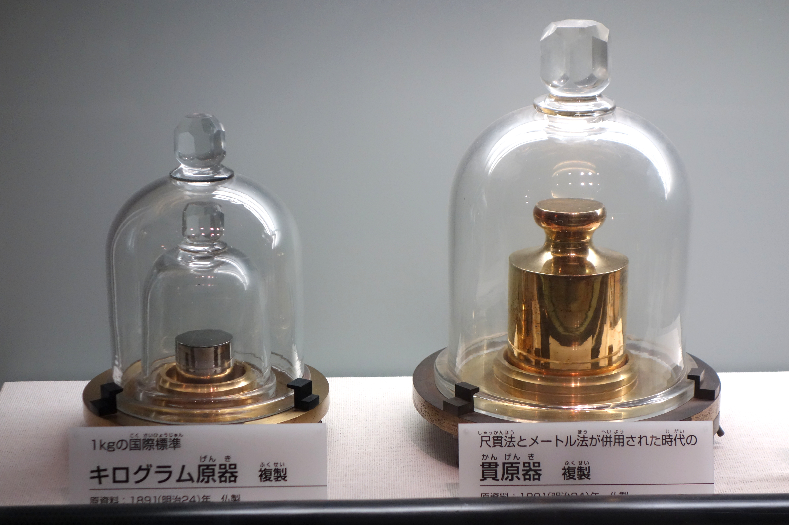
Fundamental Units
For now, we look at three fundamental units
Second - 9,192,631,770 vibrations of a cesium atom
Meter - Distance traveled by light in 1/299,792,458 second
Kilogram - Mass of a platinum-iridium cylinder kept near Paris. (Now defined using the Meter, Second and Planck’s Constant.)
Image Credit: Daderot, CC0, via Wikimedia Commons

Slide 7
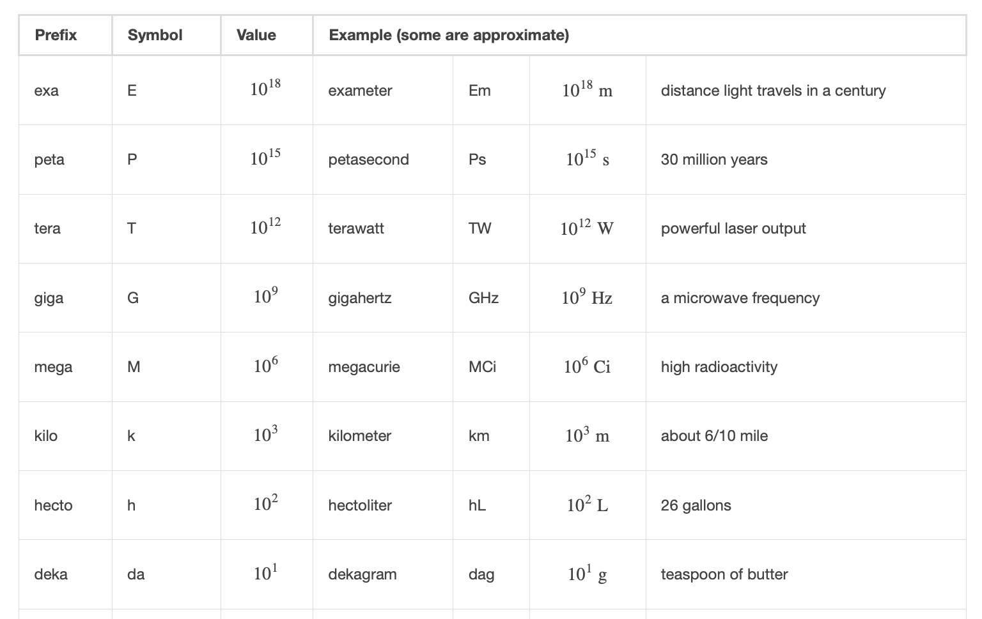
Metric Units
Metric Prefixes:
Based on powers of 10
Scientific Notation
Written as powers of10
800 = 8 x 10²
0.045 = 4.5 x 10⁻²
Image Credit: OpenStax College Physics Table 1.2 CC BY 4.0

Slide 8
Unit Conversions
Convert between units using dimensional analysis
8000 m to km
1.00 year to seconds
60.0 km/hr to m/s
$$8000meters$$
$$8000metersx\frac{1kilometer}{1000meters}$$
$$8000metersx\frac{1kilometer}{1000meters}$$
$$\frac{8000}{1000}kilometers$$
$$8kilometers$$

Slide 9
Unit Conversions
Convert between units using dimensional analysis
8000 m to km
1.00 year to seconds
60.0 km/hr to m/s
$$1.00year$$
$$1.00yearx\frac{365.25days}{1year}x\frac{24hours}{1day}x\frac{60minutes}{1hour}x\frac{60seconds}{1minute}$$
$$1.00yearx\frac{365.25days}{1year}x\frac{24hours}{1day}x\frac{60minutes}{1hour}x\frac{60seconds}{1minute}$$
$$=365.25x24x60x60seconds$$
$$=31,557,600seconds$$
$$=3.16x{10}^{7}seconds$$

Slide 10
Unit Conversions
Convert between units using dimensional analysis
8000 m to km
1.00 year to seconds
60.0 km/hr to m/s
$$60.0\frac{kilometers}{hour}$$
$$60.0\frac{kilometers}{hour}x\frac{1000meters}{1kilometer}x\frac{1hour}{3600seconds}$$
$$60.0\frac{kilometers}{hour}x\frac{1000meters}{1kilometer}x\frac{1hour}{3600seconds}$$
$$=\frac{60.0x1000}{3600}\frac{meters}{second}$$
$$=16.7\frac{meters}{second}$$

Slide 11
Summary
Physics deals with both very large and very small numbers
SI/metric units are used universally in science
We can convert between units by dimensional analysis

