Slide 1
Introduction to Physical Science
Vectors and Scalars
Presented by Robert Wagner

Slide 2
Displacement
What do we mean by displacement?
The change in position of an object
$$Δx=x_{f}-x_{0}$$
$$x_{f}isthefinalposition$$
$$x_{0}istheinitialposition$$
$$Δxisthedisplacement$$
SI unit of displacement is the meter

Slide 3
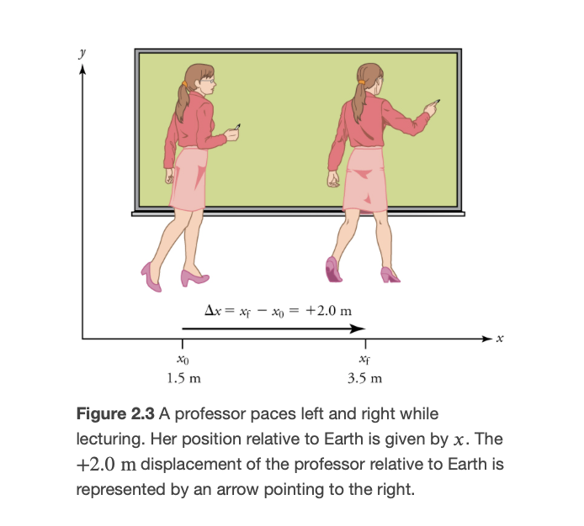
Displacement
Displacement explained
Only looks at initial and final position
Does NOT tell us about total motion!
Is a vector quantity - magnitude and direction
Example: Motion of professor
Image Credit: OpenStax College Physics Figure 2.3 CC BY 4.0

Slide 4
Displacement
Displacement explained
Only looks at initial and final position
Does NOT tell us about total motion!
Is a vector quantity - magnitude and direction
Example: Motion of professor
Distance vs. Distance traveled
Distance is the magnitude of the displacement vector
$$x_{0}=1.5m$$
$$x_{f}=3.5m$$
$$Δx=x_{f}-x_{0}$$
$$Δx=3.5m-1.5m$$
$$Δx=+2.0m$$
The positive sign indicates movement in the +x direction

Slide 5
Vectors and Scalars
Scalar Quantity:
Has a magnitude, but no direction
Temperature: ${30}^{o}C$
Distance: 5.0 meters
Vector Quantity
Has a magnitude and a direction
Velocity: 30 m/s East
Force: 35 N down
Can be indicated with an arrow - longer arrow means a larger magnitude ; direction of arrow indicates the direction
Can be indicated with a + or - sign. The sign tells the direction ; numerical value indicates magnitude

Slide 6
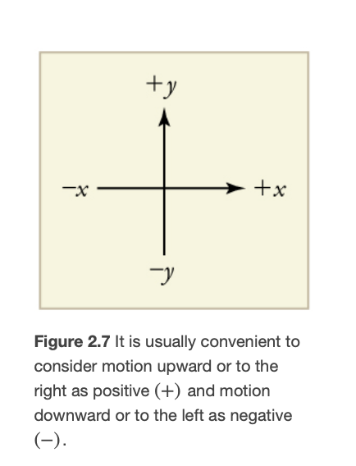
Coordinate Systems
In general,
Horizontal motion: motion to the right is positive
Vertical motion: motion upward is positive
Sometimes it is more convenient to switch these
Example: falling objects
Image Credit: OpenStax College Physics Figure 2.7 CC BY 4.0

Slide 7
Summary
Displacement is the net motion of an object. It is a vector quantity
Vectors have a magnitude and a direction - Scalars have only a magnitude
Coordinate systems can be chosen to make the analysis of the problem easier

