Slide 1
Introduction to Physical Science
Velocity and Acceleration
Presented by Robert Wagner

Slide 2
Time
One of the fundamental physical quantities
In physics, it is the interval over which change occurs.
$$Δt=t_{f}-t_{o}$$
$$t_{f}isthefinaltime$$
$$t_{o}istheinitialtime(oftendefintedtobe0.)$$
For our purposes, $t_{o}=0$, and t itself represents elapsed time.

Slide 3
Velocity
Average velocity
Change in velocity divided by change in time
Velocity is a vector ; SI unit meter/second
Ex: If we travel -20 meters in 5 seconds
Negative sign indicates the direction of motion
Velocity can be negative, speed cannot be negative
$$\overline{v}=\frac{Δx}{Δt}=\frac{x_{f}-x_{o}}{t_{f}-t_{o}}$$
$$\overline{v}=\frac{-20meters}{5seconds}$$
$$\overline{v}=-4m/s$$

Slide 4
Average Velocity
$\overline{v}$ only tells us the average motion during that time.
Velocity could vary
Instantaneous velocity
Velocity that occurs at a particular instant - (i.e. speedometer)

Slide 5
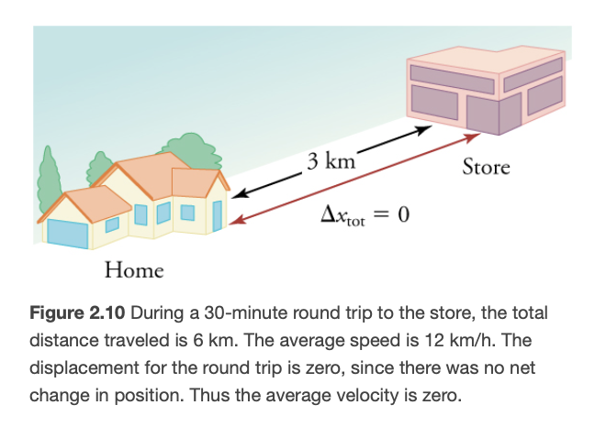
Example
A trip to the store and back
Displacement = 0 since we end up where we started!
If a trip takes 30. minutes (half an hour)
$\overline{v}=0m/s$
Average speed: ($\frac{6.0km}{0.50hour}=12km/hr$)
Why is $\overline{v}$ equal to 0 km/hr?
Velocity is positive in one direction and negative in the other.
Image Credit: OpenStax College Physics Figure 2.10 CC BY 4.0

Slide 6
Acceleration
Average Acceleration
Change in velocity divided by the change in time
Acceleration is a vector quantity
SI units are $\frac{m}{s^{2}}$
Ex: Going from 0 to 10. m/s in 5.0 seconds
Acceleration occurs when velocity changes
Can increase, decrease, or change direction
Instantaneous acceleration
$$\overline{a}=\frac{Δv}{Δt}=\frac{v_{f}-v_{o}}{t_{f}-t_{o}}$$
$$\overline{a}=\frac{Δv}{Δt}=\frac{10.m/s}{5.0s}$$
$$\overline{a}=2.0m/s^{2}$$

Slide 7
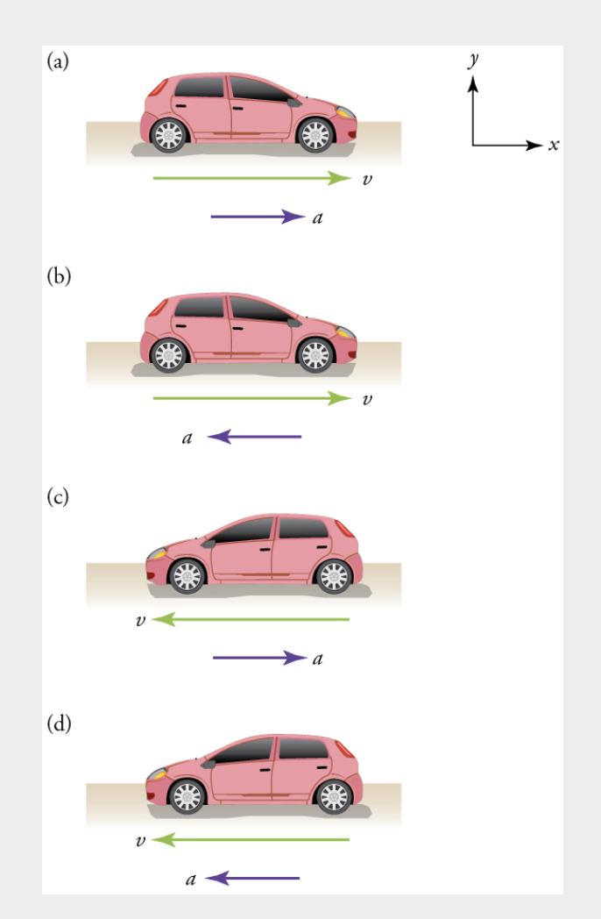
Deceleration
Acceleration opposite to the direction of motion
(a) has a positive acceleration and is speeding up
(b) has a negative acceleration and is slowing down
(c) has a positive acceleration but is slowing down
(d) has a negative acceleration and is speeding up
Deceleration $≠$ Negative acceleration
Image Credit: OpenStax College Physics - Figure 2.14 CC BY 4.0

Slide 8
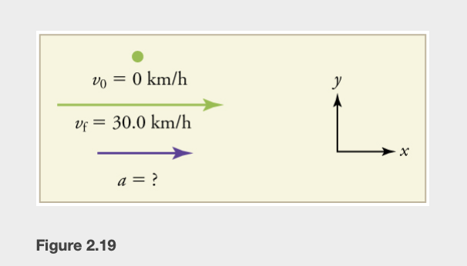
Example : Train Slowing
Train accelerates from 30.0 km/hr in the first 20.0 s of its motion
Start with a sketch
What do we know?
Calculate Δv
Solve for $\overline{a}$
Convert to get rid of mixed units - Use SI units
Image Credit: OpenStax College Physics - Figure 2.16 CC BY 4.0

Slide 9
Example : Train Slowing
Train accelerates from 30.0 km/hr in the first 20.0 s of its motion
Start with a sketch
What do we know?
Calculate Δv
Solve for $\overline{a}$
Convert to get rid of mixed units - Use SI units
$$v_{o}=0km/hr;v_{f}=30.0km/hr;Δt=20.0s$$
$$Δv=v_{f}-v_{o}=+30.0km/hr-0km/hr=30.0km/hr$$
$$\overline{a}=\frac{Δv}{Δt}=\frac{+30.0km/hr}{20.0s}=1.5km/hr/s$$
$$\overline{a}=\frac{+30.0km/hr}{20.0s}x\frac{1000m}{1km}x\frac{1hr}{3600s}$$
$$\overline{a}=0.417m/s^{2}$$
Image Credit: OpenStax College Physics - Figure 2.16 CC BY 4.0

Slide 10
Summary
Acceleration and velocity are both vectors
Deceleration is not necessarily the same as a negative acceleration
In physics, acceleration occur when an object increases speed, decreases speed or changes direction

