Slide 1
Introduction to Physical Science
Equations of Motion
Presented by Robert Wagner

Slide 2
Notation
Take the initial time to be zero
$Δt=t_{f}-t_{o}$ so, $Δt=t$
Drop the f subscript for final values
$$Δx=x-x_{o};Δv=v-v_{o}$$
Assume constant acceleration (avoid calculus!)
$$\overline{a}=a=constant$$

Slide 3
Kinematic Equations
Solving for displacement (Δx) and final position (x)
Equation 1: $x=x_{o}+\overline{v}t$
Equation 2: $\overline{v}=\frac{v_{o}+v}{2}$ (for constant acceleration)

Slide 4
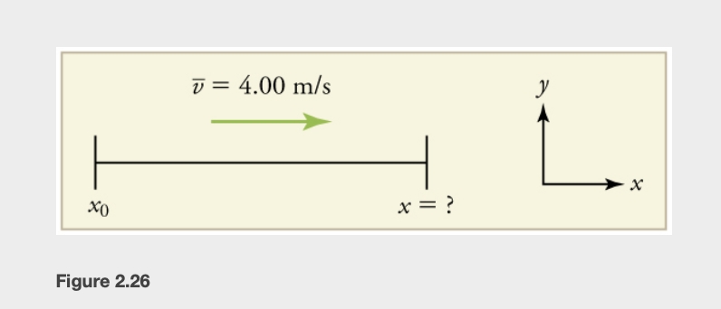
Example
A jogger runs with an average velocity of 4.00 m/s for 2.00 minutes. What is the final position?
Draw a sketch
Identify equation - final position
Identify known values
Convert units as needed (minutes to seconds)
Enter values in the equation
Image Credit: OpenStax College Physics - Figure 2.26 CC BY 4.0

Slide 5
Example
A jogger runs with an average velocity of 4.00 m/s for 2.00 minutes. What is the final position?
Draw a sketch
Identify equation - final position
Identify known values
Convert units as needed (minutes to seconds)
Enter values in the equation
$$x=x_{o}+\overline{v}t$$
$$\overline{v}=4.00m/s;Δt=2.00min;x_{o}=0m$$
$$2.00minx\frac{60seconds}{1min}=120.seconds$$
$$x=0m+(4.00m/s)(120.s)$$
$$x=480.meters$$
Image Credit: OpenStax College Physics - Figure 2.26 CC BY 4.0

Slide 6
Kinematic Equations
Solving for final velocity
$$v=v_{o}+at$$
Applies with constant acceleration

Slide 7
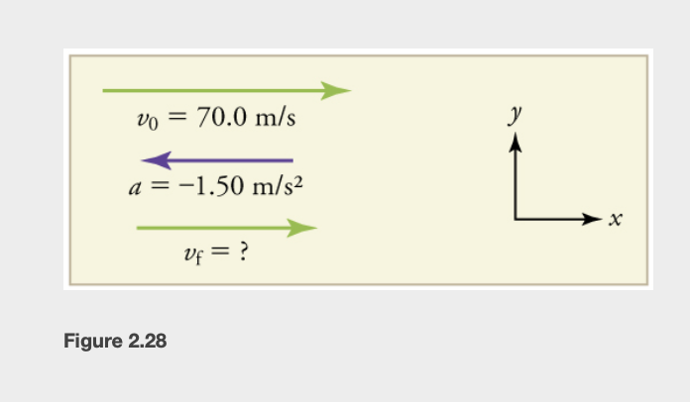
Example
An airplane lands with an initial velocity of 70.0 m/s and decelerates at 1.50 m/s² for 40.0 s. What is the final velocity?
Draw a sketch
List known values ; identify unknown
Determine equation to use
Plug in known values and solve
Acceleration negative means that final velocity will be less than initial velocity
Image Credit: OpenStax College Physics - Figure 2.28 CC BY 4.0

Slide 8
Example
An airplane lands with an initial velocity of 70.0 m/s and decelerates at 1.50 m/s² for 40.0 s. What is the final velocity?
Draw a sketch
List known values ; identify unknown
Determine equation to use
Plug in known values and solve
Acceleration negative means that final velocity will be less than initial velocity
$$v_{o}=70.0m/s;a=-1.50m/s^{2};t=40.0s$$
Unknown = $v_{f}$
$$v=v_{o}+at$$
$$v=70.0m/s+(-1.50m/s^{2})(40.0s)$$
$$v=10.0m/s$$
Image Credit: OpenStax College Physics - Figure 2.28 CC BY 4.0

Slide 9
Kinematic Equations
Solving for the final position when velocity is not constant
Acceleration $≠$ 0
$$x=x_{o}+v_{o}t+\frac{1}{2}at^{2}$$

Slide 10
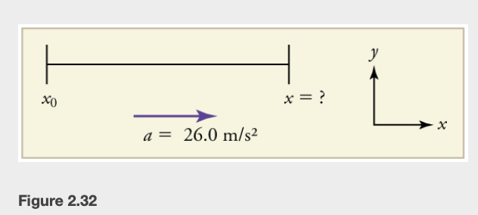
Example
A dragster accelerates at 20.0m/s² for 5.56 seconds. How far does it travel during this time?
Draw a sketch
Identify known values and unknown
Identify equation to use
Plug in known values and solve equation
Image Credit: OpenStax College Physics Figure 2.32 CC BY 4.0

Slide 11
Example
A dragster accelerates at 20.0m/s² for 5.56 seconds. How far does it travel during this time?
Draw a sketch
Identify known values and unknown
Identify equation to use
Plug in known values and solve equation
$$v_{o}=0;a=26.0m/s^{2};t=5.56s$$
Unknown: $x$
$$x=x_{o}+v_{o}t+\frac{1}{2}at^{2}$$
$x_{o}andv_{o}$ are both zero
$x=\frac{1}{2}at^{2}$
$$x=\frac{1}{2}(26.0m/s^{2})(5.56s)^{2}$$
$$x=402m$$
Image Credit: OpenStax College Physics Figure 2.32 CC BY 4.0

Slide 12
Kinematic Equations
Solving for the final velocity when velocity is not constant
Acceleration $≠$ 0
$$v^{2}=v_{o}^{2}+2a(x-x_{o})$$

Slide 13
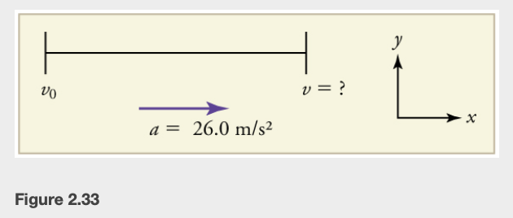
Example
Calculate the final velocity of the dragster from the previous example without using the time.
Draw a sketch
Identify known values and unknown
Identify equation to use
Plug in known values and solve equation
Image Credit: OpenStax College Physics Figure 2.32 CC BY 4.0

Slide 14
Example
Calculate the final velocity of the dragster from the previous example without using the time.
Draw a sketch
Identify known values and unknown
Identify equation to use
Plug in known values and solve equation
$$v_{o}=0;(x-x_{o})=402m;a=26.0m/s^{2}$$
Unknown - final velocity
$$v^{2}=v_{o}^{2}+2a(x-x_{o})$$
$$v^{2}=0^{2}+2(26.0m/s^{2})(402m)$$
$$v^{2}=2.09x{10}^{4}m^{2}/s^{2}$$
$$v=\sqrt{2.09x{10}^{4}m^{2}/s^{2}}=145m/s$$
Image Credit: OpenStax College Physics Figure 2.32 CC BY 4.0

Slide 15
Kinematic Equations
Summary of the kinematic equations (constant acceleration)
$$x=x_{o}+\overline{v}t$$
$$\overline{v}=\frac{v_{o}+v}{2}$$
$$v=v_{o}+at$$
$$x=x_{o}+v_{o}t+\frac{1}{2}at^{2}$$
$$v^{2}=v_{o}^{2}+2a(x-x_{o})$$

Slide 16
Problem Solving Strategies
1) Examine the situation and draw a simple sketch
2) Make a list of what is known
3) Identify what needs to be determined in the problem
4) Find an equation or equations to help you solve the problem
5) Substitute known values into the equation - check units
6) Is the answer reasonable?

Slide 17
Summary
The kinematic equations can be used to solve many problems in one dimension
In these, we assume that the acceleration is constant
Utilizing problem solving strategies will help you to solve various physics problems

