Slide 1
Introduction to Physical Science
Falling Objects
Presented by Robert Wagner

Slide 2
Gravity
All objects fall at the same rate in a gravitational field
Mass does not matter
If we can eliminate air resistance, a hammer and a feather will fall at the same rate
Free fall
Acceleration due to gravity
$$g=9.80m/s^{2}$$
Can be positive or negative depending on coordinate system used.
If up is positive, $a=-g=-9.80m/s^{2}$
If down is positive, $a=g=9.80m/s^{2}$

Slide 3
Kinematic Equations - Free Fall
Using upward direction as positive,
Equation 1: $v=v_{o}-gt$
Equation 2: $y=y_{o}+v_{o}t-\frac{1}{2}gt^{2}$
Equation 3: $v^{2}=v_{o}^{2}-2g(y-y_{o})$

Slide 4
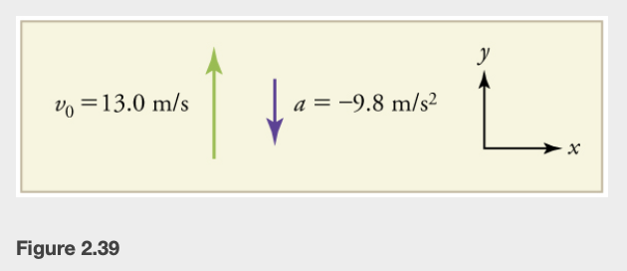
Example
A person at the edge of a cliff throws a rock straight upward with an initial velocity of 13.0 m/s. Find the position and velocity as it falls to earth at 1.00s, 2.00s and 3.00s (neglect air resistance)
Draw a sketch
Identify known values
Identify equation
Enter values in the equation and solve
Image Credit: OpenStax College Physics - Figure 2.39 CC BY 4.0

Slide 5
Example
A person at the edge of a cliff throws a rock straight upward with an initial velocity of 13.0 m/s. Find the position and velocity as it falls to earth at 1.00s, 2.00s and 3.00s (neglect air resistance)
Draw a sketch
Identify known values
Identify equation
Enter values in the equation and solve
$$y_{o}=0;v_{o}=13.0m/s;a=-g=-9.80m/s^{2}$$
$Fort=1.0s$, find position
$$y=y_{o}+v_{o}t-\frac{1}{2}gt^{2}$$
$$y_{1}=0+(13.0m/s)(1.00s)+\frac{1}{2}(-9.80m/s^{2})(1.00s)^{2}$$
$$y_{1}=+8.10m$$
+ sign means it is above its starting position
Image Credit: OpenStax College Physics - Figure 2.39 CC BY 4.0

Slide 6
Example
A person at the edge of a cliff throws a rock straight upward with an initial velocity of 13.0 m/s. Find the position and velocity as it falls to earth at 1.00s, 2.00s and 3.00s (neglect air resistance)
Draw a sketch
Identify known values
Identify equation
Enter values in the equation and solve
$$y_{o}=0;v_{o}=13.0m/s;a=-g=-9.80m/s^{2}$$
$Fort=1.0s$, find velocity
$$v_{1}=v_{o}-gt$$
$$v_{1}=13.0m/s-(9.80m/s^{2})(1.00s)^{2}$$
$$v_{1}=+3.20m/s$$
+ sign means it is moving upward
Image Credit: OpenStax College Physics - Figure 2.39 CC BY 4.0

Slide 7
Example
A person at the edge of a cliff throws a rock straight upward with an initial velocity of 13.0 m/s. Find the position and velocity as it falls to earth at 1.00s, 2.00s and 3.00s (neglect air resistance)
Draw a sketch
Identify known values
Identify equation
Enter values in the equation and solve
Determine values for 2.00 s and 3.00 s
Match the table below
Image Credit: OpenStax College Physics - Figure 2.39 ; Table 2.1 CC BY 4.0

Slide 8
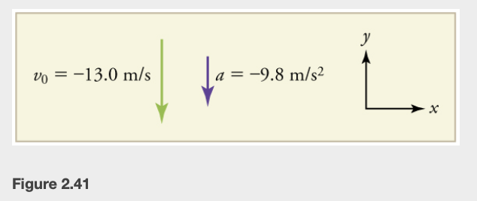
Example
A rock thrown downward with an initial velocity of 13.0 m/s, What is the velocity of the rock when it is 5.10 m below the starting point?
Draw a sketch
List known values ; identify unknown
Determine equation to use
Plug in known values and solve
Image Credit: OpenStax College Physics - Figure 2.41 CC BY 4.0

Slide 9
Example
A rock thrown downward with an initial velocity of 13.0 m/s, What is the velocity of the rock when it is 5.10 m below the starting point?
Draw a sketch
List known values ; identify unknown
Determine equation to use
Plug in known values and solve
$$y_{o}=0;v_{o}=-13.0m/s;a=-g=-9.80m/s^{2}$$
Unknown: $v_{f}$
$$v^{2}=v_{o}^{2}-2g(y-y_{o})$$
$$v^{2}=(-13.0m/s)^{2}+2(-9.80m/s^{2})(-5.10m-0m)$$
$$v^{2}=268.96m^{2}/s^{2}$$
$$v=±16.4m/s$$
Since the rock is heading down,
$$v=-16.4m/s$$
Image Credit: OpenStax College Physics - Figure 2.41 CC BY 4.0

Slide 10
Summary
In the absence of air resistance, all objects will fall at the same rate
The acceleration in free fall problems is given by $g=-9.80m/s^{2}$
The kinematic equations remain the same otherwise

