Slide 1
Introduction to Physical Science
Newton’s Laws of Motion and Gravity
Presented by Robert Wagner

Slide 2
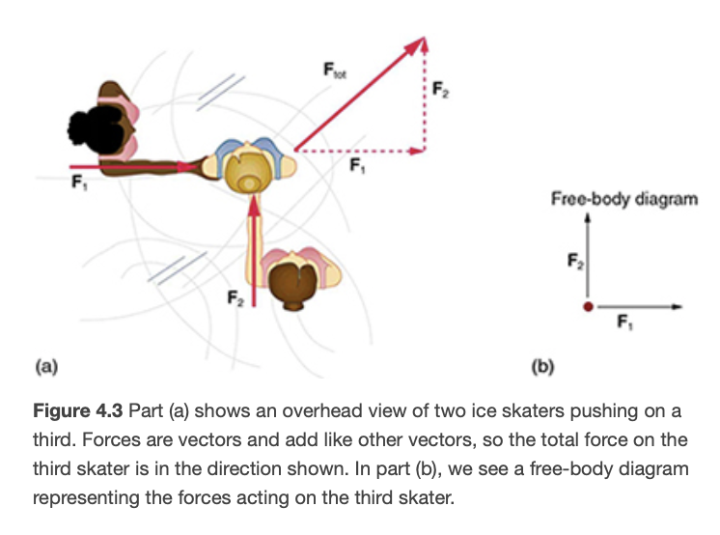
Force
A force is a push or pull
It is a vector quantity so it has both magnitude and direction
Free-body diagram
Illustrates all external forces on an object
Image Credit: OpenStax College Physics - Figure 4.3

Slide 3
Newton’s First Law of Motion
A body at rest remains at rest, or, if in motion, remains in motion at a constant velocity unless acted on by a net external force
Everyday experience - object slow down due to friction or air resistance
Consider an air hockey table
Law is universal and applies to everything
Any change in velocity (speed or direction) requires an external force (planetary orbits)
Mass - The amount of matter in an object
Differs from weight - does not depend on location
This law introduces the concept of inertia
Which has more mass - A kilogram of cotton balls or a kilogram of gold?

Slide 4
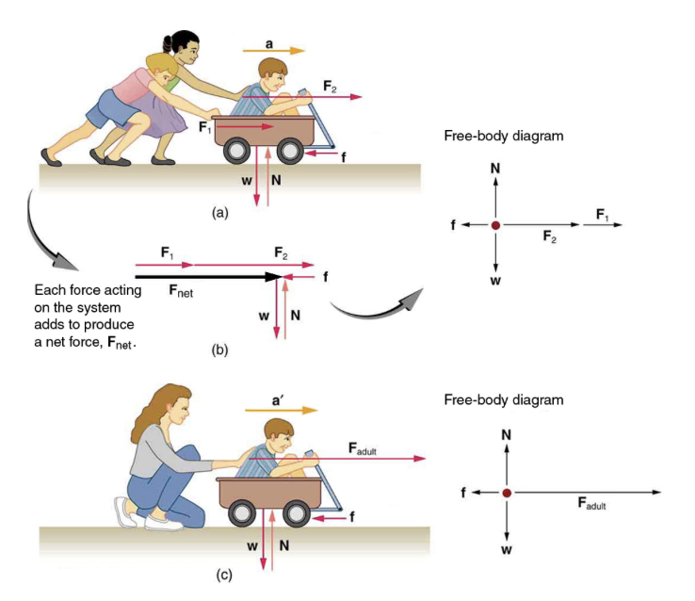
Newton’s Second Law of Motion
Relates force to change in motion
Need to consider external forces
The net force is what causes a change in motion
A free-body diagram helps us keep track of the forces
Image credit: OpenStax College Physics - Figure 4.5

Slide 5
Newton’s Second Law of Motion
A larger force will give a larger change in motion
$$a∝F_{net}$$
A larger mass will have a smaller change in motion
$$a∝\frac{1}{m}$$
Newton’s Second law:
$a=\frac{F_{net}}{m}$ or, $F_{net}=ma$
Image credit: OpenStax College Physics - Figure 4.5

Slide 6
Units for Force
SI unit for force - Newton (N)
1 Newton is the force needed to accelerate a 1 kg object at 1 m/s²
1 N = 1 kg m/s²

Slide 7
Weight and Gravitational Force
The net force on a falling object is the gravitational force
The acceleration due to gravity is g (9.80 m/s²)
Weight (w) = mg
The weight is the force with which Earth pulls on an object
So, w=mg = (1.0 kg) (9.80 m/s²) = 9.8 N

Slide 8
Free-Fall
What do we mean by “weightlessness” in space
The gravitational force and acceleration are not much lower at the International Space Station than on Earth
Astronauts are falling continually which makes them appear weightless
Mass and Weight
These are two different concepts in physics
Mass - the amount of matter contained in an object
Weight - measure fo the force of gravity pulling on an object

Slide 9
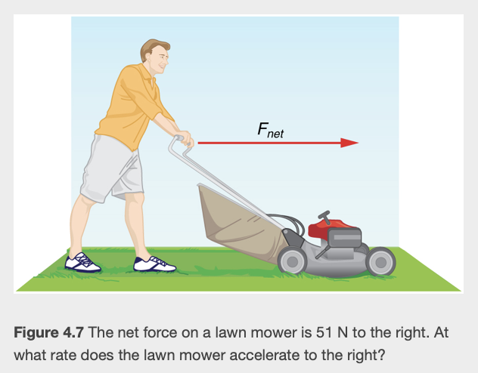
Example
The net external force exerted on a lawnmower is 51 N. The mass of the mower is 24 kg. What is the acceleration?
Draw a sketch
List known values ; identify unknown
Determine equation to use
Plug in known values and solve
Image Credit: OpenStax College Physics - Figure 4.7 CC BY 4.0

Slide 10
Example
The net external force exerted on a lawnmower is 51 N. The mass of the mower is 24 kg. What is the acceleration?
Draw a sketch
List known values ; identify unknown
Determine equation to use
Plug in known values and solve
$$F_{net}=51N;m=24kg$$
Unknown: acceleration (a)
$$a=\frac{F_{net}}{m}$$
$$a=\frac{51N}{24kg}=\frac{51kgm/s^{2}}{24kg}$$
$$a=2.1m/s^{2}$$
Image Credit: OpenStax College Physics - Figure 4.7 CC BY 4.0

Slide 11
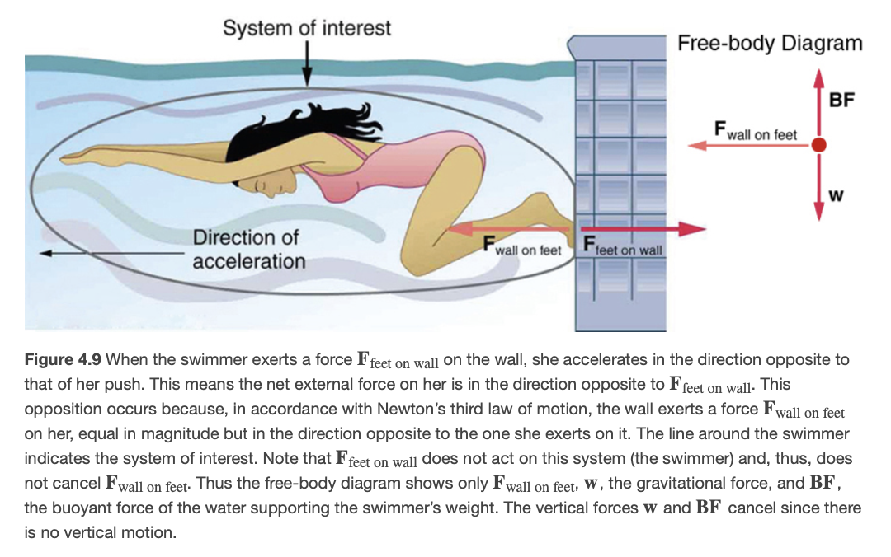
Newton’s Third Law of Motion
Whenever one body exerts a force on a second body, the first body experiences a force that is equal in magnitude and opposite in direction to the force it exerts
Forces will always occur in pairs
Force of the feet on wall is equal and opposite to the force of the wall on the feet
Our system of interest is only looking at the one force
Image credit: OpenStax College Physics - Figure 4.9 CC BY 4.0

Slide 12
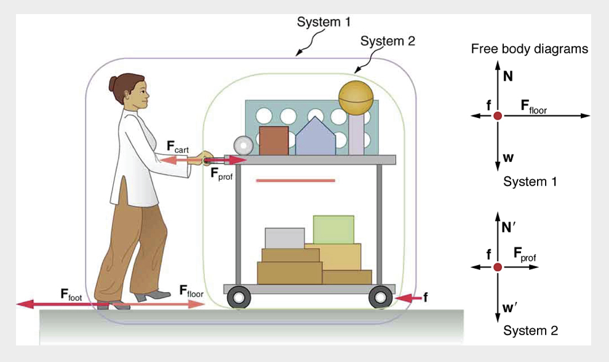
Example
Professor pushes a cart. Her mass is 65.0 kg, the cart’s mass is 12.0 kg and the equipment is 7.0 kg. Calculate the acceleration produced when the professor exerts a backward force of 150 N on the floor. Opposing forces, including friction total 24.0 N
Draw a sketch
List known values ; identify unknown
Determine equation to use
Plug in known values and solve
Image Credit: OpenStax College Physics - Figure 4.10 CC BY 4.0

Slide 13
Example
Professor pushes a cart. Her mass is 65.0 kg, the cart’s mass is 12.0 kg and the equipment is 7.0 kg. Calculate the acceleration produced when the professor exerts a backward force of 150 N on the floor. Opposing forces, including friction total 24.0 N. (System 1)
Draw a sketch
List known values ; identify unknown
Determine equation to use
Plug in known values and solve
$$F_{floor}=150N;f=24.0N;m_{prof}=65.0kg$$
$$m_{cart}=12.0kg;m_{equipment}=7.0kg$$
$$a=\frac{F_{net}}{m}$$
$$F_{net}=F_{floor}-f=150N-24.0N=126N$$
$$m=65.0kg+12.0kg+7.0kg=84kg$$
$$a=\frac{126N}{84kg}=1.5m/s^{2}$$
Image Credit: OpenStax College Physics - Figure 4.10 CC BY 4.0

Slide 14
Example
Professor pushes a cart. Her mass is 65.0 kg, the cart’s mass is 12.0 kg and the equipment is 7.0 kg. Calculate the force the professor exerts on the cart. (System 2)
Draw a sketch
List known values ; identify unknown
Determine equation to use
Plug in known values and solve
$$F_{floor}=150N;f=24.0N;m_{prof}=65.0kg$$
$$m_{cart}=12.0kg;m_{equipment}=7.0kg$$
$$F_{net}=F_{prof}-f;F_{prof}=F_{net}+f$$
$$m=12.0kg+7.0kg=19.0kg$$
$$F_{net}=ma=(19.0kg)(1.5m/s^{2})=29N$$
$$F_{prof}=F_{net}+f=29N+24.0N=53N$$
Image Credit: OpenStax College Physics - Figure 4.10 CC BY 4.0

Slide 15
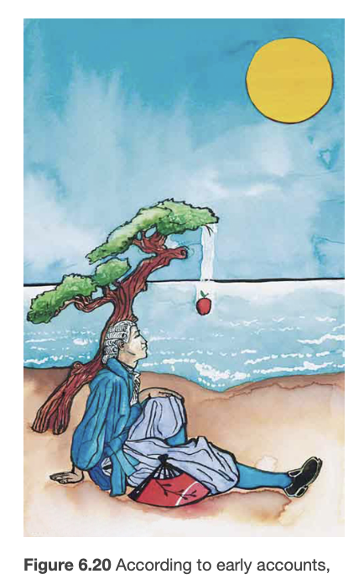
Universal Law of Gravitation
Could the orbit of our Moon be related to a falling apple?
Gravity of Earth extends out into space
Every particle in the universe attracts every other particle with a force along a line joining them
Forces between two objects are always equal and opposite
Force of Earth on Moon is equal in magnitude and opposite in direction to the force of our Moon on Earth
Image Credit: OpenStax College Physics - Figure 6.20 CC BY 4.0

Slide 16
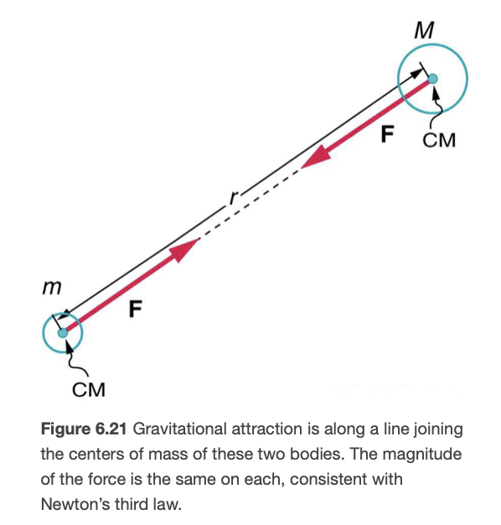
Universal Law of Gravitation
Could the orbit of our Moon be related to a falling apple?
Gravity of Earth extends out into space
Every particle in the universe attracts every other particle with a force along a line joining them
Forces between two objects are always equal and opposite
Force of Earth on Moon is equal in magnitude and opposite in direction to the force of our Moon on Earth
Image Credit: OpenStax College Physics - Figure 6.21 CC BY 4.0

Slide 17
Universal Law of Gravitation
Force is given by:
$$F=\frac{GMm}{r^{2}}$$
G is the gravitational constant: $G=6.674x{10}^{-11}\frac{Nm^{2}}{kg^{2}}$
Gravitational force is a relatively weak force compared to other forces of nature

Slide 18
Example
Calculate the gravitational force between Earth and our Moon. Use $M_{Earth}=5.98x{10}^{24}kg$ ; $m_{Moon}=7.35x{10}^{22}kg$ ;$RadiusofMoon^{′}sorbit=3.84x{10}^{8}m$
Draw a sketch
List known values ; identify unknown
Determine equation to use
Plug in known values and solve
Image Credit: OpenStax College Physics - Figure 6.21 CC BY 4.0

Slide 19
Example
Calculate the gravitational force between Earth and our Moon. Use $M_{Earth}=5.98x{10}^{24}kg$ ; $m_{Moon}=7.35x{10}^{22}kg$ ;$RadiusofMoon^{′}sorbit=3.84x{10}^{8}m$
Draw a sketch
List known values ; identify unknown
Determine equation to use
Plug in known values and solve
$M_{Earth}=5.98x{10}^{24}kg$ ; $m_{Moon}=7.35x{10}^{22}kg$ ; $RadiusofMoon^{′}sorbit=3.84x{10}^{8}m$
$$F=\frac{GMm}{r^{2}}$$
$$F=6.67x{10}^{-11}\frac{Nm^{2}}{kg^{2}}\frac{(5.98x{10}^{24}kg)(7.35x{10}^{22}kg)}{(3.84x{10}^{8}m)^{2}}$$
$$F=1.99x{10}^{20}N$$
Image Credit: OpenStax College Physics - Figure 6.21 CC BY 4.0

Slide 20
Summary
Newton’s laws of motion are universal and apply to all objects
Weight is measured in the SI unit of Newton and is very different than mass
Newton’s Universal Law of Gravitation is universal and describes the force between any two objects with mass in the universe

