Slide 1
Introduction to Physical Science
Work and Kinetic Energy
Presented by Robert Wagner

Slide 2
Definition of Work
What is work?
Product of force and the distance through which the force acts in the same direction
$W=F⋅d⋅cos(θ)$ ; For this class, we consider 1 dimension so $cos(θ)=1$
$$W=F⋅d$$
If the force is not in the direction through which the object moves, no work is done. If the object does not move, no work is done
Units = $Newton⋅meter$ = $1Joule$
Small amount of energy - would lift a 100 gram apple a distance of 1 meter

Slide 3
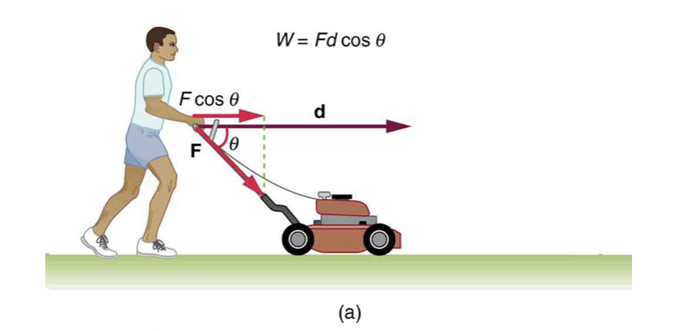
Example
How much work is done on the lawnmower by the person pushing it. The person exerts a force of 60.0 N over a distance of 25.0 meters.
Draw a sketch
Identify known values
Identify equation
Enter values in the equation and solve
Image Credit: OpenStax College Physics - Figure 7.2a CC BY 4.0

Slide 4
Example
How much work is done on the lawnmower by the person pushing it. The person exerts a force of 60.0 N over a distance of 25.0 meters.
Draw a sketch
Identify known values
Identify equation
Enter values in the equation and solve
$$F=60.0N;d=25.0m$$
$$W=F⋅d$$
$$W=(60.0N)(25.0m)$$
$$W=1510N⋅m$$
$$W=1510Joules$$
Image Credit: OpenStax College Physics - Figure 7.2a CC BY 4.0

Slide 5
What Happens to the Work Done?
Suppose a lawnmower is pushed at a constant speed
The energy is converted to friction and then to heat
Carrying an object up stairs
Converts the work into potential energy which is stored and can be released later
Net Work: Net force causes acceleration
$$W_{net}=F_{net}⋅d$$
Work-Energy Theorem
$$W_{net}=\frac{1}{2}mv^{2}-\frac{1}{2}mv_{o}^{2}$$

Slide 6
Kinetic Energy
$$\frac{1}{2}mv^{2}=KineticEnergy$$
This is the translational kinetic energy of an object with mass m, moving at velocity v in a straight line
Kinetic Energy depend on the square of the velocity
Object moving twice as fast will have four times the kinetic energy

Slide 7
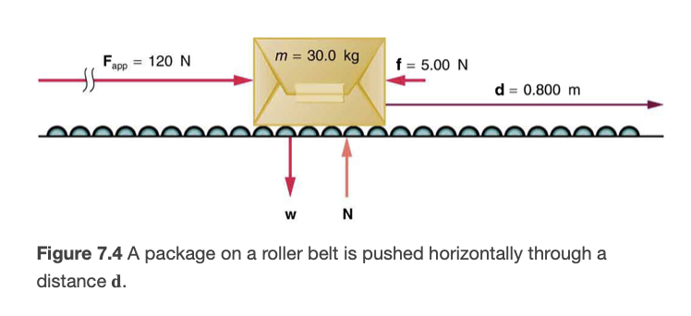
Example
A 30.0 kg package moves on a conveyor system at 0.500 m/s. What is the kinetic energy?
Draw a sketch
List known values ; identify unknown
Determine equation to use
Plug in known values and solve
Image Credit: OpenStax College Physics - Figure 7.4 CC BY 4.0

Slide 8
Example
A 30.0 kg package moves on a conveyor system at 0.500 m/s. What is the kinetic energy?
Draw a sketch
List known values ; identify unknown
Determine equation to use
Plug in known values and solve
$$m=30.0kg;v=0.500m/s$$
$$KE=\frac{1}{2}mv^{2}$$
$$KE=\frac{1}{2}(30.0kg)(0.500m/s)^{2}$$
$$KE=3.75Joules$$
Image Credit: OpenStax College Physics - Figure 7.4 CC BY 4.0

Slide 9
Example
A 30.0 kg package is pushed with a constant force of 120. N through a distance of 0.800 m. The frictional force opposing the motion is 5.00 N. What is the net work?
Draw a sketch
List known values ; identify unknown
Determine equation to use
Plug in known values and solve
Image Credit: OpenStax College Physics - Figure 7.4 CC BY 4.0

Slide 10
Example
A 30.0 kg package is pushed with a constant force of 120. N through a distance of 0.800 m. The frictional force opposing the motion is 5.00 N. What is the net work?
Draw a sketch
List known values ; identify unknown
Determine equation to use
Plug in known values and solve
$$m=30.0kg;F=120.N;d=0.800m;f=5.00N$$
$$F_{net}=120.N-5.00N=115N$$
$$W_{net}=F_{net}⋅d$$
$$W_{net}=(115N)⋅(0.800m)$$
$$W_{net}=92.0N⋅m=92.0Joules$$
No work done by the gravitational force or normal force as they operate perpendicular to the motion.
Image Credit: OpenStax College Physics - Figure 7.4 CC BY 4.0

Slide 11
Example
A 30.0 kg package is pushed with a constant force of 120. N through a distance of 0.800 m. The frictional force opposing the motion is 5.00 N. What is the final velocity?
Draw a sketch
List known values ; identify unknown
Determine equation to use
Plug in known values and solve
Image Credit: OpenStax College Physics - Figure 7.4 CC BY 4.0

Slide 12
Example
A 30.0 kg package is pushed with a constant force of 120. N through a distance of 0.800 m. The frictional force opposing the motion is 5.00 N. What is the final velocity?
Draw a sketch
List known values ; identify unknown
Determine equation to use
Plug in known values and solve
$$KE_{initial}=3.75Joules;W_{net}=92.0Joules$$
$$KE_{initial}=\frac{1}{2}mv_{o}^{2}=3.75Joules$$
$$W_{net}=\frac{1}{2}mv^{2}-\frac{1}{2}mv_{o}^{2}$$
$$\frac{1}{2}mv^{2}=W_{net}+\frac{1}{2}mv_{o}^{2}=92.0Joules+3.75Joules$$
$$\frac{1}{2}mv^{2}=95.75Joules$$
$$v=\sqrt{\frac{2(95.75Joules)}{30.0kg}}=2.53m/s$$
Image Credit: OpenStax College Physics - Figure 7.4 CC BY 4.0

Slide 13
Summary
Work is defined to be the product of the force on an object multiplied by the distance through which the force acts
The kinetic energy is the energy an object has due to its motion
The Work-Energy theorem relates the net work to the change in kinetic energy

