Slide 1
Introduction to Physical Science
Potential Energy
Presented by Robert Wagner

Slide 2
Work Against Gravity
Doing work against gravity
Potential Energy - stored energy
Force needs to lift an object is equal to its weight: mg
$$W=F⋅d=m⋅g⋅h$$
The gravitational potential energy depends only on relative position of object
Zero point often defined to be Earth’s surface
Can define it differently depending on the problem
$$Changeinpotentialenergy:ΔPE_{g}=mgh$$

Slide 3
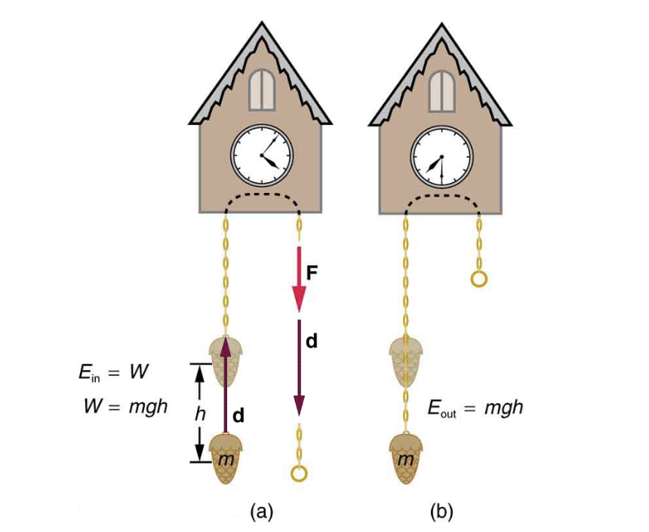
Example
What is the change in potential energy when a 0.500 kg mass hung from a cuckoo clock is raised by 1.00 m.
Draw a sketch
Identify known values
Identify equation
Enter values in the equation and solve
Image Credit: OpenStax College Physics - Figure 7.5 CC BY 4.0

Slide 4
Example
What is the change in potential energy when a 0.500 kg mass hung from a cuckoo clock is raised by 1.00 m.
Draw a sketch
Identify known values
Identify equation
Enter values in the equation and solve
$$m=0.500kg;h=1.00m;g=9.80m/s^{2}$$
$$ΔPE_{g}=mgh$$
$$ΔPE_{g}=(0.500kg)(9.80m/s^{2})(1.00m)$$
$$ΔPE_{g}=4.90kg⋅m^{2}/s^{2}$$
$$ΔPE_{g}=4.90Joules$$
Image Credit: OpenStax College Physics - Figure 7.5 CC BY 4.0

Slide 5
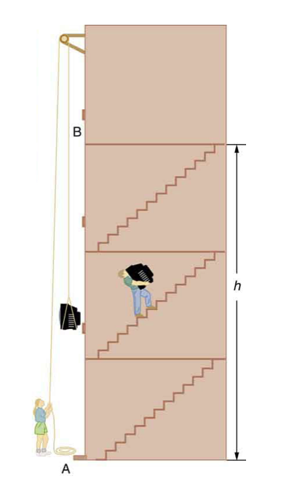
Potential Energy Calculations
The change in potential energy depends on the change in height
The path does not matter
Simplifies calculations
For both (A) and (B) in the diagram, the change in potential energy is the same
The work done is the same in both cases
Image Credit: OpenStax College College Physics - Figure 7.6 CC BY 4.0

Slide 6
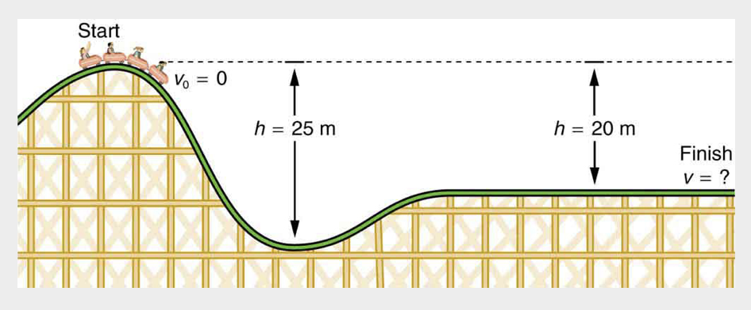
Example
What is the final speed of the roller coaster shown. It starts from rest at the top of a 20.0 m hill. (Neglect friction)
Draw a sketch
List known values ; identify unknown
Determine equation to use
Plug in known values and solve
Image Credit: OpenStax College Physics - Figure 7.4 CC BY 4.0

Slide 7
Example
What is the final speed of the roller coaster shown? It starts from rest at the top of a 20.0 m hill. (Neglect friction)
Draw a sketch
List known values ; identify unknown
Determine equation to use
Plug in known values and solve
$$v_{o}=0;h=20.0m$$
$$ΔKE=\frac{1}{2}mv^{2}-\frac{1}{2}mv_{o}^{2}$$
$ΔPE=ΔKE$
$$mgh=\frac{1}{2}mv^{2}$$
$$v=\sqrt{2gh}=\sqrt{2(9.80m/s^{2})(20.0m)}$$
$$v=19.8m/s$$
Image Credit: OpenStax College Physics - Figure 7.4 CC BY 4.0

Slide 8
Example
What is the final speed of the roller coaster shown if the initial speed is 5.00 m/s. (Neglect friction)
Draw a sketch
List known values ; identify unknown
Determine equation to use
Plug in known values and solve
$$v_{o}=5.0m/s;h=20.0m$$
$$ΔKE=\frac{1}{2}mv^{2}-\frac{1}{2}mv_{o}^{2}$$
$ΔPE=ΔKE$
$$mgh=\frac{1}{2}mv^{2}-\frac{1}{2}mv_{o}^{2}$$
$$v=\sqrt{2gh+v_{o}^{2}}=\sqrt{2(9.80m/s^{2})(20.0m)+(5.00m/s)^{2}}$$
$$v=20.4m/s$$
Image Credit: OpenStax College Physics - Figure 7.4 CC BY 4.0

Slide 9
Conservative Forces
A conservative force is one where the work done depends only on the starting and ending points, but not the path taken
Examples - gravitational force (previously discussed) ; spring
Winding a spring stores energy that can later be released
Potential Energy - Energy of a system due to position, shape or configuration
It is stored energy that can be recovered

Slide 10
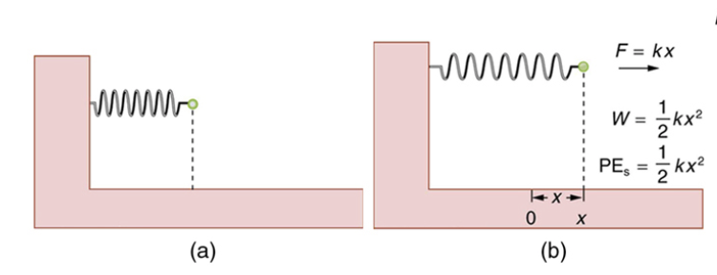
Potential Energy of a Spring
Hooke’s Law: $F=kx$ ; k = force constant
$$PE_{s}=\frac{1}{2}kx^{2}$$
The displacement from the undisturbed position is given by x
Image Credit: Modification of OpenStax College Physics - Figure 7.10 CC BY 4.0

Slide 11
Conservation of Mechanical Energy
When only conservative forces were involved:
$$ΔKE+ΔPE=0$$
$$KE+PE=constant$$
$$KE_{i}+PE_{i}=KE_{f}+PE_{f}$$
Energy changes form
Changes between kinetic energy and potential energy
Total energy remains constant

Slide 12
Example
A 0.100 kg toy car is propelled by a spring. The track rises by 0.180 m above the starting point. The spring is compressed 4.00cm and has a force constant 250.0 N/m. (Neglect Friction)
Draw a sketch
List known values ; identify unknown
Determine equation to use
Plug in known values and solve
Image Credit: OpenStax College Physics - Figure 7.12 CC BY 4.0

Slide 13
Example
A 0.100 kg toy car is propelled by a spring. The track rises by 0.180 m above the starting point. The spring is compressed 4.00cm and has a force constant 250.0 N/m. What is the speed of the car before it starts up the slope?(Neglect Friction)
Draw a sketch
List known values ; identify unknown
Determine equation to use
Plug in known values and solve
$$m=0.100kg;h=18cm;k=250.0N/m$$
$$KE_{i}+PE_{i}=KE_{f}+PE_{f}$$
$$\frac{1}{2}mv_{i}^{2}+mgh_{i}+\frac{1}{2}kx_{i}^{2}=\frac{1}{2}mv_{f}^{2}+mgh_{f}+\frac{1}{2}kx_{f}^{2}$$
$$\frac{1}{2}kx_{i}^{2}=\frac{1}{2}mv_{f}^{2}$$
$$v_{f}=\sqrt{\frac{k}{m}}x_{i}=\sqrt{\frac{250.0N/m}{0.100kg}}(0.0400m)$$
$$v_{f}=2.00m/s$$
Image Credit: OpenStax College Physics - Figure 7.12 CC BY 4.0

Slide 14
Example
A 0.100 kg toy car is propelled by a spring. The track rises by 0.180 m above the starting point. The spring is compressed 4.00cm and has a force constant 250.0 N/m. What is the speed of the car at the top of the slope?(Neglect Friction)
Draw a sketch
List known values ; identify unknown
Determine equation to use
Plug in known values and solve
$$m=0.100kg;h=18cm;k=250.0N/m$$
$$KE_{i}+PE_{i}=KE_{f}+PE_{f}$$
$$\frac{1}{2}mv_{i}^{2}+mgh_{i}+\frac{1}{2}kx_{i}^{2}=\frac{1}{2}mv_{f}^{2}+mgh_{f}+\frac{1}{2}kx_{f}^{2}$$
$$\frac{1}{2}kx_{i}^{2}=\frac{1}{2}mv_{f}^{2}+mgh_{f}$$
$$v_{f}=\sqrt{\frac{kx_{i}^{2}}{m}-2gh_{f}}=\sqrt{\frac{250.0N/m}{0.100kg}(0.0400m)^{2}-2(9.80m/s^{2})(0.180m}$$
$$v_{f}=0.687m/s$$
Image Credit: OpenStax College Physics - Figure 7.12 CC BY 4.0

Slide 15
Summary
Potential energy is energy that is stored - examples can be gravity or stored energy in a spring
The zero point for gravitational potential energy can be selected depending on the specific problem
Conservative forces are forces that only depend on the initial and final positions, not the path taken between them

