Slide 1
Introduction to Physical Science
Conservation of Energy
Presented by Robert Wagner

Slide 2
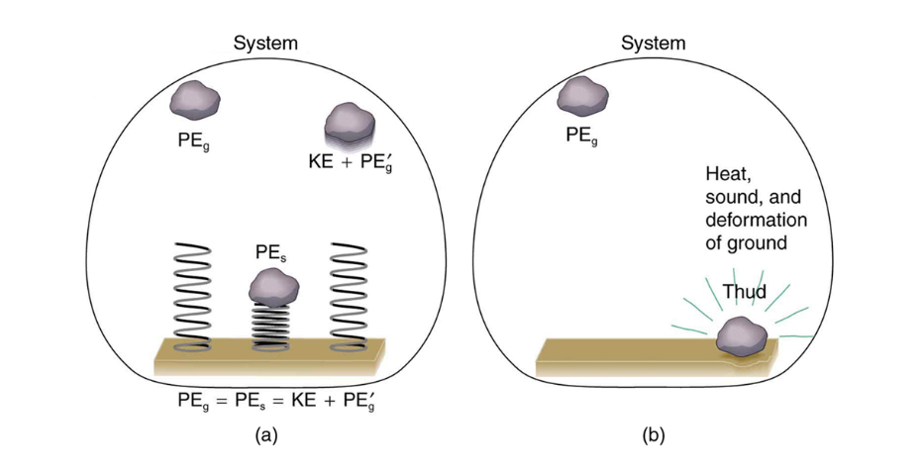
Nonconservative Forces
Example: Frictional force
Work done against friction depends on the path taken
Friction - convert to thermal energy, removing energy from the system
Work done by a nonconservative force can add or remove mechanical energy from a system
Image Credit: OpenStax College Physics Figure 7.15 CC BY 4.0

Slide 3
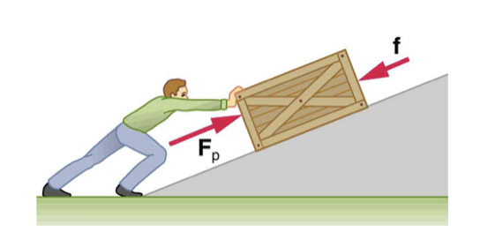
Work-Energy Theorem
Net work = change in mechanical energy of the system
$$W_{net}=W_{nc}+W_{c}=ΔKE$$
$$KE_{i}+PE_{i}+W_{nc}=KE_{f}+PE_{f}$$
If we push a box up a ramp, it gains mechanical energy. So, the work done by the person is greater than the work done by friction.
Image Credit: OpenStax College Physics Figure 7.16 CC BY 4.0

Slide 4
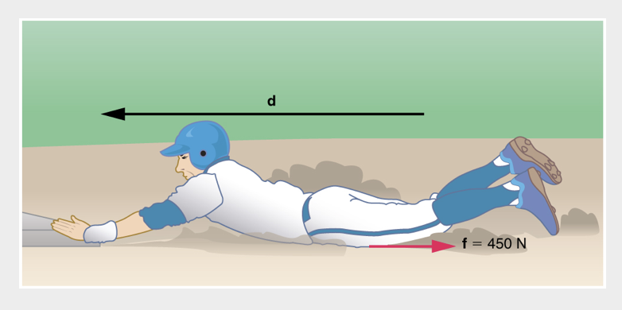
Example
Calculate the distance a 65.0 kg baseball player slides, given that the initial speed was 6.00 m/s and the force of friction is a constant 450. N.
Draw a sketch
Identify known values
Identify equation
Enter values in the equation and solve
Image Credit: OpenStax College Physics - Figure 7.17 CC BY 4.0

Slide 5
Example
Calculate the distance a 65.0 kg baseball player slides, given that the initial speed was 6.00 m/s and the force of friction is a constant 450. N.
Draw a sketch
Identify known values
Identify equation
Enter values in the equation and solve
$$m=65.0kg;v_{i}=6.00m/s;f=450.N$$
$$KE_{i}+PE_{i}+W_{nc}=KE_{f}+PE_{f}$$
$$KE_{i}+W_{nc}=0$$
$$\frac{1}{2}mv_{i}^{2}-fd=0$$
$$d=\frac{mv_{i}^{2}}{2f}=\frac{(65.0kg)(6.00m/s)^{2}}{(2)(450.N)}$$
$$d=2.60m$$
Image Credit: OpenStax College Physics - Figure 7.17 CC BY 4.0

Slide 6
Law of Conservation of Energy
The total energy in any process is constant
The form of energy may change
The energy can be transferred from one system to another
Examples of different forms of energy
Kinetic and Potential energy
Electrical energy, Chemical energy, Radiant energy, Nuclear energy, Thermal energy

Slide 7
Problem Solving Strategies for Energy
Determine the system and the quantity to be calculated - make a sketch
Examine all forces involved
Conservative forces? $KE_{i}+PE_{i}=KE_{f}+PE_{f}$
Nonconservative forces? $KE_{i}+PE_{i}+W_{nc}+OE_{i}=KE_{f}+PE_{f}+OE_{f}$
Eliminate terms when possible
Ex: Choose initial or final height to be 0
Check that the answer is reasonable
Does the velocity make sense?

Slide 8
Transformation of Energy
Conversion takes place all the time
Chemical energy in food —> Thermal energy
Photosynthesis: Light energy —> Chemical energy
Boiler: Chemical energy —> Thermal energy —> Mechanical energy —> Electrical energy
Solar cell: Light energy —> Electrical energy

Slide 9
Efficiency
The output of useful energy will always be less than the energy input
$$Efficiency=\frac{usefulenergyorworkoutput}{totalenergyinput}=\frac{W_{out}}{E_{in}}$$
Examples:
Gasoline engine = 30%
Gas heater = 98%
Swimming = 4%
Steam engine = 17%

Slide 10
Summary
Nonconservative forces can add or remove mechanical energy from a system
Friction is a common example of a nonconservative force
The efficiency of the transfer of energy conversion varies, but is always less than 100%

