Slide 1
Introduction to Physical Science
Power
Presented by Robert Wagner

Slide 2
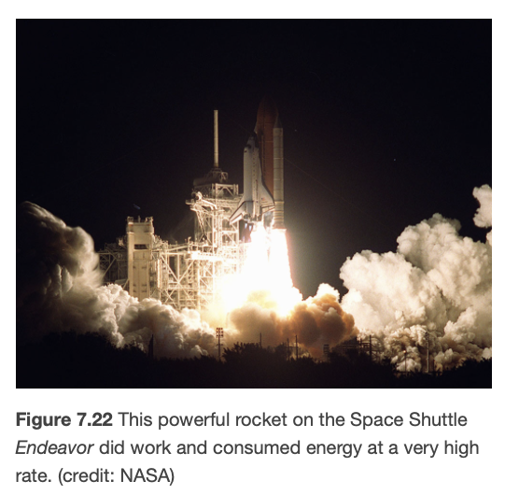
Power
Scientific definition of power
The rate at which work is done
$$P=\frac{W}{t}$$
SI units power: watt
1 Watt = 1 Joule/second
Image Credit: OpenStax College Physics Figure 7.22 (NASA) Public Domain

Slide 3
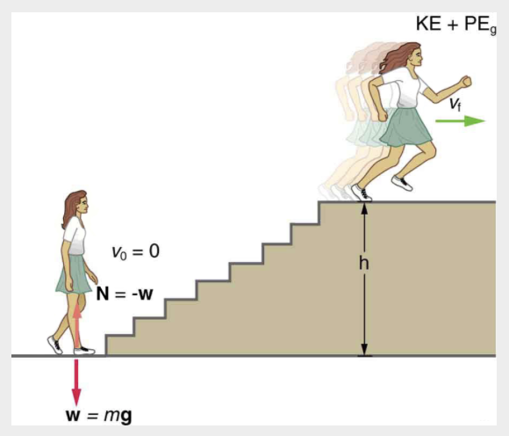
Example
Calculate the power output for a 60.0 kg woman who runs up a 3.00 m flight of stairs in 3.50 s, starting from rest and having a final speed of 2.00 m/s.
Draw a sketch
Identify known values
Identify equation
Enter values in the equation and solve
Image Credit: OpenStax College Physics - Figure 7.23 CC BY 4.0

Slide 4
Example
Calculate the power output for a 60.0 kg woman who runs up a 3.00 m flight of stairs in 3.50 s, starting from rest and having a final speed of 2.00 m/s.
Draw a sketch
Identify known values
Identify equation
Enter values in the equation and solve
$$m=60.0kg;h=3.00m;t=3.50s;v_{f}=2.00m/s$$
$$W=KE+PE=KE_{f}+PE_{g}$$
$$W=\frac{1}{2}mv_{f}^{2}+mgh$$
$$P=\frac{W}{t}=\frac{\frac{1}{2}mv_{f}^{2}+mgh}{t}$$
$$P=\frac{0.5(60.0kg)(2.00m/s)^{2}+(60.0kg)(9.80m/s^{2})(3.00m)}{3.50s}$$
$$P=538W$$
Image Credit: OpenStax College Physics - Figure 7.23 CC BY 4.0

Slide 5
Power Examples
Sunlight
$$1.3\frac{kW}{m^{2}}$$
Only a small amount of this is retained by Earth
Power => Energy transfer
Some energy is lost as thermal energy
Coal power plant
Consumes 2500 megawatts to produce 1000 megawatts of electricity
1500 megawatts lost as heat

Slide 6
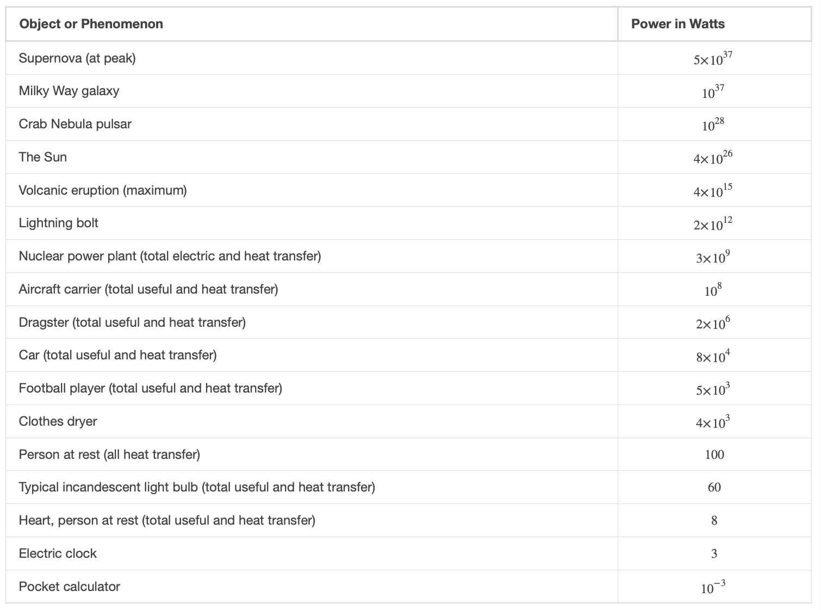
Power Examples
Table Credit: OpenStax College Physics - Table 7.3 CC BY 4.0

Slide 7
Power and Energy Consumption
Power consumption rate
$$P=\frac{W}{t}=\frac{E}{t}$$
E is the energy supplied by the electric company
Energy used is expressed in units of kilowatt-hours ($kW⋅h$)

Slide 8
Example
$$P=0.200kW;t=(6.00h/d)(30d);$$
$$rate=\$0.120perkW⋅hr$$
$$E=Pt$$
$$E=(0.200kW)(6.00h/d)(30.0d)$$
$$E=36.0kW⋅h$$
$$Cost=E⋅r$$
$$Cost=(36.0kW⋅h)(\$0.120perkW⋅h)$$
$$Cost=\$4.32permonth$$
What is the cost of running a 0.200 kW computer 6.00 h per day if the cost of electricity is $0.120 per kW-h
Draw a sketch
Identify known values
Identify equation
Enter values in the equation and solve

Slide 9
Summary
Power is defined to be the rate at which work is done
Energy conversion to power cannot be 100% efficient
The amount of energy used is generally expressed in kilowatt-hours

