Slide 1
Introduction to Physical Science
Conservation of Momentum
Presented by Robert Wagner

Slide 2
Conservation of Momentum
Momentum is conserved in an isolated system
Net force ($F_{net}$) = 0
When $F_{net}$ = 0, $p_{tot}=constant$
Or, $p_{f}=p_{i}$

Slide 3
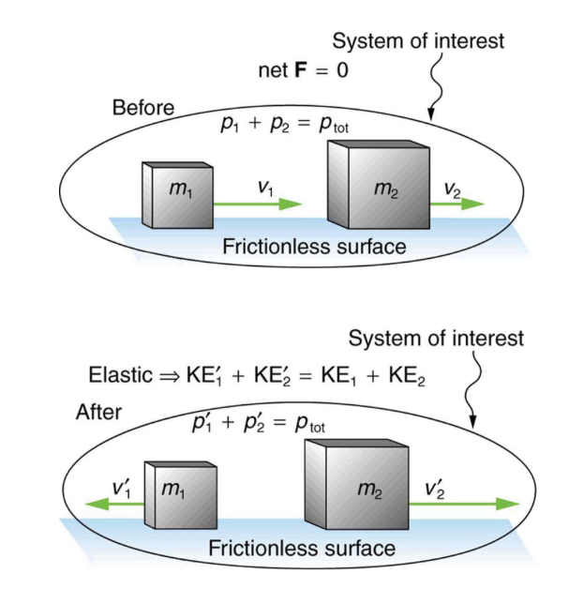
Elastic Collisions
Internal kinetic energy is conserved in an elastic collision
$$\frac{1}{2}m_{1}v_{1}^{2}+\frac{1}{2}m_{2}v_{2}^{2}=\frac{1}{2}m_{1}v′_{1}^{2}+\frac{1}{2}m_{2}v_{2}′^{2}$$
Momentum is also conserved
$$m_{1}v_{1}+m_{2}v_{2}=m_{1}v_{1}′+m_{2}v_{2}′$$
Image Credit: OpenStax College Physics - Figure 8.6 CC BY 4.0

Slide 4
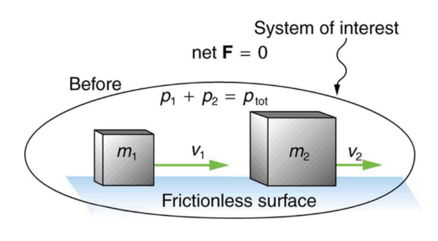
Example
Calculate the velocities of two objects following an elastic collision, given that m1= 0.500 kg ; m2=3.5 kg, v1 = 4.00 m/s, v2 = 0. And v’1=-3.00 m/s
Draw a sketch
Identify known values
Identify equation
Enter values in the equation and solve
Image Credit: OpenStax College Physics - Figure 8.6 CC BY 4.0

Slide 5
Example
Calculate the velocities of two objects following an elastic collision, given that m1= 0.500 kg ; m2=3.5 kg, v1 = 4.00 m/s, v2 = 0. And v’1=-3.00 m/s
Draw a sketch
Identify known values
Identify equation
Enter values in the equation and solve
$$m_{1}=0.500kg;m_{2}=3.50kg;v_{1}=4.00m/s$$
$$v_{2}=0;v_{1}′=-3.00m/s$$
$$m_{1}v_{1}+m_{2}v_{2}=m_{1}v_{1}′+m_{2}v_{2}′$$
$$v_{2}′=\frac{m_{1}v_{1}+m_{2}v_{2}-m_{1}v_{1}′}{m_{2}}$$
$$v_{2}′=\frac{(0.500kg)(4.00m/s)-(0.500kg)(-3.00m/s)}{3.50kg}$$
$$v_{2}′=1.00m/s$$
Image Credit: OpenStax College Physics - Figure 8.6 CC BY 4.0

Slide 6
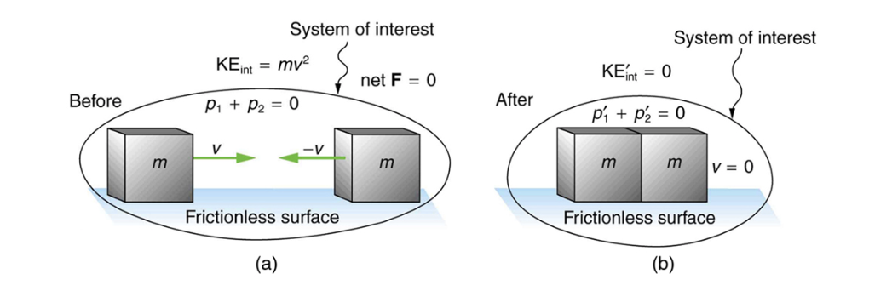
Inelastic Collisions
In an inelastic collision, the internal kinetic energy is not conserved
Perfectly inelastic collision is one where the two objects stick together after the collision
Image Credit: OpenStax College Physics - Figure 8.8 CC BY 4.0

Slide 7
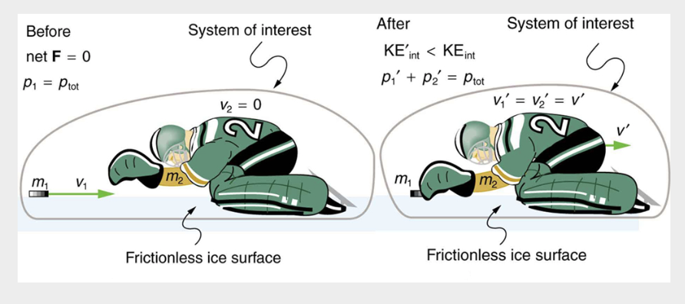
Example
Find the recoil of a 70.0 kg ice hockey goalie, who at rest catches a 0.150 kg hockey puck traveling at a velocity of 35.0 m/s
Draw a sketch
Identify known values
Identify equation
Enter values in the equation and solve
Image Credit: OpenStax College Physics - Figure 8.9 CC BY 4.0

Slide 8
Example
$$m_{1}=70.0kg;m_{2}=0.150kg;v_{1}=0;v_{2}=35.0m/s$$
$$v_{1}′=v_{2}′=v′$$
$$m_{1}v_{1}+m_{2}v_{2}=m_{1}v_{1}′+m_{2}v_{2}′$$
$$m_{1}v_{1}=(m_{1}+m_{2})v′$$
$$v′=\frac{m_{1}}{m_{1}+m_{2}}v_{1}$$
$$v′=\frac{0.150kg}{0.150kg+70.0kg}(35.0m/s)=0.0748m/s$$
Find the recoil of a 70.0 kg ice hockey goalie, who at rest catches a 0.150 kg hockey puck traveling at a velocity of 35.0 m/s
Draw a sketch
Identify known values
Identify equation
Enter values in the equation and solve
Image Credit: OpenStax College Physics - Figure 8.9 CC BY 4.0

Slide 9
Example
For the previous problem - what was the kinetic energy lost in the collision?
Draw a sketch
Identify known values
Identify equation
Enter values in the equation and solve
Image Credit: OpenStax College Physics - Figure 8.9 CC BY 4.0

Slide 10
Example
$$m_{1}=70.0kg;m_{2}=0.150kg;v_{1}=0;v_{2}=35.0m/s$$
$$KE_{int}=\frac{1}{2}m_{2}v_{2}^{2}=\frac{1}{2}(0.150kg)(35.0m/s)^{2}$$
$$KE_{int}=91.9Joules$$
$$KE′_{int}=\frac{1}{2}(m_{1}+m_{2})v′^{2}$$
$$KE′_{int}=\frac{1}{2}(70.0kg+0.015kg)(0.0748m/s)^{2}$$
$$KE′_{int}=0.196Joules$$
$$KE′_{int}-KE_{int}=0.196J-91.9J=-91.7J$$
For the previous problem - what was the kinetic energy lost in the collision?
Draw a sketch
Identify known values
Identify equation
Enter values in the equation and solve
Image Credit: OpenStax College Physics - Figure 8.9 CC BY 4.0

Slide 11
Summary
Momentum is conserved in an isolated system ($F_{net}=0$)
The internal kinetic energy of the system will be conserved in an elastic collision
The internal kinetic energy of a system will not be conserved in an inelastic collision

