Slide 1
Introduction to Physical Science
Temperature
Presented by Robert Wagner

Slide 2
Temperature
Temperature to humans can be a matter of perception.
If you place one hand in hot water and another hand in cold water. What happens when you place both hands in room temperature water?
Scientifically, temperature is a measure of the average velocities of the particles in a substance
This is what is measured with a thermometer

Slide 3
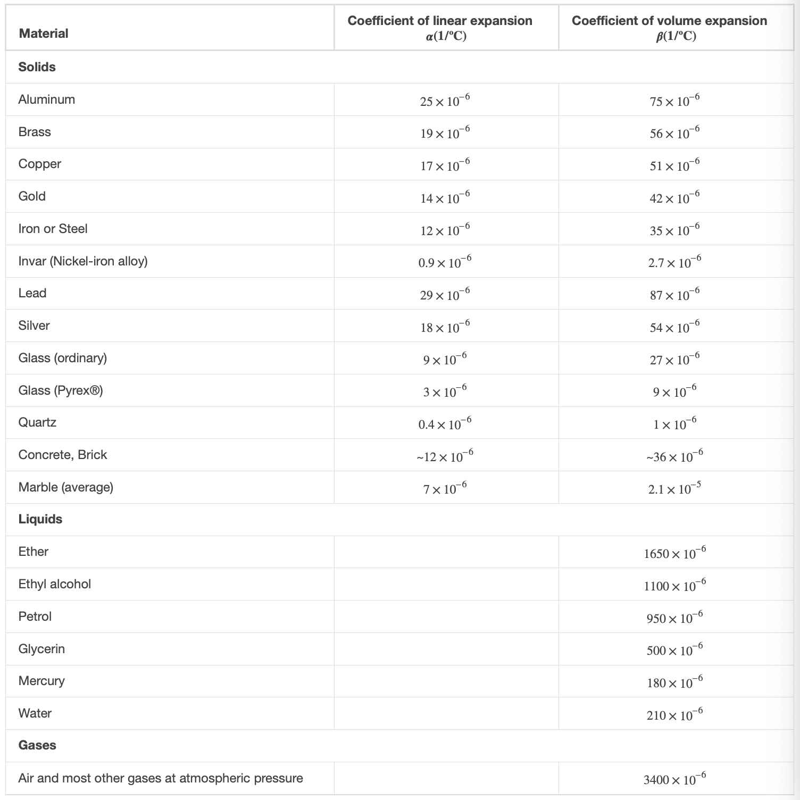
Linear Thermal Expansion
The change in length of a substance depends on the temperature, material and the length itself:
$$ΔL=αLΔT$$
$α$ is the coefficient of linear expansion
Coefficient of linear expansion
Depends on the properties of the materials involved
Image Credit: OpenStax College Physics - Table 13.2 CC BY 4.0

Slide 4
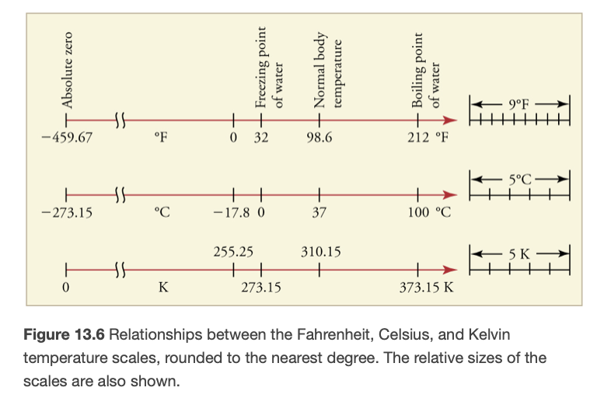
Example
Room temperature is generally considered to be about ${25.0}^{o}C$. What would this be in ${}^{o}F$? In Kelvins?
Draw a sketch
Identify known values
Identify equation
Enter values in the equation and solve
Image Credit: OpenStax College Physics - Figure 13.6 CC BY 4.0

Slide 5
Example
Room temperature is generally considered to be about ${25.0}^{o}C$. What would this be in ${}^{o}F$? In Kelvins?
Draw a sketch
Identify known values
Identify equation
Enter values in the equation and solve
$$T(^{o}C)={25.0}^{o}C$$
$$T(^{o}F)=\frac{9}{5}T(^{o}C)+32$$
$$T(^{o}F)=\frac{9}{5}(25.0)+32={77.0}^{o}F$$
$$T(K)=T(^{o}C)+273.15$$
$$T(K)=25.0+273.15=298K$$
Image Credit: OpenStax College Physics - Figure 13.6 CC BY 4.0

Slide 6
Thermal Equilibrium
If two systems, A & B are in thermal equilibrium with each other, and B is in thermal equilibrium with a third system, C, then A is also in thermal equilibrium with C.
The Zeroth Law of Thermodynamics
Heat will flow from hotter object to cooler objects, equalizing their temperatures.
This is how a thermometer measures temperature
Image Credit: OpenStax College Physics - Figure 8.8

Slide 7
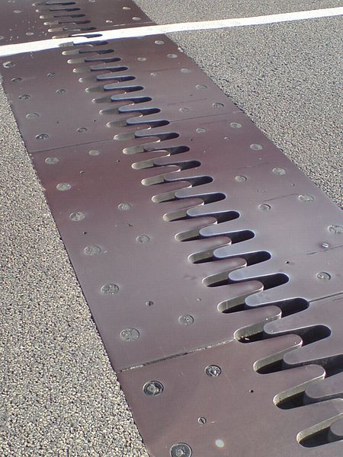
Thermal Expansion
Thermal expansion is related to the change in temperature
Greater temperature change means greater expansion
The amount of expansion also depends on the material
Alcohol in a thermometer expands more than the glass
Image Credit: Ingolfson, Public domain, via Wikimedia Commons

Slide 8
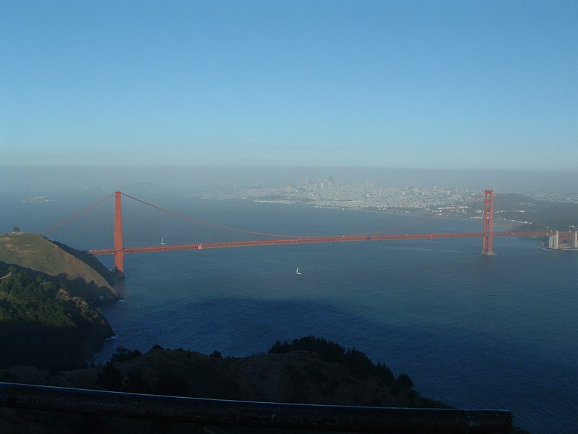
Example
The span of a bridge is 1275 m long at its coldest. The bridge is exposed to temperatures ranging from $-{15.0}^{o}C$ to $+{40.0}^{o}C$. What is the change in length between these temperatures if the bridge is made of steel?
Draw a sketch
Identify known values
Identify equation
Enter values in the equation and solve
Image Credit: Csman at Russian Wikipedia., CC BY 1.0 <https://creativecommons.org/licenses/by/1.0>, via Wikimedia Commons

Slide 9
Example
The span of a bridge is 1275 m long at its coldest. The bridge is exposed to temperatures ranging from $-{15.0}^{o}C$ to $+{40.0}^{o}C$. What is the change in length between these temperatures if the bridge is made of steel?
Draw a sketch
Identify known values
Identify equation
Enter values in the equation and solve
$$L=1275m;ΔT={55}^{o}C;α(steel)=\frac{12x{10}^{-6}}{{}^{o}C}$$
$$ΔL=αLΔT$$
$$ΔL=(\frac{12x{10}^{-6}}{{}^{o}C})(1275m)({55}^{o}C)$$
$$ΔL=0.84m$$
Image Credit: Csman at Russian Wikipedia., CC BY 1.0 <https://creativecommons.org/licenses/by/1.0>, via Wikimedia Commons

Slide 10
Thermal Expansion in Two and Three Dimensions
Two Dimensions:
$$ΔA=2αAΔT$$
Three Dimensions
$$ΔV=βVΔT$$
$β$ is the coefficient of volume expansion

Slide 11
Example
Suppose a 60.0 L steel gasoline tank is full. The gas and tank have a temperature of 15.0ºC. How much gasoline will spill by the time they warm to 35.0ºC?
Draw a sketch
Identify known values
Identify equation
Enter values in the equation and solve
$$V=60.0L;ΔT={20.0}^{o}C;β(steel)=\frac{35x{10}^{-6}}{{}^{o}C}$$
$$β(gas)=\frac{950x{10}^{-6}}{{}^{o}C}$$
$$ΔV_{s}=β_{s}ΔT;ΔV_{gas}=β_{gas}V_{gas}ΔT$$
$$V_{spill}=ΔV_{gas}-ΔV_{s};V_{gas}=V_{s}$$
$$V_{spill}=(β_{gas}-β_{s})VΔT$$
$$V_{spill}=\frac{(950-35)x{10}^{-6}}{{}^{o}C}(60.0L)({20.0}^{o}C)=1.10L$$

Slide 12
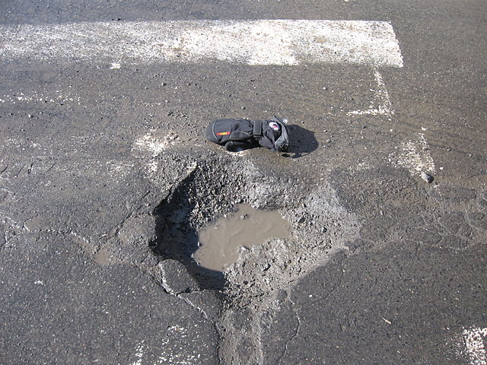
Thermal Stress
Thermal stress is caused by expansion and contraction as the temperature changes.
Damage to roads - potholes
Weathering of rocks
Rupturing of tank
Glass cooking pans
Dental fillings
Image Credit: Miguel Tremblay - Public Domain - Wikimedia Commons

Slide 13
Summary
Temperature is a measure of the average kinetic energies of the particle in a substance
Objects in contact will reach thermal equilibrium as heat is transferred from a hotter object to a cooler one
Thermal stress occurs when changes in temperature are rapid or when material in unable to expand and contract freely

