Slide 1
Introduction to Physical Science
The Ideal Gas Law
Presented by Robert Wagner

Slide 2
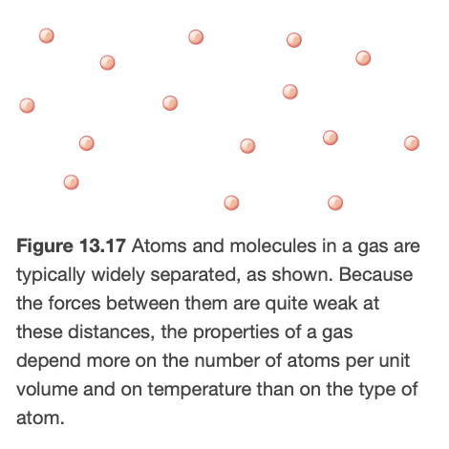
Behavior of Gases
Composed of atoms and molecules
$$N_{2},O_{2},Ar,Ne$$
Gases are easily compressed
Particles are very spread out relative to their sizes
Standard Temperature and Pressure (STP)
$$0^{o}Cand1.01x{10}^{5}Pa$$
Image Credit: OpenStax College Physics - Figure 13.17 CC BY 4.0

Slide 3
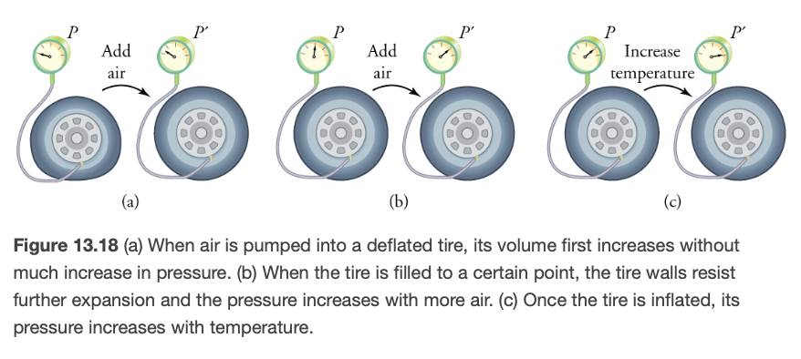
Relation of Pressure, Temperature and Volume
Inflating a tire
First volume increases
Next, pressure increases
Increased temperature will give an increase in pressure
Ideal Gas Law relates these
$$PV=NkT$$
$k=1.38x{10}^{-23}J/K$ ; Boltzmann Constant
Image Credit: OpenStax College Physics - Figure 13.18 CC BY 4.0

Slide 4
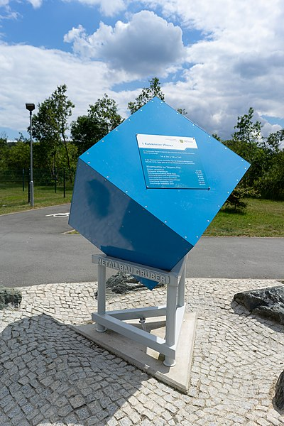
Example
Calculate the number of molecules in a cubic meter of gas at STP (Standard temperature and pressure)
Draw a sketch
Identify known values
Identify equation
Enter values in the equation and solve
Image Credit: PantheraLeo1359531, CC BY 4.0 <https://creativecommons.org/licenses/by/4.0>, via Wikimedia Commons

Slide 5
Example
Calculate the number of molecules in a cubic meter of gas at STP (Standard temperature and pressure)
Draw a sketch
Identify known values
Identify equation
Enter values in the equation and solve
$$T=0^{o}C(273K);P=1.01x{10}^{5}Pa;$$
$$V=1.00m^{3};k=1.38x{10}^{-23}J/K$$
$$PV=NkT$$
$$N=\frac{PV}{kT}$$
$$N=\frac{(1.01x{10}^{5}Pa)(1.00m^{3})}{(1.38x{10}^{-23}(273K)}$$
$$N=2.68x{10}^{25}molecules$$
Image Credit: PantheraLeo1359531, CC BY 4.0 <https://creativecommons.org/licenses/by/4.0>, via Wikimedia Commons

Slide 6
Moles and Avogadro’s Number
Because the number of molecules is so large, we come up with another unit
One mole is defined to be the number of atoms in exactly 12 graphs of carbon-12
This is known as Avogadro’s number ($N_{A}$)
$$N_{A}=6.02x{10}^{23}mol^{-1}$$
For all gases there are $22.5L/mol$ - see example 13.8 in the textbook for how this is determined.

Slide 7
Ideal Gas Law (moles)
The Ideal Gas Law can be restated in terms of moles.
$$PV=nRT$$
$$R=8.31J/mol⋅K$$
$$R=1.99cal/mol⋅K$$
$$R=0.821L⋅atm/mol⋅K$$
Image Credit: OpenStax College Physics - Figure 8.8

Slide 8
Example
How many moles of gas are in a bike tire with a volume of $2.00x{10}^{-3}m^{3}$, a pressure of $7.00x{10}^{5}Pa$ at a temperature of ${18.0}^{o}C$?
Draw a sketch
Identify known values
Identify equation
Enter values in the equation and solve
Image Credit: PierreSelim, CC BY 3.0 <https://creativecommons.org/licenses/by/3.0>, via Wikimedia Commons

Slide 9
Example
How many moles of gas are in a bike tire with a volume of $2.00x{10}^{-3}m^{3}$, a pressure of $7.00x{10}^{5}Pa$ at a temperature of ${18.0}^{o}C$?
Draw a sketch
Identify known values
Identify equation
Enter values in the equation and solve
$$P=7.00x{10}^{5}Pa;V=2.00x{10}^{-3}m^{3}$$
$$T={18.0}^{o}C(291K);R=8.31J/mol⋅K$$
$$n=\frac{PV}{RT}$$
$$n=\frac{(7.00x{10}^{5}Pa)(2.00x{10}^{-3}m^{3})}{(8.31J/mol⋅K)(291K)}$$
$$n=0.579mol$$
Image Credit: PierreSelim, CC BY 3.0 <https://creativecommons.org/licenses/by/3.0>, via Wikimedia Commons

Slide 10
Problem Solving Strategies
Determine that an ideal gas is involved
List the known values and convert to SI units
Determine the unknown
Which form of ideal gas law to use?
Do you know molecules or moles?
Manipulate the equation as needed to solve for unknown
Substitute in known values
Check to make sure the answer is reasonable

Slide 11
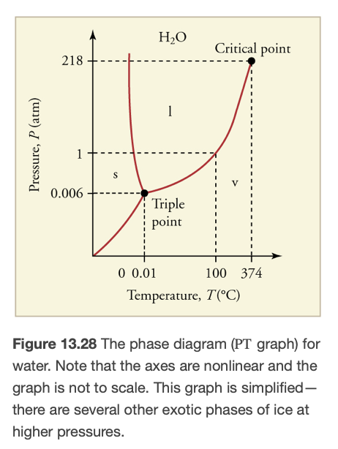
Phase Diagrams
Matter can be in the solid, liquid or gas phase
A phase diagram plots temperature and pressure
Boundaries between phases
Critical point - liquid phase no longer exists
Triple point - all three phases exist
Sublimation - phase change from solid to gas
Image Credit: OpenStax College Physics - Figure 13.18 CC BY 4.0

Slide 12
Summary
The ideal gas law relates pressure, temperature and volume of an ideal gas
Avogadro’s number give the number of molecules in a specified quantity of matter
A phase diagram shows at which temperatures and pressures the different phases will exist

