Slide 1
Introduction to Physical Science
Heat Capacity
Presented by Robert Wagner

Slide 2
Heat
Heat is the spontaneous transfer of energy due to a temperature difference
SI unit = Joule
Heat is often measure in calories
1 calorie is the temperature needed to raise the temperature of 1.00 g of water by 1.00ºC
More often used - kilocalorie
This is what we call a Calorie when taking about food energy

Slide 3
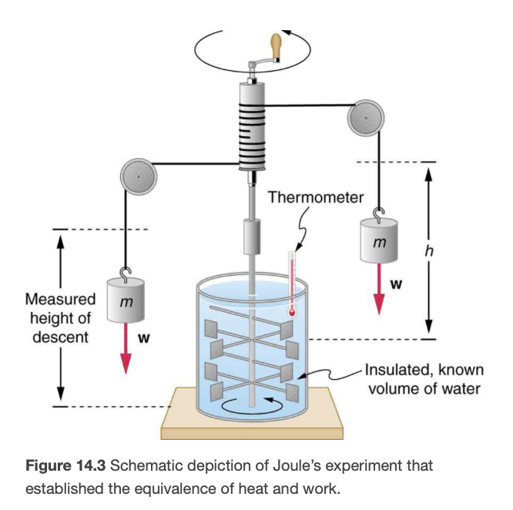
Mechanical Equivalent of Heat
Heat is a form of energy
Mechanical Equivalent of Heat
The work needed to produce the same effects as heat transfer
1.000 kcal = 4186 Joules
James Prescott Joule
Experiment: Gravitational potential energy —> Kinetic Energy —> Heat
Image Credit: OpenStax College Physics - Figure 14.3 CC BY 4.0

Slide 4
Heat and Phase Changes
When heat is added or removed from a system —> internal energy changes
May increase/decrease temperature
May involve a phase change

Slide 5
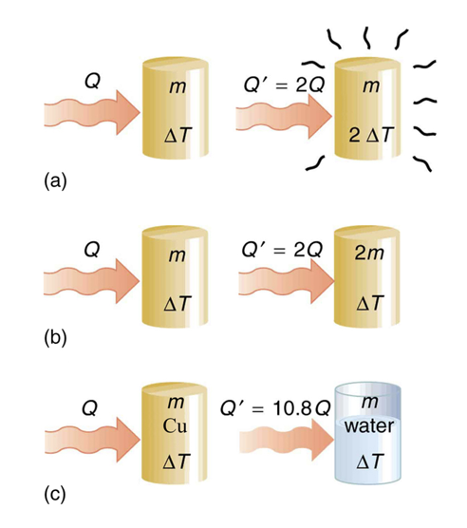
Temperature Change and Heat Capacity
If there are no phase changes, the heat transfer depends on
Change in temperature
Mass of the system
The substance and phase of the substance
$$Q=mcΔT$$
c = specific heat - amount of heat needed to raise the temperature of 1.00 kg by 1.00ºC.
SI unit: $J/(kg⋅K)$
Also used: $kcal/(kg⋅^{o}C)$
Image Credit: OpenStax College Physics - Figure 14.4 CC BY 4.0

Slide 6
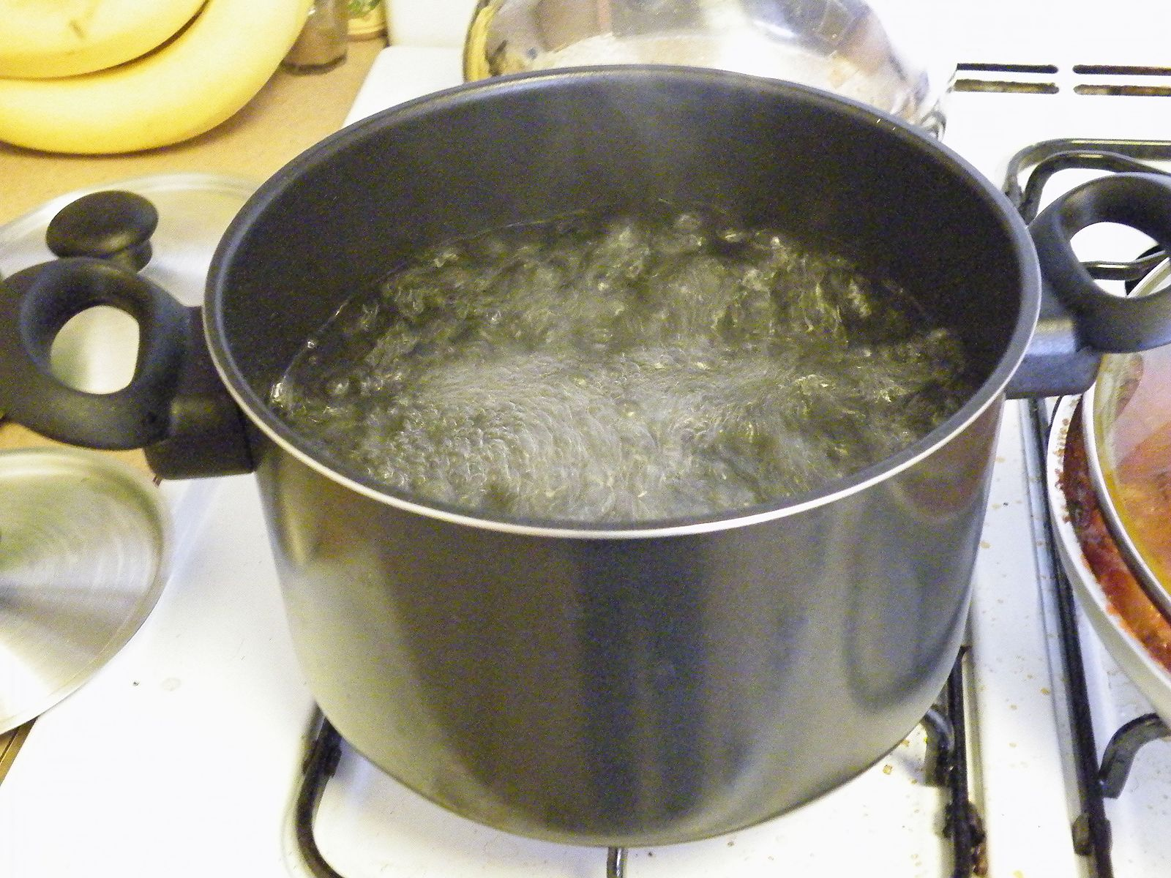
Example
An 0.500 kg aluminum pan is used to heat 0.250 liters of water from 20.0ºC to 80.0ºC. How much heat is required?
Draw a sketch
Identify known values
Identify equation
Enter values in the equation and solve
Image Credit: GRAN, CC BY 3.0 <https://creativecommons.org/licenses/by/3.0>, via Wikimedia Commons

Slide 7
Example
An 0.500 kg aluminum pan is used to heat 0.250 liters of water from 20.0ºC to 80.0ºC. How much heat is required?
Draw a sketch
Identify known values
Identify equation
Enter values in the equation and solve
$$m_{pan}=0.500kg;V_{water}=0.250L;ΔT={60.0}^{o}C$$
$$c_{water}=4186J/kg⋅^{o}C;c_{Al}=900.J/kg⋅^{o}C$$
(See Table 14.1)
$$m_{water}=V_{water}⋅ρ_{water}=0.250L⋅1000kg/m^{3}=0.250kg$$
$$Q_{w}=m_{w}c_{w}ΔT$$
$$Q_{w}=(0.250kg)(4186J/kg⋅^{o}C)({60.0}^{o}C)=62.8kJ$$
$$Q_{Al}=m_{Al}c_{Al}ΔT$$
$$Q_{Al}=(0.500kg)(900J/kg^{o}C)({60.0}^{o}C)=27.0kJ$$
$$Q_{Total}=Q_{w}+Q_{Al}=62.8kJ+27.0kJ=89.8kJ$$
Image Credit: GRAN, CC BY 3.0 <https://creativecommons.org/licenses/by/3.0>, via Wikimedia Commons

Slide 8
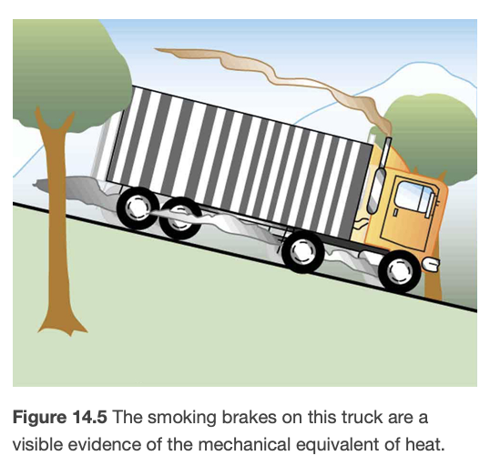
Example
Calculate the temperature increase of 100. Kg of brake material with an average specific heat of 800. J/kgºC if the material retains 10% of the energy from a 10,000. kg truck descending 75.0 m at a constant speed
Draw a sketch
Identify known values
Identify equation
Enter values in the equation and solve
Image Credit: OpenStax College Physics - Figure 14.5 CC BY 4.0

Slide 9
Example
Calculate the temperature increase of 100. Kg of brake material with an average specific heat of 800. J/kgºC if the material retains 10% of the energy from a 10,000. kg truck descending 75.0 m at a constant speed
Draw a sketch
Identify known values
Identify equation
Enter values in the equation and solve
$$m_{truck}=10000.kg;h=75.0m;$$
$$m_{brake}=100.kg;c_{brake}=800.J/kg^{o}C$$
$$PE=m_{truck}gh=(10000kg)(9.80m/s^{2})(75.0m)$$
$$PE=7.35x{10}^{6}J$$
$$10\%ofPE=7.35x{10}^{5}J$$
$$Q=mcΔTorΔT=\frac{Q}{mc}$$
$$ΔT=\frac{7.35x{10}^{5}J}{(100.kg)(800.J/kg^{o}C)}$$
$$ΔT={9.2}^{o}C$$
Image Credit: OpenStax College Physics - Figure 14.5 CC BY 4.0

Slide 10
Summary
Heat is the spontaneous transfer of energy due to a temperature difference
The Mechanical Equivalent of Heat relates energy in kilocalories to energy in Joules
The heat capacity of a substance tells how much energy is needed to raise the temperature of a kilogram of a substance by a degree Celsius

