Slide 1
Introduction to Physical Science
Latent Heat
Presented by Robert Wagner

Slide 2
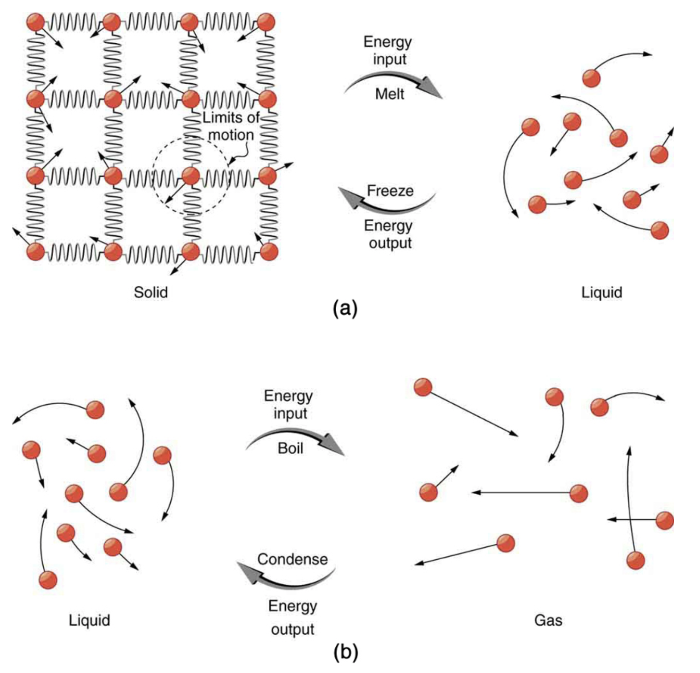
Heat in Phase Changes
Not all heat transfers involve a temperature change
Can involve a phase change
Ice melts —> Liquid water
Energy is required for melting
Need to break apart molecular bonds
Energy needed:
$Q=mL_{f}$ (melting/freezing)
$Q=mL_{v}$ (vaporization/condensation)
$L_{f}L_{v}$ - Determined experimentally (See Table 14.2)
Image Credit: OpenStax College Physics - Figure 14.7 CC BY 4.0

Slide 3
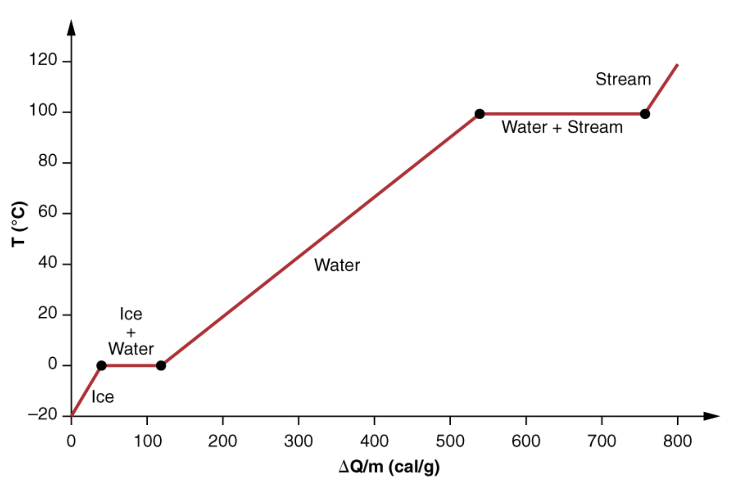
Latent Heat Coefficients
Latent heat
Units: J/kg
Latent heat coefficients
Latent - invisible because no temperature change occurs
Phase changes
Need to look at in parts
Image Credit: OpenStax College Physics - Figure 14.8 CC BY 4.0

Slide 4
Example
$$T_{soda}={20.0}^{o}C;m_{soda}=0.25kg;T_{ice}=0^{o}C;m_{ice}=0.018kg$$
$$Q_{ice}=-Q_{soda}$$
$$Q_{ice}=m_{ice}L_{f}+m_{ice}c_{w}(T_{f}-0^{o}C)$$
$$Q_{soda}=m_{soda}c_{w}(T_{f}-{20.0}^{o}C)$$
$$T_{f}=\frac{m_{soda}c_{w}({20.0}^{o}C)-m_{ice}L_{f}}{(m_{soda}+m_{ice})c_{w}}$$
$$T_{f}=\frac{(0.25kg)(4186J/kg⋅^{o}C)({20.0}^{o}C)-(0.018kg)(334000J/kg)}{(0.25kg+0.018kg)(4186K/kg⋅^{o}C)}$$
$$T_{f}=\frac{20930J-6012J}{1122J/^{o}C}={13}^{o}C$$
Three ice cubes are used to chill a soda at 20ºC with a mass of soda of 0.25 kg. The ice is at 0ºC. The ice cubes each have a mass of 6.0 g. Ignore heat loss and assume the heat capacity of soda is the same as that of water. What is the final temperature?
Draw a sketch
Identify known values
Identify equation
Enter values in the equation and solve

Slide 5
Sublimation
Direct transition from solid —> gas
Example: Dry ice
Latent heat of sublimation: $L_{s}$
$$Q=mL_{s}$$
Sublimation requires energy - makes dry ice an effective coolant

Slide 6
Heat Transfer - Problem Solving Strategies
Examine situation
Change in temperature or phase?
Heat transfer in or out of system?
Identify what changes temperature or phase
Identify given quantities and unknowns
Solve the equation for the quantity to be determined
Substitute in values to determine numerical answer
Check to see if the answer is reasonable

Slide 7
Summary
Heat transfer can result in an increase in temperature or a phase change
Latent heat tells the energy needed for a change in phase
Sublimation is the direct change from solid to gas without passing through the liquid phase

