Slide 1
Introduction to Physical Science
Heat Transfer
Presented by Robert Wagner

Slide 2
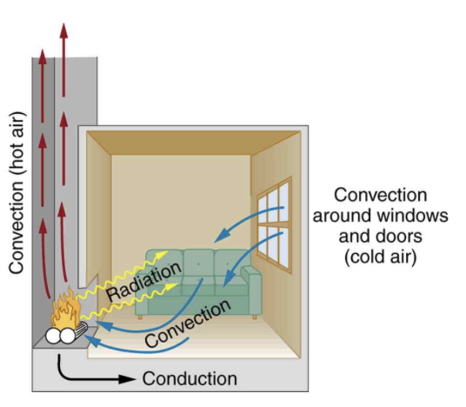
Methods of Heat Transfer
There are three methods by which heat is transferred
Conduction: Transfer by physical contact
Convection: Transfer by bulk movement of material
Radiation: Transfer by absorption or emission of electromagnetic radiation
Image Credit: OpenStax College Physics - Figure 14.12 CC BY 4.0

Slide 3
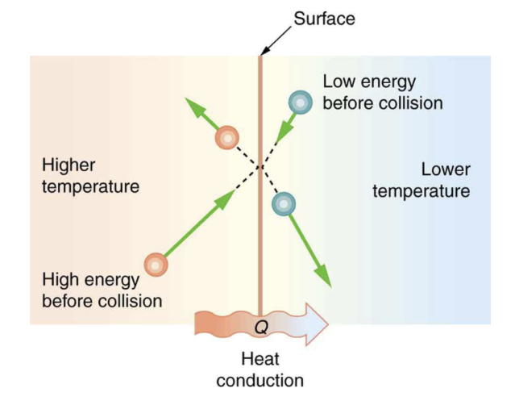
Conduction
Conduction is a transfer of kinetic energy. It depends on:
Temperature difference
Cross-sectional area
Thickness of material
Coefficient of thermal conductivity
Rate of heat transfer:
$$\frac{Q}{t}=\frac{kA(T_{2}-T_{1})}{d}$$
Image Credit: OpenStax College Physics - Figure 14.14 CC BY 4.0

Slide 4
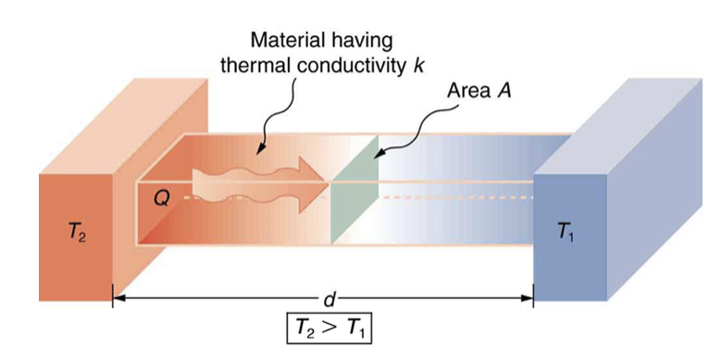
Conduction
Conduction is a transfer of kinetic energy. It depends on:
Temperature difference
Cross-sectional area
Thickness of material
Coefficient of thermal conductivity (Table 14.3)
Rate of heat transfer:
$$\frac{Q}{t}=\frac{kA(T_{2}-T_{1})}{d}$$
Image Credit: OpenStax College Physics - Figure 14.15 CC BY 4.0

Slide 5
Example
$$A=0.950m^{2};T_{1}=0^{o}C;T_{2}={35.0}^{o}C$$
$$d=2.50cm;t=1day=86000s$$
$$\frac{Q}{t}=\frac{kA(T_{2}-T_{1})}{d}orQ=\frac{kA(T_{2}-T_{1})}{d}t$$
$$Q=mL_{f}$$
$$Q=\frac{(0.10J/s⋅m⋅^{o}C)(0.950m^{2})({35.0}^{o}C-0^{o}C)}{0.0250m}(86400s)$$
$$Q=1.15x{10}^{6}J$$
$$m=\frac{Q}{L_{f}}=\frac{1.15x{10}^{6}J}{334x{10}^{3}J/kg}=3.44kg$$
A styrofoam box has a total area of 0.950 m² and walls of thickness 2.50 cm. It contains ice and beverages at 0ºC. How much ice melts in one day if kept in a car trunk at 35.0ºC?
Draw a sketch (if applicable)
Identify known values
Identify equation
Enter values in the equation and solve

Slide 6
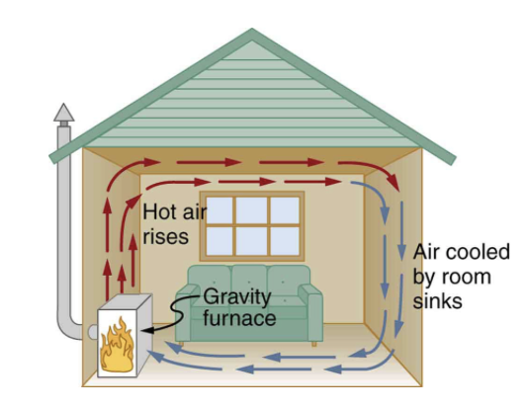
Convection
Convection is driven by the bulk motion of matter.
Driven by buoyant forces
Hot material rises
Cool material sinks
Image Credit: OpenStax College Physics - Figure 14.17 CC BY 4.0

Slide 7
Example
$$V_{house}=12.0mx18.0mx3.00m;ΔT={10.0}^{o}C$$
$$t=30.0min=1800s$$
$$m_{air}=ρ_{air}V_{house}$$
$$m_{air}=(1.29kg/m^{3})(648m^{3})=836kg$$
$$Q=mcΔT$$
$$Q=(836kg)(1000J/kg⋅^{o}C)({10.0}^{o}C)=8.36x{10}^{6}J$$
$$\frac{Q}{t}=\frac{8.36x{10}^{6}J}{1800s}=4.64kW$$
Suppose a house has inside dimensions of 12.0 m x 18.0 m x 3.00 m and that all air is replaced in 30.0 min. Calculate the heat transfer rate to warm in the incoming cold air by 10.0ºC.
Draw a sketch (if applicable)
Identify known values
Identify equation
Enter values in the equation and solve

Slide 8
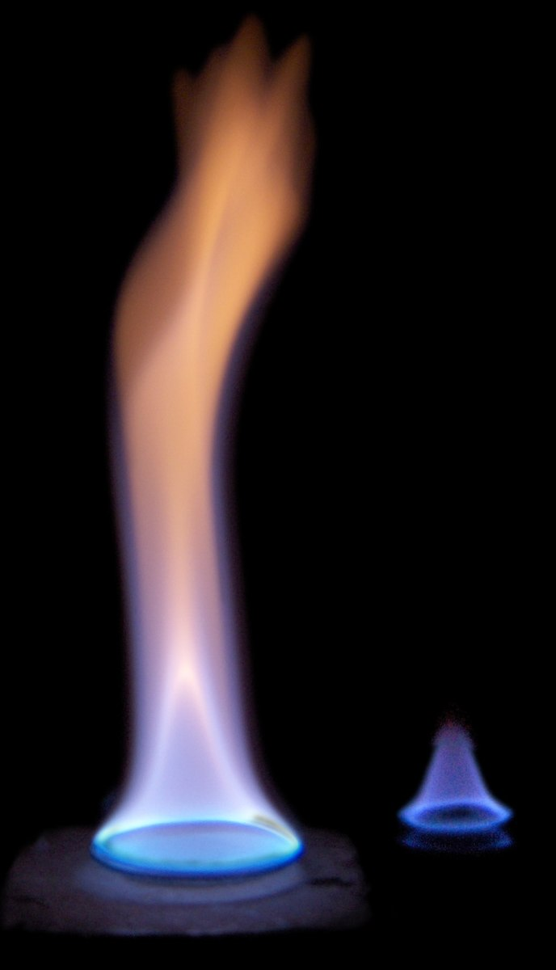
Radiation
Energy of electromagnetic radiation depends on wavelength
Rate of heat transfer by radiation determined by color
Black - most effective
White - least effective
Ideal Radiator - appears black
Image Credit: Tuohirulla, Public domain, via Wikimedia Commons

Slide 9
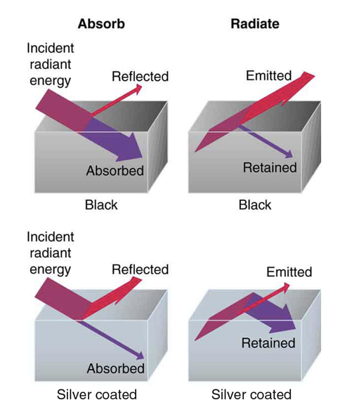
Radiation
Energy of electromagnetic radiation depends on wavelength
Rate of heat transfer by radiation determined by color
Black - most effective
White - least effective
Ideal Radiator - appears black
Image Credit: Tuohirulla, Public domain, via Wikimedia Commons

Slide 10
Stefan-Boltzmann Law of Radiation
Rate of heat transfer by emitted radiation:
$$\frac{Q}{t}=σeAT^{4}$$
Stefan - Boltzmann constant
$$σ=5.67x{10}^{-8}J/s⋅m^{2}⋅K^{4}$$
Emissivity: e - Depends on the specific substance
An ideal radiator or blackbody would have e=1

Slide 11
Stefan-Boltzmann Law of Radiation
Net rate of heat transfer by emitted radiation:
$$\frac{Q}{t}=σeA(T_{2}^{4}-T_{1}^{4})$$
Net transfer is from hot —> cold

Slide 12
Example
$$T_{2}={22.0}^{o}C(295K);T_{1}={33.0}^{o}C(306K)$$
$$A=1.50m^{2};e=0.97$$
$$\frac{Q}{t}=σeA(T_{2}^{4}-T_{1}^{4})$$
$$\frac{Q}{t}=(5.67x{10}^{-8}J/s⋅m^{2}⋅K^{4})(0.97)(1.50m^{2})[(295K)^{4}-(306K)^{4}]$$
$$\frac{Q}{t}=-99J/s$$
$$\frac{Q}{t}=-99W$$
What is the net rate of heat transfer by radiation, with an unclothed person in a dark room with an ambient temperature of 22.0ºC. Normal skin temperature is 33.0ºC. The surface area is 1.50m² and the emissivity of skin of 0.97 (in the infrared.)
Draw a sketch (if applicable)
Identify known values
Identify equation
Enter values in the equation and solve

Slide 13
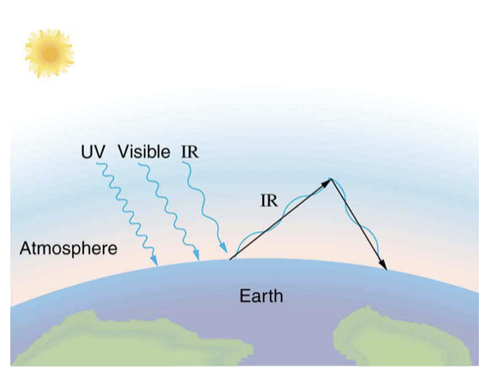
Greenhouse Effect
Depends on emissivity of Earth
Average value: 0.65
More clouds => more reflectivity
Balance between incoming solar radiation and energy radiated by Earth
Infrared can be trapped by $CO_{2}H_{2}O$ in Earth’s atmosphere
Makes temperature about 40ºC higher and makes life on Earth possible
Image Credit: OpenStax College Physics - Figure 14.28 CC BY 4.0

Slide 14
Methods of Heat Transfer - Problem Solving Strategies
Examine situation
Type of heat transfer involved?
Conduction, convection, or radiation
Identify given quantities and unknowns
Solve the appropriate equation for the quantity to be determined
Different equations discussed for conduction, convection and radiation
Substitute in values to determine numerical answer
Check to see if the answer is reasonable

Slide 15
Summary
Heat transfer can be from conduction, convection, or radiation
Heat transfer is calculated differently in each case
The greenhouse effect on Earth shows transfer by radiation

