Slide 1
Introduction to Physical Science
Thermodynamics
Presented by Robert Wagner

Slide 2
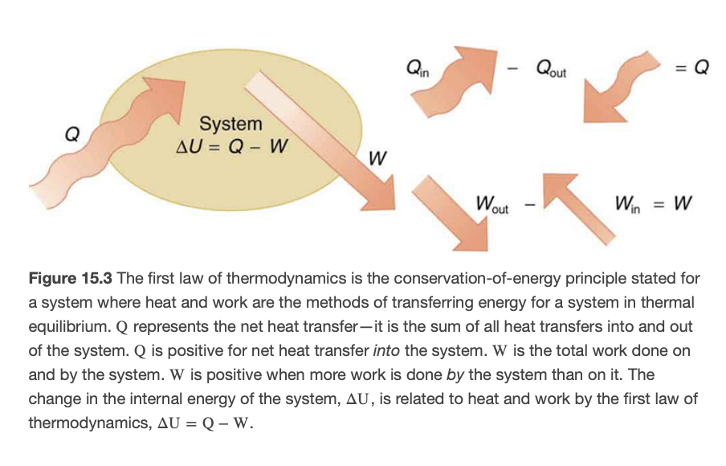
First Law of Thermodynamics
Change in internal energy of a system is equal to the net heat transfer into the system minus the net work done by the system
$$ΔU=Q-W$$
Conservation of energy for a system in thermal equilibrium
Image Credit: OpenStax College Physics - Figure 15.3 CC BY 4.0

Slide 3
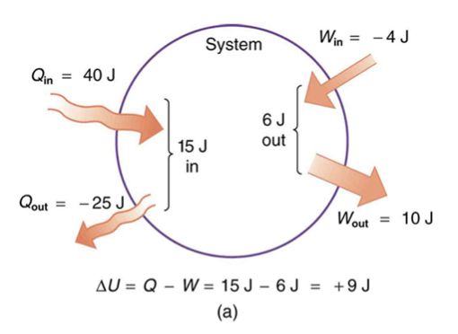
Example
There is a heat transfer of 40.00 J to a system, while the system does 10.0 J of work. Later, there is heat transfer of 25.00 J out of the system while 4.00 J of work is done on the system. What is the net change in internal energy of the system?
Draw a sketch (if applicable)
Identify known values
Identify equation
Enter values in the equation and solve
Image Credit: OpenStax College Physics - Figure 15.4a CC BY 4.0

Slide 4
Example
There is a heat transfer of 40.00 J to a system, while the system does 10.0 J of work. Later, there is heat transfer of 25.00 J out of the system while 4.00 J of work is done on the system. What is the net change in internal energy of the system?
Draw a sketch (if applicable)
Identify known values
Identify equation
Enter values in the equation and solve
$$Q_{1}=40.00J;Q_{2}=-25.00J$$
$$W_{1}=10.00J;W_{2}=-4.00J$$
$$Q_{net}=Q_{1}+Q_{2}$$
$$W_{net}=W_{1}+W_{2}$$
$$Q=40.00J-25.00J=15.00J$$
$$W=10.00J-4.00J=6.00J$$
$$ΔU=Q-W=15.00J-6.00J$$
$$ΔU=9.00J$$
Image Credit: OpenStax College Physics - Figure 15.4a CC BY 4.0

Slide 5
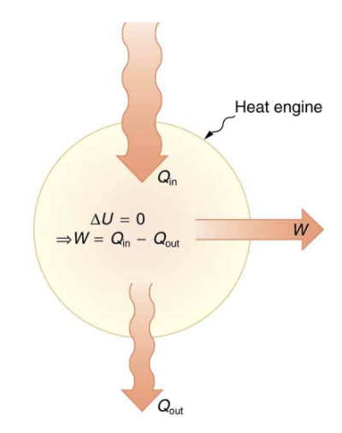
Heat Engine
A device that uses heat energy to do work
Car engine
Steam turbines
Work done depends on the path taken
PV diagram
Vertical paths - constant volume - isochoric
Horizontal paths - constant pressure - isobaric. $W=PΔV$
Image Credit: OpenStax College Physics - Figure 15.7 CC BY 4.0

Slide 6
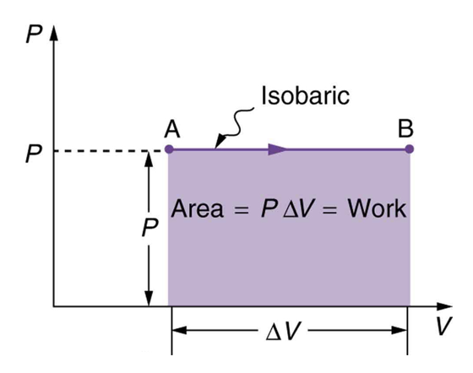
Heat Engine
A device that uses heat energy to do work
Car engine
Steam turbines
Work done depends on the path taken
PV diagram
Vertical paths - constant volume - isochoric
Horizontal paths - constant pressure - isobaric. $W=PΔV$
Image Credit: OpenStax College Physics - Figure 15.10 CC BY 4.0

Slide 7
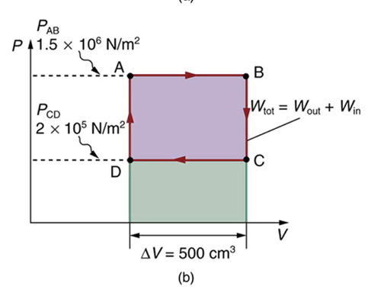
Example
Calculate the total work done in the cyclical path ABCDA shown here. Calculate the work done along each segment to get the total work.
Draw a sketch (if applicable)
Identify known values
Identify equation
Enter values in the equation and solve
Image Credit: OpenStax College Physics - Figure 15.12b CC BY 4.0

Slide 8
Example
Calculate the total work done in the cyclical path ABCDA shown here. Calculate the work done along each segment to get the total work.
Draw a sketch (if applicable)
Identify known values
Identify equation
Enter values in the equation and solve
$$P_{AB}=1.50x{10}^{6}N/m^{2};P_{CD}=2.00x{10}^{5}N/m^{2}$$
$$ΔV=500.cm^{3}=5.00x{10}^{-4}m^{3}$$
$$W_{AB}=P_{AB}ΔV_{AB}$$
$$W_{AB}=(1.50x{10}^{6}N/m^{2})(5.00x{10}^{-4}m^{3})=750.J$$
$$W_{BC}=P_{BC}ΔV_{BC}=0$$
$$W_{CD}=P_{CD}ΔV_{CD}$$
$$W_{CD}=(2.00x{10}^{6}N/m^{2})(-5.00x{10}^{-4}m^{3})=-100.J$$
$$W_{DA}=P_{DA}ΔV_{DA}=0$$
$$W=W_{AB}+W_{BC}+W_{CD}+W_{DA}=650.J$$
Image Credit: OpenStax College Physics - Figure 15.12b CC BY 4.0

Slide 9
Reversible Processes
Reversible process - the system and environment can return to their original states by following the reverse path
When dissipative processes like friction or turbulence exist, a process cannot be reversible

Slide 10
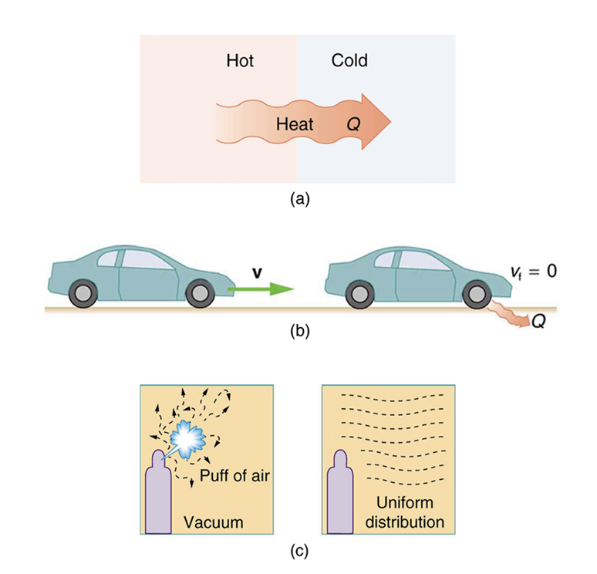
Second Law of Thermodynamics
Many process occur spontaneously in one direction only
They are irreversible processes
Heat will never transfer spontaneously from a cool object to a hot one
Mechanical energy can be completely converted to thermal energy, but the reverse cannot occur
Air will spread through a container, but not group in a corner
Image Credit: OpenStax College Physics - Figure 15.16 CC BY 4.0

Slide 11
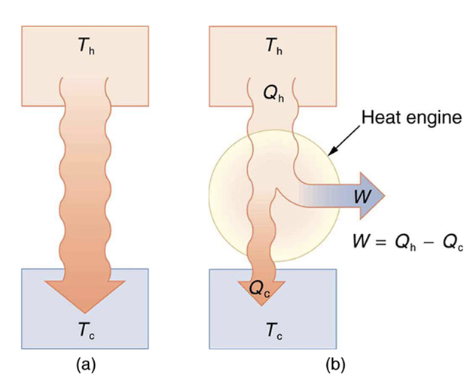
Second Law of Thermodynamics (2)
1st Expression
Heat transfer occurs spontaneously from higher to lower temperature bodies, but never spontaneously in the reverse direction.
Heat Engines
Want high efficiency $W=Q_{h};Q_{c}=0$
2nd expression
It is impossible for any system for heat transfer from a reservoir to completely convert work in a cyclical process in which the system returns to its original state.
Image Credit: OpenStax College Physics - Figure 15.17 CC BY 4.0

Slide 12
Cyclical Processes
A cyclical process brings a system back to its original state at the end of each cycle.
$$W_{net}=Q_{h}-Q_{c}$$
Conversion efficiency: ratio of what we get to what is input
$$Eff=\frac{W}{Q_{h}}=\frac{Q_{h}-Q_{c}}{Q_{h}}=1-\frac{Q_{c}}{Q_{h}}$$
Efficiency can never be 1. Some energy is always lost
Image Credit: OpenStax College Physics - Figure 15.17 CC BY 4.0

Slide 13
Example
A coal power plant uses heat transfer from burning coal to turn turbines which generate electricity. Suppose in a single day, the station has 2.50x10¹⁴ J heat transfer from coal and 1.48x10¹⁴ J heat transfer into the environment. What is the work done by the power station? What is the efficiency of the power station?
Draw a sketch (if applicable)
Identify known values
Identify equation
Enter values in the equation and solve
Image Credit: OpenStax College Physics - Figure 15.17 CC BY 4.0

Slide 14
Example
A coal power plant uses heat transfer from burning coal to turn turbines which generate electricity. Suppose in a single day, the station has 2.50x10¹⁴ J heat transfer from coal and 1.48x10¹⁴ J heat transfer into the environment. What is the work done by the power station? What is the efficiency of the power station?
Draw a sketch (if applicable)
Identify known values
Identify equation
Enter values in the equation and solve
$$Q_{h}=2.50x{10}^{14}J;Q_{c}=1.48x{10}^{14}J$$
$$W=Q_{h}-Q_{c}$$
$$W=2.50x{10}^{14}J-1.48x{10}^{14}J=1.02x{10}^{14}J$$
$$Eff=\frac{W}{Q_{h}}$$
$$Eff=\frac{1.02x{10}^{14}J}{2.50x{10}^{14}J}=0.408=40.8\%$$
Image Credit: OpenStax College Physics - Figure 15.17 CC BY 4.0

Slide 15
Summary
1st Law: Law of conservation of energy. Change in energy = energy in less the energy out
Heat engines are devices that we use to do work on a system
2nd Law: A system can never convert heat to work with 100% efficiency

