Slide 1
Introduction to Physical Science
Oscillations
Presented by Robert Wagner

Slide 2
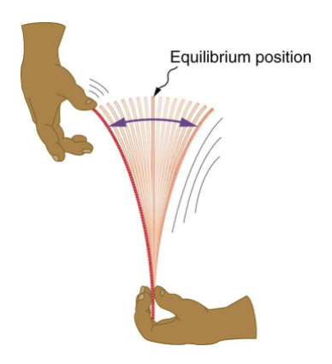
Oscillations
An object oscillating back and forth must be experiencing a force
Recall Newton’s first law
Deformation of ruler causes a force in the opposite direction
Restoring force:
$$F=-kx$$
x is the displacement from equilibrium
k is the force constant (N/m)
Image Credit: OpenStax College Physics - Figure 16.2 CC BY 4.0

Slide 3
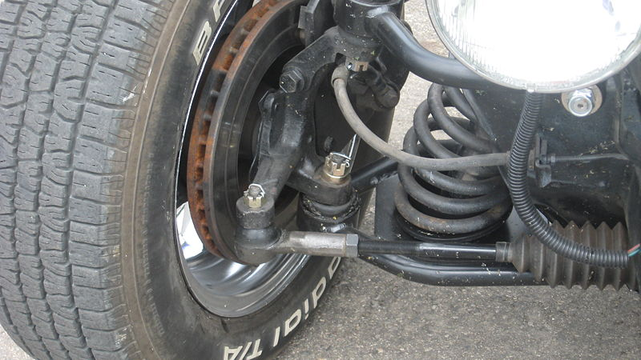
Example
What is the force constant for the suspension system of a car that settles 1.20 cm when an 80.0 kg person gets in.
Draw a sketch (if applicable)
Identify known values
Identify equation
Enter values in the equation and solve
Image Credit: Trekphiler, CC BY 3.0 <https://creativecommons.org/licenses/by/3.0>, via Wikimedia Commons

Slide 4
Example
What is the force constant for the suspension system of a car that settles 1.20 cm when an 80.0 kg person gets in.
Draw a sketch (if applicable)
Identify known values
Identify equation
Enter values in the equation and solve
$$x=1.20cm=-0.012m;m=80.0kg$$
$$F=w=mg=(80.0kg)(9.80m/s^{2})$$
$$F=784N$$
$$F=-kx;k=-\frac{F}{x}$$
$$k=-\frac{784N}{-0.012m}$$
$$k=6.53x{10}^{4}N/m$$
Image Credit: Trekphiler, CC BY 3.0 <https://creativecommons.org/licenses/by/3.0>, via Wikimedia Commons

Slide 5
Elastic Potential Energy
Work must be done to produce a deformation
Work is stored as potential energy
$$PE_{el}=\frac{1}{2}kx^{2}$$

Slide 6
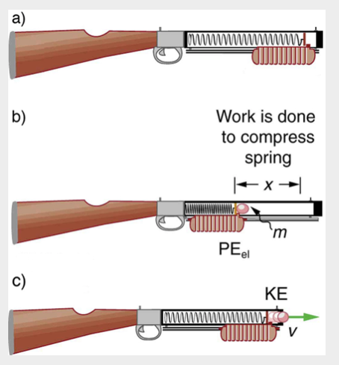
Example
How much energy is stored in the spring of a tranquilizer gun that has a force constant of 50.0 N/m? Neglect friction and the mass of the spring to calculated the speed with which the 2.00 g projectile will be ejected.
Draw a sketch (if applicable)
Identify known values
Identify equation
Enter values in the equation and solve
Image Credit: OpenStax College Physics - Figure 16.7 CC BY 4.0

Slide 7
Example
How much energy is stored in the spring of a tranquilizer gun that has a force constant of 50.0 N/m? Neglect friction and the mass of the spring to calculated the speed with which the 2.00 g projectile will be ejected.
Draw a sketch (if applicable)
Identify known values
Identify equation
Enter values in the equation and solve
$$k=50.0N/m;x=0.150m;m=2.00g=0.002kg$$
$$PE_{el}=\frac{1}{2}kx^{2}=\frac{1}{2}(50.0N/m)(0.150m)^{2}$$
$$PE_{el}=0.563N⋅m$$
$$KE=PE_{el}=\frac{1}{2}mv^{2}$$
$$v=\sqrt{\frac{2PE_{el}}{m}}=\sqrt{\frac{2(0.563J)}{(0.002kg)}}=23.7m/s$$
Image Credit: OpenStax College Physics - Figure 16.7 CC BY 4.0

Slide 8
Periodic Motion
A periodic motion is a motion that repeats itself at regular intervals
Time to complete one oscillation is the period, T
The frequency is defined to be the number of oscillations per unit time
$$f=\frac{1}{T}$$
SI unit - Hertz (Hz). 1 Hz = 1 cycle/s or 1/s

Slide 9
Example
A medical imaging device produces ultrasound by oscillating with a period of 0.400 μs. What is the frequency? The frequency of middle C is 264 Hz. What is the time for one complete oscillation?
Draw a sketch (if applicable)
Identify known values
Identify equation
Enter values in the equation and solve
$$T=0.400μs=0.400x{10}^{-6}s$$
$$f=\frac{1}{T}=\frac{1}{0.400x{10}^{-6}s}$$
$$f=2.50x{10}^{6}Hz=2.50MHz$$
$$f=264Hz$$
$$f=\frac{1}{T};T=\frac{1}{f}$$
$$T=\frac{1}{264Hz}=\frac{1}{264cycles/s}=3.79x{10}^{-3}s=3.79ms$$

Slide 10
Summary
Oscillations result from a restoring force that works opposite to the deformation
The force constant measures the stiffness of a spring
The period and frequency of an oscillation are inversely related

