Slide 1
Introduction to Physical Science
Simple Harmonic Motion
Presented by Robert Wagner

Slide 2
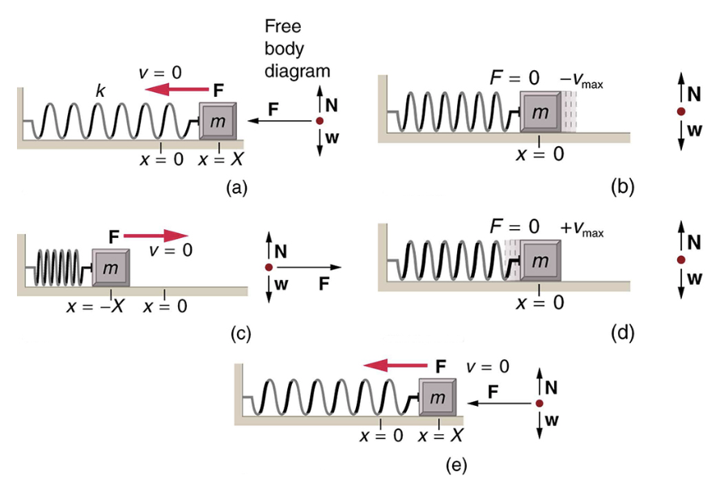
Simple Harmonic Motion
Net force can be described by Hooke’s Law
$$F=-kx$$
No damping - so no friction or other non-conservative forces
Period of a simple harmonic oscillator
$$T=2π\sqrt{\frac{m}{k}}andf=\frac{1}{2π}\sqrt{\frac{k}{m}}$$
Neither T nor f depends on the amplitude
Image Credit: OpenStax College Physics - Figure 16.9 CC BY 4.0

Slide 3
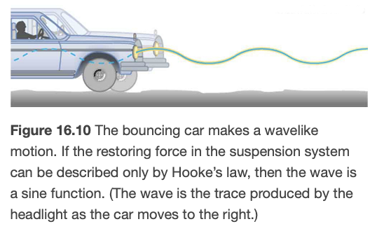
Example
Calculate the period and frequency of oscillation for a car if the total mass is 900. kg and the force constant of the suspension system is 6.53x10⁴ N/m.
Draw a sketch (if applicable)
Identify known values
Identify equation
Enter values in the equation and solve
Image Credit: OpenStax College Physics - Figure 16.10 CC BY 4.0

Slide 4
Example
Calculate the period and frequency of oscillation for a car if the total mass is 900. kg and the force constant of the suspension system is 6.53x10⁴ N/m.
Draw a sketch (if applicable)
Identify known values
Identify equation
Enter values in the equation and solve
$$m=900.kg;k=6.53x{10}^{4}N/m$$
$$f=\frac{1}{2π}\sqrt{\frac{k}{m}}=\frac{1}{2π}\sqrt{\frac{6.53x{10}^{4}N/m}{900.kg}}$$
$$f=1.36s^{-1}=1.36Hz$$
$$T=\frac{1}{f}=\frac{1}{1.356Hz}=0.738s$$
Image Credit: OpenStax College Physics - Figure 16.10 CC BY 4.0

Slide 5
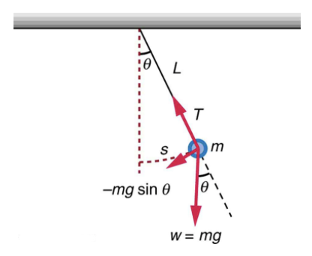
A Simple Pendulum
Common pendulums
Clocks, swings, etc.
Simple pendulum
Small mass suspended from a light wire or string
For small angles (<15º) - exhibits simple harmonic motion
Restoring force: $F=-\frac{mg}{L}s$
$k=\frac{mg}{L}$ ; $F=-kx$
Image Credit: OpenStax College Physics - Figure 16.14 CC BY 4.0

Slide 6
A Simple Pendulum (2)
Period of a pendulum
$$T=2π\sqrt{\frac{L}{g}}$$
Depends only on the pendulum length, NOT the mass!
Image Credit: OpenStax College Physics - Figure 16.14 CC BY 4.0

Slide 7
Example
What is the acceleration due to gravity in a region where a simple pendulum having a length of 75.000 cm has a period of 1.7357 s?
Draw a sketch (if applicable)
Identify known values
Identify equation
Enter values in the equation and solve
Image Credit: OpenStax College Physics - Figure 16.14 CC BY 4.0

Slide 8
Example
What is the acceleration due to gravity in a region where a simple pendulum having a length of 75.000 cm has a period of 1.7357 s?
Draw a sketch (if applicable)
Identify known values
Identify equation
Enter values in the equation and solve
$$L=75.000cm=0.75000m;T=1.7357s$$
$$T=2π\sqrt{\frac{L}{g}}$$
$$g=4π^{2}\frac{L}{T^{2}}$$
$$g=4π^{2}\frac{0.75000m}{(1.7357s)^{2}}$$
$$g=9.8281m/s^{2}$$
Image Credit: OpenStax College Physics - Figure 16.14 CC BY 4.0

Slide 9
Summary
Simple harmonic motion occurs when the net restoring force can be described by Hooke’s Law.
The period of a simple harmonic oscillator has no dependence on amplitude
A pendulum behaves as a simple harmonic oscillator for small displacements. The period is independent of the mass.

