Slide 1
Introduction to Physical Science
Waves
Presented by Robert Wagner

Slide 2
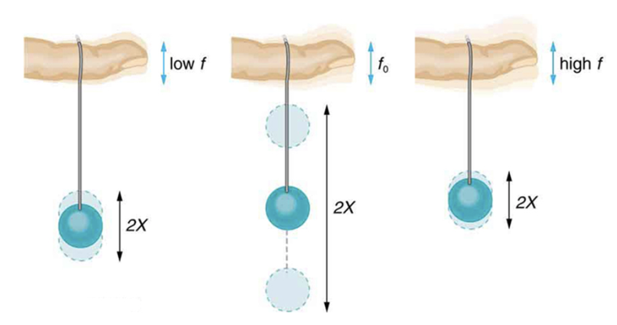
Forced Oscillation
Objects can be forced to oscillate by using a driving force at a specific frequency
Not how the object wishes to oscillate
Natural frequency - How the system would oscillate if there were no driving or damping forces.
Resonance
A system being driven at its natural frequency
Image Credit: OpenStax College Physics - Figure 16.26 CC BY 4.0

Slide 3
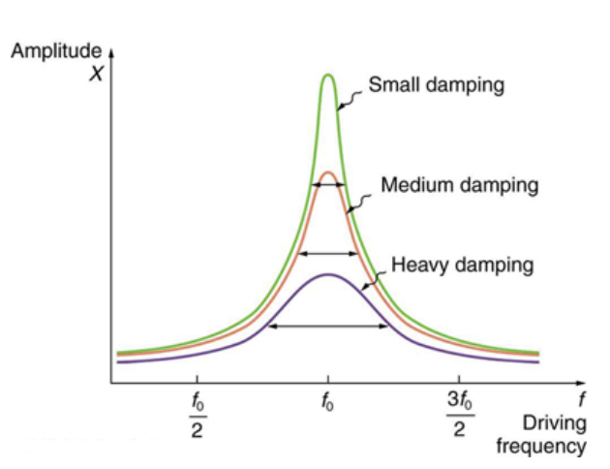
Resonance
Increase the amplitude of the wave by driving it at its natural frequency
Less damping => higher peak
Examples
Pushing a child on a swing
MRI - Magnetic resonance Imaging
Tacoma Narrows bridge
Image Credit: OpenStax College Physics - Figure 16.27 CC BY 4.0

Slide 4
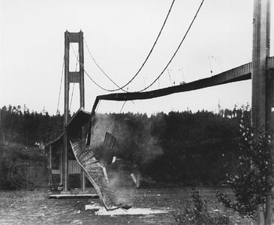
Resonance
Increase the amplitude of the wave by driving it at its natural frequency
Less damping => higher peak
Examples
Pushing a child on a swing
MRI - Magnetic resonance Imaging
Tacoma Narrows bridge
Image Credit: Barney Elliot, Public Domain, via Wikimedia Commons

Slide 5
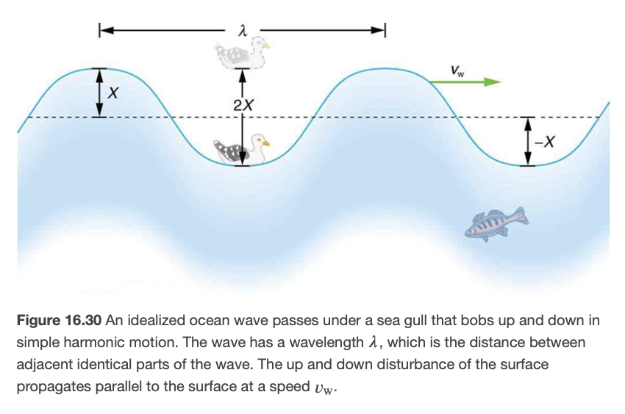
Waves
What is a wave?
A disturbance that propagates from where it was created
Water waves, sound waves, etc.
Wave velocity
The speed at which the disturbance moves
$$v_{w}=fλ$$
Image Credit: OpenStax College Physics - Figure 16.30 CC BY 4.0

Slide 6
Example
Calculate the velocity of the ocean wave shown if the distance between crests is 10.0 m and the time for a seagull to bob up and down is 5.00 s.
Draw a sketch (if applicable)
Identify known values
Identify equation
Enter values in the equation and solve
Image Credit: OpenStax College Physics - Figure 16.14 CC BY 4.0

Slide 7
Example
Calculate the velocity of the ocean wave shown if the distance between crests is 10.0 m and the time for a seagull to bob up and down is 5.00 s.
Draw a sketch (if applicable)
Identify known values
Identify equation
Enter values in the equation and solve
$$λ=10.0m;T=5.00s$$
$$f=\frac{1}{T}=\frac{1}{5.00s}=0.200s^{-1}$$
$$v_{w}=fλ$$
$$v_{w}=(0.200s^{-1})(10.0m)$$
$$v_{w}=2.00m/s$$
Image Credit: OpenStax College Physics - Figure 16.14 CC BY 4.0

Slide 8
Transverse and Longitudinal Waves
Transverse or shear wave
Disturbance is perpendicular to the direction of motion
Longitudinal or compressional wave
The disturbance is parallel to the direction of propagation
Image Credit: OpenStax College Physics - Figure 16.31 & 16.32 CC BY 4.0

Slide 9
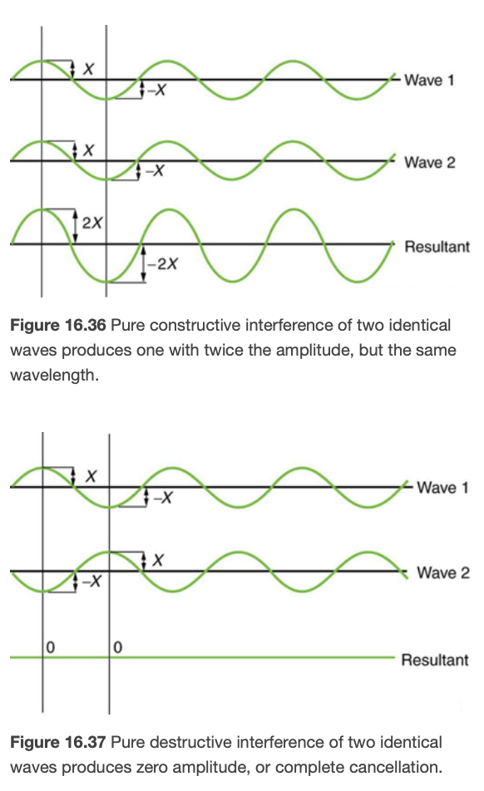
Superposition of Waves
Waves superimpose upon one another when they arrive at the same point at the same time.
Amplitudes of the disturbances will add together
Constructive interference
Waves reinforce each other
Destructive interference
Waves cancel each other
Image Credit: OpenStax College Physics - Figure 16.36 & 16.37 CC BY 4.0

Slide 10
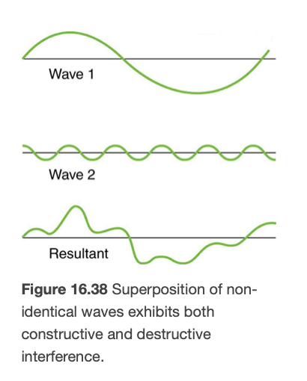
Superposition of Waves (2)
Can be more complex - may have some constructive and some destructive interference
Example
Wave pool
Image Credit: OpenStax College Physics - Figure 16.38 CC BY 4.0

Slide 11
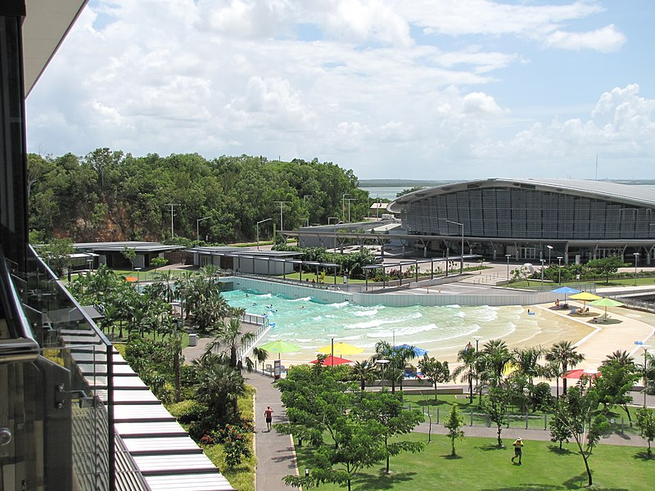
Superposition of Waves (2)
Can be more complex - may have some constructive and some destructive interference
Example
Wave pool
Image Credit: kenhodge13, CC BY 2.0 <https://creativecommons.org/licenses/by/2.0>, via Wikimedia Commons

Slide 12
Summary
A natural frequency is the frequency at which a system would oscillate if there are no external forces or damping forces
A wave is a disturbance that propagates away from the location at which it was created
Waves will superimpose on each other - reinforcing each other or canceling each other

