Slide 1
Introduction to Physical Science
Sound
Presented by Robert Wagner

Slide 2
Sound
Sound is a disturbance of matter from the source outward - a wave
Hearing is the perception of sound waves
Not all frequencies of sound can be heard - ultrasound for example
Vibrating strings can produce sound waves
Create impressions and rarefactions that propagate outward in waves
Image Credit: OpenStax College Physics - Figure 17.3, 17.4, 17.5 CC BY 4.0

Slide 3
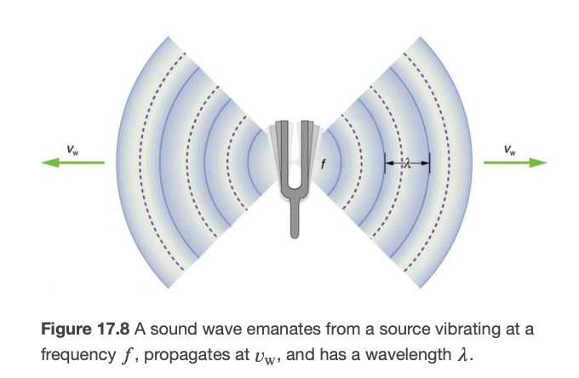
Speed of Sound
Sound is a wave so it travels at a certain speed and has a frequency(pitch) and a wavelength
$$v_{w}=fλ$$
Speed of sound will vary depending on what it is traveling through
Fastest through solids
Slowest through gases
Cannot travel through a vacuum!
Image Credit: OpenStax College Physics - Figure 16.27 CC BY 4.0

Slide 4
Sound Waves in Atmosphere
Sound speed depends on temperature and pressure of atmosphere. At sea level, the speed of sound is
$$v_{w}=(331m/s)\sqrt{\frac{T}{273K}}$$
Examples
At 0ºC, the speed of sound is 331 m/s
At 20ºC, the speed of sound is 343 m/s
Speed of sound is nearly independent of frequency.
Think what this might mean for music in a large stadium!

Slide 5
Example
Calculate the wavelengths of sounds at the extremes of the audible range, 20 and 20,000 Hz (Consider each to have 2 significant figures), in 30.0ºC air.
Draw a sketch (if applicable)
Identify known values
Identify equation
Enter values in the equation and solve
$$f_{min}=20Hz;f_{max}=20,000Hz;T={30.0}^{o}C$$
$$v_{w}=(331m/s)\sqrt{\frac{T}{273K}}$$
$$v_{w}=(331m/s)\sqrt{\frac{303K}{273K}}=348.7m/s$$
$$v_{w}=fλ;λ=\frac{v_{w}}{f}$$
$$λ_{max}=\frac{348.7m/s}{20Hz}=17m$$
$$λ_{min}=\frac{348.7m/s}{20000Hz}=1.7cm$$

Slide 6
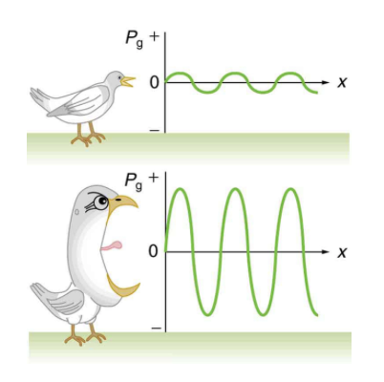
Sound Intensities
Intensity depends on how energetically the source is vibrating
A more intense wave will have larger amplitude oscillations
Sound intensities are often measured in decibels
Defined in terms of logarithms
$$β(dB)=10log_{10}\frac{I}{I_{o}}$$
$$I_{o}={10}^{-12}W/m^{2}$$
Image Credit: OpenStax College Physics - Figure 17.12 CC BY 4.0

Slide 7
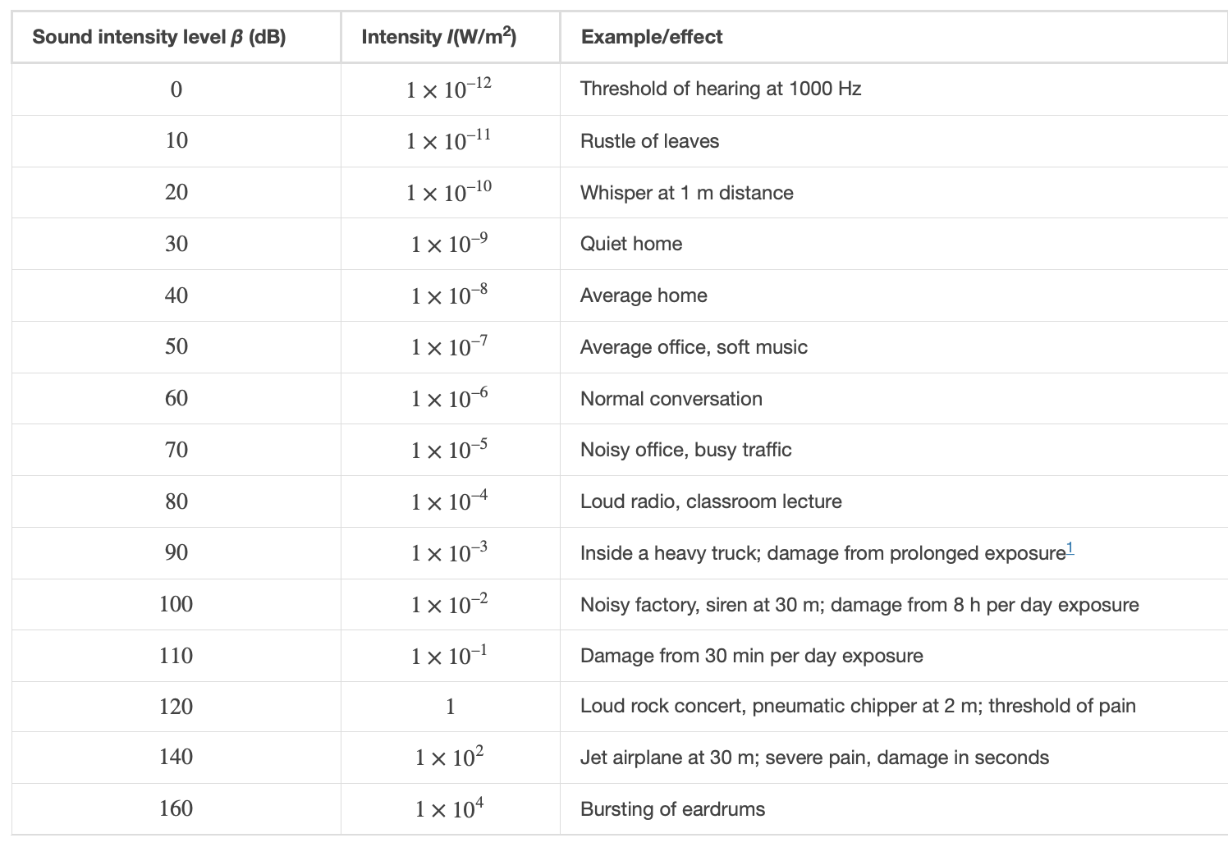
Decibel Scale
Log scale shows a large range with small numbers
Image Credit: OpenStax College Physics - Table 17.2 CC BY 4.0

Slide 8
Example
A sound wave traveling in the atmosphere has an intensity of $5.04x{10}^{-4}W/m^{2}$. What would this be in decibels?
Draw a sketch (if applicable)
Identify known values
Identify equation
Enter values in the equation and solve
$$I=5.04x{10}^{-4}W/m^{2}$$
$$β(dB)=10log_{10}\frac{I}{I_{o}}$$
$$β(dB)=10log_{10}\frac{5.04x{10}^{-4}W/m^{2}}{{10}^{-12}W/m^{2}}$$
$$β(dB)=87dB$$

Slide 9
Summary
Sound waves are a disturbance of matter that propagates outward from a source at a frequency our ears are sensitive to
The speed of sound depends on the medium through which it travel and the temperature
We can measure the intensity of sound using the logarithmic scale - decibels

