Slide 1
Introduction to Physical Science
Doppler Effect
Presented by Robert Wagner

Slide 2
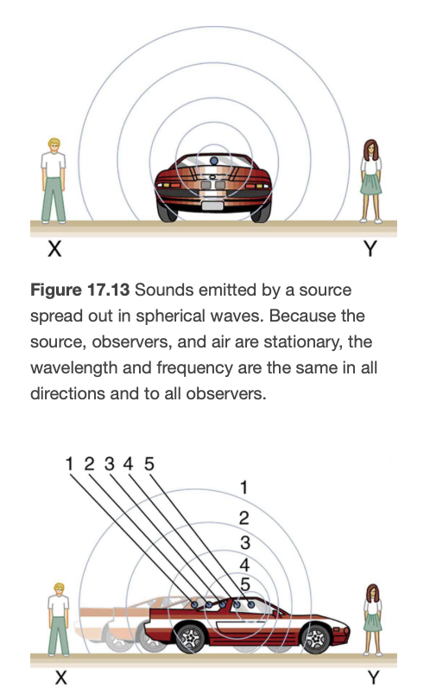
The Doppler Effect
A change in frequency because of the motion of the source or observer
Moving closer => Shift to higher frequencies
Moving away => Shift to lower frequencies
Motion causes the wavefronts to be compressed in the direction of motion and expanded opposite to the direction of motion
Will also occur when the observer is moving and the source stationary
Image Credit: OpenStax College Physics - Figure 17.13 & 17.14 CC BY 4.0

Slide 3
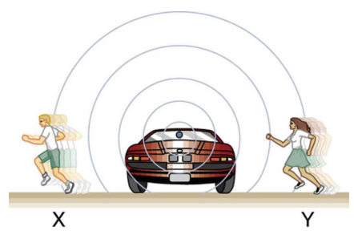
The Doppler Effect
A change in frequency because of the motion of the source or observer
Moving closer => Shift to higher frequencies
Moving away => Shift to lower frequencies
Motion causes the wavefronts to be compressed in the direction of motion and expanded opposite to the direction of motion
Will also occur when the observer is moving and the source stationary
Image Credit: OpenStax College Physics - Figure 17.15 CC BY 4.0

Slide 4
The Doppler Effect (2)
The observed frequency is given by:
$$f_{obs}=f_{s}\left(\frac{v_{w}}{v_{w}±v_{s}}\right)$$
For a stationary observer and a moving source
Here, approach is indicated by the - sign and recession by the + sign
Or, by
$$f_{obs}=f_{s}\left(\frac{v_{w}±v_{obs}}{v_{w}}\right)$$
For a moving observer and a stationary source
Here, approach is indicated by the + sign and recession by the - sign

Slide 5
Example
Suppose a train that has a 150. Hz horn is moving at 35.0 m/s in still air on a day when the speed of sound is 340. m/s. What frequencies are observed by a stationary person at the side of the tracks as the train approached and recedes?
Draw a sketch (if applicable)
Identify known values
Identify equation
Enter values in the equation and solve
$$v_{w}=340.m/s;f_{s}=150.Hz;v_{s}=35.0m/s$$
$$f_{obs}=f_{s}\left(\frac{v_{w}}{v_{w}-v_{s}}\right)$$
$$f_{obs}=(150.Hz)\left(\frac{340.m/s}{340.m/s-35.0m/s}\right)=167Hz$$
$$f_{obs}=f_{s}\left(\frac{v_{w}}{v_{w}+v_{s}}\right)$$
$$f_{obs}=(150.Hz)\left(\frac{340.m/s}{340.m/s+35.0m/s}\right)=136Hz$$

Slide 6
Example
Suppose a train that has a 150. Hz horn is moving at 35.0 m/s in still air on a day when the speed of sound is 340. m/s. What frequency is heard by the train’s engineer traveling on the train?
Draw a sketch (if applicable)
Identify known values
Identify equation
Enter values in the equation and solve
$$v_{w}=340.m/s;f_{s}=150.Hz;v_{s}=35.0m/s$$
Relative velocity between them is 0 m/s!
With no velocity difference, there will be no Doppler shift!
The source and observer are not moving relative to one another.

Slide 7
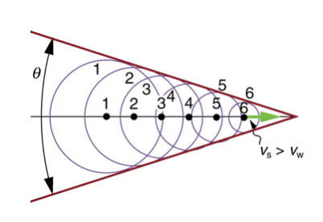
Sonic Boom
What would happen if the moving source approaches or exceeds the speed of sound?
Constructive interference will occur along the red lines in the image
Two sonic booms are created - one from the nose of the plane and the other from the tail
For lower altitudes, the boom can break windows!
Image Credit: OpenStax College Physics - Figure 17.16 CC BY 4.0

Slide 8
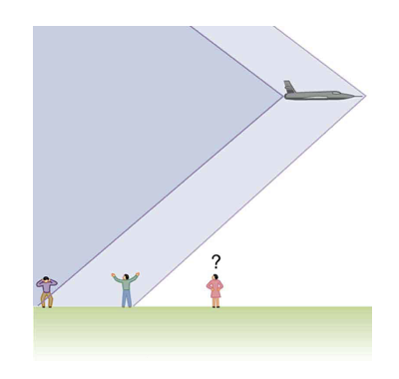
Sonic Boom
What would happen if the moving source approaches or exceeds the speed of sound?
Constructive interference will occur along the red lines in the image
Two sonic booms are created - one from the nose of the plane and the other from the tail
For lower altitudes, the boom can break windows!
Image Credit: OpenStax College Physics - Figure 17.17 CC BY 4.0

Slide 9
Summary
The Doppler effect is a change in frequency due to the motion of the source or observer
Approaching motion results in higher frequency while receding motion results in a lower frequency
A sonic boom can occur when an aircraft exceeds the speed of sound

