Slide 1
Introduction to Physical Science
Electric Current and Ohm’s Law
Presented by Robert Wagner

Slide 2
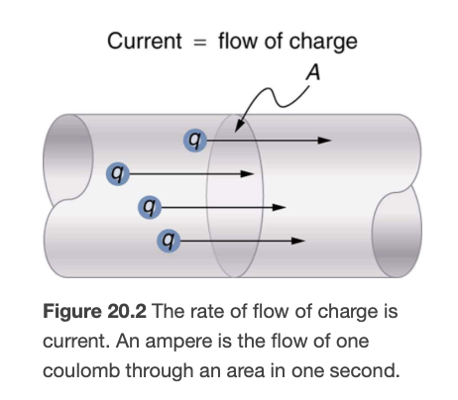
Electric Current
Defined as the rate at which charge flows
$$I=\frac{ΔQ}{Δt}$$
SI unit: Ampere. 1 A = 1 C/s
Image Credit: OpenStax College Physics - Figure 20.2 CC BY 4.0

Slide 3
Example
$$ΔQ=720.C;Δt=4.00s$$
$$I=\frac{ΔQ}{Δt}=\frac{720.C}{4.00s}=180.A$$
$$Δt=\frac{ΔQ}{I}$$
$$Δt=\frac{1.00C}{0.300x{10}^{-3}C/s}=3.33x{10}^{3}s$$
What is the current involved when a truck battery sets in motion 720. C of charge in 4.00 s while starting an engine? How long does it take 1.00 C of charge to flow through a handheld calculator if a 0.300 mA current is flowing?
Draw a sketch (if applicable)
Identify known values
Identify equation
Enter values in the equation and solve

Slide 4
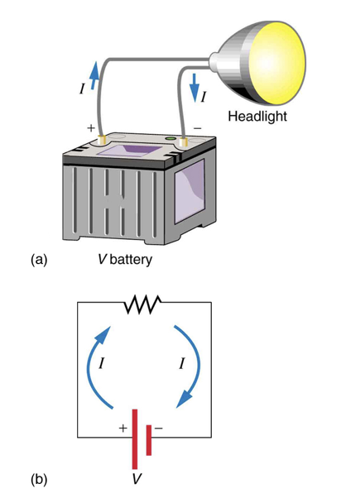
Current Flow
Schematic diagram
Can represent a wide variety of situations
Current flow from positive to negative
Direction in which positive charges would flow
In most cases, it is the electrons that flow
The convention comes from the historical definition
Image Credit: OpenStax College Physics - Figure 20.3 CC BY 4.0

Slide 5
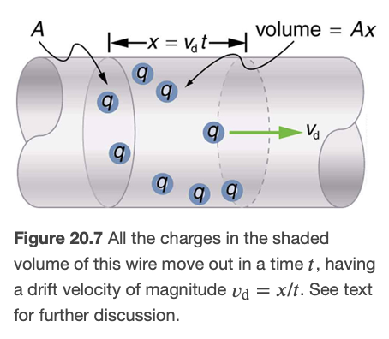
Drift Velocity
Electrons follow paths that appear random
In the presence of an electric field, the electrons will drift slowly
Drift velocity: v_{d}
Drift velocity is very small
Order of 10⁻⁴ m/s
Take 3 hours to travel one meter
Image Credit: OpenStax College Physics - Figure 20.7 CC BY 4.0

Slide 6
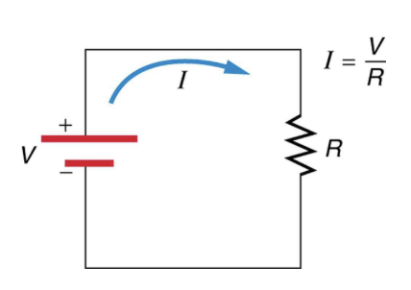
Ohm’s Law
The current in a metal is directly proportional to the voltage applied
$$I∝V$$
The current is inversely proportional to the resistance
$$I∝\frac{1}{R}$$
Ohm’s Law
$$I=\frac{V}{R}$$
Image Credit: OpenStax College Physics - Figure 20.8 CC BY 4.0

Slide 7
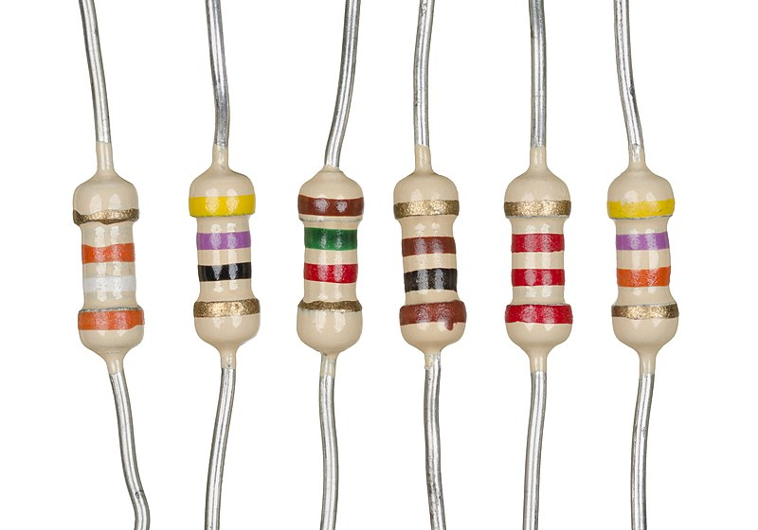
Resistance
Resistance is measured in Ohms
1 Ohm (Ω)= 1 Volt/1 Ampere
Bands on the resistor are color coded to tell the amount of the resistance
Image Credit: Evan-Amos, Public domain, via Wikimedia Commons

Slide 8
Example
$$I=2.50A;V=12.0V$$
$$I=\frac{V}{R};R=\frac{V}{I}$$
$$R=\frac{12.0V}{2.50A}$$
$$R=4.80Ω$$
What is the resistance of an automobile headlight through which 2.50 A flows when 12.0 V is applied to it.
Draw a sketch (if applicable)
Identify known values
Identify equation
Enter values in the equation and solve

Slide 9
Summary
Electric current is defined as the rate at which charge flows
The electrons move slowly through a wire at the drift velocity
Ohm’s law relates the current, voltage and resistance in a circuit

