Slide 1
Introduction to Physical Science
Resistance and Electric Power
Presented by Robert Wagner

Slide 2
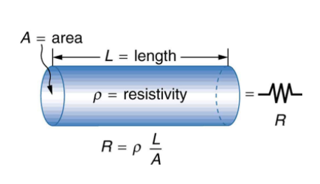
Resistance
The electrical resistance of a cylindrical object is proportional to its length and inversely proportional to the area.
The resistance also depends on the resistivity of the substance, ρ. What the substance is composed of
$$R=\frac{ρL}{A}$$
Resistivity has units of $Ω⋅m$
Image Credit: OpenStax College Physics - Figure 20.11 CC BY 4.0

Slide 3
Conductors, Semiconductors, & Insulators
Conductor - small resistivity
Semiconductor - intermediate resistivity
Insulators - large resistivity
See Table 20.1 in the OpenStax College Physics textbook
Image Credit: OpenStax College Physics - Figure 20.11 CC BY 4.0

Slide 4
Example
$$L=4.00x{10}^{-2}m;R=0.350Ω;ρ=5.6x{10}^{-8}Ω⋅m$$
$$R=\frac{ρL}{A};A=\frac{ρL}{R}$$
$$A=\frac{(5.6x{10}^{-8}Ω⋅m)(4.00x{10}^{-2}m)}{0.350Ω}$$
$$A=6.40x{10}^{-9}m^{2}$$
$$A=πr^{2};r=\sqrt{\frac{A}{π}}$$
$$r=\sqrt{\frac{6.40x{10}^{-9}m^{2}}{π}}=4.5x{10}^{-5}m=0.045mm$$
A car headlight filament is made of tungsten and has a resistance of 0.350Ω. If the filament is a cylinder 4.00 cm long, what is its radius?
Draw a sketch (if applicable)
Identify known values
Identify equation
Enter values in the equation and solve

Slide 5
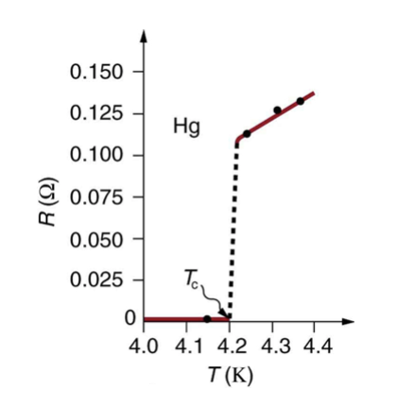
Temperature Variation of Resistance
The resistivity of a material depends on the temperature
Superconductors
Resistance drops to zero at very low temperatures
Image Credit: OpenStax College Physics - Figure 20.12 CC BY 4.0

Slide 6
Power in Electric Circuits
Power is the rate of energy use or conversion
Light bulbs - power quoted on Watts (60 Watt bulb)
Power can be written in a number of ways
$$P=IV$$
$$P=\frac{V^{2}}{R}$$
$$P=I^{2}R$$

Slide 7
Example
$$I=2.50A;V=12.0V;R=0.350Ω$$
$$P=IV=(2.50A)(12.0V)=30.0W$$
$$P=\frac{V^{2}}{R}=\frac{(12.0V)^{2}}{0.350Ω}=411W$$
$$P=I^{2}R;I=\sqrt{\frac{P}{R}}$$
$$I=\sqrt{\frac{411W}{0.350Ω}}=34.3A$$
An automobile headlight has a current of 2.50 A when a voltage of 12.0 V is applied to it. It has a cold resistance of 0.350 Ω. What is the power dissipated when it is hot and cold? What is the current drawn when cold?
Draw a sketch (if applicable)
Identify known values
Identify equation
Enter values in the equation and solve

Slide 8
Cost of Electricity
Energy cost is related to the power consumed
$$E=Pt$$
The unit for energy on an electric bill is the kilowatt hour ($kW⋅h$)
$$1kW⋅h=3.6x{10}^{6}J$$
Reducing energy costs can be done in two ways
Reducing the time used
Improving the efficiency
CFL vs. Incandescent bulb

Slide 9
Example
If the cost of electricity is 12 cents per kWh, what is the cost of using a 60W incandescent bulb for 1000 hours. If we replace it with a CFL at 1/4 the wattage, what would be the cost for 1000 hours?
Draw a sketch (if applicable)
Identify known values
Identify equation
Enter values in the equation and solve
$$c=12cents/kWh;P=60W;t=1000hr$$
$$E=Pt=(60.0W)(1000.hr)=60000W⋅h$$
$$E=60.0kW⋅h$$
$$Cost=(Energy)(rate)$$
$$Cost=(60.0kW⋅h)(\$0.12/kWh)$$
$$Cost=\$7.20$$
$$Cost(CFL)=\frac{Cost}{4}=\$1.80$$

Slide 10
Summary
The electrical resistance of an object depends on its length, area and composition
Conductors, semiconductors and insulators all have different levels of resistance
Power is the rate of energy use. Energy use is often measured in $kW⋅h$

