Slide 1
Introduction to Physical Science
Electric Circuits
Presented by Robert Wagner

Slide 2
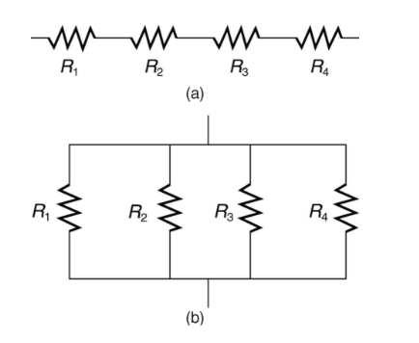
Types of Circuits
Circuits will generally have multiple components (resistors)
Two basic combinations
Series
Parallel
Image Credit: OpenStax College Physics - Figure 21.2 CC BY 4.0

Slide 3
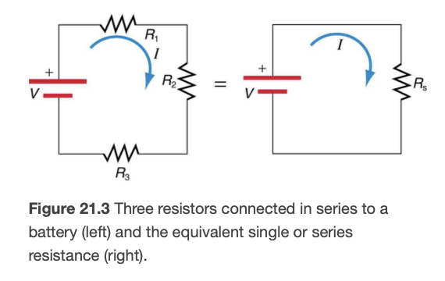
Resistors in Series
Resistors are in series when the current must flow through each resistor in turn
Current is the same through each resistor
$V_{1}=IR_{1},etc.$
The total resistance $(R_{s})$is the sum of the individual resistances
$$R_{s}=R_{1}+R_{2}+R_{3}+⋯$$
Image Credit: OpenStax College Physics - Figure 21.3 CC BY 4.0

Slide 4
Example
A battery with voltage 12.0 V, is applied through three resistances (in series): $R_{1}=1.00Ω,R_{2}=6.00Ω,R_{3}=13.0Ω$. What are the total resistance, current and total power dissipated.
Draw a sketch (if applicable)
Identify known values
Identify equation
Enter values in the equation and solve
Image Credit: OpenStax College Physics - Figure 21.3 CC BY 4.0

Slide 5
Example
A battery with voltage 12.0 V, is applied through three resistances (in series): $R_{1}=1.00Ω,R_{2}=6.00Ω,R_{3}=13.0Ω$. What are the total resistance, current and total power dissipated.
Draw a sketch (if applicable)
Identify known values
Identify equation
Enter values in the equation and solve
$$V=12.0V;R_{1}=1.00Ω,R_{2}=6.00Ω,R_{3}=13.0Ω$$
$$R_{s}=R_{1}+R_{2}+R_{3}$$
$$R_{s}=1.00Ω+6.00Ω+13.0Ω=20.0Ω$$
$$I=\frac{V}{R_{s}}=\frac{12.0V}{20.0Ω}=0.600A$$
$$P=IV=(0.600A)(12.0V)=7.20W$$
Image Credit: OpenStax College Physics - Figure 21.3 CC BY 4.0

Slide 6
Example
A battery with voltage 12.0 V, is applied through three resistances (in series): $R_{1}=1.00Ω,R_{2}=6.00Ω,R_{3}=13.0Ω$. What is the voltage drop across each resistor?
Draw a sketch (if applicable)
Identify known values
Identify equation
Enter values in the equation and solve
$$V=12.0V;R_{1}=1.00Ω,R_{2}=6.00Ω,R_{3}=13.0Ω$$
$$V_{1}=IR_{1}$$
$$V_{1}=(0.600A)(1.0Ω)=0.600V$$
$$V_{2}=IR_{2}$$
$$V_{2}=(0.600A)(6.0Ω)=3.60V$$
$$V_{3}=IR_{3}$$
$$V_{3}=(0.600A)(13.0Ω)=7.80V$$
$$V_{1}+V_{2}+V_{3}=7.80V+3.60V+0.600V=12.0V$$
Image Credit: OpenStax College Physics - Figure 21.3 CC BY 4.0

Slide 7
Resistors in Parallel
In a parallel circuit, the current will be split among multiple resistors.
Total resistance is the sum of the inverse of each resistance
$$\frac{1}{R_{p}}=\frac{1}{R_{1}}+\frac{1}{R_{2}}+\frac{1}{R_{3}}+⋯$$
The total resistance will be less than all of the individual resistances
Image Credit: OpenStax College Physics - Figure 21.4a CC BY 4.0

Slide 8
Example
A battery with voltage 12.0 V, is applied through three resistances (in parallel): $R_{1}=1.00Ω,R_{2}=6.00Ω,R_{3}=13.0Ω$. What are the total resistance, current and total power dissipated.
Draw a sketch (if applicable)
Identify known values
Identify equation
Enter values in the equation and solve
Image Credit: OpenStax College Physics - Figure 21.4a CC BY 4.0

Slide 9
Example
A battery with voltage 12.0 V, is applied through three resistances (in parallel): $R_{1}=1.00Ω,R_{2}=6.00Ω,R_{3}=13.0Ω$. What are the total resistance, total current and total power dissipated.
Draw a sketch (if applicable)
Identify known values
Identify equation
Enter values in the equation and solve
$$V=12.0V;R_{1}=1.00Ω,R_{2}=6.00Ω,R_{3}=13.0Ω$$
$$\frac{1}{R_{p}}=\frac{1}{R_{1}}+\frac{1}{R_{2}}+\frac{1}{R_{3}}+⋯$$
$$\frac{1}{R_{p}}=\frac{1}{1.00Ω}+\frac{1}{6.00Ω}+\frac{1}{13.0Ω}$$
$$\frac{1}{R_{p}}=(1+0.167+0.0769)\frac{1}{Ω}$$
$$\frac{1}{R_{p}}=1.2439\frac{1}{Ω}or,R_{p}=0.804Ω$$
Image Credit: OpenStax College Physics - Figure 21.4a CC BY 4.0

Slide 10
Example
A battery with voltage 12.0 V, is applied through three resistances (in parallel): $R_{1}=1.00Ω,R_{2}=6.00Ω,R_{3}=13.0Ω$. What are the total resistance, total current and total power dissipated.
Draw a sketch (if applicable)
Identify known values
Identify equation
Enter values in the equation and solve
$$V=12.0V;R_{1}=1.00Ω,R_{2}=6.00Ω,R_{3}=13.0Ω$$
$$R_{p}=0.804Ω$$
$$I=\frac{V}{R_{p}}=\frac{12.0V}{0.804Ω}=14.9A$$
$$P=IV=(14.9A)(12.0V)=179W$$
Image Credit: OpenStax College Physics - Figure 21.4a CC BY 4.0

Slide 11
Example
A battery with voltage 12.0 V, is applied through three resistances (in parallel): $R_{1}=1.00Ω,R_{2}=6.00Ω,R_{3}=13.0Ω$. What is the current through each resistor?
Draw a sketch (if applicable)
Identify known values
Identify equation
Enter values in the equation and solve
$$V=12.0V;R_{1}=1.00Ω,R_{2}=6.00Ω,R_{3}=13.0Ω$$
$$I_{1}=\frac{V}{R_{1}}=\frac{12.0V}{1.00Ω}=12.0A$$
$$I_{2}=\frac{V}{R_{2}}=\frac{12.0V}{6.00Ω}=2.0A$$
$$I_{3}=\frac{V}{R_{3}}=\frac{12.0V}{13.00Ω}=0.92A$$
$$I_{1}+I_{2}+I_{3}=12.0A+2.0A+0.92A$$
$$I_{1}+I_{2}+I_{3}=14.92A$$
Image Credit: OpenStax College Physics - Figure 21.4a CC BY 4.0

Slide 12
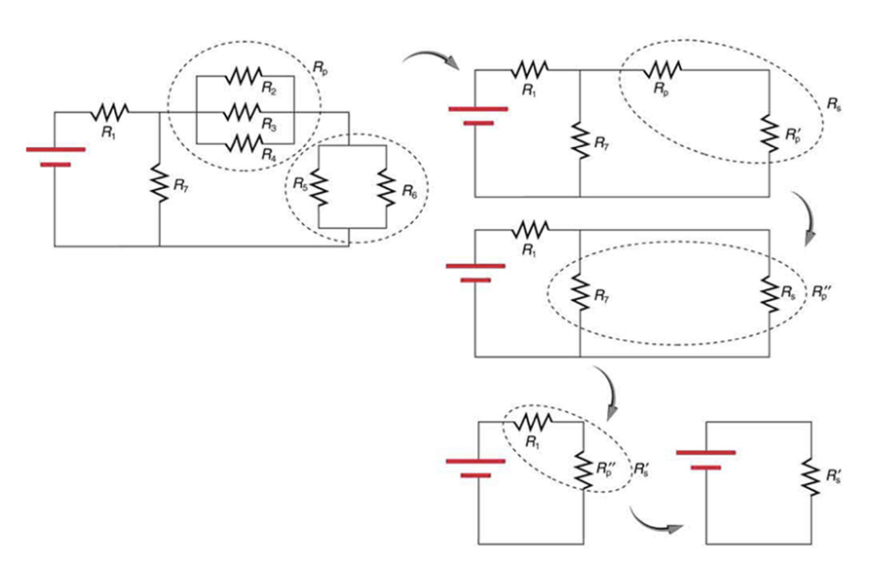
Combination Circuits
We often have more complex circuits involving both series and parallel components.
We can reduce these to a single equivalent resistance
Image Credit: OpenStax College Physics - Figure 21.5 CC BY 4.0

Slide 13
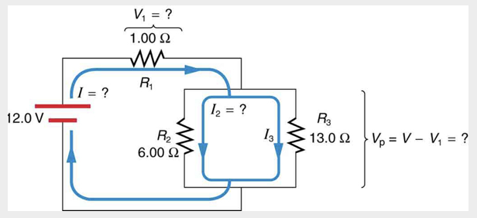
Example
For the circuit shown, find the total resistance, voltage drop across R₁, current through R₂, and power dissipated by R₂.
Draw a sketch (if applicable)
Identify known values
Identify equation
Enter values in the equation and solve
Image Credit: OpenStax College Physics - Figure 21.6 CC BY 4.0

Slide 14
Example
For the circuit shown, find the total resistance, voltage drop across R₁, current through R₂, and power dissipated by R₂.
Draw a sketch (if applicable)
Identify known values
Identify equation
Enter values in the equation and solve
$$\frac{1}{R_{p}}=\frac{1}{R_{2}}+\frac{1}{R_{3}}=\frac{1}{6.00Ω}+\frac{1}{13.0Ω}$$
$$\frac{1}{R_{p}}=0.2436\frac{1}{Ω}$$
$$R_{p}=4.11Ω$$
$$R_{tot}=R_{1}+R_{p}=1.00Ω+4.11Ω=5.11Ω$$
Image Credit: OpenStax College Physics - Figure 21.6 CC BY 4.0

Slide 15
Example
For the circuit shown, find the total resistance, voltage drop across R₁, current through R₂, and power dissipated by R₂.
Draw a sketch (if applicable)
Identify known values
Identify equation
Enter values in the equation and solve
$$I=\frac{V}{R_{tot}}=\frac{12.0V}{5.11Ω}=2.35A$$
$$V_{1}=IR_{1}$$
$$V_{1}=(2.35A)(1.00Ω)=2.35V$$
$$V_{p}=V-V_{1}=12.0V-2.35V=9.65V$$
$$I_{2}=\frac{V_{p}}{R_{2}}=\frac{9.65V}{6.00Ω}=1.61A$$
$$P_{2}=(I_{2})^{2}R_{2}=(1.61A)^{2}(6.00Ω)=15.5W$$
Image Credit: OpenStax College Physics - Figure 21.6 CC BY 4.0

Slide 16
Problem Solving Strategies
Draw a circuit digram - label all resistors and voltage sources - this identifies your known values
Identify unknowns
Determine if the resistors are in series, parallel or a combination
Reduce the problem in to steps considering how to handle series and parallel components
Check to make sure answers are reasonable

Slide 17
Summary
Electrical Circuits can involve resistors in series, parallel, or a combination of these two
Resistors in series add directly and resistors in parallel add inversely
Combination circuits are more complex and include both series and parallel components

