Slide 1
Introduction to Physical Science
Kirchoff’s Rules
Presented by Robert Wagner

Slide 2
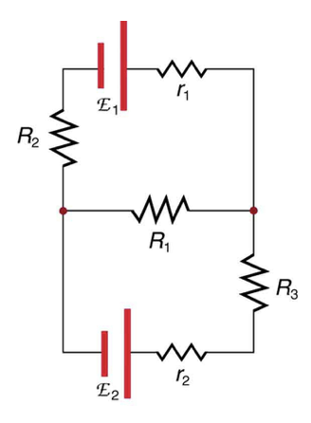
Kirchoff’s Rules
Some circuits cannot be reduced as in the previous lesson
Kirchoff’s rules apply to any circuit - simple or complex
Related to laws of conservation of charge and conservation of energy
Image Credit: OpenStax College Physics - Figure 21.21 CC BY 4.0

Slide 3
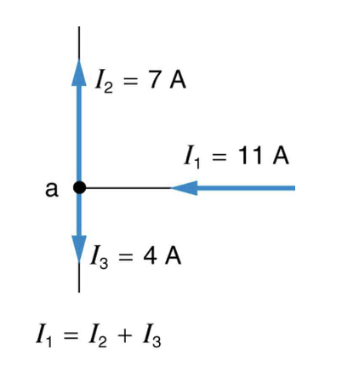
First Rule: The Junction Rule
The sum of all currents entering a junction must equal the sum of all currents leaving the junction
Related to conservation of charge
Charge entering the junction must equal charge leaving the junction
Image Credit: OpenStax College Physics - Figure 21.22 CC BY 4.0

Slide 4
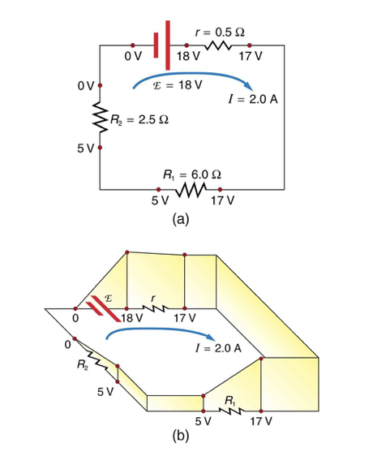
Second Rule: The Loop Rule
The algebraic sum of changes in potential around any closed circuit path (loop) must be zero
Related to conservation of energy
Potential difference represents changes in energy - there are no other ways to transfer energy in or out of the circuit
Image Credit: OpenStax College Physics - Figure 21.23 CC BY 4.0

Slide 5
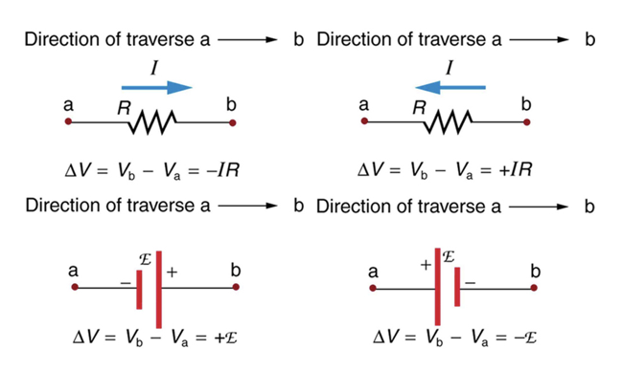
Applying Kirchoff’s Rules
Label the direction in which the current is flowing in each branch of the circuit
If you choose the wrong direction, it will only change the sign
Identify a closed loop and decide which way to go - clockwise or counterclockwise
Image Credit: OpenStax College Physics - Figure 21.24 CC BY 4.0

Slide 6
Summary
Kirchoff’s rules allow is to solve more complex circuits
They are related to the conservations of charge and conservation of energy
Selecting the direction of current flow and direction around the loop do not matter

