Slide 1
Introduction to Physical Science
Magnetism
Presented by Robert Wagner

Slide 2
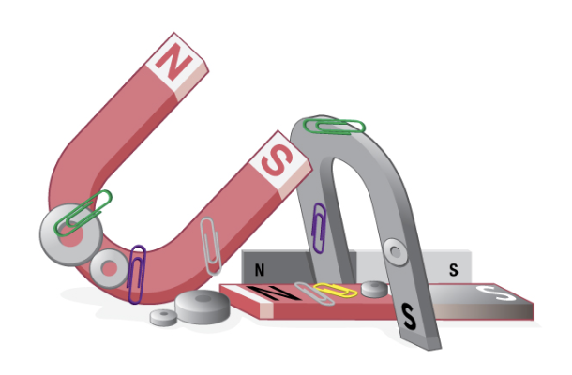
Magnets
Magnets attract certain materials like iron
Magnets can attract or repel other magnets
All magnets have two poles (two poles cannot be separated)
North magnetic pole
South magnetic pole
Like poles repel and unlike poles attract
Image Credit: OpenStax College Physics - Figure 22.3 CC BY 4.0

Slide 3
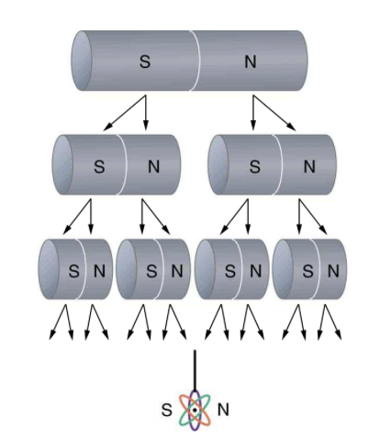
Magnets
Magnets attract certain materials like iron
Magnets can attract or repel other magnets
All magnets have two poles (two poles cannot be separated)
North magnetic pole
South magnetic pole
Like poles repel and unlike poles attract
Image Credit: OpenStax College Physics - Figure 22.6 CC BY 4.0

Slide 4
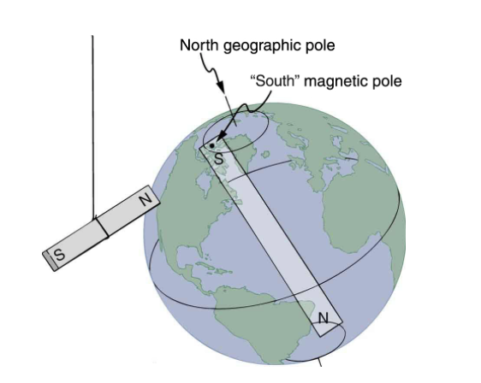
Magnets
Magnets attract certain materials like iron
Magnets can attract or repel other magnets
All magnets have two poles (two poles cannot be separated)
North magnetic pole
South magnetic pole
Like poles repel and unlike poles attract
Image Credit: OpenStax College Physics - Figure 22.4 CC BY 4.0

Slide 5
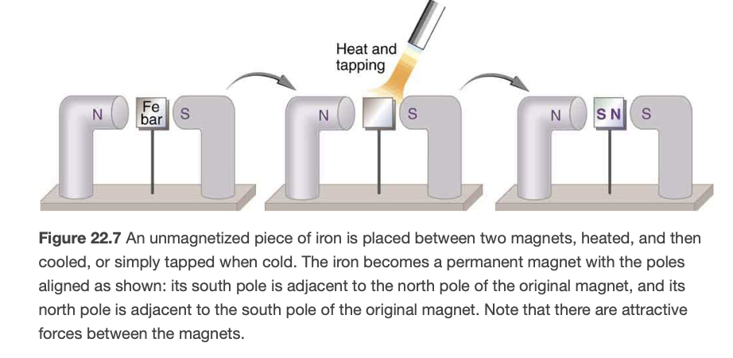
Ferromagnets
Materials that exhibit strong magnetic effects are called ferromagnets (ferro for iron)
These materials are strongly attracted to magnets
They can be made into permanent magnets through heating
Image Credit: OpenStax College Physics - Figure 22.7 CC BY 4.0

Slide 6
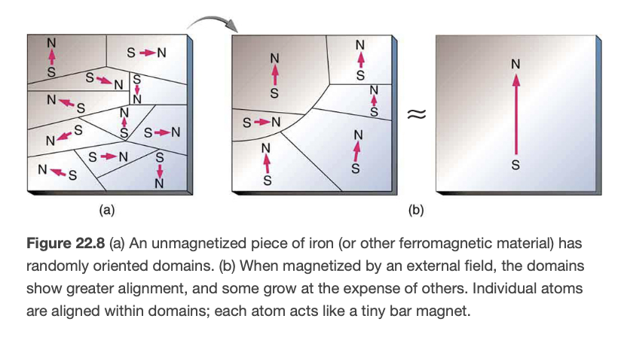
Ferromagnets
Materials that exhibit strong magnetic effects are called ferromagnets (ferro for iron)
These materials are strongly attracted to magnets
They can be made into permanent magnets through heating
Image Credit: OpenStax College Physics - Figure 22.8 CC BY 4.0

Slide 7
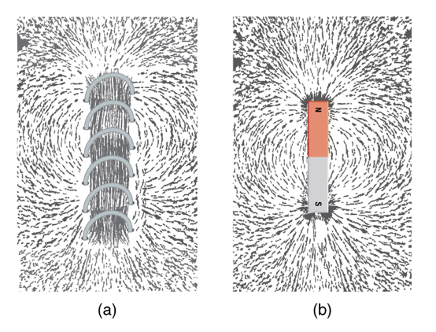
Electromagnets
Electric currents can cause magnetic effects
Electromagnetic - Temporarily induced magnet
Behave like a permanent magnet
Combination of ferromagnet and electromagnet can give very strong magnetic effects
Image Credit: OpenStax College Physics - Figure 22.10 CC BY 4.0

Slide 8
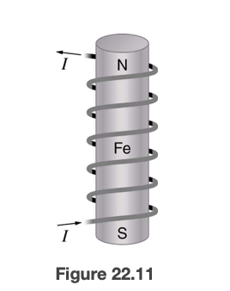
Electromagnets
Electric currents can cause magnetic effects
Electromagnetic - Temporarily induced magnet
Behave like a permanent magnet
Combination of ferromagnet and electromagnet can give very strong magnetic effects
Ferromagnetic materials can be used for memory devices
Image Credit: OpenStax College Physics - Figure 22.11 CC BY 4.0

Slide 9
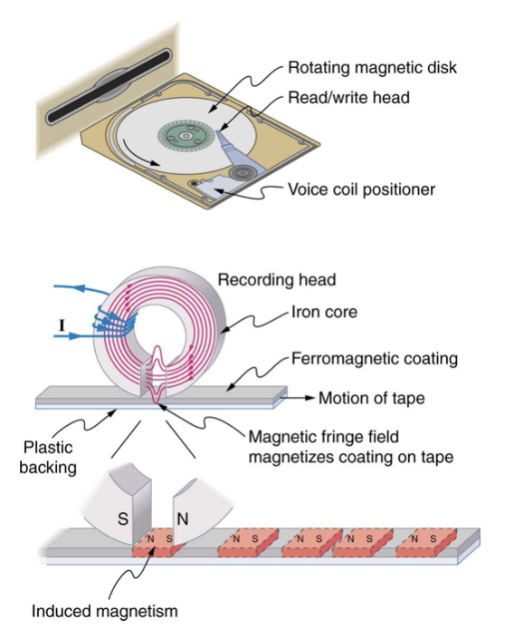
Electromagnets
Electric currents can cause magnetic effects
Electromagnetic - Temporarily induced magnet
Behave like a permanent magnet
Combination of ferromagnet and electromagnet can give very strong magnetic effects
Ferromagnetic materials can be used for memory devices
Image Credit: OpenStax College Physics - Figure 22.12 CC BY 4.0

Slide 10
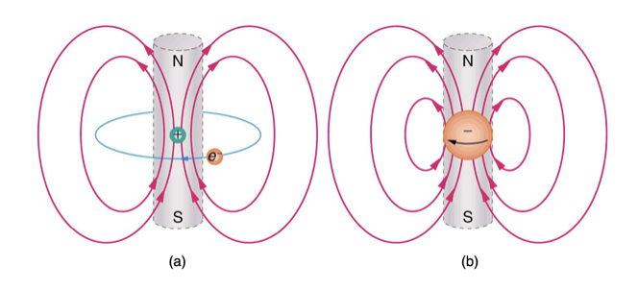
Where Does Magnetism Come From?
Electric currents are the source of magnetism
Ferromagnets - electric currents at submicroscopic level
Current loops always produce a magnetic dipole - having a north and south magnetic pole
Isolated magnetic poles - magnetic monopoles have not been observed to exist
Image Credit: OpenStax College Physics - Figure 21.24 CC BY 4.0

Slide 11
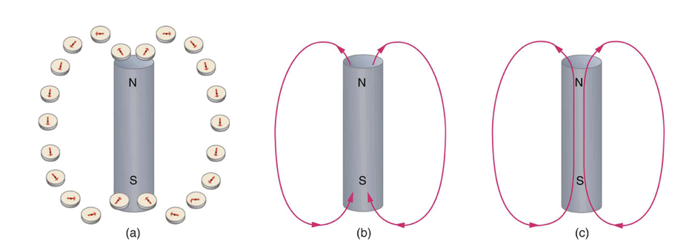
Magnetic Field Lines
Direction of magnetic field lines:
Direction to which the north end of a compass needle points
Magnetic field (called B-field)
Field strength is proportional to how close the lines are
Magnetic field lines can never cross
Magnetic field lines are continuous closed loops
Image Credit: OpenStax College Physics - Figure 22.15 CC BY 4.0

Slide 12
Summary
Magnets attract materials like iron and have north and south magnetic poles
Ferromagnetic materials (like iron) can be made into permanent magnets through heating
Electromagnets are temporary magnets induced by electrical currents

