Slide 1
Introduction to Physical Science
Electromagnetic Waves
Presented by Robert Wagner

Slide 2
Maxwell’s Equations
Maxwell’s Equations - showed that electric and magnetic forces are really just different manifestations of the same thing
Changing magnetic fields will produce electric fields and changing electric fields will produce magnetic fields
Predicted waves - electromagnetic waves would move at the speed of light
Light is an example of an electromagnetic wave
Other types now known - radio waves, ultraviolet, etc.

Slide 3
Maxwell’s Equations
Maxwell’s Equations:
Electric field lines originate on positive charges and end on negative charges
Magnetic field lines are continuous - no beginning or end. Magnetic monopoles are not known to exist
A changing magnetic field will produce an electric field
Magnetic fields are generated by moving charges or changing electric fields

Slide 4
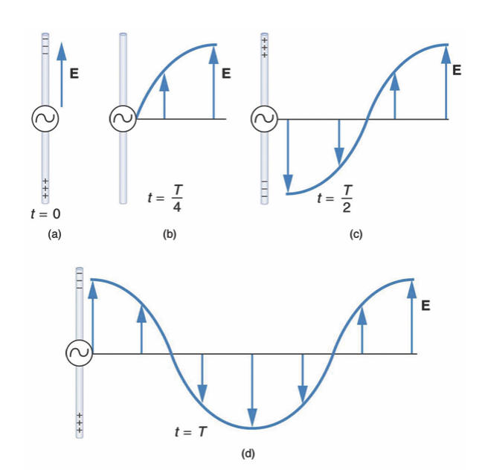
Production of Electromagnetic Waves
Consider current in a long straight wire
AC - alternative current
Electric field (E) produced by charge in the wire
Field changes as current changes and propagates outward
Corresponding magnetic field (B) propagates outward as well
Image Credit: OpenStax College Physics - Figure 24.5 CC BY 4.0

Slide 5
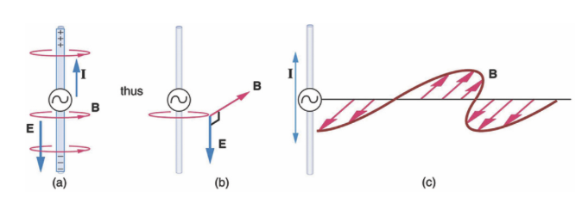
Production of Electromagnetic Waves
Consider current in a long straight wire
AC - alternative current
Electric field (E) produced by charge in the wire
Field changes as current changes and propagates outward
Corresponding magnetic field (B) propagates outward as well
Image Credit: OpenStax College Physics - Figure 24.6 CC BY 4.0

Slide 6
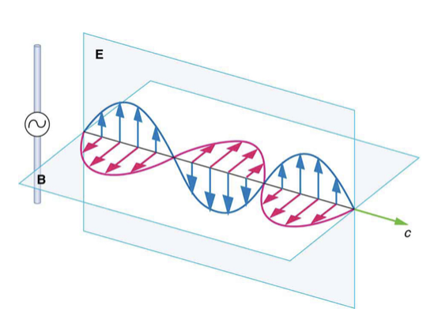
Electromagnetic Waves
Electric and magnetic fields propagate outward - perpendicular to each other - transverse wave
Waves will propagate out in all directions
Any accelerating charge will produce electromagnetic radiation
Examples - Antennae produce and detect standing waves from radio/TV broadcasts
Image Credit: OpenStax College Physics - Figure 24.7 CC BY 4.0

Slide 7
Summary
Maxwell’s equations - show that the magnetic and electric forces are different manifestations of the same thing
Electromagnetic waves are produced as charges move such as current in a wire
Electromagnetic waves are produced by any accelerating charges

