Slide 1
Introduction to Physical Science
Electromagnetic Spectrum
Presented by Robert Wagner

Slide 2
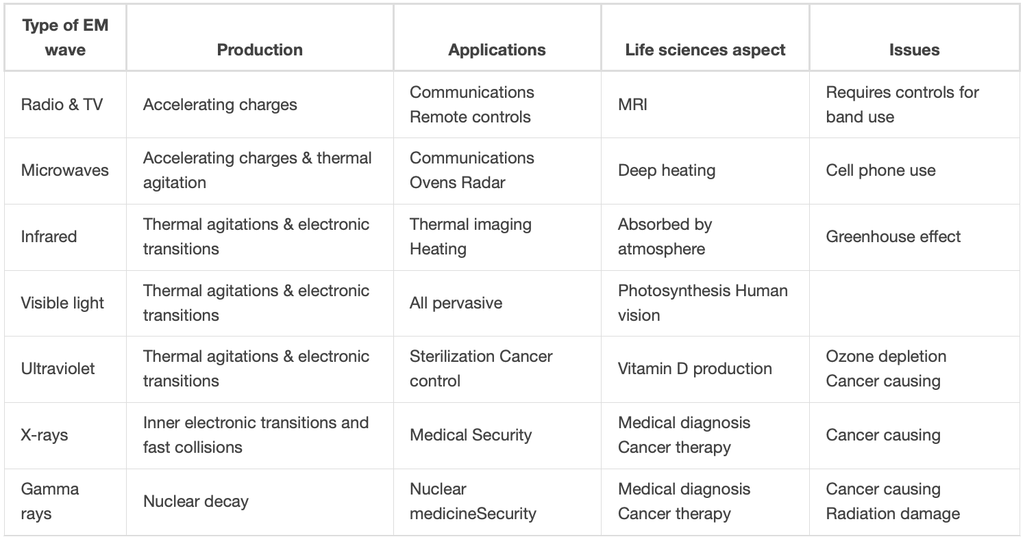
The Electromagnetic Spectrum
Electromagnetic waves are grouped according to wavelength/frequency
Image Credit: OpenStax College Physics - Table 24.1 CC BY 4.0

Slide 3
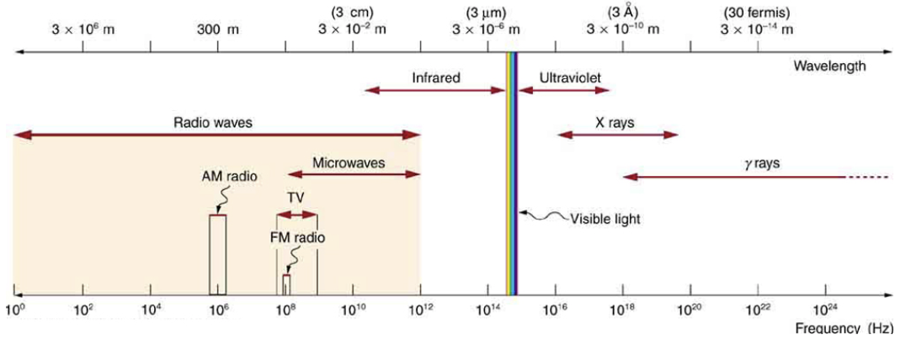
Electromagnetic Waves
For electromagnetic waves, $v_{w}=c$, the speed of light
$$c=fλ$$
Higher frequency = smaller wavelength
Image Credit: OpenStax College Physics - Figure 24.9 CC BY 4.0

Slide 4
General Rules
High frequency electromagnetic waves are more energetic and more penetrating than low frequency waves
High frequency electromagnetic waves carry more information pr unit time than low frequency waves
The shorter the wavelength of the electromagnetic radiation probing a material - the smaller detail it is able to resolve

Slide 5
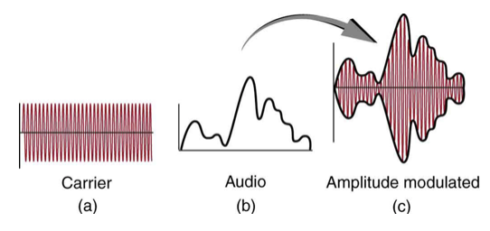
Radio Waves
Longest wavelength
Often used as carriers of radio waves
AM - Amplitude modulation on carrier wave
FM - Frequency modulation on carrier wave
Television - uses VHF and UHF of much wider ranges since they carry more information
Image Credit: OpenStax College Physics - Figure 24.12 CC BY 4.0

Slide 6
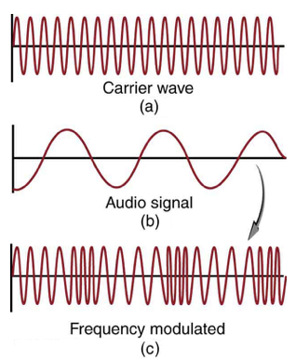
Radio Waves
Longest wavelength
Often used as carriers of radio waves
AM - Amplitude modulation on carrier wave
FM - Frequency modulation on carrier wave
Television - uses VHF and UHF of much wider ranges since they carry more information
Image Credit: OpenStax College Physics - Figure 24.13 CC BY 4.0

Slide 7
Example
Calculate the wavelengths of a 1530 kHz Am radio signal, a 105.1 MHz FM radio signal and a 1.90 GHz cell phone signal.
Draw a sketch (if applicable)
Identify known values
Identify equation
Enter values in the equation and solve
$$f_{1}=1530kHz=1530x{10}^{3}cycles/sec$$
$$f_{2}=105.1MHz=105.1x{10}^{6}cycles/sec$$
$$f_{3}=1.90GHz=1.90x{10}^{9}cycles/sec$$
$$λ=\frac{c}{f}$$
$$λ_{1}=\frac{c}{f_{1}}=\frac{3.00x{10}^{8}m/s}{1530x{10}^{3}cycles/sec}=196m$$
$$λ_{2}=\frac{c}{f_{2}}=\frac{3.00x{10}^{8}m/s}{105.1x{10}^{6}cycles/sec}=2.85m$$
$$λ_{3}=\frac{c}{f_{3}}=\frac{3.00x{10}^{8}m/s}{1.90x{10}^{9}cycles/sec}=0.158m$$
Image Credit: OpenStax College Physics - Figure 21.3 CC BY 4.0

Slide 8
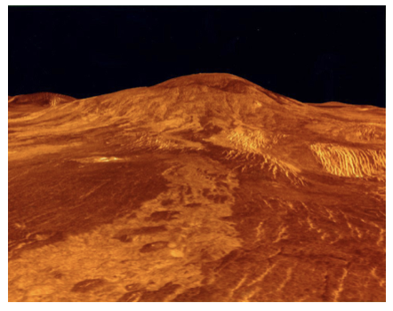
Microwaves
Shorter wavelengths than radio
Carry more information per unit time => better for communications
Radar - application of microwaves
Used by spacecraft to map the surface of Venus
Microwave ovens - used to heat food
Frequencies are selected so polar molecules (like water) absorb the energy increasing the temperatures
Image Credit: OpenStax College Physics - Figure 24.15 - Public Domain NASA

Slide 9
Infrared
Longer wavelengths than visible - below red
Produced by thermal motions
Night vision goggles
Detect radiation emitted by warm objects
Earth heated by our Sun
Earth is cooler - emits infrared
Infrared absorbed by $CO_{2}andH_{2}O$
Greenhouse effect

Slide 10
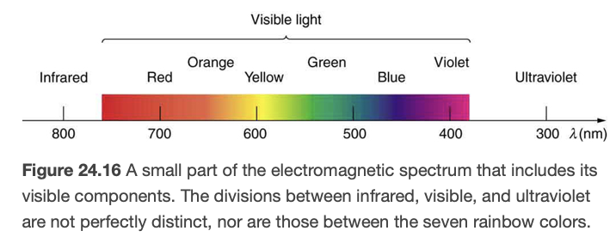
Visible Light
Produced by vibrations of atoms and molecules
Radiation from our Sun peaks in the visible portion of the spectrum
Photosynthesis - Use of sunlight to produce food in plants
Image Credit: OpenStax College Physics - Figure 24.16 CC BY 4.0

Slide 11
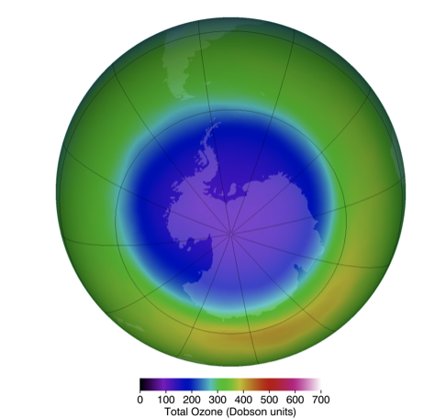
Ultraviolet Radiation
Ultraviolet - above violet
Divided into UV-A, UV-B and UV-C
Most UV-B and all UV-C are absorbed by ozone ($O_{3}$) in Earth’s atmosphere
UV-B - causes skin cancer
Tanning - body adapts to have more energy absorbed in upper skin layers
Ozone Hole - Depletion of ozone due to CFCs in Earth’s atmosphere
Some UV-B needed - helps vitamin D production, treat jaundice and kill germs
Image Credit: OpenStax College Physics - Figure 24.17 CC BY 4.0

Slide 12
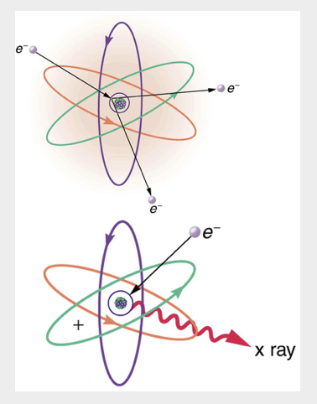
X-Rays
High energy - much more penetrating
Can be produced by high voltage discharge - ionization of atoms
X-ray images - medical uses
More sophisticated - CT scan can show 3-dimensional information
Image Credit: OpenStax College Physics - Figure 24.18 CC BY 4.0

Slide 13
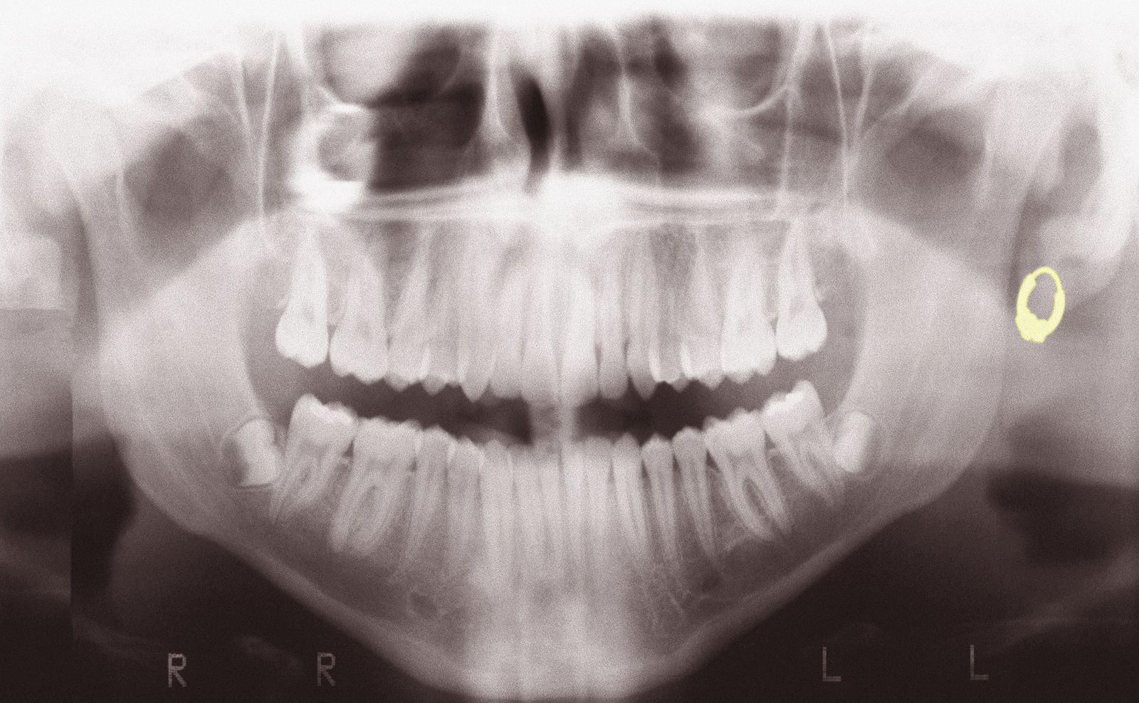
X-Rays
High energy - much more penetrating
Can be produced by high voltage discharge - ionization of atoms
X-ray images - medical uses
More sophisticated - CT scan can show 3-dimensional information
Image Credit: Sérgio Valle Duarte, CC BY 3.0 <https://creativecommons.org/licenses/by/3.0>, via Wikimedia Commons

Slide 14
Gamma Rays
Highest energy electromagnetic radiation
Radiation emitted by atomic nucleus
Sometimes used in cancer therapy
High energy can kill cancer cells

Slide 15
Electromagnetic Waves from Space
Astronomers now use the entire electromagnetic spectrum
Visible light and radio waves are visible from Earth’s surface
Infrared can be viewed from high mountains, planes or satellites
UV, X-Ray and Gamma Rays must be studied from space telescopes.

Slide 16
Summary
The electromagnetic spectrum is divided into parts by wavelength/frequency
All electromagnetic waves travel at the speed of light and have their wavelength and frequency related by: $c=fλ$
Different parts of the electromagnetic spectrum have different uses because of the wavelength and energy of the radiation

