Slide 1
Introduction to Physical Science
Optics: Reflection & Refraction
Presented by Robert Wagner

Slide 2
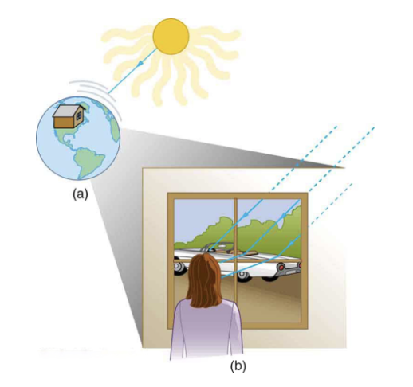
Light as a Ray
Light travels in straight lines - rays
We do not see the wave nature of light when light interacts with everyday objects
Geometric optics - describes how light changes direction when it interacts with matter
Image Credit: OpenStax College Physics - Figure 25.3 CC BY 4.0

Slide 3
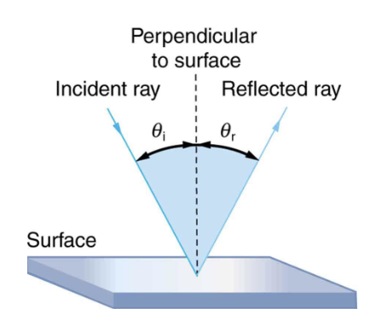
Law of Reflection
We measure angles from the perpendicular to the surface at the point where light strikes
Rough surface - rays are reflected in all directions - diffused
Smooth surface - Light is reflected at specific angles
Law of Reflection: The angle of reflection equals the angle of incidence
Image Credit: OpenStax College Physics - Figure 25.4 CC BY 4.0

Slide 4
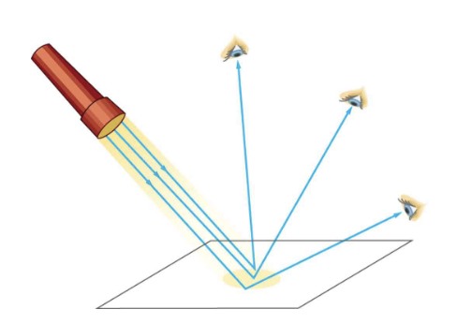
Law of Reflection
We measure angles from the perpendicular to the surface at the point where light strikes
Rough surface - rays are reflected in all directions - diffused
Smooth surface - Light is reflected at specific angles
Law of Reflection: The angle of reflection equals the angle of incidence
Image Credit: OpenStax College Physics - Figure 25.6 CC BY 4.0

Slide 5
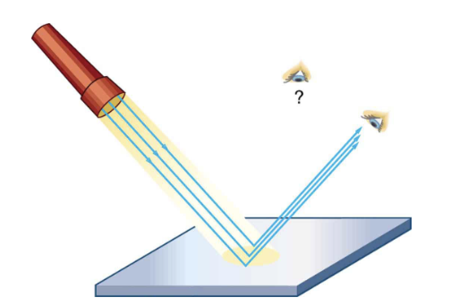
Law of Reflection
We measure angles from the perpendicular to the surface at the point where light strikes
Rough surface - rays are reflected in all directions - diffused
Smooth surface - Light is reflected at specific angles
Law of Reflection: The angle of reflection equals the angle of incidence
Image Credit: OpenStax College Physics - Figure 25.7 CC BY 4.0

Slide 6
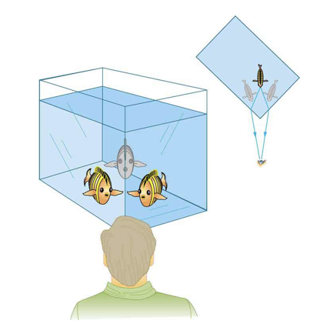
Law of Refraction
Refraction: The changing of the direction of a light ray when it passes through variations in matter
Can see multiple images of objects
Light waves change direction when passing through different materials
Light changes speed (c = speed of light in a vacuum)
Image Credit: OpenStax College Physics - Figure 25.10 CC BY 4.0

Slide 7
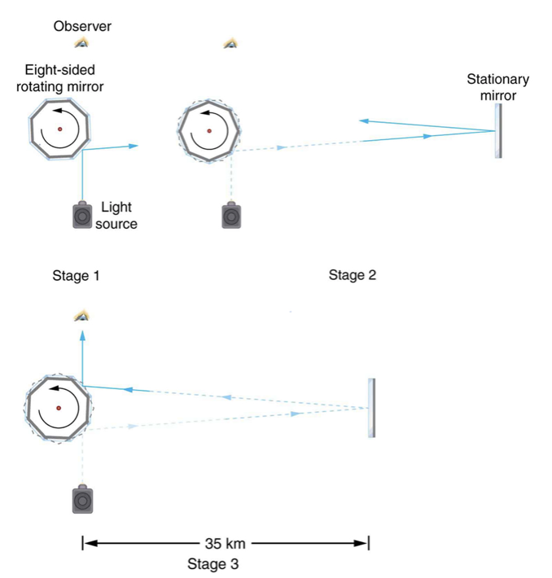
The Speed of Light
How to measure the speed of light?
Early attempts - knew light moved extremely fast
Roemer - Measured speed of light using Jupiter’s moons (25% error)
Michelson - Measured using rotating mirrors and stationary mirror 35 km away (0.04% error)
Speed of light (c) = 2.99792458 x10⁸ m/s)
Image Credit: OpenStax College Physics - Figure 25.11 CC BY 4.0

Slide 8
Index of Refraction
The speed of light through material will be less than the speed of light in a vacuum
Index of refraction: $n=\frac{c}{v}$, where $n≥1$
The larger the index of refraction, the more light slows down in that material
Air: n = 1.000293
Diamond: n = 2.419

Slide 9
Example
Calculate the speed of light in zircon, a material used in jewelry to imitate diamond.
Draw a sketch (if applicable)
Identify known values
Identify equation
Enter values in the equation and solve
$$n_{zircon}=1.923(Table25.1)$$
$$n=\frac{c}{v};v=\frac{c}{n}$$
$$v=\frac{3.00x{10}^{8}m/s}{1.923}=1.56x{10}^{8}m/s$$

Slide 10
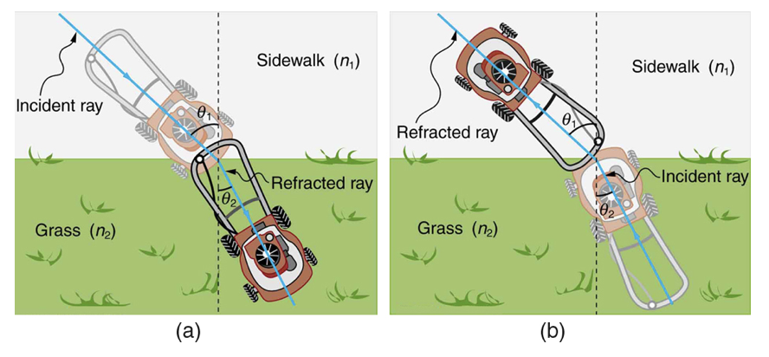
Law of Refraction
Light rays will change direction when they pass from one medium to another
It moves closer to the perpendicular when it slows down
It moves away from he perpendicular when it speeds up
Snell’s Law: $n_{1}sinθ_{1}=n_{2}sinθ_{2}$
Image Credit: OpenStax College Physics - Figure 25.12 CC BY 4.0

Slide 11
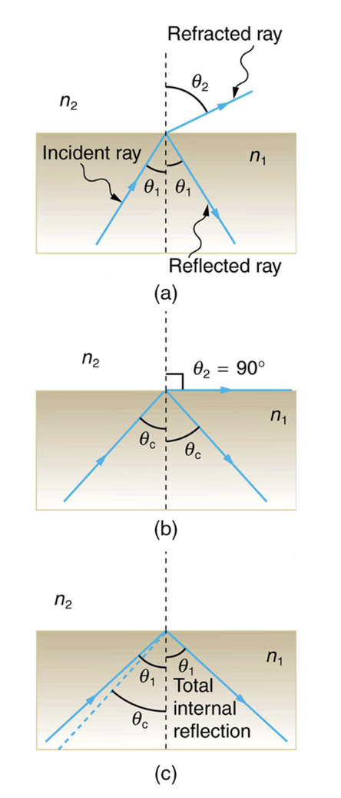
Total Internal Reflection
At a boundary, some light is reflected and some refracted
The critical angle is the angle such that the angle of refraction is equal to 90 degrees
For greater angles, all of the light is reflected - total internal reflection
Image Credit: OpenStax College Physics - Figure 25.13 CC BY 4.0

Slide 12
Summary
We can use geometric optics to describe what happens to light rays
Law of reflection: Angle of reflection equals angle of incidence
Law of refraction: Snell’s law
Total internal reflection occurs when the angle of the ray is greater than the critical angle

