Slide 1
Introduction to Physical Science
Image Formation - Lenses
Presented by Robert Wagner

Slide 2
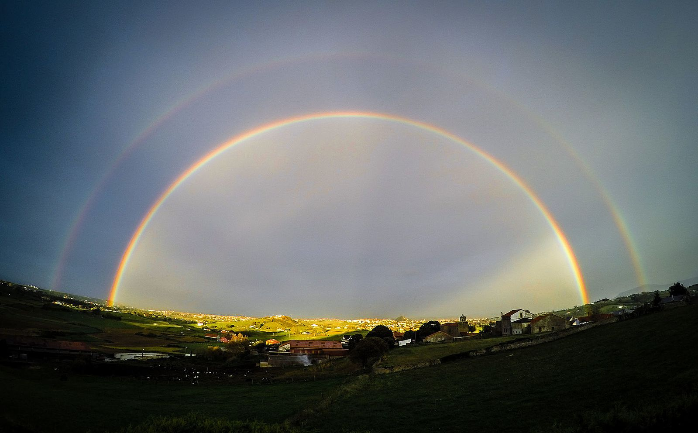
Dispersion
The spreading of white light into its full spectrum of wavelengths
Refraction is responsible for dispersion in things like rainbows
The index of refraction (n) depends on wavelength
Rainbows are produced by a combination of reflection and refraction
Image Credit: Luis Marina, CC BY 2.0 <https://creativecommons.org/licenses/by/2.0>, via Wikimedia Commons

Slide 3
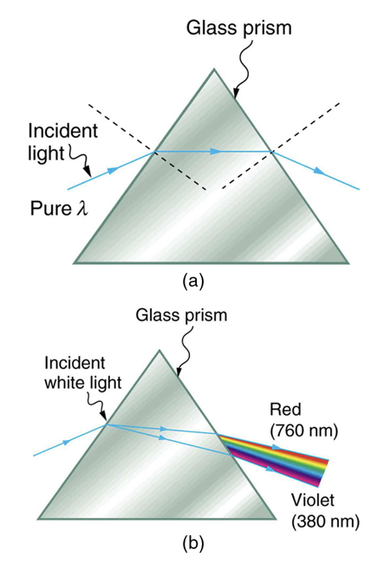
Dispersion
The spreading of white light into its full spectrum of wavelengths
Refraction is responsible for dispersion in things like rainbows
The index of refraction (n) depends on wavelength
Rainbows are produced by a combination of reflection and refraction
Image Credit: OpenStax College Physics - Figure 25.23 CC BY 4.0

Slide 4
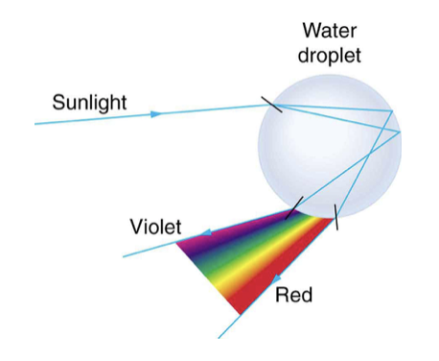
Dispersion
The spreading of white light into its full spectrum of wavelengths
Refraction is responsible for dispersion in things like rainbows
The index of refraction (n) depends on wavelength
Rainbows are produced by a combination of reflection and refraction
Image Credit: OpenStax College Physics - Figure 25.24 CC BY 4.0

Slide 5
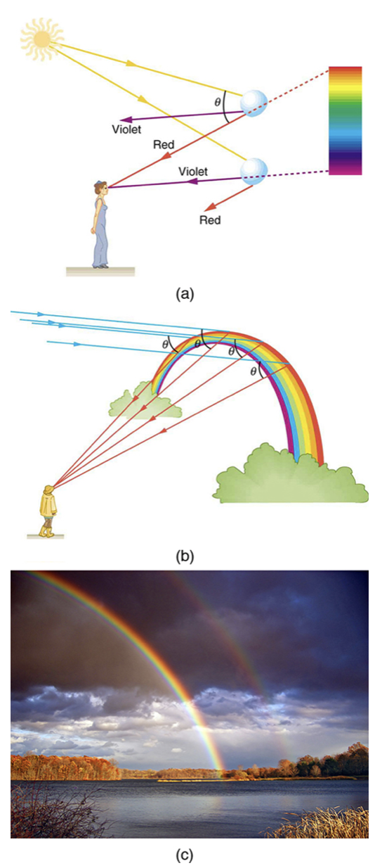
Dispersion
The spreading of white light into its full spectrum of wavelengths
Refraction is responsible for dispersion in things like rainbows
The index of refraction (n) depends on wavelength
Rainbows are produced by a combination of reflection and refraction
Image Credit: OpenStax College Physics - Figure 25.25 CC BY 4.0

Slide 6
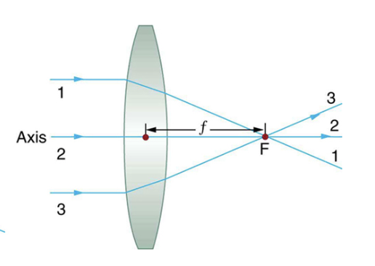
Lenses
Convex lens - converging lens - rays are bent toward the axis
Concave Lens - diverging lens - rays are bent away from the axis
The focal point of a lens is the point at which the rays cross
The focal length of the lens is the distance from the center of the lens to its focal point
The power of a lens is the inverse of its focal length
$$P=\frac{1}{f}$$
Image Credit: OpenStax College Physics - Figure 25.27

Slide 7
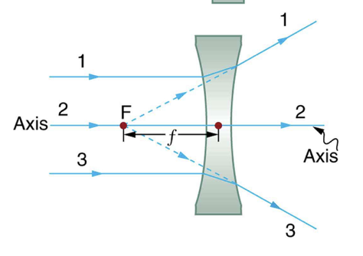
Lenses
Convex lens - converging lens - rays are bent toward the axis
Concave Lens - diverging lens - rays are bent away from the axis
The focal point of a lens is the point at which the rays cross
The focal length of the lens is the distance from the center of the lens to its focal point
The power of a lens is the inverse of its focal length
$$P=\frac{1}{f}$$
Image Credit: OpenStax College Physics - Figure 25.27 CC BY 4.0

Slide 8
Example
If a magnifying glass is found to concentrate sunlight to a small spot 8.00 cm away from the lens. What are the focal length and power of the lens?
Draw a sketch (if applicable)
Identify known values
Identify equation
Enter values in the equation and solve
$$d=8.00cm=0.0800m$$
$$f=8.00cm$$
$$P=\frac{1}{f}=\frac{1}{0.0800m}$$
$$P=12.5m^{-1}=12.5D$$
D is the diopter, a measure of optical power

Slide 9
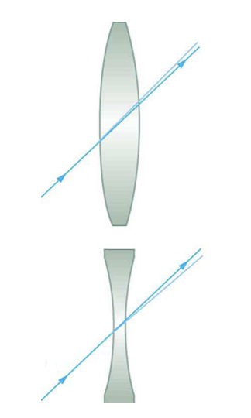
Ray Tracing and Thin Lenses
Thin lens - lens that is thin enough that no dispersion occurs and thin enough that a ray through the center is undeviated
A thin lens is an ideal concept of a lens where we can consider that the light bends only once
Image Credit: OpenStax College Physics - Figure 25.31 CC BY 4.0

Slide 10
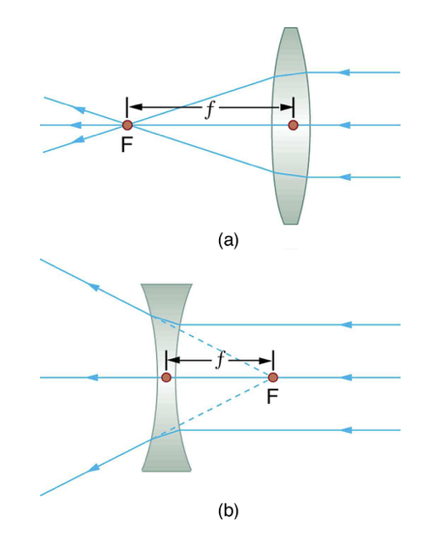
Rules for Ray Tracing
A ray entering a converging lens parallel to its axis, passes through the focal point
A ray entering a diverging lens parallel to its axis seems to come from the focal point
A ray passing through the center of a converging or diverging lens does not change direction
A ray entering a converging lens through its focal point exits parallel to its axis
A ray that enters a diverging lens by heading toward the focal point on the opposite side exits parallel to its axis
Image Credit: OpenStax College Physics - Figure 25.31 CC BY 4.0

Slide 11
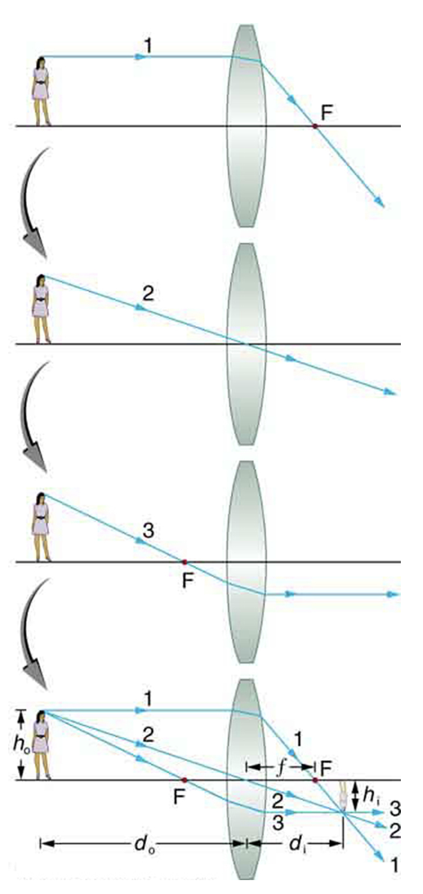
Image Formation
Use rules for thin lenses
Since we are looking at the rays from the person’s head, they intersect at the image of the person’s head
Real image - light rays actually cross at the image location and can be projected (on a screen, for example)
Image Credit: OpenStax College Physics - Figure 25.33 CC BY 4.0

Slide 12
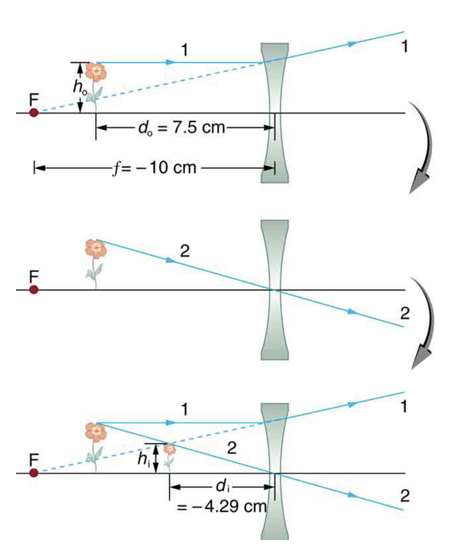
Image Formation (2)
Use rules for thin lenses
Since we are looking at the rays from the top of the flower, they intersect at the image of the top of the flower
Virtual image - light rays do not actually cross at the image location and can not be projected (on a screen, for example)
Image Credit: OpenStax College Physics - Figure 25.39 CC BY 4.0

Slide 13
Summary
Dispersion is the spreading of light into its component wavelengths
Lenses can be converging or diverging
A thin lens allows us to consider the light to bend only once and to use ray tracing rules

