Slide 1
Introduction to Physical Science
Image Formation - Mirrors
Presented by Robert Wagner

Slide 2
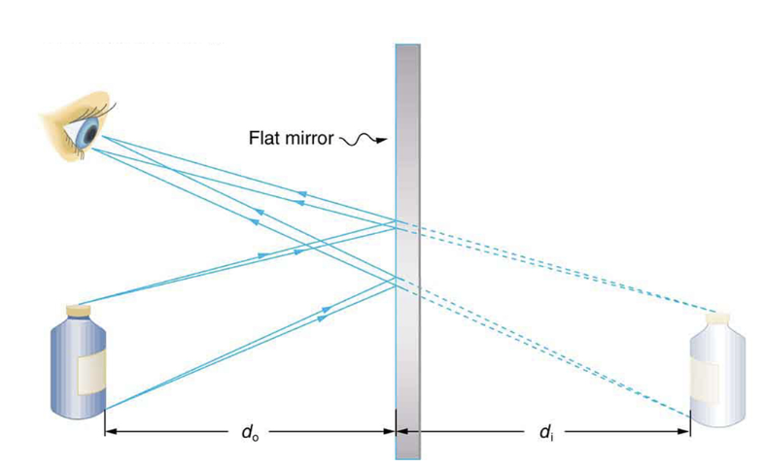
Flat Mirrors
Law of reflection - angle of reflection equals angle of incidence
Rays can be traced backwards and the image appears to be behind the mirror - a virtual image
Image Credit: OpenStax College Physics - Figure 25.40 CC BY 4.0

Slide 3
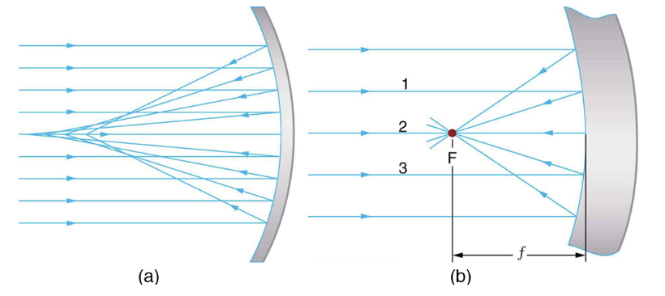
Concave Mirrors
Spherical mirrors - light rays do not converge at the same point - no defined focal point
Parabolic mirror - all light rays will converge at the focal point
If a spherical mirror is small compared to its radius of curvature, it will behave like a parabolic mirror
Image Credit: OpenStax College Physics - Figure 25.41 CC BY 4.0

Slide 4
Concave Mirrors (2)
Power of a mirror: $P=\frac{1}{f}$
Focal length of a mirror: $f=\frac{R}{2}$
R is the radius of curvature of the mirror
Smaller radius of curvature => smaller focal length => more powerful mirror

Slide 5
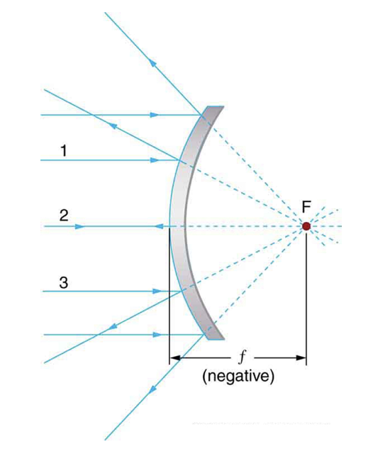
Convex Mirrors
Focal point of a convex mirror is behind the mirror
Focal length and power will both be negative - diverging mirror
Image Credit: OpenStax College Physics - Figure 25.42 CC BY 4.0

Slide 6
Example
A mirror has a radius of curvature of 20.0 m. What is the focal length and power of the telescope?
Draw a sketch (if applicable)
Identify known values
Identify equation
Enter values in the equation and solve
$$R=20.0m$$
$$f=\frac{R}{2}=\frac{20.0}{2}=10.0m$$
$$P=\frac{1}{f}=\frac{1}{10.0m}$$
$$P=0.100m^{-1}=0.100D$$

Slide 7
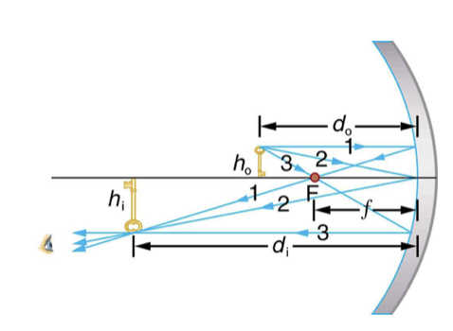
Ray Tracing Rules
A ray approaching a concave converging mirror parallel to its axis is reflected through the focal point on the same side
A ray approaching a convex diverging mirror parallel to its axis is reflected so that it seems to come from the focal point behind the mirror
Any ray striking the center of the mirror is followed by following the law of reflection
A ray approaching a concave converging mirror through its focal point is reflected parallel to its axis
A ray approaching a convex diverging mirror by heading towards its focal point is reflected parallel to its axis
Image Credit: OpenStax College Physics - Figure 25.43 CC BY 4.0

Slide 8
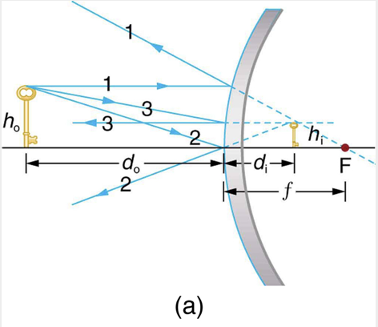
Ray Tracing Rules
A ray approaching a concave converging mirror parallel to its axis is reflected through the focal point on the same side
A ray approaching a convex diverging mirror parallel to its axis is reflected so that it seems to come from the focal point behind the mirror
Any ray striking the center of the mirror is followed by following the law of reflection
A ray approaching a concave converging mirror through its focal point is reflected parallel to its axis
A ray approaching a convex diverging mirror by heading towards its focal point is reflected parallel to its axis
Image Credit: OpenStax College Physics - Figure 25.46a CC BY 4.0

Slide 9
Summary
Flat mirror follow the law of reflection and form virtual images
Concave converging mirrors have the focal point in front of the mirror. A convex diverging mirror has a focal point behind the mirror
Ray tracing rules for mirror allow us to determine the location and size of the image formed.

