Slide 1
Introduction to Physical Science
Vision
Presented by Robert Wagner

Slide 2
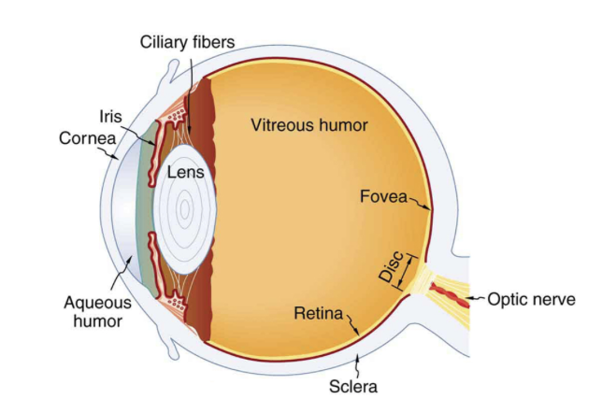
The Eye
The cornea and lens act as a thin lens to project an image on the retina
The pupil allows for various opening sizes allowing us to see in a wide range of light levels.
Image Credit: OpenStax College Physics - Figure 26.2 CC BY 4.0

Slide 3
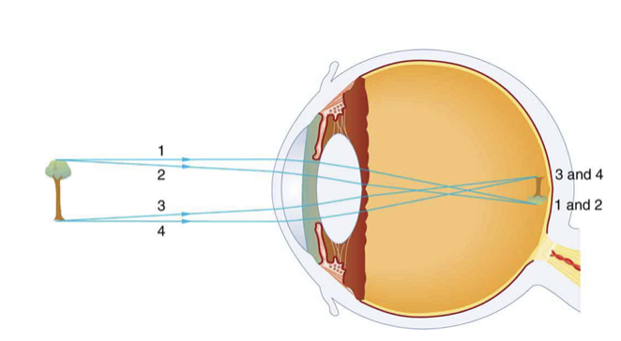
Image Formation
Image on the retina is inverted - our brain inverts the image giving us the sense of an upright object
Lens adapts for us to see at a distance and close up
Relaxed - viewing distant objects
Accommodates - viewing nearby objects
Image Credit: OpenStax College Physics - Figure 26.3 CC BY 4.0

Slide 4
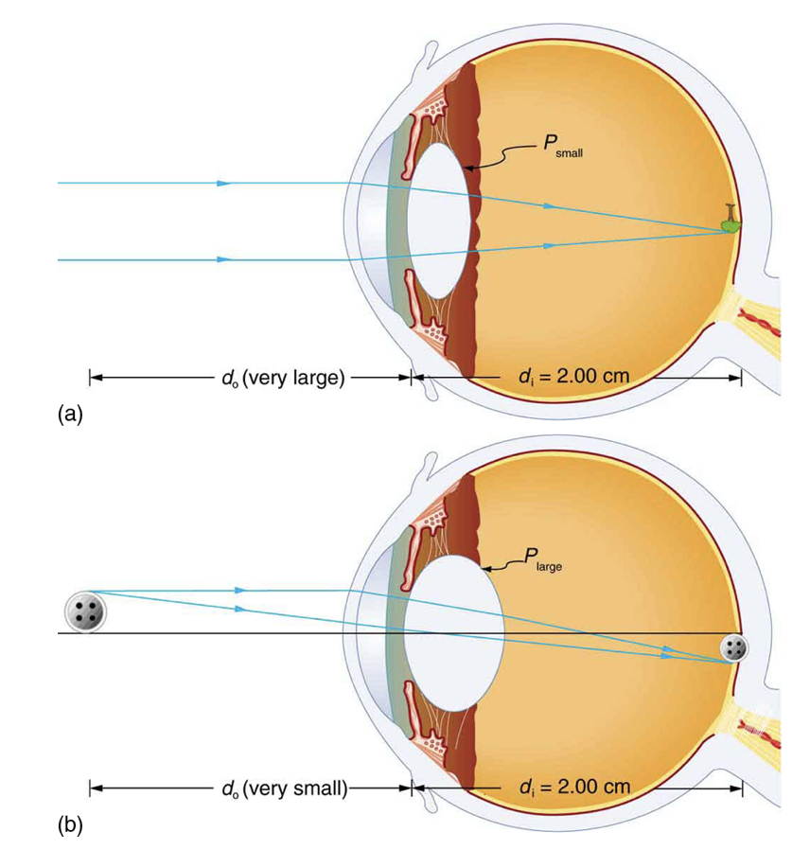
Image Formation
Image on the retina is inverted - our brain inverts the image giving us the sense of an upright object
Lens adapts for us to see at a distance and close up
Relaxed - viewing distant objects
Accommodates - viewing nearby objects
Image Credit: OpenStax College Physics - Figure 26.4 CC BY 4.0

Slide 5
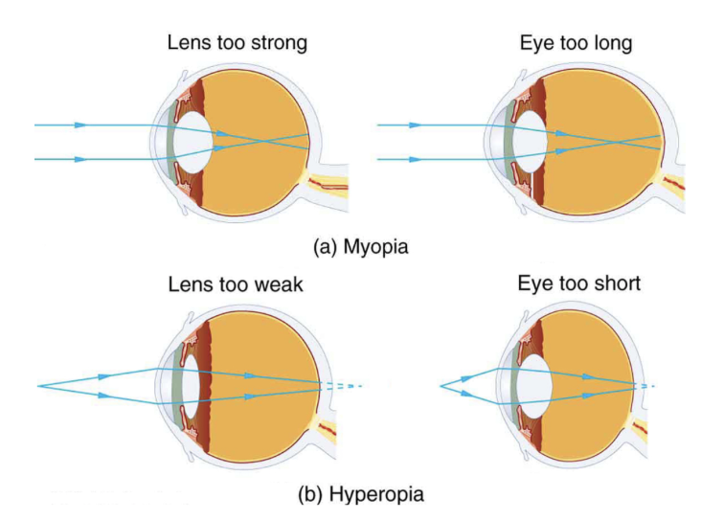
Vision Correction
Common vision defects
Nearsightedness - myopia
Inability to see distant objects clearly
Farsightedness - hyperopia
Inability to see nearby objects clearly
Image Credit: OpenStax College Physics - Figure 25.41 CC BY 4.0

Slide 6
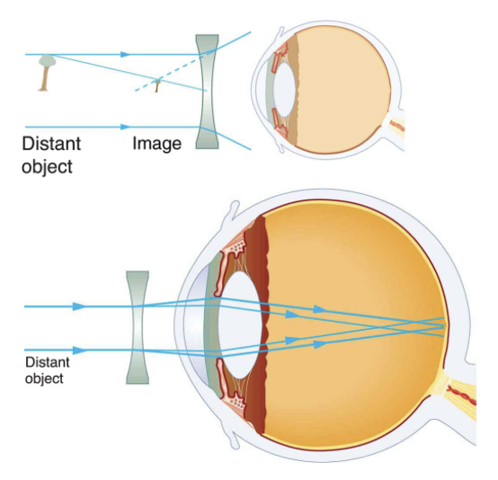
Vision Correction (2)
Correcting for nearsightedness - myopia
Diverging lens to compensate for over convergence of eye
Correcting for farsightedness - hyperopia
Converging lens to compensate for under convergence of eye
Image Credit: OpenStax College Physics - Figure 26.6 CC BY 4.0

Slide 7
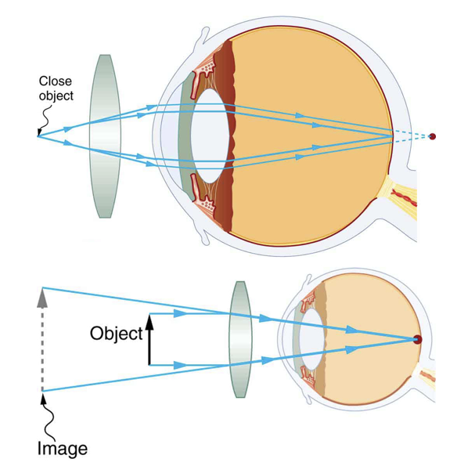
Vision Correction (2)
Correcting for nearsightedness - myopia
Diverging lens to compensate for over convergence of eye
Correcting for farsightedness - hyperopia
Converging lens to compensate for under convergence of eye
Image Credit: OpenStax College Physics - Figure 26.7 CC BY 4.0

Slide 8
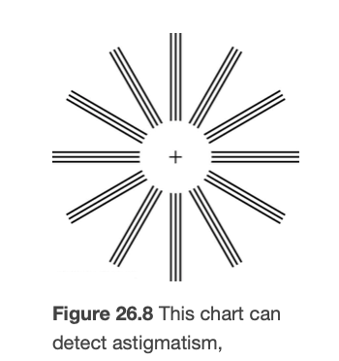
Astigmatism
Definition - an unevenness or asymmetry in the focus of the eye
Often caused by irregularities in the shape of the cornea
Corrected with glasses with the opposite irregularity
Image Credit: OpenStax College Physics - Figure 26.8 CC BY 4.0

Slide 9
Summary
The cornea and lens of the eye combine to become effectively a thin lens
Common defects in vision include nearsightedness (myopia) and farsightedness (hyperopia)
Astigmatism is due to irregularities in the eye and can be corrected for as well

