Slide 1
Introduction to Physical Science
Microscopes and Telescopes
Presented by Robert Wagner

Slide 2
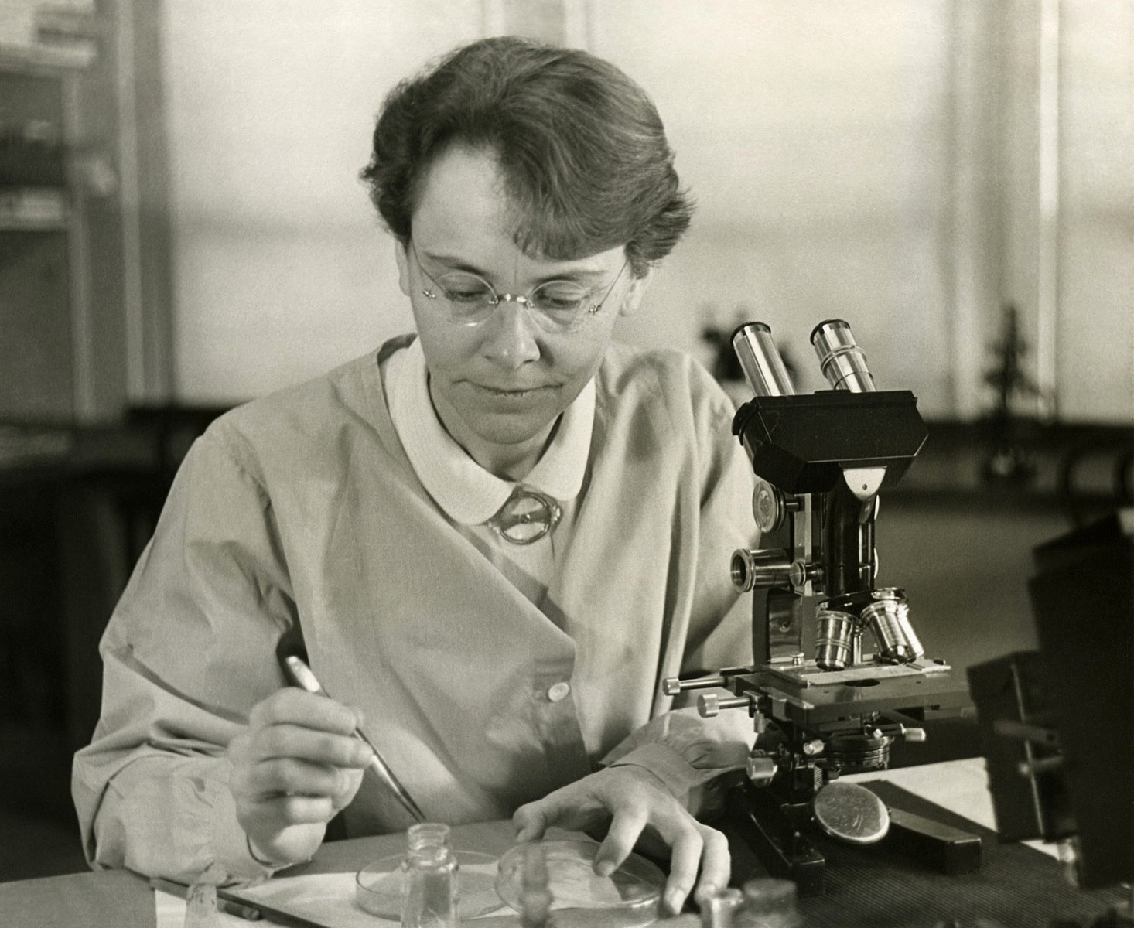
The Microscope
While the eye had a great ability to see large and small - there are limits.
Optical instruments allow us to see beyond what our eyes could normally see.
Microscopes developed in the early 1600s
Simplest version has an objective lens and an eyepiece
Image Credit: Smithsonian Institution/Science Service; Restored by Adam Cuerden, Public domain, via Wikimedia Commons

Slide 3
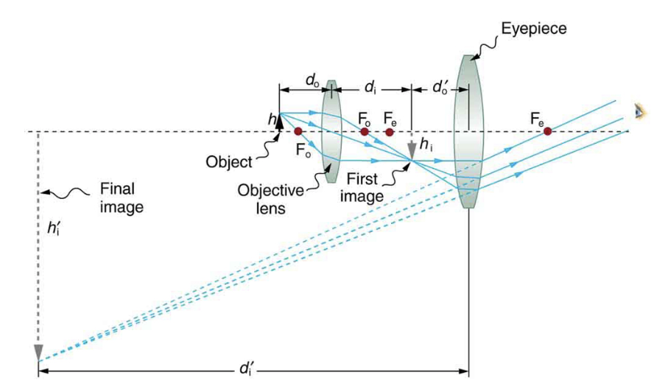
The Microscope
While the eye had a great ability to see large and small - there are limits.
Optical instruments allow us to see beyond what our eyes could normally see.
Microscopes developed in the early 1600s
Simplest version has an objective lens and an eyepiece
Image Credit: OpenStax College Physics - Figure 26.16 CC BY 4.0

Slide 4
Telescopes
Each lens in a microscope magnifies the image
Total magnification
$$m=m_{o}m_{e}$$
If $m_{e}=15X$ and $m_{o}=10X$
$$m=10Xx15X=150X$$

Slide 5
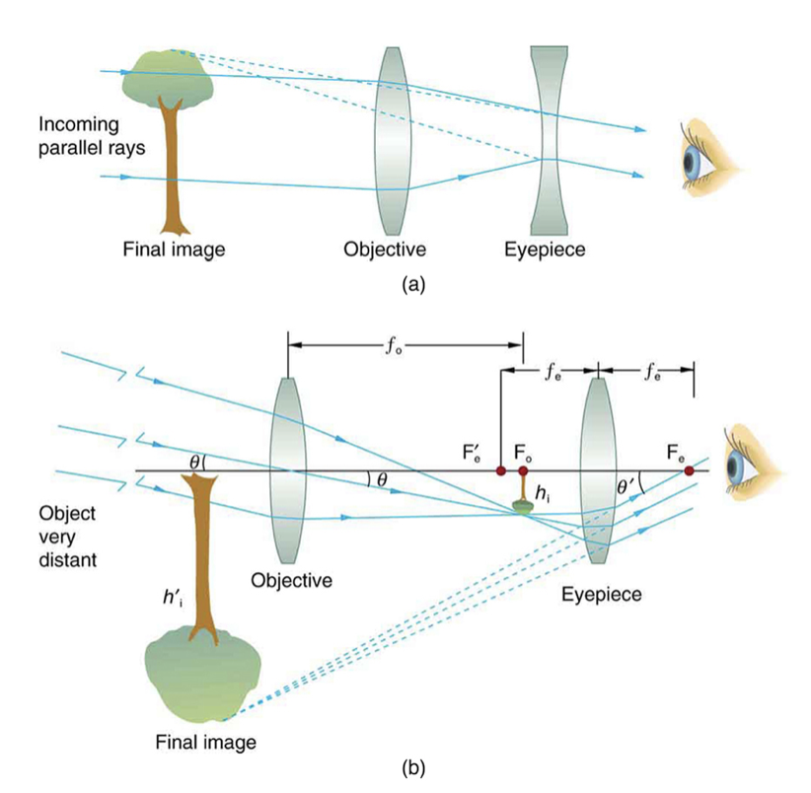
Telescopes
A basic telescope will also have an objective and an eyepiece
Using a convex and a concave lens will give an upright image (spyglass)
Using two convex lenses will give an inverted image (telescope)
Image Credit: OpenStax College Physics - Figure 26.23 CC BY 4.0

Slide 6
Telescope Magnification
$$M=-\frac{f_{o}}{f_{e}}$$
Maximum magnification:
Long focal length objective and short focal length eyepiece
Magnification is a relatively unimportant factor in astronomical telescopes
Image Credit: OpenStax College Physics - Figure 25.41

Slide 7
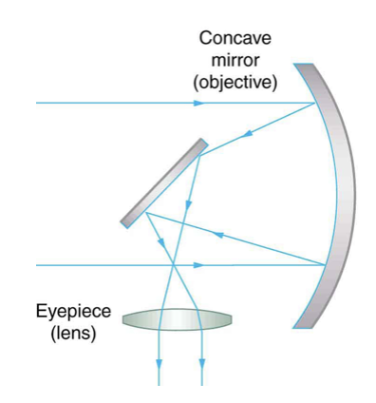
Reflecting Telescopes
A mirror can be used as the objective for a telescope as well.
Mirrors can be made much larger than lenses and have other advantages as well in modern optical telescopes
Telescopes can also be constructed that can observe other parts of the electromagnetic spectrum
Image Credit: OpenStax College Physics - Figure 26.25 CC BY 4.0

Slide 8
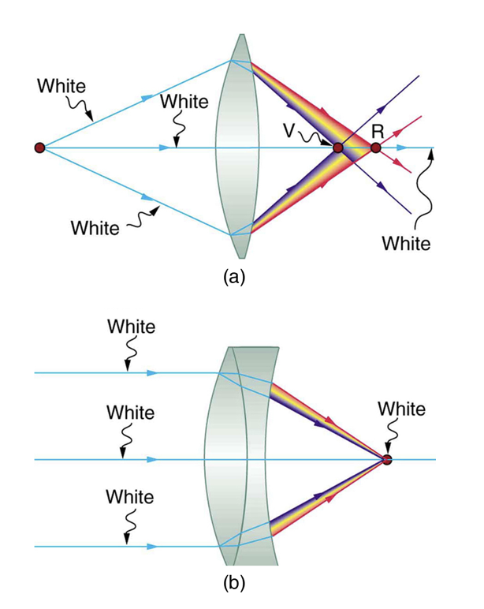
Aberrations
Chromatic aberration - Lens can behave like a prism
Corrected by using multiple lenses
Spherical aberration - rays focusing at different distances from the lens/mirror
Coma - Off-center object image will be distorted
Image Credit: OpenStax College Physics - Figure 26.28 CC BY 4.0

Slide 9
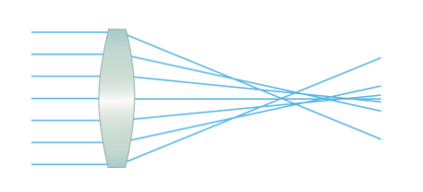
Aberrations
Chromatic aberration - Lens can behave like a prism
Corrected by using multiple lenses
Spherical aberration - rays focusing at different distances from the lens/mirror
Coma - Off-center object image will be distorted
Image Credit: OpenStax College Physics - Figure 26.30 CC BY 4.0

Slide 10
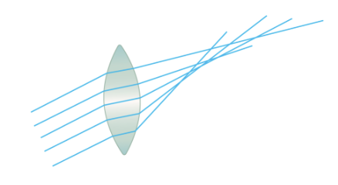
Aberrations
Chromatic aberration - Lens can behave like a prism
Corrected by using multiple lenses
Spherical aberration - rays focusing at different distances from the lens/mirror
Coma - Off-center object image will be distorted
Image Credit: OpenStax College Physics - Figure 26.29 CC BY 4.0

Slide 11
Summary
Microscopes and telescopes both magnify images allowing us to see the worlds of the very large and very small
The magnification of a telescope or microscope depends on the objective and the eyepiece
Various aberrations are associated with using lenses/mirror but can be corrected to some extent

