Slide 1
Introduction to Physical Science
Atomic Theory
Presented by Robert Wagner

Slide 2
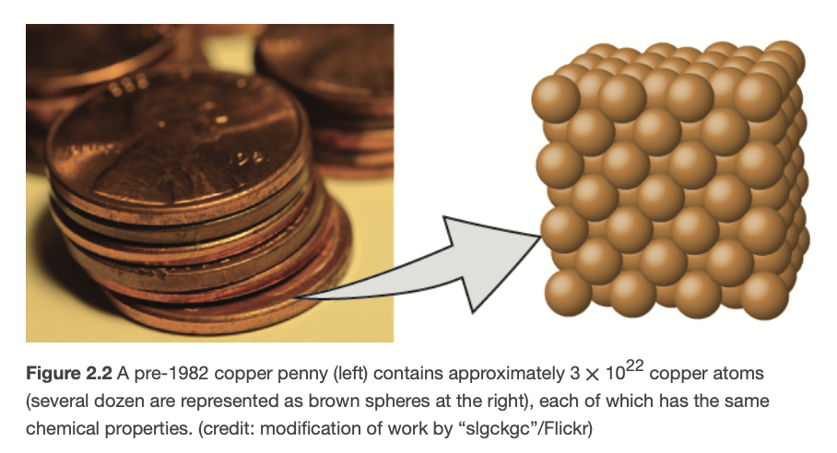
Dalton’s Atomic Theory
Matter is composed of atoms. An atom is the smallest unit that participates in a chemical change
An element consists of only one type of atom
Atoms of one element differ in properties from atoms of other elements
Image Credit: OpenStax Chemistry - Figure 2.2 (Modification of work by “slgckgc”/Flickr)

Slide 3
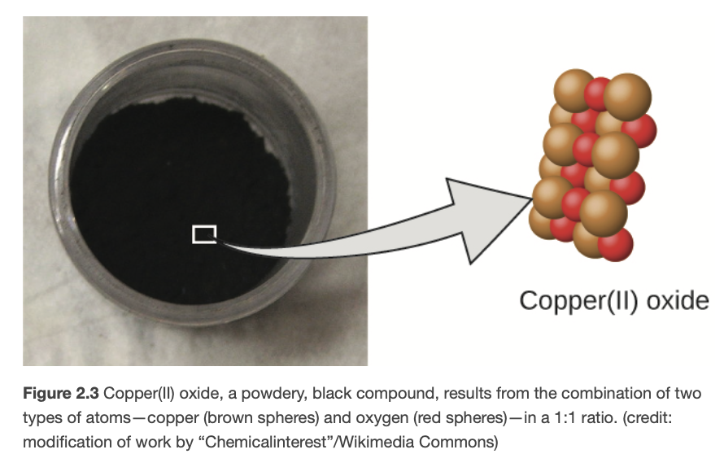
Dalton’s Atomic Theory (2)
A compound consists of two or more elements combined in a small, whole-number ratio.
Atoms are neither created nor destroyed during a chemical change, but are rearranged to yield new substances
Image Credit: OpenStax Chemistry - Figure 2.3 (Modification of work by “Chemicalinterest”/Wikimedia Commons)

Slide 4
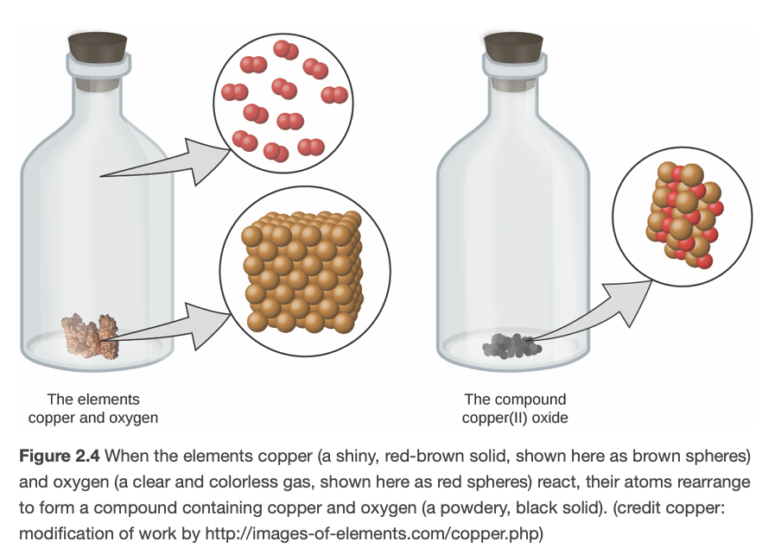
Dalton’s Atomic Theory (2)
A compound consists of two or more elements combined in a small, whole-number ratio.
Atoms are neither created nor destroyed during a chemical change, but are rearranged to yield new substances
Image Credit: OpenStax Chemistry - Figure 2.4 (Copper: modification of work by http://images-of-elements.com/copper.php)

Slide 5
Example
Would this reaction violate Dalton’s rules?
Remember, atoms cannot be created to destroyed!
Look at this version
Image Credit: OpenStax Chemistry - Example 2.1 CC BY 4.0

Slide 6
Example
Would this reaction violate Dalton’s rules?
Remember, atoms cannot be created to destroyed!
Look at this version
Image Credit: OpenStax Chemistry - Example 2.1 CC BY 4.0

Slide 7
Law of Definite Proportions
The numbers of atoms of the elements in a given compound always exist in the same ratio
Example: isooctane
Image Credit: OpenStax Chemistry - Table 2.1 CC BY 4.0

Slide 8
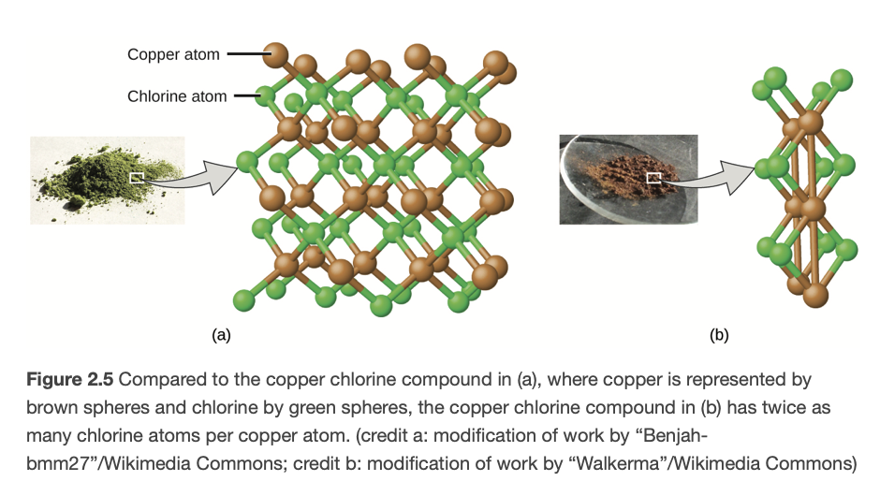
Law of Multiple Proportions
When two elements react to form more than one compound, a fixed mass of one element will react with masses of the other element in a ratio of small, whole numbers
Carbon and chlorine:
Green solid: 1.116 g Cl to 1 g Cu
Brown solid: 0.558 g Cl to 1 g Cu
Image Credit: OpenStax Chemistry - Figure 2.5 (a - modification of work by “Benjah-bmm27”/Wikimedia Commons ; b - modification of work by “Walkerma”/Wikimedia Commons

Slide 9
Example
Compound A: 4.27 g Carbon and 5.69 g Oxygen
Compound B: 5.19 g Carbon and 13.84 g Oxygen
Ratios are not the same - different compounds
Small whole number ratio - law of multiple proportions
$$COCO_{2}$$
Compound A: Compound B:
$$\frac{1.33gO}{1gC}\frac{2.67gO}{1gC}$$
$$\frac{\frac{1.33gO}{1gC}}{\frac{2.67gO}{1gC}}=\frac{1}{2}$$

Slide 10
Development of Atomic Theory
Thomson - used cathode ray tube to measure the charge to mass ratio of the electron
$$1.759x{10}^{11}C/kg$$
Millikan - oil drop experiment - Determine charge of electron
$$1.6x{10}^{-19}C$$
Combine these to determine the mass of electron
$$m_{e}=1.602x{10}^{-19}Cx\frac{1kg}{1.759x{10}^{11}C}=9.107x{10}^{-31}kg$$
Image Credit: J.J. Thomson, Public domain, via Wikimedia Commons

Slide 11
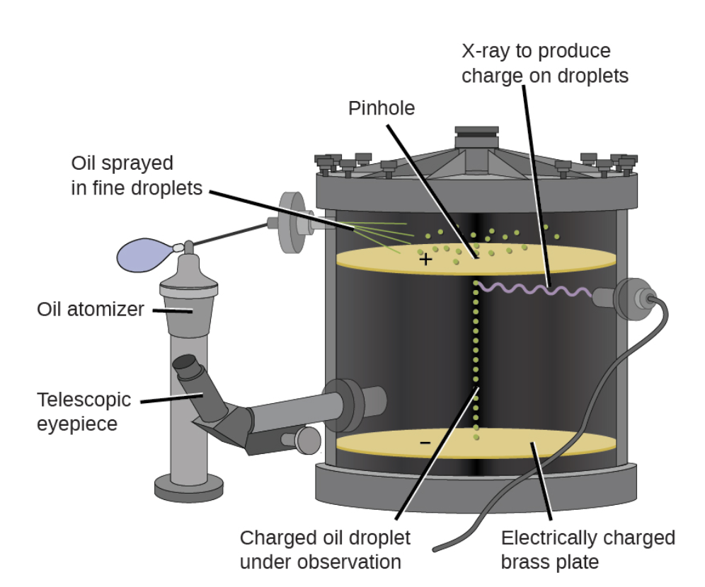
Development of Atomic Theory
Thomson - used cathode ray tube to measure the charge to mass ratio of the electron
$$1.759x{10}^{11}C/kg$$
Millikan - oil drop experiment - Determine charge of electron
$$1.6x{10}^{-19}C$$
Combine these to determine the mass of electron
$$m_{e}=1.602x{10}^{-19}Cx\frac{1kg}{1.759x{10}^{11}C}=9.107x{10}^{-31}kg$$
Image Credit: OpenStax Chemistry - Figure 2.7 CC BY 4.0

Slide 12
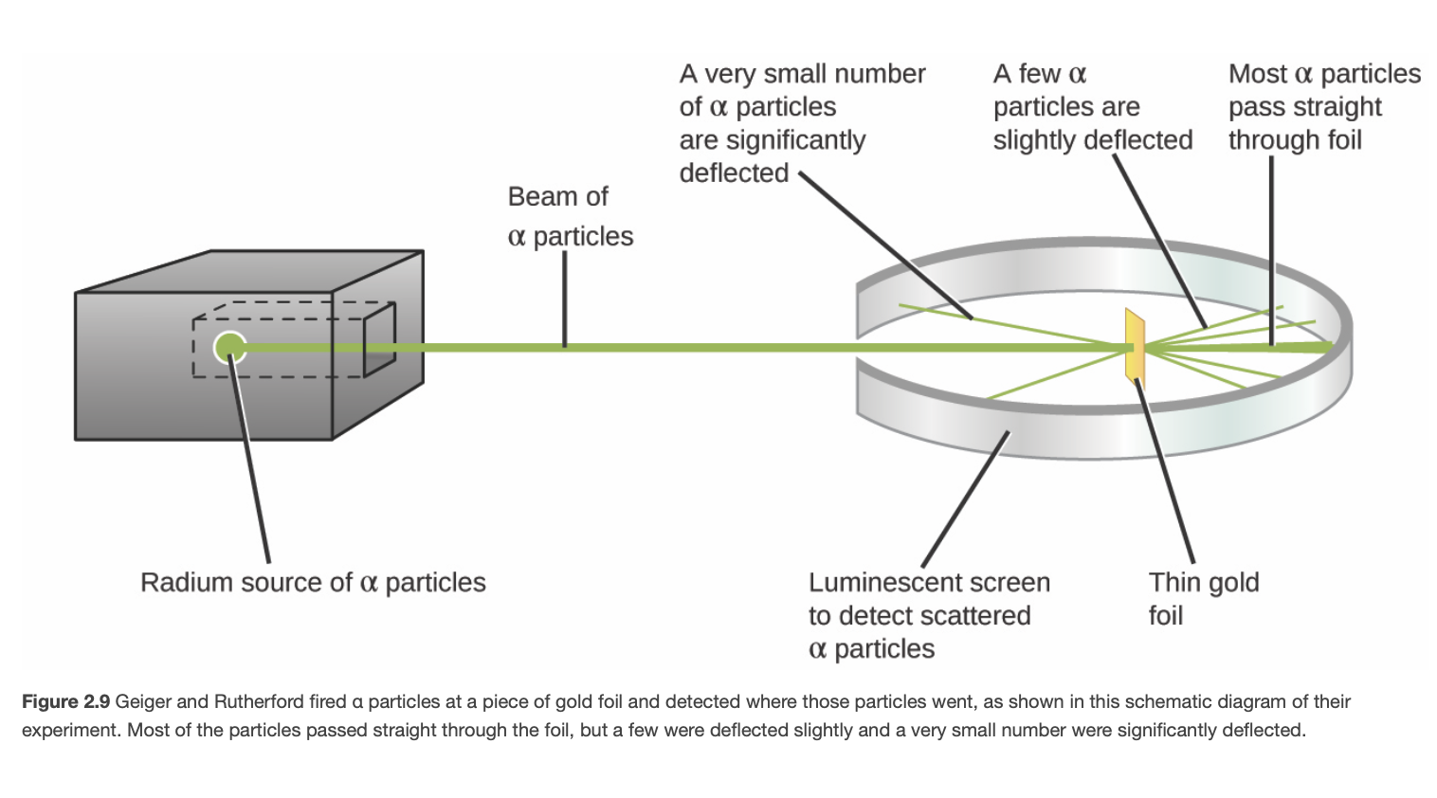
Atomic Theory
Various models
“Plum Pudding” - electrons imbedded in positively charged mass
Saturn-like atom - Electrons orbit around a positively charged nucleus
Rutherford Experiment
Volume - mostly empty space
Small, heavy, positively charged nucleus
Image Credit: OpenStax Chemistry - Figure 2.9 CC BY 4.0

Slide 13
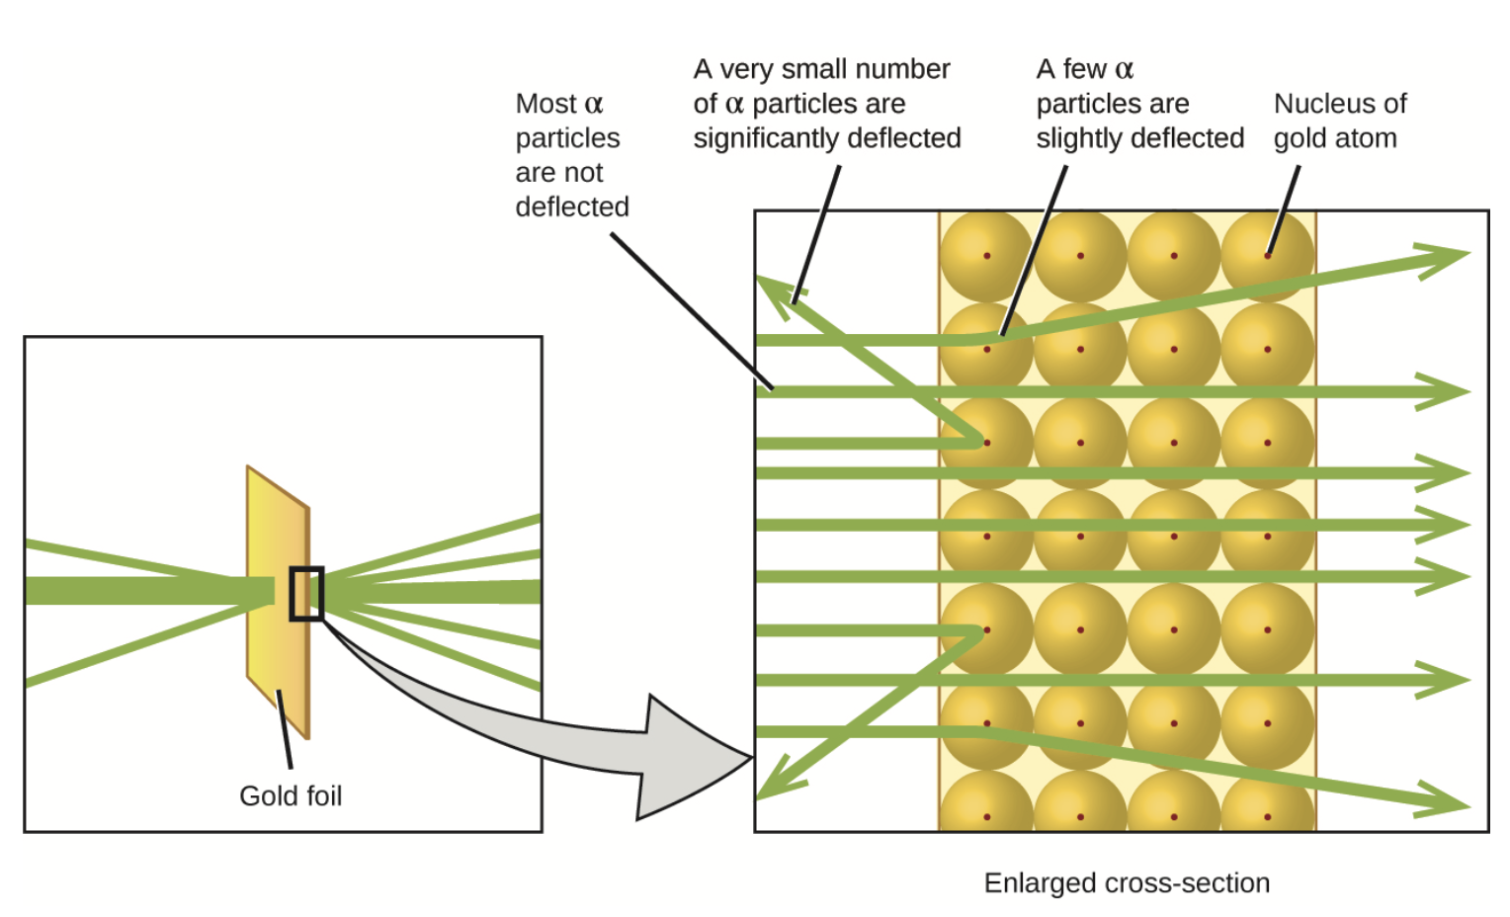
Atomic Theory
Various models
“Plum Pudding” - electrons imbedded in positively charged mass
Saturn-like atom - Electrons orbit around a positively charged nucleus
Rutherford Experiment
Volume - mostly empty space
Small, heavy, positively charged nucleus
Image Credit: OpenStax Chemistry - Figure 2.10 CC BY 4.0

Slide 14
Isotopes & Neutrons
Isotopes - apparently new elements found in the early 1900s
Same material, just differ in mass
Neutron - discovered in 1932
Explain existence of isotopes. Isotopes have the same number of protons, but different numbers of neutrons

Slide 15
Summary
Modern atomic theory began with the studies of Dalton
The laws of definite and multiple proportions tell how atoms combine together in specific ratios
Rutherford’s experiment explained atoms as mostly empty space with a massive, compact nucleus

