Slide 1
Introduction to Physical Science
Atomic Structure and Chemical Formulae
Presented by Robert Wagner

Slide 2
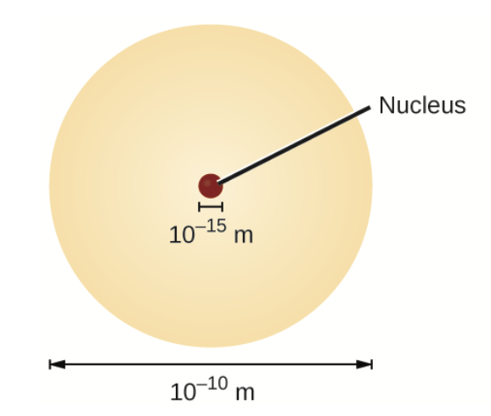
Atomic Structure
We learned that an atom consists of a tiny nucleus surrounded by electrons
If the nucleus were the size of a blueberry, the entire atom would be the size of a football stadium!
New units:
Fundamental unit of charge: e
Atomic mass unit - amu
Image Credit: OpenStax Chemistry - Figure 2.11 CC BY 4.0

Slide 3
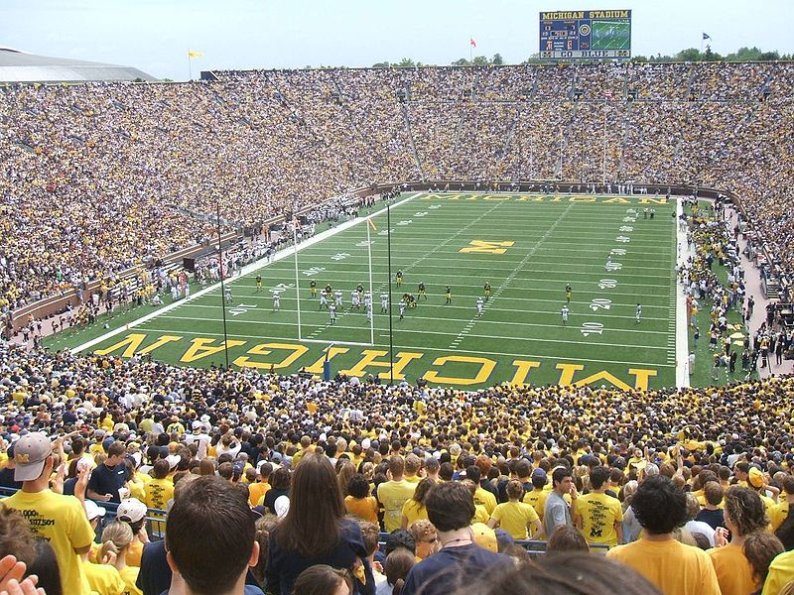
Atomic Structure
We learned that an atom consists of a tiny nucleus surrounded by electrons
If the nucleus were the size of a blueberry, the entire atom would be the size of a football stadium!
New units:
Fundamental unit of charge: e
Atomic mass unit - amu
Image Credit: User ThatsHowIRoll on en.wikipedia, Public domain, via Wikimedia Commons

Slide 4
Units
New units make it easier to deal with the numbers for such small objects
Image Credit: OpenStax Chemistry - Table 2.2 CC BY 4.0

Slide 5
Atomic Number
The atomic number (Z) defines the atom. It is the number of protons in the nucleus of the atom
The mass number (A) is the total number of protons and neutrons in the atom
The atomic charge of an atom is the number of protons minus the number of electrons.
If they are not equal, the atom is electrically charged and is called an ion
Anion - negatively charged
Cation - positively charged

Slide 6
Example
Iodine atoms added to salt are anions each with a -1 charge and a mass number of 127. How many protons, neutrons and electrons would be in one of these iodine anions?
Atom - Iodine ; anion ; A = 127
For iodine, we can look up the atomic number: Z = 53 = number of protons
A = 127 and Z = 53 so, the number of neutrons is 127-53 = 74
If it were neutral, the number of protons would be the same as the number of electrons but we have a -1 charge
53 + 1 = 54 electrons.
So, 53 protons, 74 neutrons and 54 electrons

Slide 7
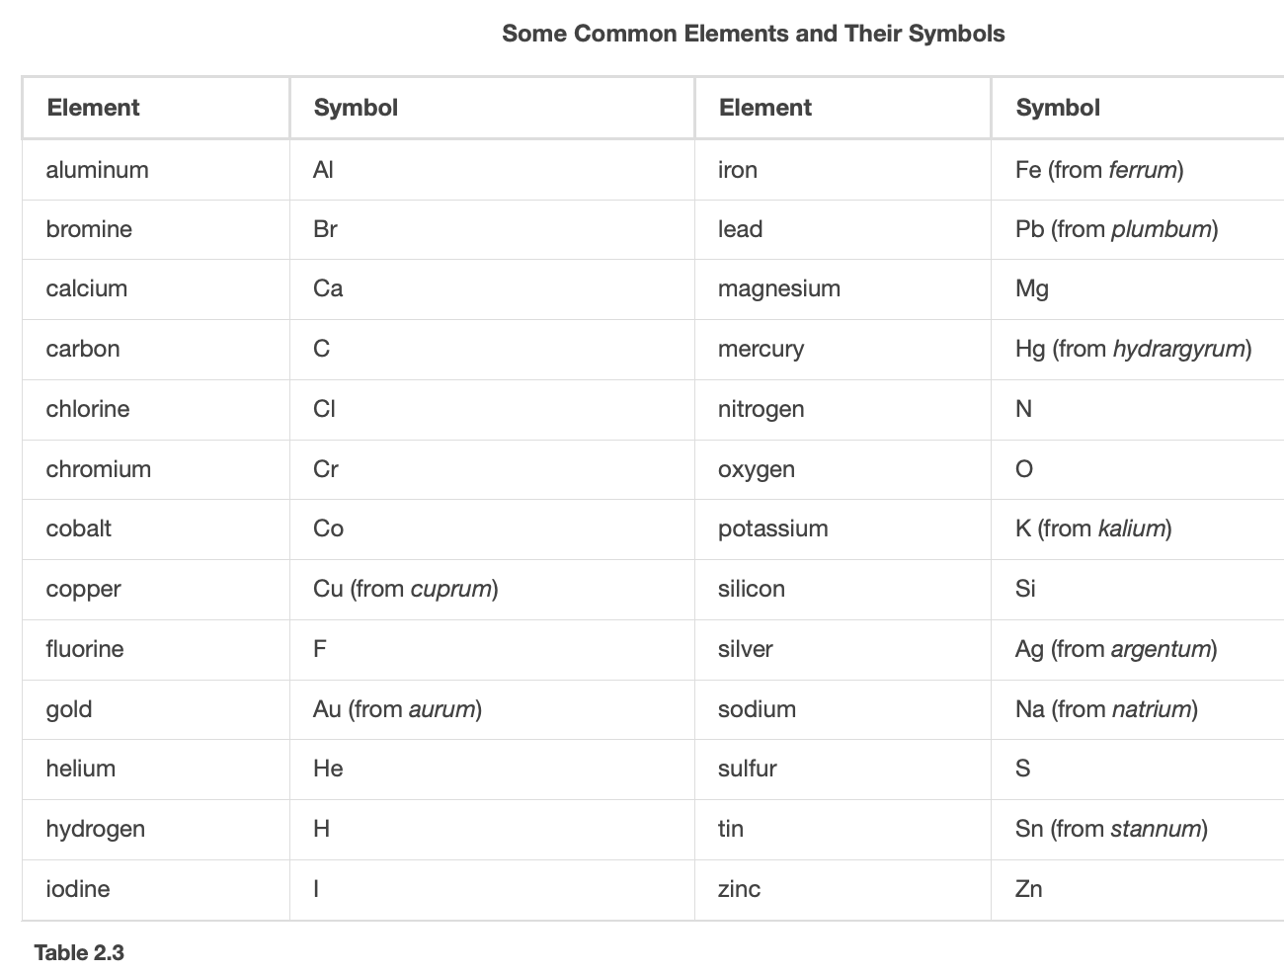
Chemical Symbols
Chemical symbol - 1-3 letter abbreviation for an element
Only the first letter is capitalized
Examples
Image Credit: OpenStax Chemistry - Table 2.3 CC BY 4.0

Slide 8
Isotopes
Isotopes have different numbers of neutrons in the nucleus
Magnesium has isotopes with mass numbers of 24, 25 and 26
These can be written as:
²⁴Mg, ²⁵Mg, ²⁶Mg
Magnesium-24 or Mg-24, etc.
Image Credit: OpenStax Chemistry - Figure 2.14 CC BY 4.0

Slide 9
Atomic Mass
May not be whole numbers because different isotopes exist
Average mass = sum of (fractional abundance x mass of isotope) for each isotope
Example: Boron
$${}^{10}B:19.9\%ofatoms;10.0129amu$$
$${}^{11}B:80.1\%ofatoms;11.0093amu$$
$$AvgMass=(0.199x10.0129amu)+$$
$(0.801x11.0093amu)$
$$AvgMass=1.99amu+8.82amu$$
$$AvgMass=10.81amu$$

Slide 10
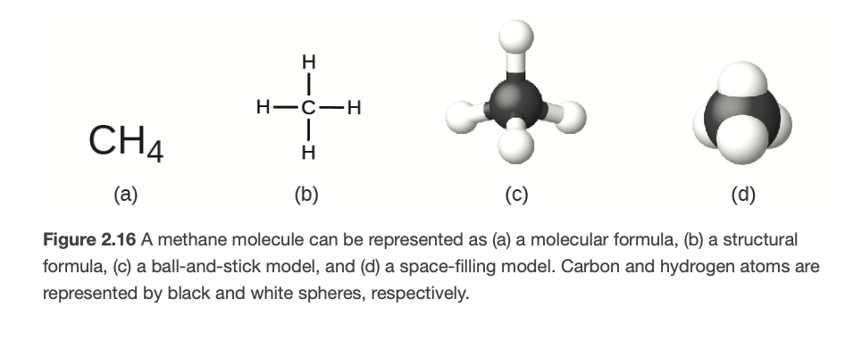
Chemical Formulae
Molecular Formula - uses chemical symbols and numbers
Structural Formula - Shows how atoms are connected
Ball and Stick and Space-filling models - shows the geometric arrangement of the atoms
Image Credit: OpenStax Chemistry - Figure 2.16 CC BY 4.0

Slide 11
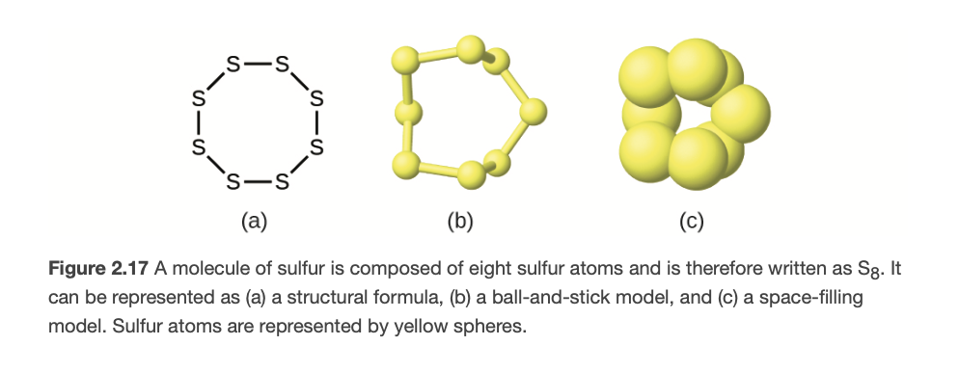
Chemical Formulae
Molecular Formula - uses chemical symbols and numbers
Structural Formula - Shows how atoms are connected
Ball and Stick and Space-filling models - shows the geometric arrangement of the atoms
Image Credit: OpenStax Chemistry - Figure 2.17 CC BY 4.0

Slide 12
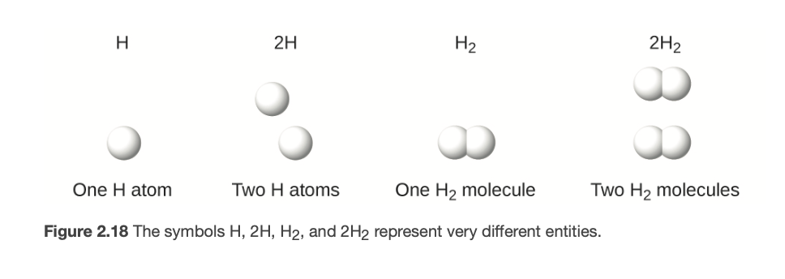
Molecules
The subscript and the number in front of the symbol represent two different things
Subscript - number of atoms bonded together
Number in front - How many of those molecules/atoms
Example - Hydrogen
Image Credit: OpenStax Chemistry - Figure 2.18 CC BY 4.0

Slide 13
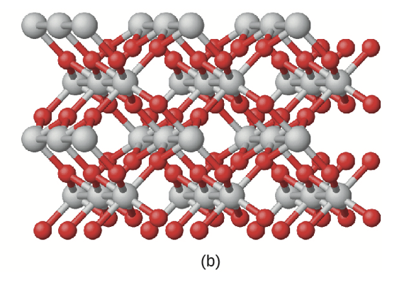
Empirical Formulae
An empirical formula includes information on the types of atoms present and the simplest whole-number ratio of the number of atoms in the compound.
Example: $TiO_{2}$
Differs from a molecular formula which gives the actual numbers of each atom in a molecule
Example: Acetic Acid: $C_{2}H_{4}O_{2}$
Image Credit: OpenStax Chemistry - Figure 2.19b CC BY 4.0

Slide 14
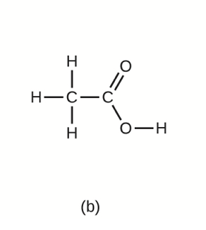
Empirical Formulae
An empirical formula includes information on the types of atoms present and the simplest whole-number ratio of the number of atoms in the compound.
Example: $TiO_{2}$
Differs from a molecular formula which gives the actual numbers of each atom in a molecule
Example: Acetic Acid: $C_{2}H_{4}O_{2}$
$$Molecular:C_{2}H_{4}O_{2}$$
$$Empirical:CH_{2}O$$
Image Credit: OpenStax Chemistry - Figure 2.21b CC BY 4.0

Slide 15
Example
Molecules of glucose contain 6 carbon atoms, 12 hydrogen atoms and 6 oxygen atoms. What are the molecular and empirical formulae for glucose.
$$6C;12H;6O$$
$$Molecular:C_{6}H_{12}O_{6}$$
Ratio of C:H:O = 1:2:1
$$Empirical:CH_{2}O$$

Slide 16
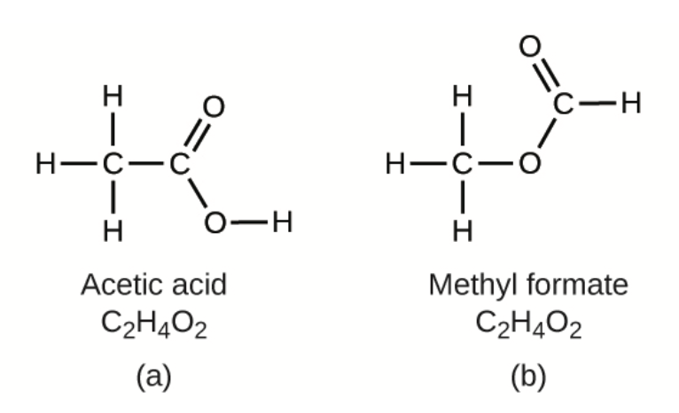
Isomers
Isomers have the same chemical formulae but different chemical structures
Example: $C_{2}H_{4}O_{2}$

Slide 17
Summary
Atoms can be described by the atomic number (Z), mass number (A) and atomic charge
Molecular formulae are used to identify specific elements and differentiate between isotopes. A structural formula will show how the atoms are bonded together
An empirical formula differs from a molecular formula in that it reduces to the simplest whole-number ratio

