Slide 1
Introduction to Physical Science
The Periodic Table
Presented by Robert Wagner

Slide 2
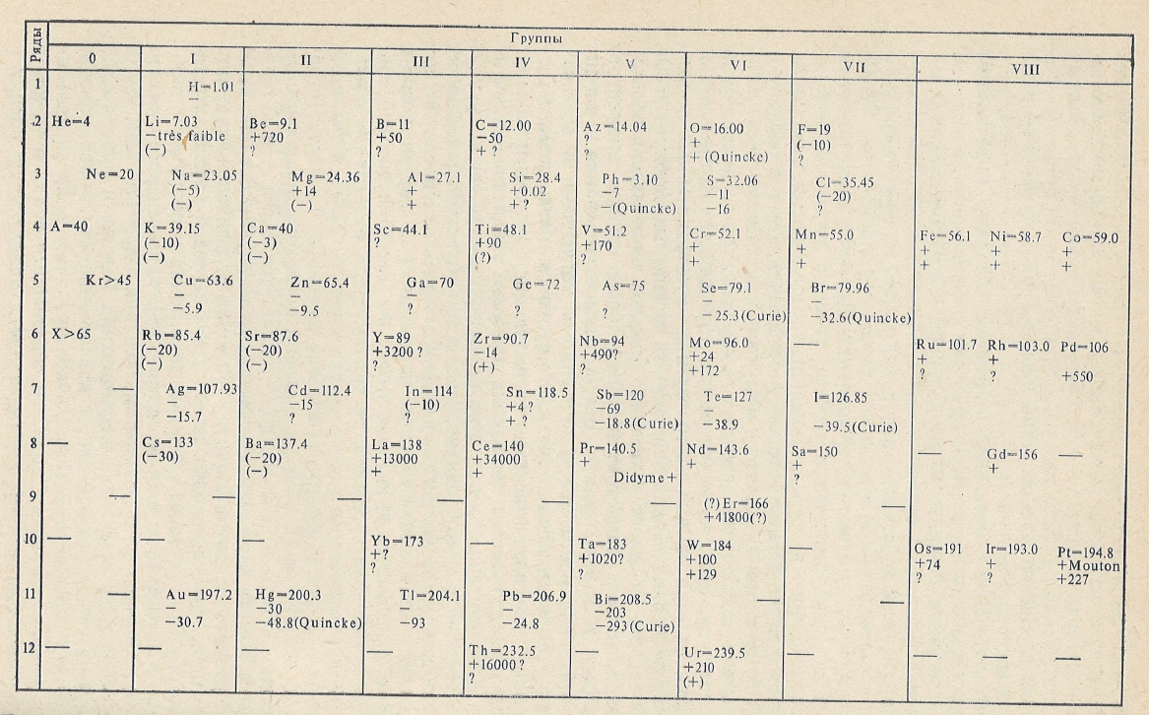
History
As scientists studied elements, they learned that they could be grouped together by their chemical properties
Predicted existence of elements not yet discovered
Image Credit: Nauka, Public domain, via Wikimedia Commons

Slide 3
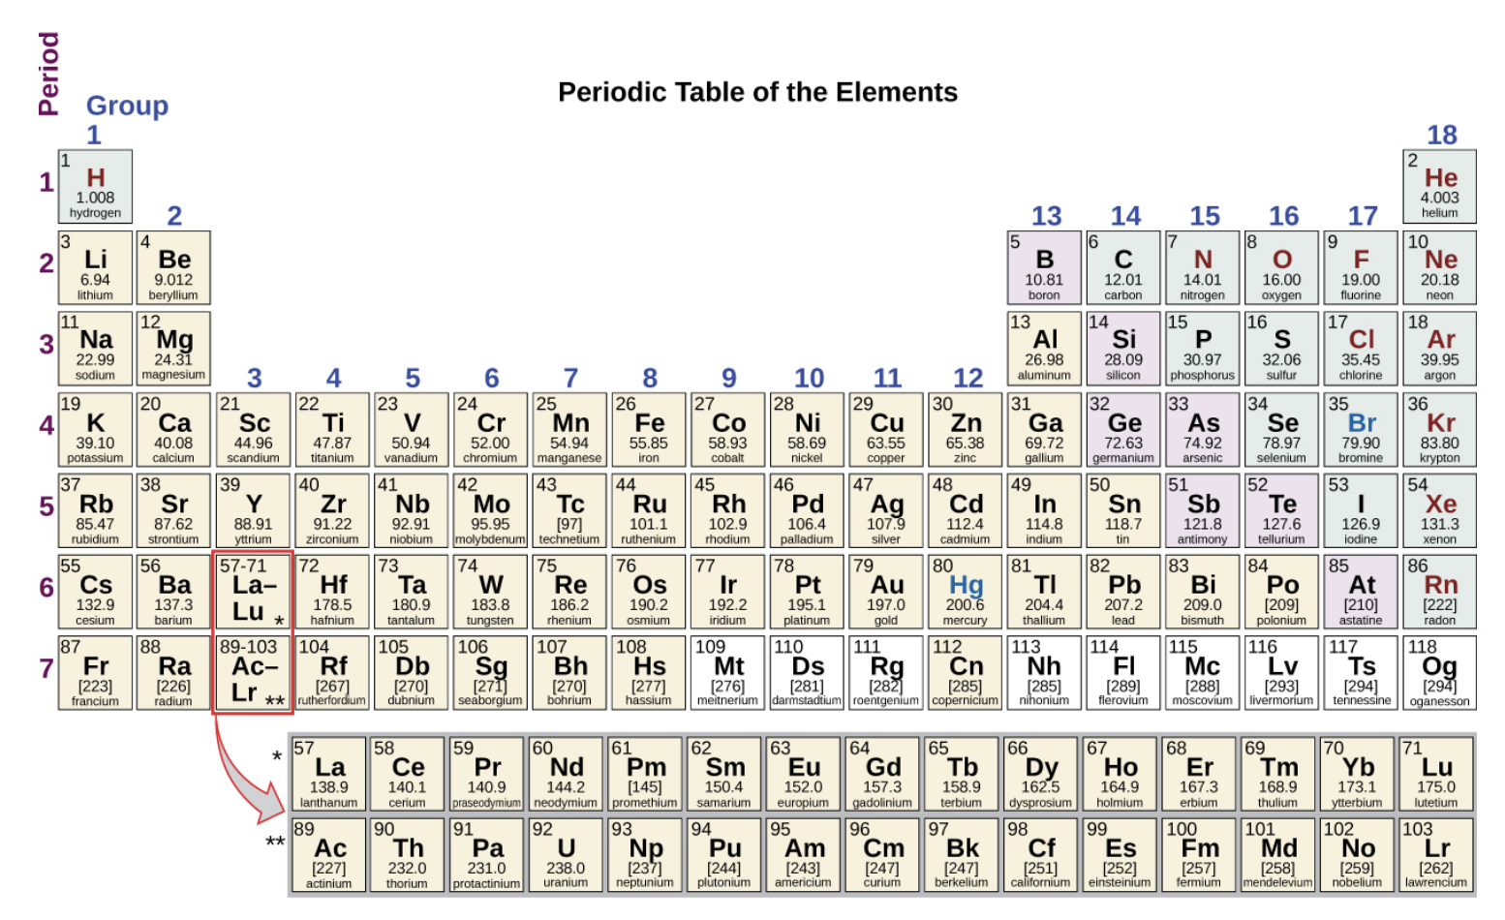
Periodic Table
Periodic Law: The properties of the elements are periodic functions of their atomic numbers
Modern periodic table:
Orders elements by increasing atomic number
Atoms with similar properties are grouped in vertical columns (groups)
Rows are called periods or series
Image Credit: OpenStax Chemistry - Figure 2.26 CC BY 4.0

Slide 4
Periodic Table (2)
Image Credit: OpenStax Chemistry - Figure 2.26 CC BY 4.0

Slide 5
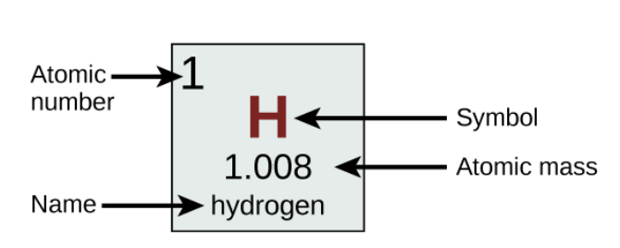
Periodic Table (3)
Each box represents a specific element
Contains information on some of the properties of the element
Image Credit: OpenStax Chemistry - Figure 2.26 (part) CC BY 4.0

Slide 6
Metals, Metalloids and Non-Metals
Metals - shiny, malleable, good conductors of heat and electricity
Non-Metals - dull in appearance, not good conductors of heat and electricity
Metalloids - Have some properties of both metals and non-metals
Image Credit: OpenStax Chemistry - Figure 2.26 CC BY 4.0

Slide 7
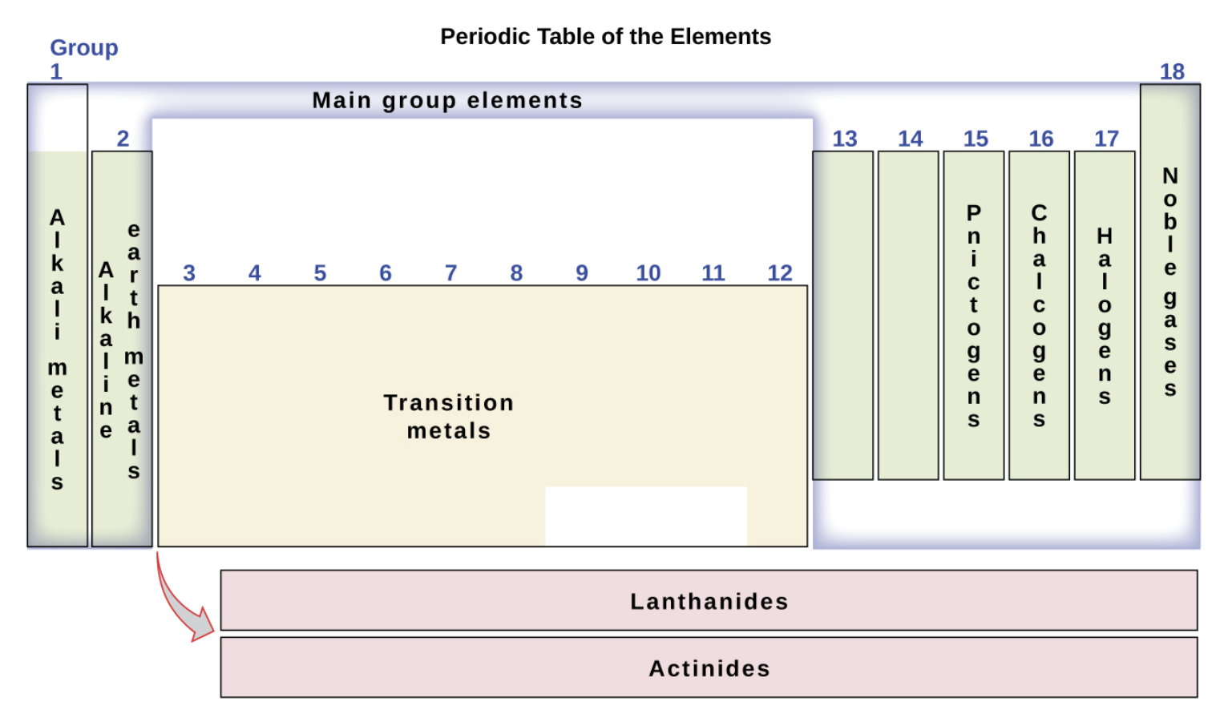
Groupings
Main group elements - Columns 1-2 and 13-18
Transition metals - columns 3-12
Lanthanides & Actinides
Hydrogen - has properties of Group 1 and Group 17 - unique element
Image Credit: OpenStax Chemistry - Figure 2.27 CC BY 4.0

Slide 8
Example
Identify the group name for the following elements:
Chlorine
Calcium
Sodium
Sulfur
Chlorine: Halogen (Group 17)
Calcium: Alkaline Earth Metal (Group 2)
Sodium: Alkali Metal(Group 1)
Sulfur: Chalcogen (Group 16)

Slide 9
More Properties
Why do these properties exist?
We can look at this more when we study how electrons are grouped in the atoms - we will look at this in a future lesson.

Slide 10
Summary
Certain elements were found to have similar chemical properties to other elements
The Periodic Table groups these elements together such that those with similar properties fall in the same columns
Different parts of the periodic table have different properties in terms of metals and non-metals.

