Slide 1
Introduction to Physical Science
Compounds and Nomenclature
Presented by Robert Wagner

Slide 2
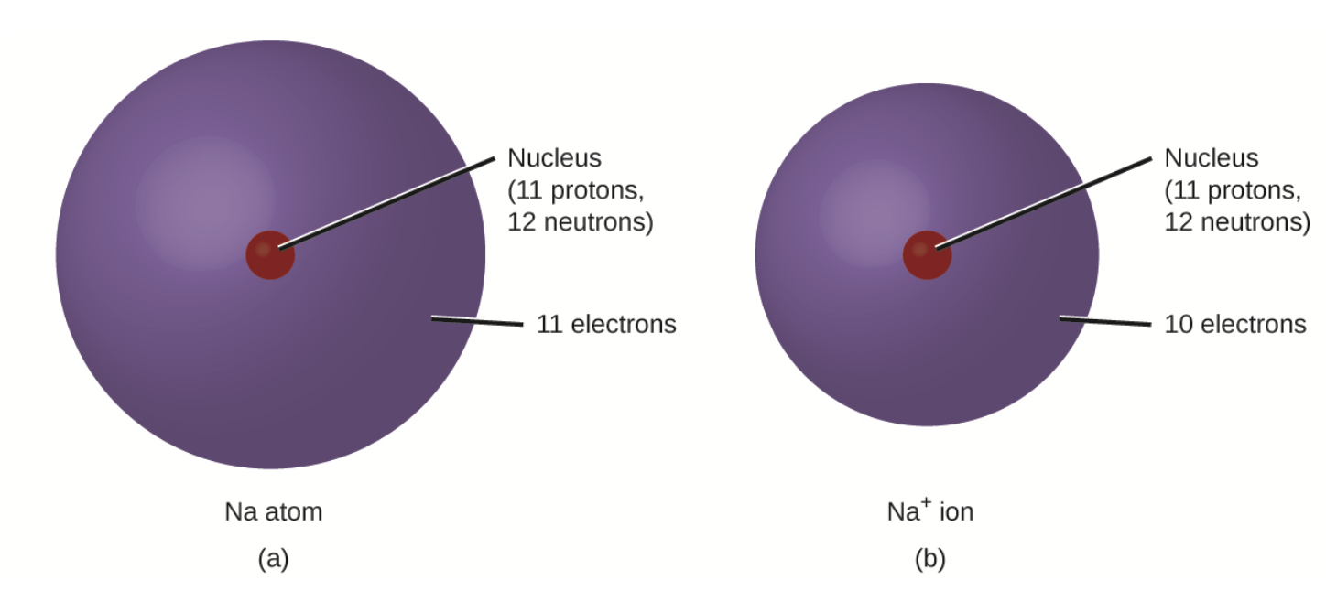
Chemical Reactions
In chemical reactions, the nucleus remains unchanged
Electrons can be added, lost or shared with other atoms
Ions - electrically charged particles formed when atoms either gain or lose electrons.
Image Credit: Nauka, Public domain, via Wikimedia Commons

Slide 3
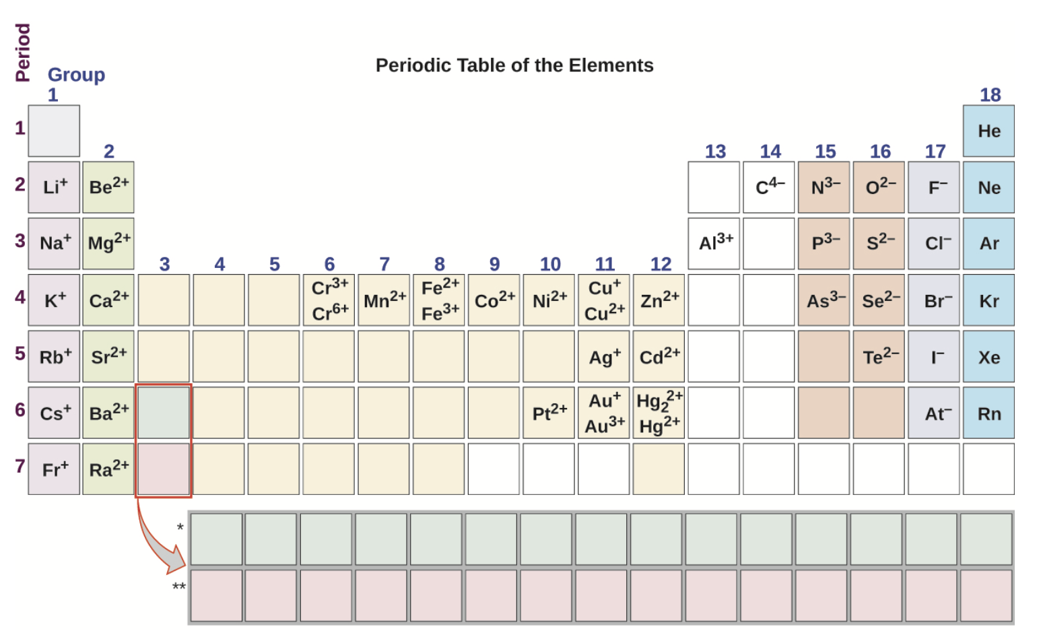
Anions and Cations
Cations - positive charge - lose electrons
Anions - negative charge - gain electrons
Examples
Group 1 - lose 1 electron
Group 2 - lose 2 electrons
Group 17 - gain 1 electron
Image Credit: OpenStax Chemistry - Figure 2.29 CC BY 4.0

Slide 4
Example
An ion found in some compounds used as antiperspirants contains 13 protons and 10 electrons. What is its symbol?
Known: contains 13 protons and 10 electrons
13 protons implies that the atomic number is 13
From the periodic table, this is Aluminum (Al)
Charge: 13 positive and 10 negative means a net charge of 3+
$$Al^{3+}$$

Slide 5
Example
Magnesium and nitrogen react to form an ionic compound. Predict which forms an anion, which forms a cation, and the charges of each ion. Write the symbol for each ion and name them.
Known: Magnesium and nitrogen
Magnesium - group 2 (metal) - form positive ion (cation)
Mg - loses to electrons - charge 2+
$$Mg^{2+}Magnesiumion$$
Nitrogen - group 15 (nonmetal) - form negative ion (anion)
Nitrogen - gains 3 electrons - charge 3-
$$N^{3-}Nitrideion$$

Slide 6
Monatomic & Polyatomic Ions
Monatomic ions - formed from only one atom
Polyatomic ions - electrically charged molecules
Oxyanions - polyatomic ions that contain one or more oxygen atoms

Slide 7
Naming - Prefixes
Suffixes:
-ate and -ite refer to ions containing more or fewer oxygen atoms
Prefixes:
Per- means more oxygen atoms than -ate
Hypo- means fewer oxygen atoms than -ite
Examples:
Perchlorate: $ClO_{4}^{-}$
Chlorate: $ClO_{3}^{-}$
Chlorite: $ClO_{2}^{-}$
Hypochlorite: $ClO^{-}$

Slide 8
Ionic and Covalent Bonds
Ionic bonds - electrons are transferred. Bonded by the electrostatic force
Covalent (molecular) bonds - electrons are shared. Bonded by forces between nuclei and the shared electrons

Slide 9
Ionic Compounds
Generally forms between a nonmetal and a metal.
$$Na^{+}andCl^{-}becomesNaCl$$
$$Ca^{2+}andCl^{-}becomesCaCl_{2}$$
Properties of ionic compounds
Solids
Melt and boil at high temperatures
Molten - conduct electricity

Slide 10
Example
The gemstone sapphire is mostly a compound of aluminum and oxygen that contains aluminum cations, $Al^{3+}$, and oxygen anions, $O^{2-}$. What is the formula of this compound?
$$Compounds:Al^{3+}O^{2-}$$
Need to match positive and negative charges
$2xAl^{3+}=$6 positive charges
$3xO^{2-}=$6 negative charges
$$Al_{2}O_{3}$$

Slide 11
Example
Baking powder contains calcium dihydrogen phosphate, and ionic compound composed of the ions $Ca^{2+}H_{2}PO_{4}^{-}$ What is the formula of this compound?
$$Compounds:Ca^{2+}H_{2}PO_{4}^{-}$$
Need to match positive and negative charges
$1xCa^{2+}=$2 positive charges
$2xH_{2}PO_{4}^{-}=$2 negative charges
$$Ca(H_{2}PO_{4})_{2}$$

Slide 12
Molecular Compounds
Atoms are sharing rather than transferring electrons
Combination of nonmetals
Properties of molecular compounds
Liquids or gases
Melt and boil at low temperatures
Non-conductive

Slide 13
Example
Predict whether the following compounds are ionic or molecular:
$KI$ - the source of iodine in table salt
$H_{2}O_{2}$ - Hydrogen peroxide
$CHCl_{3}$ - Chloroform
$Li_{2}CO_{3}$ - Used in antidepressants
$$Compounds:KI,H_{2}O_{2},CHCl_{3},Li_{2}CO_{3}$$
$KI$: Potassium(K) is a metal, Iodine(I) is a nonmetal - Ionic
$H_{2}O_{2}$: Hydrogen(H) is a nonmetal and Oxygen(O) is a nonmetal - Molecular
$CHCl_{3}$: Carbon(C) is a nonmetal, Hydrogen(H) is a nonmetal, and Chlorine(Cl) is a nonmetal - Molecular
$Li_{2}CO_{3}$: Lithium(Li) is a metal, Carbonate$(CO_{3})$ is a polyatomic ion - Ionic

Slide 14
Naming - Ionic Compounds (Monatomic)
Nomenclature - collection of rules for naming things
Monatomic ions
Name of cation (metal)
Name of anion (nonmetal) using suffix -ide
Image Credit: OpenStax Chemistry - Table 2.7 CC BY 4.0

Slide 15
Naming - Ionic Compounds (Polyatomic)
Monatomic ions
Name of cation
Name of anion
Image Credit: OpenStax Chemistry - Table 2.8 CC BY 4.0

Slide 16
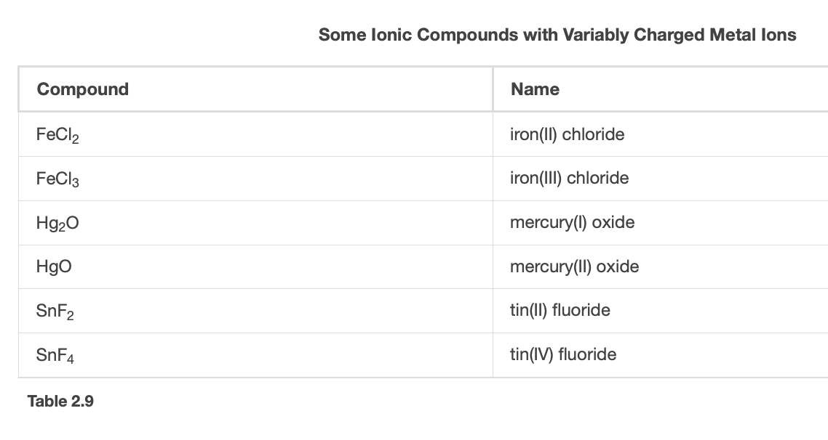
Naming - Metal Ions
Metal ions
Metal ion with charge in parentheses after the metal
Name of anion with -ide suffix
Image Credit: OpenStax Chemistry - Table 2.9 CC BY 4.0

Slide 17
Example
Name the following ionic compounds:
$$Fe_{2}S_{3}$$
$$CuSe$$
$$GaN$$
$$Ti_{2}(SO_{4})_{3}$$
$$Anions:S^{2-},Se^{2-},N^{3-},SO_{4}^{2-}$$
$$Cations:Fe^{3+},Cu^{2+},Ga^{3+},Ti^{3+}$$
Iron(III) Sulfide
2) Copper(II) Selenide
3) Gallium(III) Nitride
4) Titanium(III) Sulfate

Slide 18
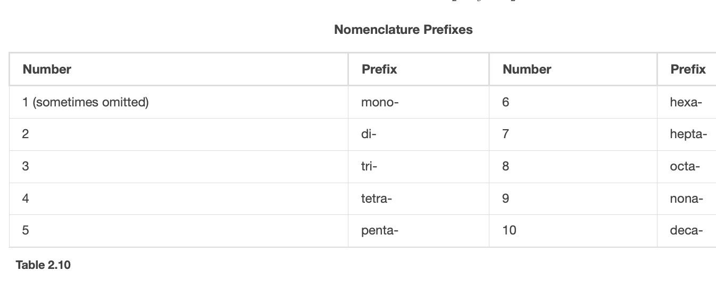
Molecular (Covalent) Compounds
Different ratios are possible ($COCO_{2}$)
Use prefixes to specify the number of atoms of each element
Mono- is not included if the first element has only one atom
Image Credit: OpenStax Chemistry - Table 2.10 CC BY 4.0

Slide 19
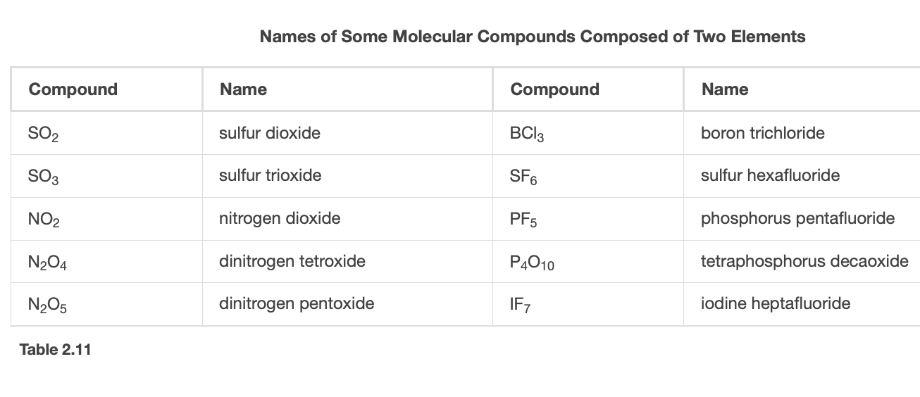
Molecular (Covalent) Compounds
Different ratios are possible ($COCO_{2}$)
Use prefixes to specify the number of atoms of each element
Mono- is not included if the first element has only one atom
Exceptions $N_{2}O$ (Nitrous oxide)
Image Credit: OpenStax Chemistry - Table 2.11 CC BY 4.0

Slide 20
Example
Name the following ionic compounds:
$$SF_{6}$$
$$N_{2}O_{3}$$
$$Cl_{2}O_{7}$$
$$P_{4}O_{6}$$
1) Sulfur Hexafluoride
2) Dinitrogen Trioxide
3) Dichlorine Heptoxide
4) Tetraphosphorus Hexoxide

Slide 21
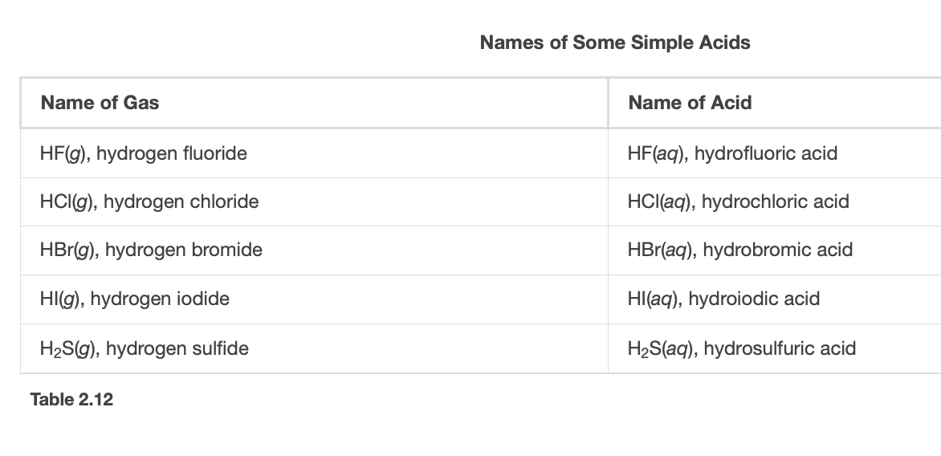
Binary Acids
Consists of hydrogen and one nonmetallic element
Hydrogen is changed to hydro-
The nonmetallic element name adds the -ic suffix
The word acid is added
Image Credit: OpenStax Chemistry - Table 2.12 CC BY 4.0

Slide 22
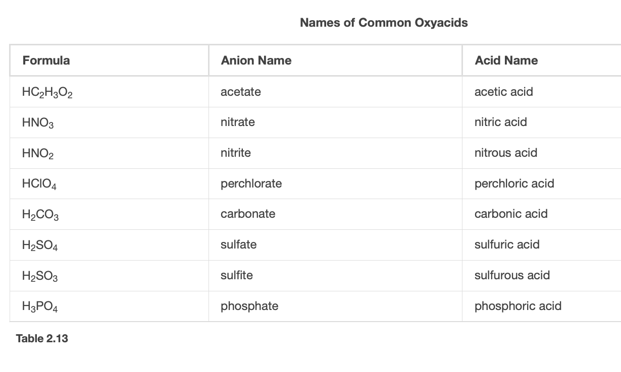
Oxyacids
Contain hydrogen, oxygen and at least one other element
Omit hydrogen
Start with root name of anion
Replace -ate with -ic or -ite with -ous
Add “acid”
Image Credit: OpenStax Chemistry - Table 2.13 CC BY 4.0

Slide 23
Summary
Ionic compounds are formed when electrons are transferred between atoms
Molecular (covalent) compounds are formed when electrons are shared between atoms
Naming conventions for compounds vary depending on the specific types of bonds and the compounds

