Slide 1
Introduction to Physical Science
Classifying Chemical Reactions
Presented by Robert Wagner

Slide 2
Types of Chemical Reactions
Precipitation Reaction
Dissolved substances react to form solids
Acid-Base Reaction
The hydrogen ion ($H^{+}$) is transferred from one chemical species to another
Oxidation-Reduction Reaction
Reaction involving transfer of electrons

Slide 3
Precipitation Reactions
Solubility
Maximum concentration of a substance that can be achieved
Soluble
A substance that has a high solubility
Insoluble
A substance with a low solubility
Precipitate
Occurs when the concentration exceeds the solubility

Slide 4
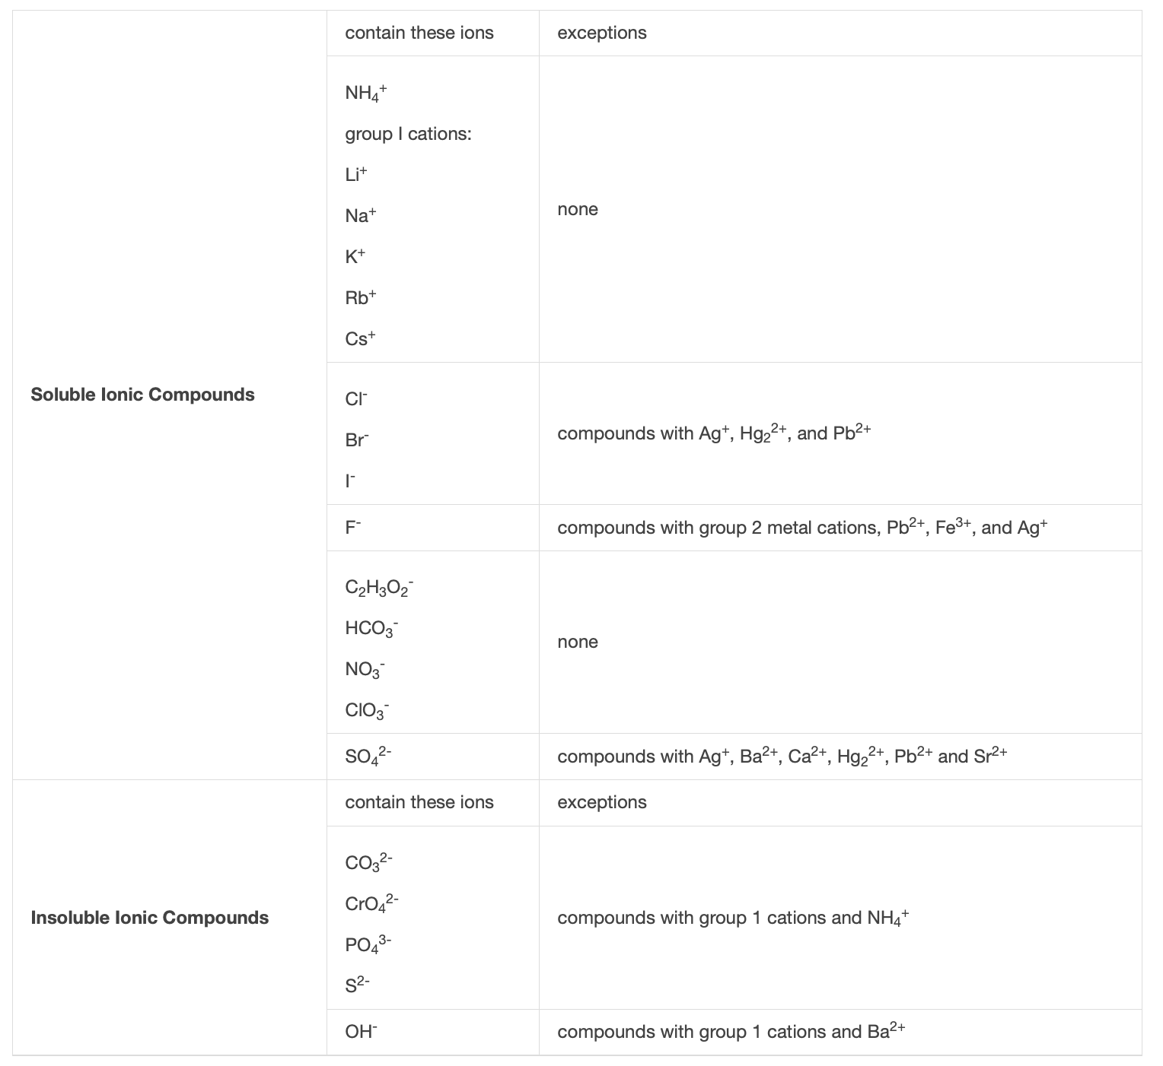
Solubility Table
Soluble compounds are less likely to precipitate than insoluble compounds
Image Credit: OpenStax Chemistry - Table 4.1 CC BY 4.0

Slide 5
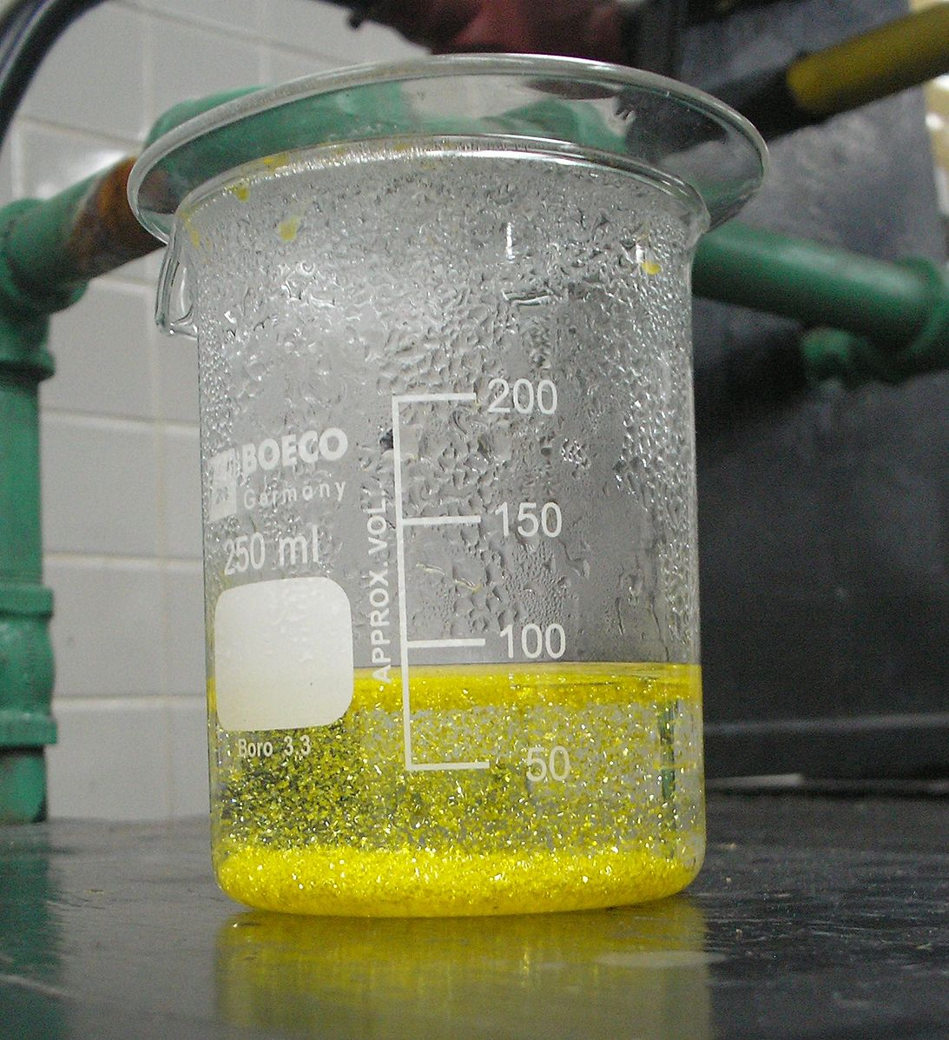
Example
Mixture of potassium iodide ($KI$) and lead Nitrate ($Pb(NO_{3})_{2}$)
$$2KI(aq)+Pb(NO_{3})_{2}(aq)⟶PbI_{2}(s)+2KNO_{3}(aq)$$
Net Equation:
$$Pb^{2+}(aq)+2I^{-}(aq)⟶PbI_{2}(s)$$
Image Credit: Der Kreole, CC BY 3.0 <https://creativecommons.org/licenses/by/3.0>, via Wikimedia Commons

Slide 6
Example
Mixing silver nitrate ($AgNO_{3}$) and sodium fluoride ($NaF$)
Ions Formed:
$$Ag^{+};NO_{3}^{-};Na^{+};F^{-}$$
Other compounds that can form:
$$NaNO_{3}AgF$$
Review solubility guidelines
$$NaF(aq)+AgNO_{3}(aq)⟶AgF(s)+NaNO_{3}(aq)$$
Or,
$$Ag^{+}(aq)+F^{-}(aq)⟶AgF(s)$$

Slide 7
Examples
Determine the precipitate for each of the following reactions. Write the net ionic equation
Potassium Sulfate & Barium Nitrate
Lithium Chloride & Silver Acetate
$$K_{2}SO_{4}+Ba(NO_{3})_{2}⟶2KNO_{3}+BaSO_{4}$$
$$BaSO_{4}isinsoluble$$
$$Ba^{2+}(aq)+SO_{4}^{2-}(aq)⟶BaSO_{4}(s)$$
$$LiCl+AgC_{2}H_{3}O_{2}⟶AgCl+LiC_{2}H_{3}O_{2}$$
$$AgClisinsoluble$$
$$Ag^{+}(aq)+Cl^{-}(aq)⟶AgCl(s)$$

Slide 8
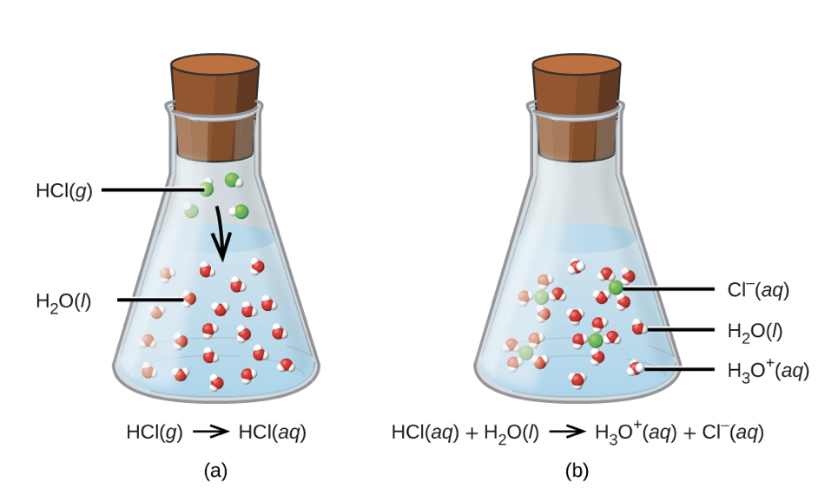
Acid-Base Reactions
In these reactions, a hydrogen ion is transferred
An acid is a substance that will give hydronium ions ($H_{3}O^{+}$) when dissolved in water
Example:
$$HCl(aq)+H_{2}O(aq)⟶Cl^{-}(aq)+H_{3}O^{+}(aq)$$
Strong acid - All of the compound dissociates
Weak acid - only some of the compound dissociates
Image Credit: OpenStax Chemistry - Figure 4.5 CC BY 4.0

Slide 9
Acid-Base Reactions
In these reactions, a hydrogen ion is transferred
A base is a substance that yields hydroxide ions ($OH^{-}$) when dissolved in water
Example:
$$NaOH(aq)⟶Na^{+}(aq)+OH^{-}(aq)$$
Strong base - All of the compound dissociates
Weak base - only some of the compound dissociates
Ex: $NH_{3}(aq)+H_{2}O(l)⇌NH_{4}^{+}(aq)+OH^{-}(aq)$

Slide 10
Neutralization Reaction
An acid and a base react together to produce a salt and water
$$acid+base⟶salt+water$$
Example:
$$Mg(OH)_{2}(s)+2HCl(aq)⟶MgCl_{2}(aq)+2H_{2}O(l)$$
Salt - magnesium chloride

Slide 11
Example
$$HOCl(aq)+H_{2}O(l)⇌?$$
$$HOCl(aq)+H_{2}O(l)⇋OCl^{-}(aq)+H_{3}O^{+}$$
$$Ba(OH)_{2}(aq)+HNO_{3}(aq)⟶?$$
$$Ba(OH)_{2}(aq)+2HNO_{3}(aq)⟶Ba(NO_{3})_{2}(aq)+2H_{2}O(l)$$
Write balanced equations for the acid-base reactions described:
Weak acid hydrogen hypochlorite reacts with water
A solution of barium hydroxide is neutralized with a solution of nitric acid

Slide 12
Oxidation-Reduction Reactions
Oxidation-reduction reactions (redox)
Oxidation - loss of electrons
Reduction - gain of electrons
Reducing agent - species that is oxidized
Oxidizing agent - species that is reduced

Slide 13
Oxidation Number
Oxidation number or oxidation state:
Oxidation number of an atom in an elemental substance is zero
Oxidation number of a monatomic ion is equal to the ion’s charge
Oxidation numbers for common non-metals
Hydrogen: +1 when combined with nonmetals, -1 when combined with metals
Oxygen: -2 in most compounds
Halogens: -1 for Fluorine (always) Generally -1 for other halogens
Sum of oxidation numbers in a molecule is equal to the charge on the molecule or ion

Slide 14
Example
$H_{2}S$: H has oxidation number of +1
Charge on $H_{2}S$ = 0
2 hydrogens: oxidation of +2
0 = +2 + ? ; Oxidation of S must be -2
$SO_{3}^{2-}$: O has an oxidation number of -2
Charge on $SO_{3}^{2-}$ is -2
-2 = -2(3) + ?
-2 = -6 + ?
Oxidation of S must be +4
Assign oxidation numbers to the following:
$$H_{2}S$$
$$SO_{3}^{2-}$$

Slide 15
Summary
Three types of reactions: Precipitation, Acid-Base, & Oxidation-Reduction
The solubility of a substance tells how much of it can remain dissolved under specific circumstances
Acids give hydronium ions in water ; bases give hydroxide ions
Oxidation is a loss of electrons while reduction is a gaining of electrons

