Slide 1
Introduction to Physical Science
Quantization & The Bohr Model
Presented by Robert Wagner

Slide 2
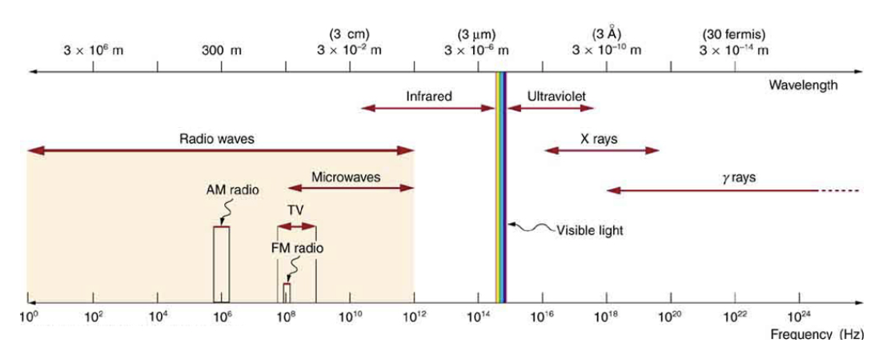
Electromagnetic Waves
Travel at the speed of light:
$$c=2.998x{10}^{8}m/s$$
Electromagnetic spectrum
Range of energies
Blackbody radiation
Ideal emitter - emits radiation at all frequencies based on its temperature
Image Credit: OpenStax College Physics - Figure 24.9 CC BY 4.0

Slide 3
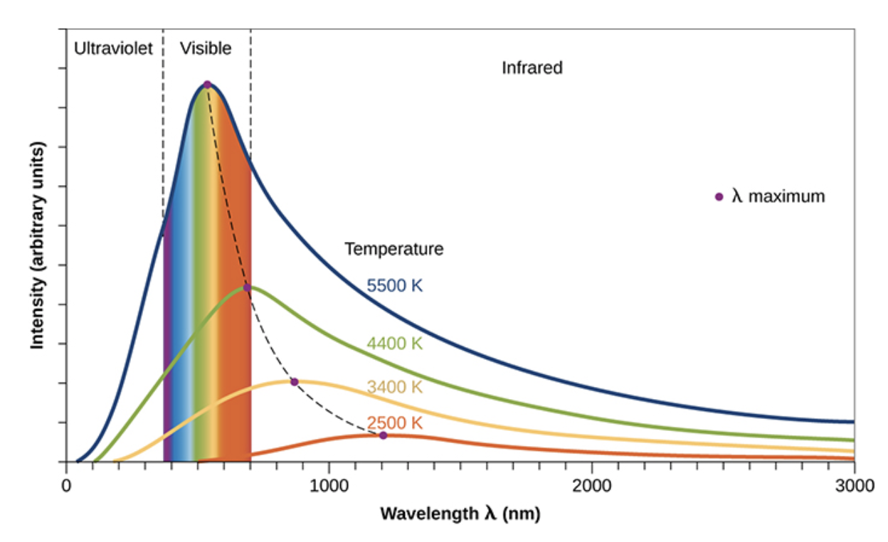
Electromagnetic Waves
Travel at the speed of light:
$$c=2.998x{10}^{8}m/s$$
Electromagnetic spectrum
Range of energies
Blackbody radiation
Ideal emitter - emits radiation at all frequencies based on its temperature
Image Credit: OpenStax Chemistry - Figure 6.10 CC BY 4.0

Slide 4
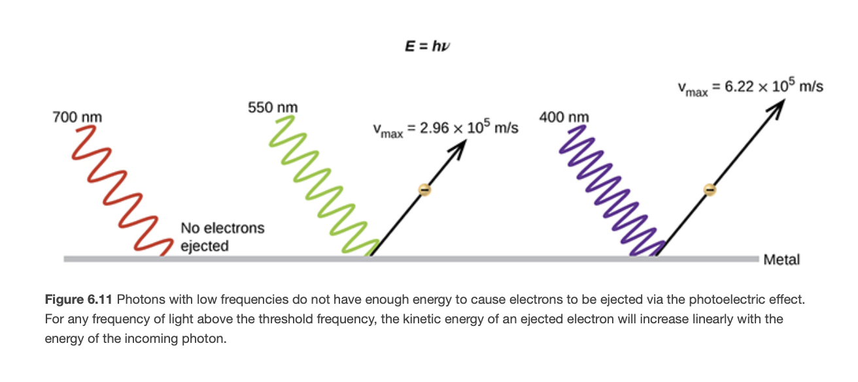
Photoelectric Effect
Dual nature of light
Acts as a particle or a wave depending on the circumstances
Photoelectric effect - Einstein
Electrons are ejected only when photons of the minimum required energy strike the surface
Image Credit: OpenStax Chemistry - Figure 6.11 CC BY 4.0

Slide 5
Example
Light from a neon sign has radiation with a wavelength of 640 nm. What is the energy of the photon emitted?
$$λ=640nm$$
$$E=hν=\frac{hc}{λ}$$
$$E=\frac{(6.626x{10}^{-34}J⋅s)(2.998x{10}^{8}m/s)}{(640nm)(\frac{1m}{{10}^{9}nm})}$$
$$E=3.10x{10}^{-19}J$$

Slide 6
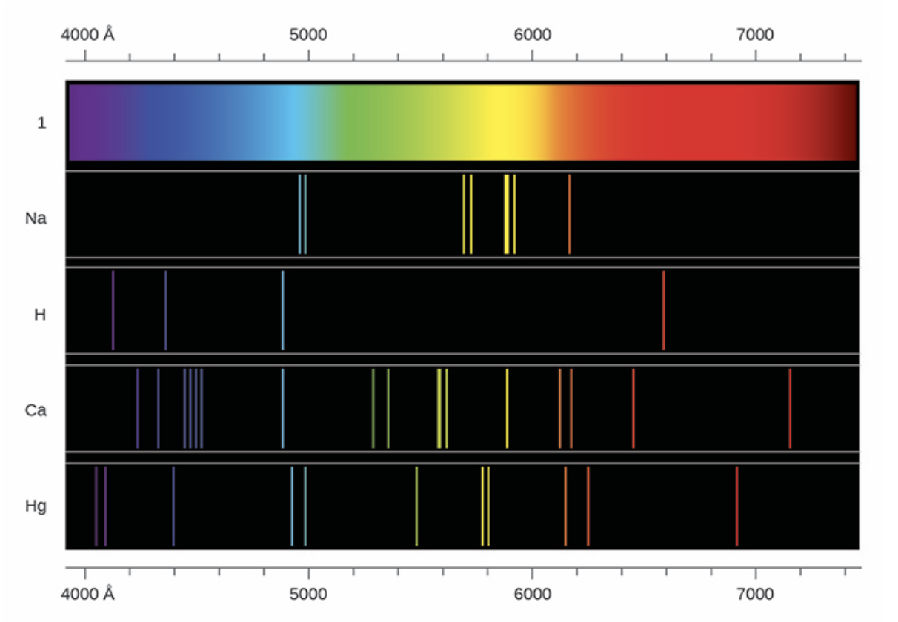
Line Spectra
Energy only given off at specific wavelengths
Pattern of lines is different for each specific type of atom
Hydrogen - Balmer lines in visible spectrum. Followed a pattern based on whole integers
Image Credit: OpenStax Chemistry - Figure 6.13 CC BY 4.0

Slide 7
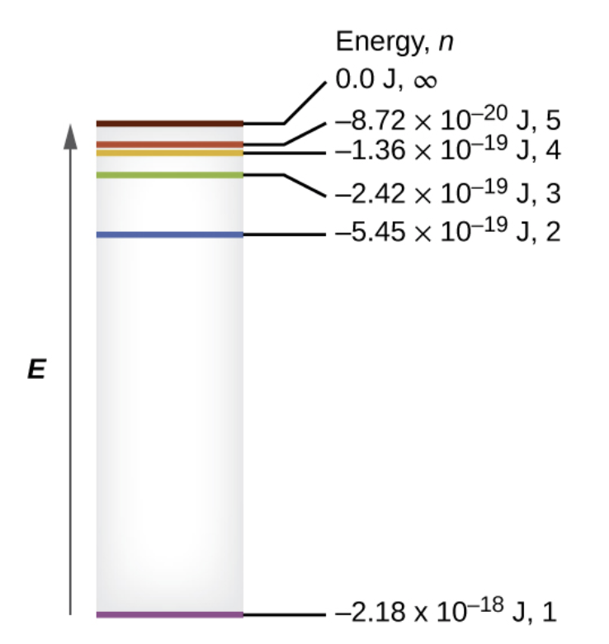
Bohr Model
Previous examples - ideas of quantization
Theories that worked well in macroscopic domain did not work in the microscopic world of atoms
Specific discrete energy levels.
Bohr model for single electron atoms
$$E_{n}=-\frac{kZ^{2}}{n^{2}}$$
$$k=2.179x{10}^{-18}J$$
Image Credit: OpenStax Chemistry - Figure 6.14 CC BY 4.0

Slide 8
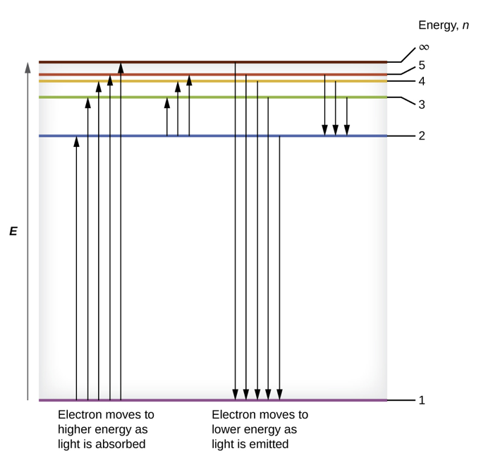
Bohr Model
Previous examples - ideas of quantization
Theories that worked well in macroscopic domain did not work in the microscopic world of atoms
Specific discrete energy levels.
Bohr model for single electron atoms
$$E_{n}=-\frac{kZ^{2}}{n^{2}}$$
$$k=2.179x{10}^{-18}J$$
Image Credit: OpenStax Chemistry - Figure 6.15 CC BY 4.0

Slide 9
Example
If a spark promotes an electron in a hydrogen atom into an orbit with n=3, what is the energy in joules of the electron?
$$n=3$$
$$E=-\frac{kZ^{2}}{n^{2}}$$
$$E=-\frac{(2.179x{10}^{-18}J)(1)^{2}}{(3)^{2}}$$
$$E=-2.421x{10}^{-19}J$$

Slide 10
Bohr Model - Summary
The energies of electrons in an atom are quantized and described by quantum numbers.
Quantum numbers - integer numbers with specific allowed values
An electron’s energy increases with increasing distance from the nucleus
The discrete lines in the spectra of the elements result from the quantized energies of the electrons

Slide 11
Summary
The photoelectric effect and the line spectra are examples that lead to the understanding of quantization
The Bohr model explain the energy levels in a single electron atom
Quantum numbers describe the specific states for electron energies

