Slide 1
Introduction to Physical Science
Quantum Theory
Presented by Robert Wagner

Slide 2
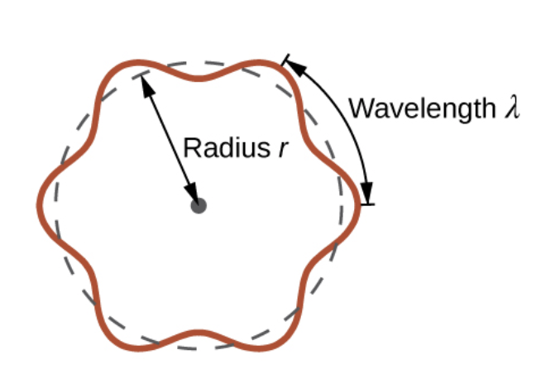
Wave Nature of Particles
Macroscopic particle has a well-defined momentum (p = mv)
Microscopic world - follow different rules than those for macroscopic objects
Light behaves like a particle ; Can an electron behave like a wave
de Broglie wavelength - electron behaves like a wave
$$λ=\frac{h}{mv}=\frac{h}{p}$$
$$2πr=nλ,n=1,2,3,...$$
Image Credit: OpenStax College Physics - Figure 6.17 CC BY 4.0

Slide 3
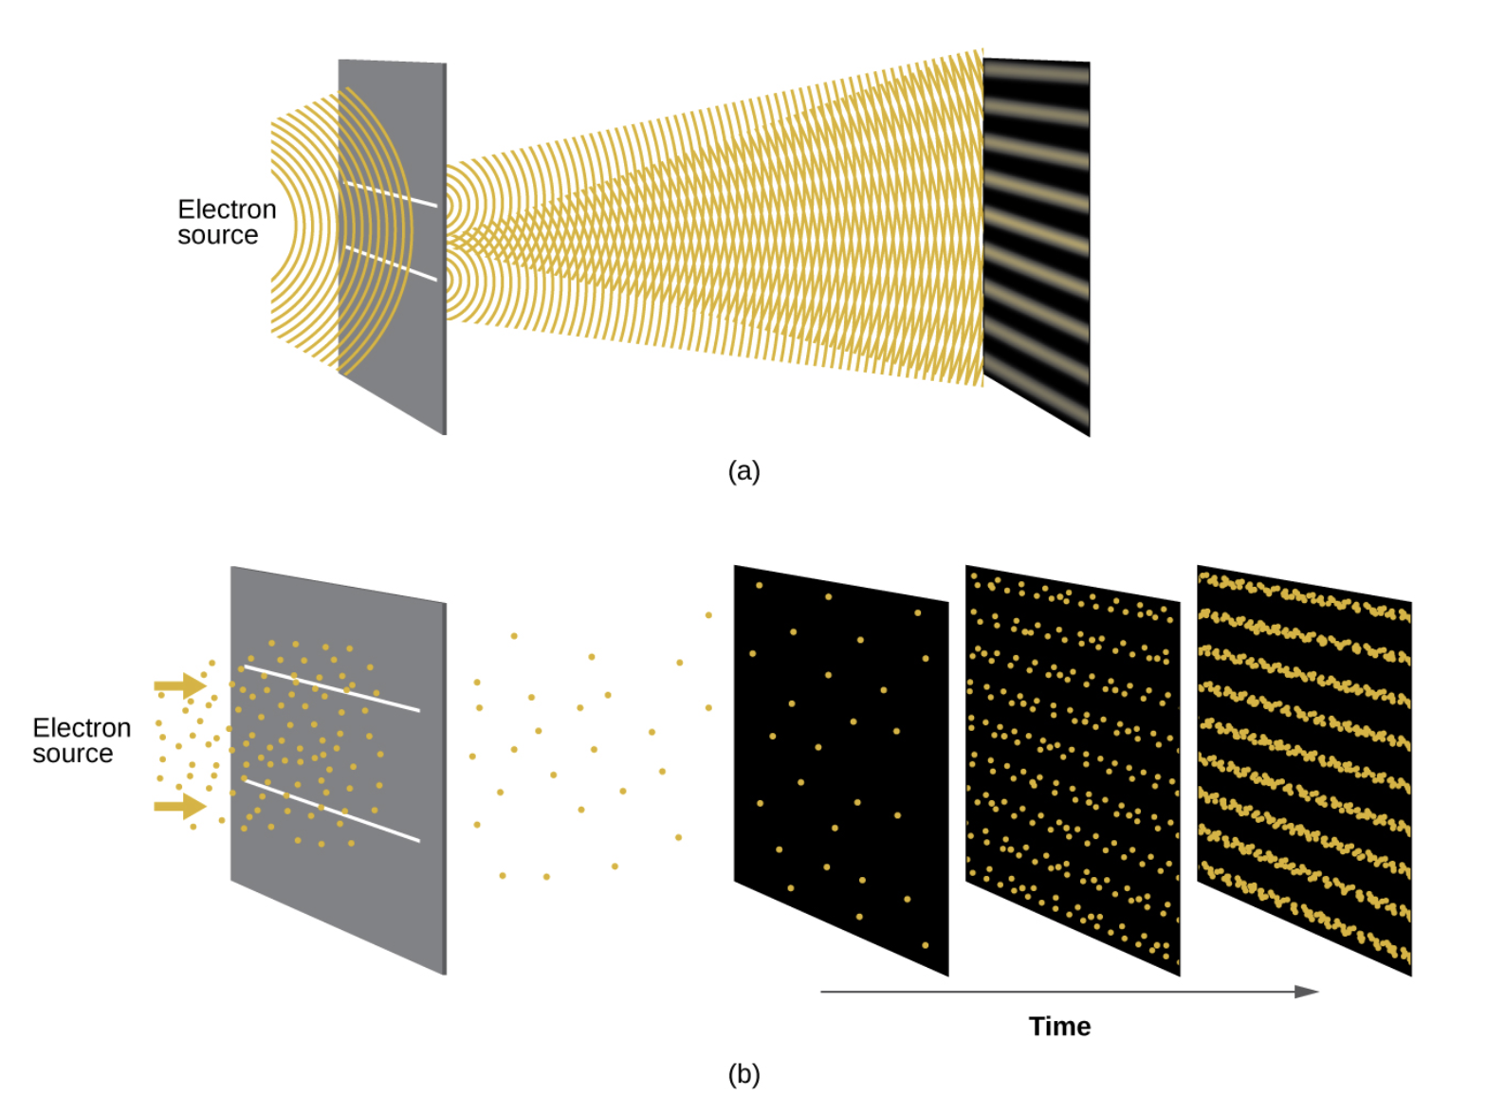
Electrons as Waves
Electrons sent through slits create an interference pattern
Electrons have a dual nature
Image Credit: OpenStax Chemistry - Figure 6.18 CC BY 4.0

Slide 4
Example
If an electron travels at a velocity of $1.000x{10}^{7}m/s$ and has a mass of $9.109x{10}^{-28}g$, what is its wavelength?
$$v=1.000x{10}^{7}m/s;m=9.109x{10}^{-28}g$$
$$λ=\frac{h}{mv}$$
$$λ=\frac{6.626x{10}^{-34}kg⋅m^{2}/s}{(9.109x{10}^{-31}kg)(1.00x{10}^{7}m/s)}$$
$$λ=7.274x{10}^{-11}m$$

Slide 5
Heisenberg Uncertainty Principle
How accurately can we measure the properties of an electron (or other particle)?
A limit to how accurately we can measure the position and momentum of an electron simultaneously.
$$\frac{ℏ}{2}=Δx⋅Δp$$
Not significant for macroscopic objects
Gives and ultimate limit on what can be known in science

Slide 6
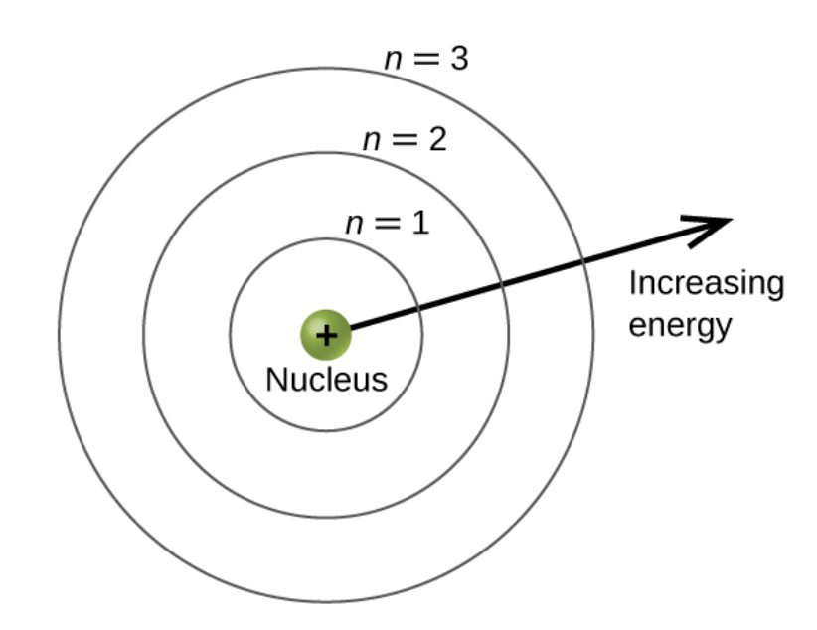
Principal Quantum Number
Principal quantum number (shell number)
Location of energy level
Energy levels n = 1,2,3,…
Secondary quantum number (angular momentum)
Levels: l = 0,1,2,…,n-1
Orbitals: l = 0 are s orbitals ; l = 1 are p orbitals ; l = 2 are d orbitals ; f, g, & h for l = 3,4,&5
Image Credit: OpenStax Chemistry - Figure 6.19 CC BY 4.0

Slide 7
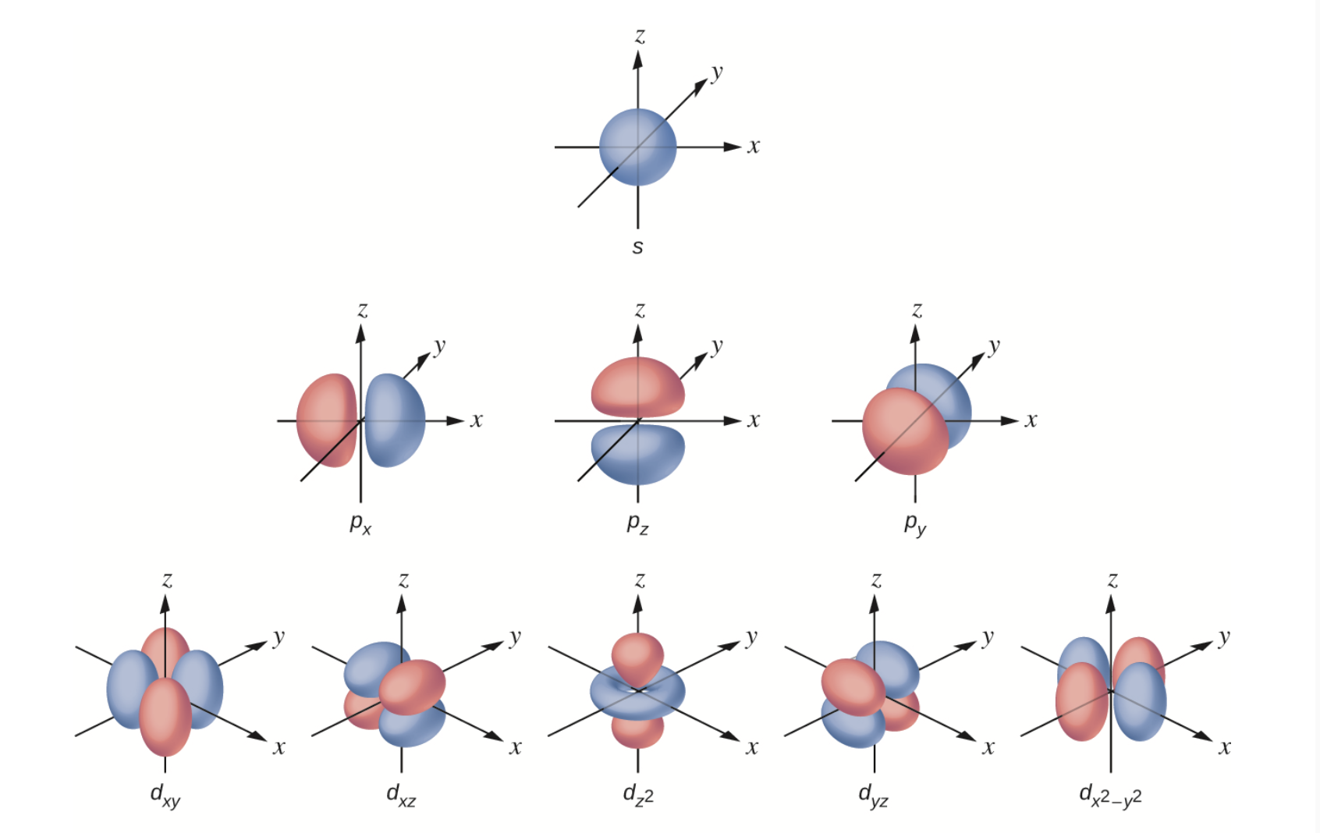
Quantum Numbers
Principal quantum number (shell number)
Location of energy level
Energy levels n = 1,2,3,…
Secondary quantum number (angular momentum)
Levels: l = 0,1,2,…,n-1
Orbitals: l = 0 are s orbitals ; l = 1 are p orbitals ; l = 2 are d orbitals ; f, g, & h for l = 3,4,&5
Image Credit: OpenStax Chemistry - Figure 21 (part) CC BY 4.0

Slide 8
Quantum Numbers (2)
Magnetic quantum number
Spatial orientation of the orbital
Number of orbitals: 2l+1
Principal quantum number: General value of electron energy
Secondary quantum number: Shape of the orbital
Magnetic quantum number: Orientation of orbital in space
Image Credit: OpenStax Chemistry - Figure 21 (part) CC BY 4.0

Slide 9
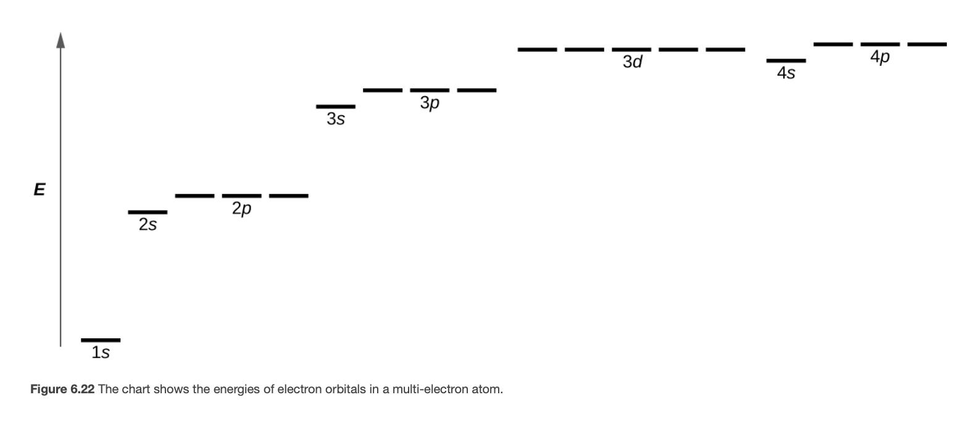
Orbital Energies
Orbital is labeled by its principal quantum number and secondary quantum number
Spin quantum number
Electron can have spin “up” or spin “down”
Image Credit: OpenStax Chemistry - Figure 6.22 CC BY 4.0

Slide 10
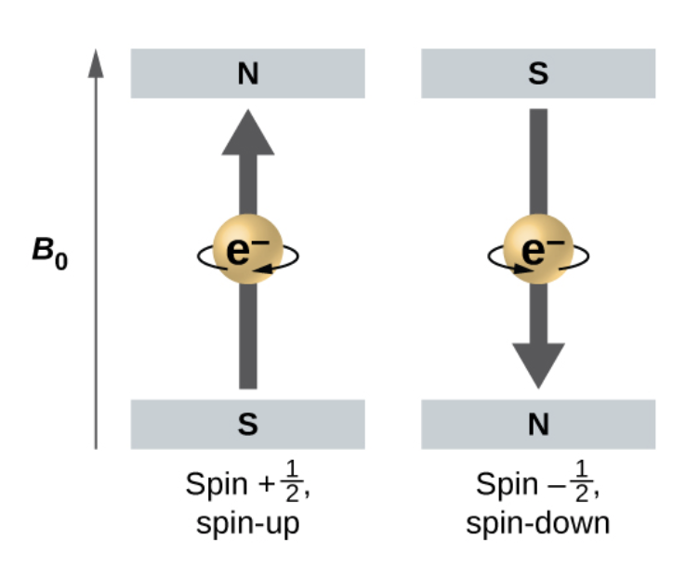
Orbital Energies
Orbital is labeled by its principal quantum number and secondary quantum number
Spin quantum number
Electron can have spin “up” or spin “down”
Image Credit: OpenStax Chemistry - Figure 6.23 CC BY 4.0

Slide 11
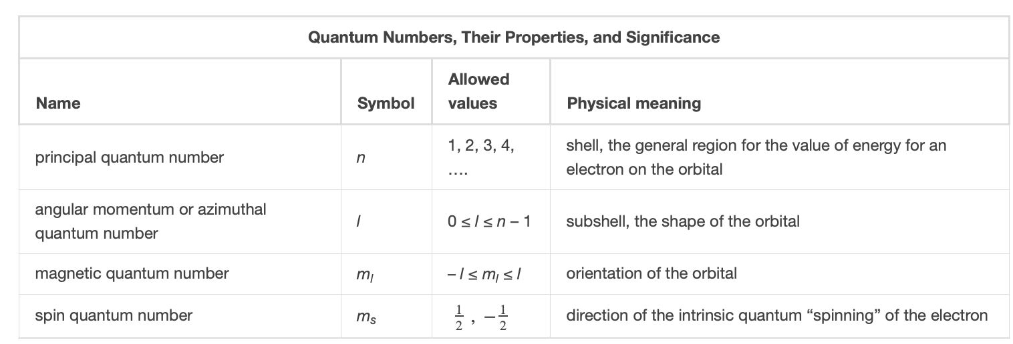
Pauli Exclusion Principle
The electron is described by the four quantum numbers.
Exclusion principle
No two electrons in an atom can have the same set of quantum numbers
At most two electrons can occupy each orbital
Image Credit: OpenStax Chemistry - Table 6.1 CC BY 4.0

Slide 12
Example
How many electrons can occupy a shell with n=2? n=5?
$$n=2;n=5$$
n = 2 has four orbitals: one 2s orbital and 3 2p orbitals. Two electrons per orbital means 8 electrons.
n = 5 has 25 orbitals: one 5s orbits, three 5p orbitals, five 5d orbitals, seven 5f orbitals, nine 5g orbitals. Two electrons per orbital means 50 electrons in the shell.

Slide 13
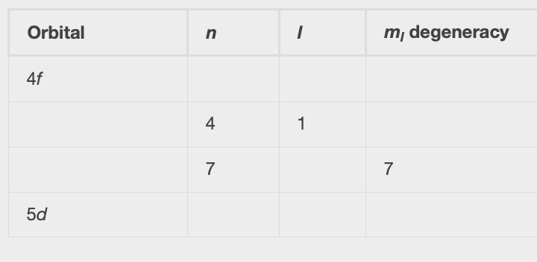
Example
Complete the table for atomic orbitals.
n = primary quantum number
l = secondary quantum number (s,p,d,f,…)
m_{l}=2l+1
Image Credit: OpenStax Chemistry - Example 6.9 CC BY 4.0

Slide 14
Summary
Electrons (and other particles) have been found to behave like waves much as light can behave like a particle
The uncertainty principle limits how accurately we can know the position and momentum of a particle simultaneously
Four quantum numbers specify the state of an electron within an atom

