Slide 1
Introduction to Physical Science
Electron Configurations
Presented by Robert Wagner

Slide 2
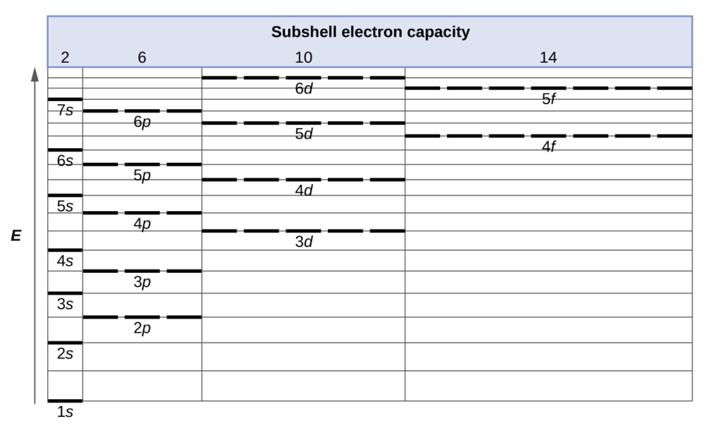
Orbital Energies
In general, energy of orbital increase as the principal quantum number increases
Secondary quantum numbers:
s < p < d < f
Pattern does not hold for larger atoms:
3d is higher energy than 4s
4s will fill first
Image Credit: OpenStax College Physics - Figure 6.24 CC BY 4.0

Slide 3
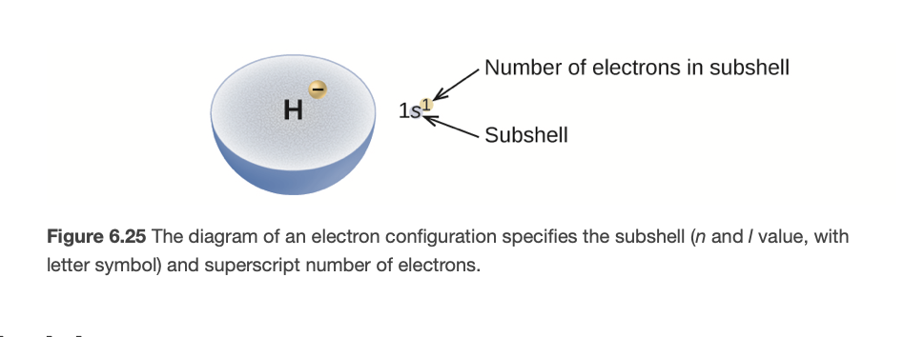
Electron Configuration
The electron configuration of an atom is described with a symbol that contains three pieces of information
The number of the principal quantum shell, n
The letter that designates the orbital type, l
A superscript that designates the number of electrons that particular subshell
Image Credit: OpenStax Chemistry - Figure 6.25 CC BY 4.0

Slide 4
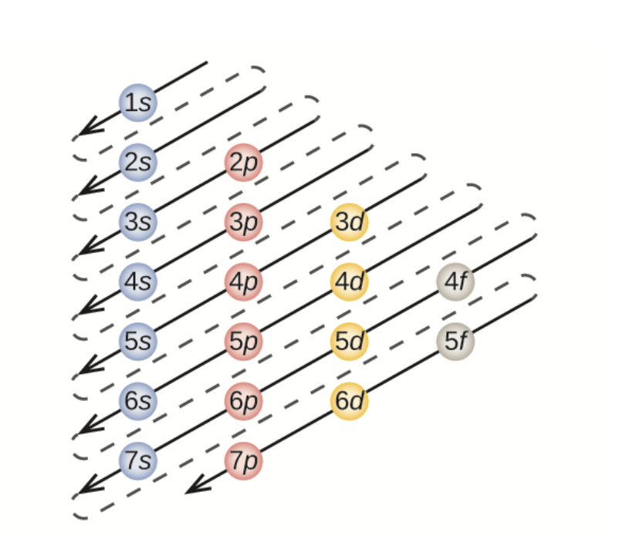
Aufbau Principle
A way to “build up” the electron configuration of more complex elements
Each additional electron will occupy the lowest energy subshell available
Diagram to help with ordering to fill shells
Image Credit: OpenStax Chemistry - Figure 6.26 CC BY 4.0

Slide 5
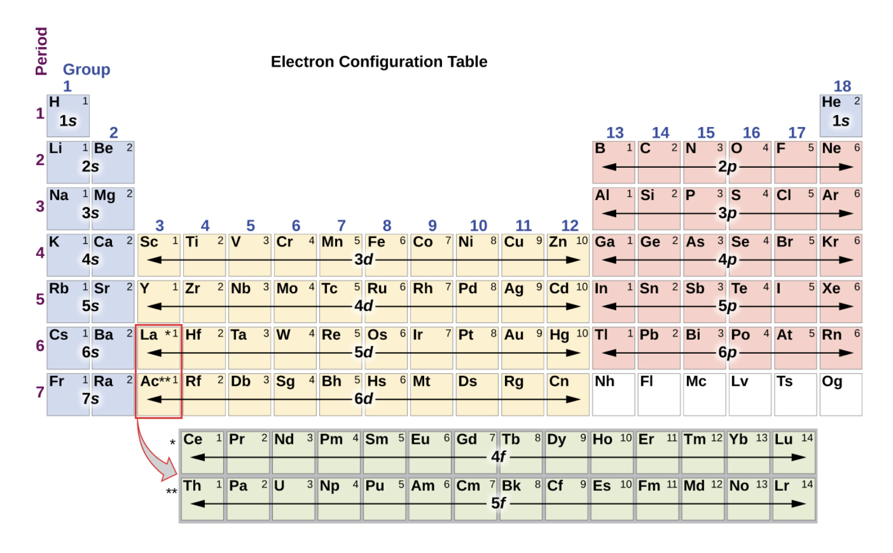
Aufbau Principle
A way to “build up” the electron configuration of more complex elements
Each additional electron will occupy the lowest energy subshell available
Diagram to help with ordering to fill shells
Image Credit: OpenStax Chemistry - Figure 6.26 CC BY 4.0

Slide 6
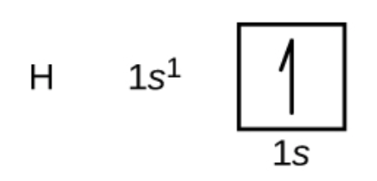
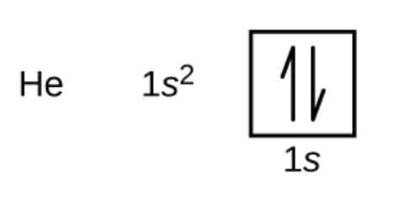
Examples
Hydrogen
$$1s^{1}$$
Helium
$$1s^{2}$$
Oxygen
$$1s^{2}2s^{2}2p^{4}$$
Image Credit: OpenStax Chemistry - Section 6.4 Examples CC BY 4.0

Slide 7
Valence Electrons
Valence electrons are the electrons in the outermost shell
Core electrons - inner shell electrons - corresponds to a noble gas configuration
Use noble gas as an abbreviation to write the electron configuration
Image Credit: OpenStax Chemistry - Figure 6.28 CC BY 4.0

Slide 8
Example
What is the electron configuration for a phosphorus atom? What atom has the configuration: $[Ar]4s^{2}3d^{5}$?
$$P:Atomicnumber=15$$
1s = 2 electrons ; 2s = 2 electrons
2p = 6 electrons ; 3s = 2 electrons
3p = 3 electrons
$$1s^{2}2s^{2}2p^{6}3s^{2}3p^{3}$$
$[Ar]4s^{2}3d^{5}$ ; Ar has 18 electrons so this atom has 25
Element 25 is manganese (Mn)

Slide 9
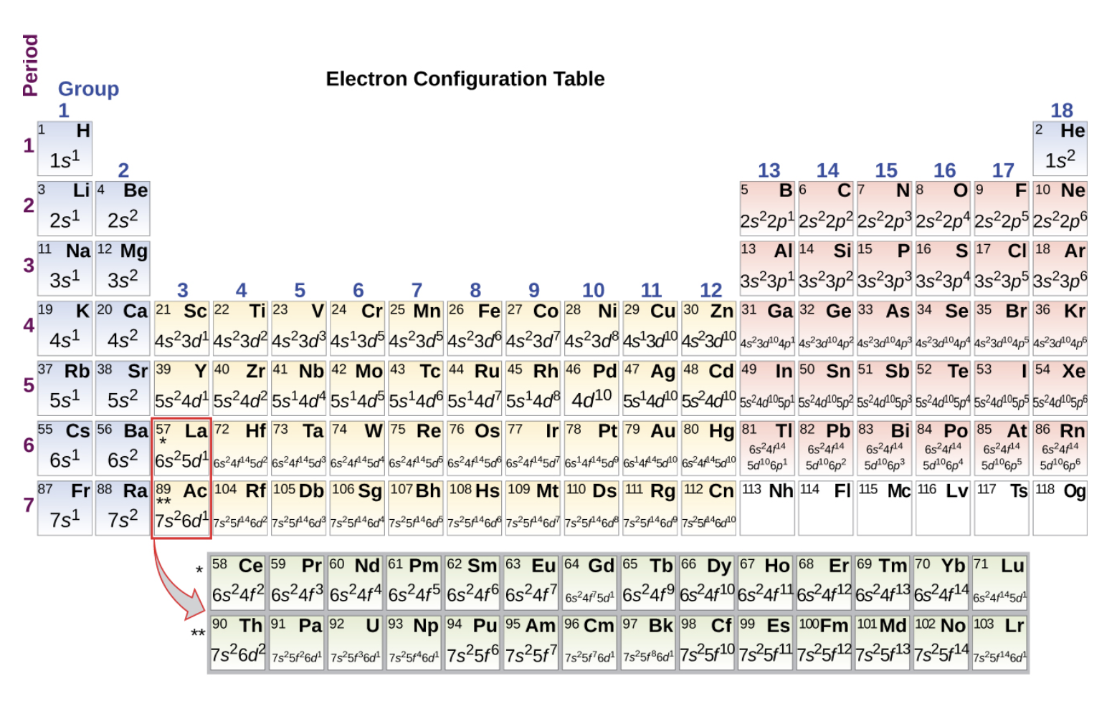
Electron Configurations and the Periodic Table
Main group elements
Last electron added goes in an s or p shell
Transition elements
Metallic elements where last electron goes in a d shell
Inner transition elements
Metallic elements where the last added electron goes in an f shell
Image Credit: OpenStax Chemistry - Figure 6.29 CC BY 4.0

Slide 10
Electron Configurations of Ions
Recall:
Ions are formed when an atoms gains or loses electrons
Lost electrons
Main group elements - last added are first removed
Transition elements - highest s shell electrons removed first, then d or f shell
Added electrons
Follow the Aufbau principle

Slide 11
Example
Write the electron configuration of
$$Na^{+}$$
$$P^{3-}$$
$$Fe^{2+}$$
Electrons Na: 11; P: 15 ; Fe: 26
$$Na:1s^{2}2s^{2}2p^{6}3s^{1}$$
$$Na^{+}:1s^{2}2s^{2}3p^{6}$$
$$P:1s^{2}2s^{2}2p^{6}3s^{2}3p^{3}$$
$$P^{3-}:1s^{2}2s^{2}2p^{6}3s^{2}3p^{6}$$
$$Fe:1s^{2}2s^{2}2p^{6}3s^{2}3p^{6}4s^{2}3d^{6}$$
$$Fe^{2+}:1s^{2}2s^{2}2p^{6}3s^{2}3p^{6}3d^{6}$$

Slide 12
Summary
Electrons will fill the lowest energy subshells first
The Aufbau Principle is used to build up electron configurations
Main group elements have different patterns for losing electrons than the transition metals

