Slide 1
Introduction to Physical Science
Ionic and Covalent Bonding
Presented by Robert Wagner

Slide 2
Ionic Bonding
Ions are formed when an atoms gains or loses electrons
Cation - positive ion
Anion - negative ion
Compounds composed of ions are held together by ionic bonds
Compounds tend to be brittle
Have high melting and boiling points
Easily dissolve in water
Compounds are quite different than the materials that they are composed of
Ex: Sodium Chloride

Slide 3
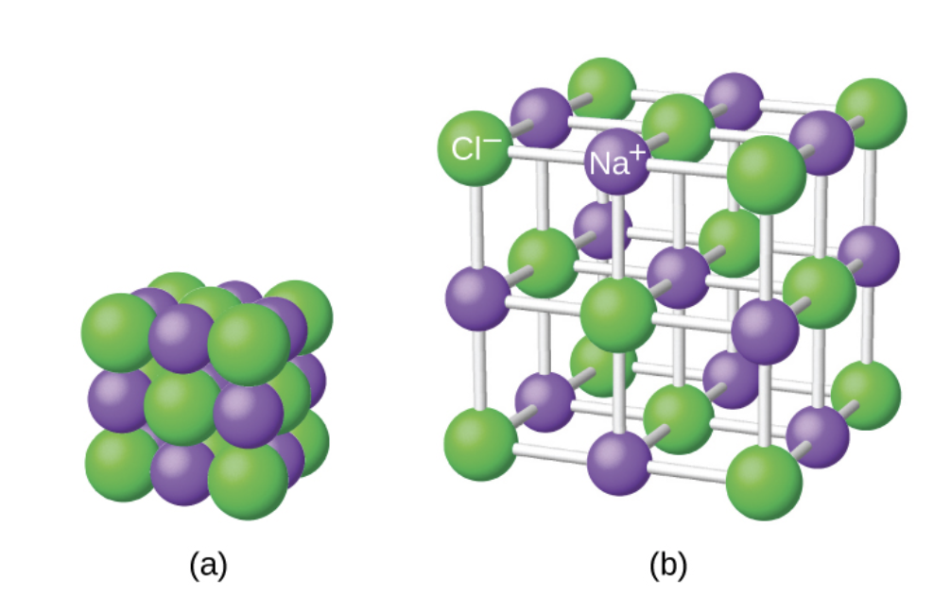
Formation of Ionic Compounds
Binary ionic compounds - formed from two elements
A metal - the cation
A nonmetal - the anion
All substances will be electrically neutral
NaCl, Al₂O₃
Formula does not represent the actual arrangement of ions
Image Credit: OpenStax Chemistry - Figure 7.3 CC BY 4.0

Slide 4
Electronic Structures of Cations
Groups 1 & 2
Group number is equal to the number of valence electrons
Groups 13-17
Group number exceeds the number of valence electrons by 10
Transition and Inner Transition Metals
Transition metals generally form a 2+ or 3+ cation
Inner transition metals generally form a 3+ cation

Slide 5
Example
What will the electronic configurations be for chromium ($Cr^{3+}$) and Zinc($Zn^{2+}$)?
$$Cr:Z=24;Zn:Z=30$$
1s = 2 electrons ; 2s = 2 electrons
2p = 6 electrons ; 3s = 2 electrons
3p = 6 electrons ; 4s = 2 electrons
3d = 10 electrons
$$Cr:1s^{2}2s^{2}2p^{6}3s^{2}3p^{6}4s^{1}3d^{5}=[Ar]3d^{5}4s^{1}$$
$$Zn:1s^{2}2s^{2}2p^{6}3s^{2}3p^{6}4s^{2}3d^{10}=[Ar]3d^{10}4s^{2}$$
$$Zn^{2+}:[Ar]3d^{10}$$
$$Cr^{3+}:[Ar]3d^{3}$$

Slide 6
Electronic Structures of Anions
These will gain enough electrons to fill their outer s and p orbitals
Charge = number of electrons gained
Oxygen: $1s^{2}2s^{2}2p^{4}$
Needs two elections to fill p shell
Charge: 2- or $O^{2-}$

Slide 7
Example
What is the electron configuration for a the selenium and iodine anions?
$$Se:Z=34;I=53$$
1s = 2 electrons ; 2s = 2 electrons
2p = 6 electrons ; 3s = 2 electrons
3p = 6 electrons ; 4s = 2 electrons
3d = 10 electrons ; 4p = 6 electrons
5s = 2 electrons ; 4d = 10 electrons
5p = 6 electrons
$$Se=1s^{2}2s^{2}2p^{6}3s^{2}3p^{6}3d^{10}4s^{2}4p^{4}$$
$$I=1s^{2}2s^{2}2p^{6}3s^{2}3p^{6}3d^{10}4s^{2}4p^{6}4d^{10}5s^{2}5p^{5}$$
$$Se^{2-}=1s^{2}2s^{2}2p^{6}3s^{2}3p^{6}3d^{10}4s^{2}4p^{6}$$
$$I^{-}=1s^{2}2s^{2}2p^{6}3s^{2}3p^{6}3d^{10}4s^{2}4p^{6}4d^{10}5s^{2}5p^{6}$$

Slide 8
Covalent Bonds
Atoms share electrons
Form between atoms that have similar tendencies to attract electrons
Covalent bonds
Compounds have lower melting and boiling points
Softer than ionic compounds (often gases or liquids)
Insoluble in water
Poor conductors of electricity

Slide 9
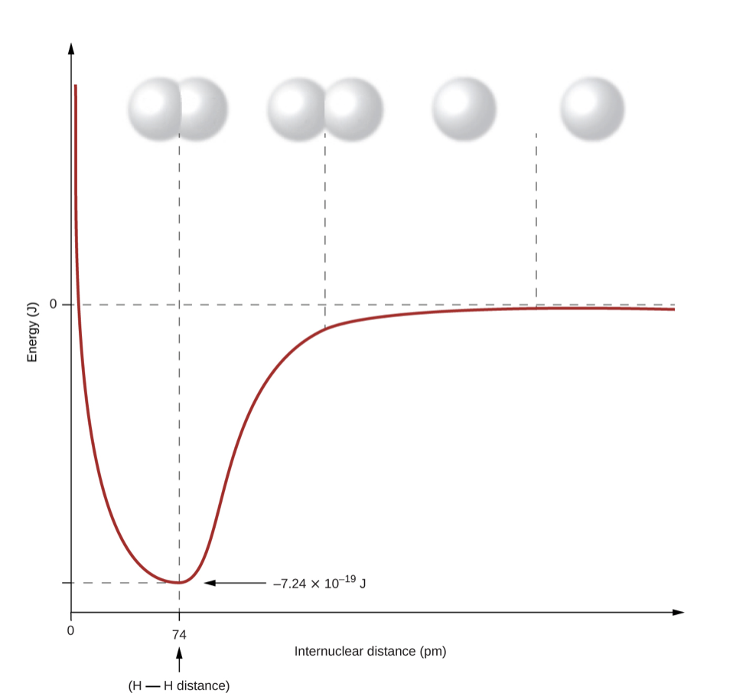
Formation of Covalent Bonds
Covalent bonds between hydrogen atoms
As atoms approach, their 1s electrons will overlap
Electrons interact with both nuclei
Bond length
Distance at which the lowest energy is achieved
Image Credit: OpenStax Chemistry - Figure 7.4 CC BY 4.0

Slide 10
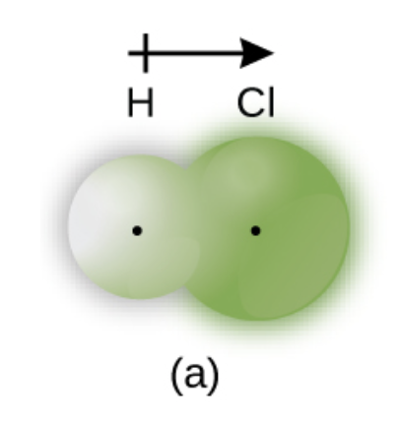
Pure vs. Polar Covalent Bonds
When the atoms are the same, electrons are shared equally
Different atoms will have different affinities for the electrons
Sharing is unequal
Electron spends more time with one atom than the other
Polar covalent bond: HCl
Image Credit: OpenStax Chemistry - Figure 7.5a CC BY 4.0

Slide 11
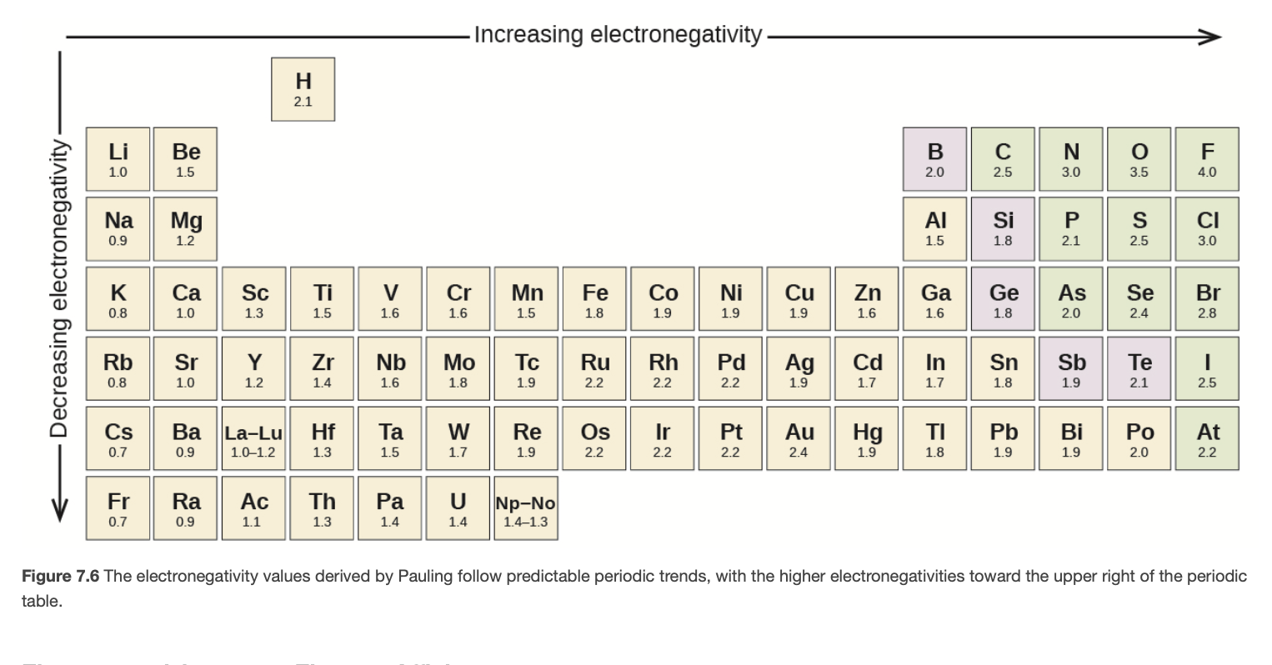
Electronegativity
Electronegativity
A measure of the tendency of atoms to attract electrons
Larger value => More strongly the atoms attracts its electrons
Periodic Table
Electronegativities increase to the right
Electronegativities decrease downward
Image Credit: OpenStax Chemistry - Figure 7.6 CC BY 4.0

Slide 12
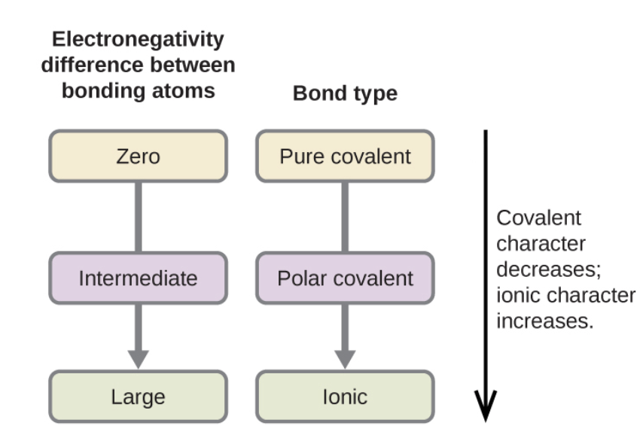
Electronegativity and Bond type
Electronegativity Difference
The difference in negativity estimates the bond polarity and bond type
Types of bonds
Large electronegativity difference = ionic
Small electronegativity difference = covalent
Image Credit: OpenStax Chemistry - Figure 7.8 (part) CC BY 4.0

Slide 13
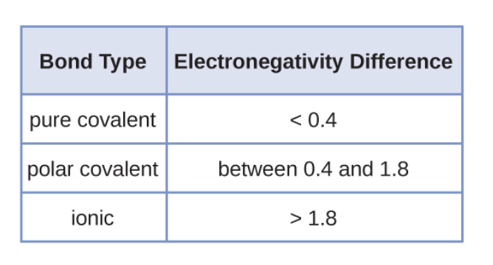
Electronegativity and Bond type
Electronegativity Difference
The difference in negativity estimates the bond polarity and bond type
Types of bonds
Large electronegativity difference = ionic
Small electronegativity difference = covalent
Image Credit: OpenStax Chemistry - Figure 7.8 (part) CC BY 4.0

Slide 14
Example
Identify the type of bond in the following based on the electronegativities
C-C
N-H
H-F
Electronegativities: C: 2.5 ; N: 3.0 ; H: 2.1 ; F: 4.0
$$C-C:2.5-2.5=0(Covalent)$$
$$N-H:3.0-2.1=0.9(PolarCovalent)$$
$$H-F:4.0-2.1=1.9(Ionic)$$

Slide 15
Summary
In an ionic bond, electrons are transferred from one atom to another
In a covalent bond, electrons are shared between atoms
Electronegativities can help us determine the type of bond between two atoms

