Slide 1
Introduction to Physical Science
Lewis Symbols
Presented by Robert Wagner

Slide 2
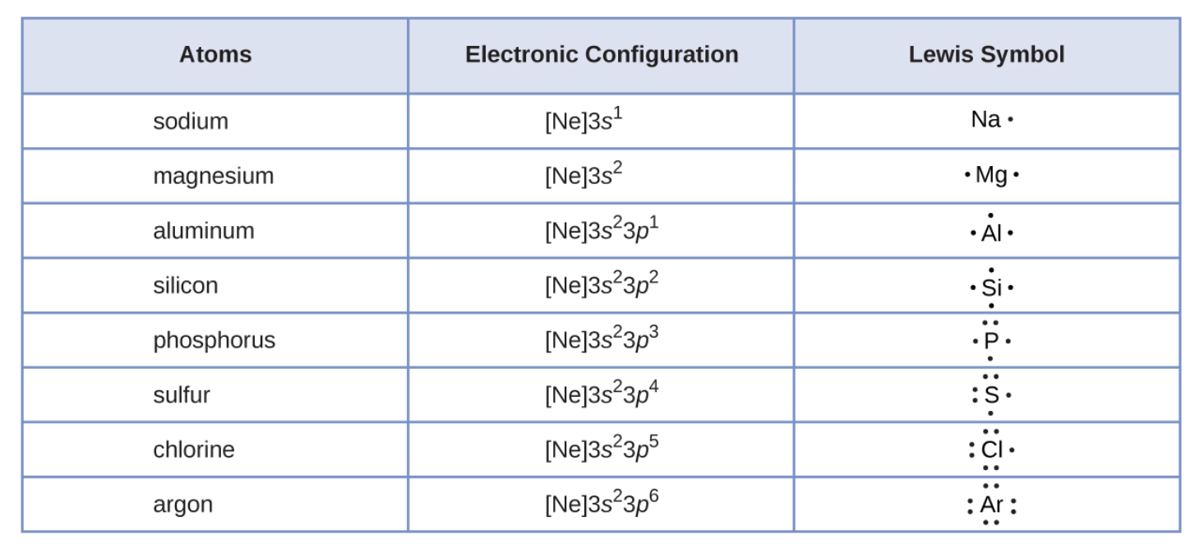
Lewis Symbols
Used to describe the valence electron configuration
Elemental Symbol
Dot for each electron
Calcium
Does not show the inner electrons
Image Credit: OpenStax Chemistry - Figure 7.9 CC BY 4.0

Slide 3
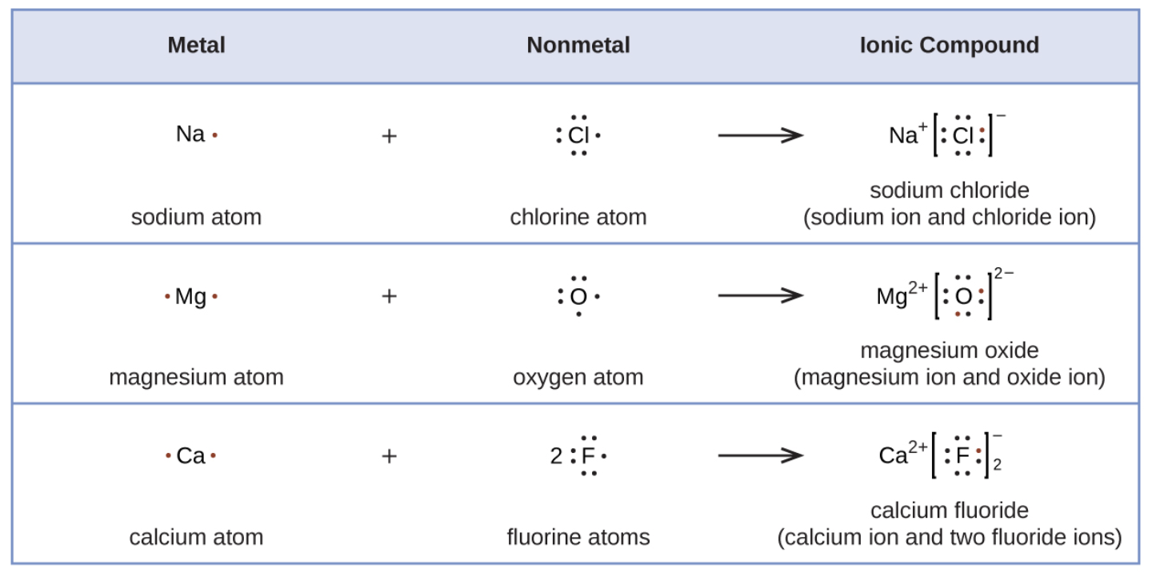
Formation of Ionic Compounds
Can use Lewis Symbols to show electron transfer for ionic bonds
Can use Lewis Symbols to show covalent bonds as well
Single bond - single pair of shared electrons
Image Credit: OpenStax Chemistry - Figure 7.10 CC BY 4.0

Slide 4
Formation of Ionic Compounds
Can use Lewis Symbols to show electron transfer for ionic bonds
Can use Lewis Symbols to show covalent bonds as well
Single bond - single pair of shared electrons
Image Credit: OpenStax Chemistry - Chapter 7.3 Examples CC BY 4.0

Slide 5
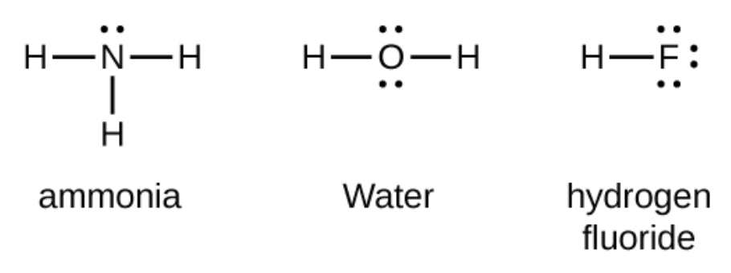
The Octet Rule
It is the tendency of main group atoms to form enough bonds to get eight electrons in the valence shell
Exceptions
Hydrogen - needs only two electrons to fill its valence shell
Transition & Inner Transition elements do not follow octet rule
Image Credit: OpenStax Chemistry - Chapter 7.3 Examples CC BY 4.0

Slide 6
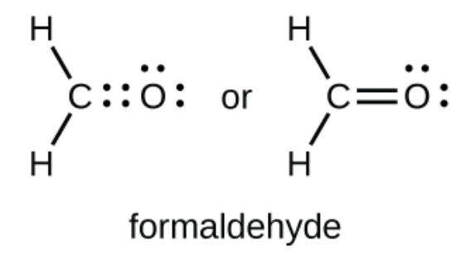
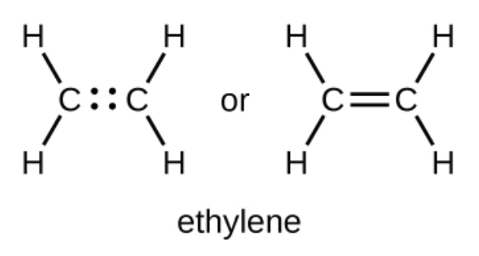
Double and Triple Bonds
Sometimes an atom needs to share more than one pair of electrons
Double bond
Two pairs of electrons are shared
Triple bond
Three pairs of electrons are shared
Image Credit: OpenStax Chemistry - Chapter 7.3 Examples CC BY 4.0

Slide 7
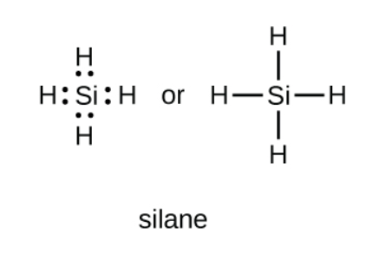
Writing Lewis Structures
For simple molecules and ions
Pair up the unpaired electrons
Example: $SiH_{4}$
Si has 4 valence electrons
Each hydrogen has one valence electron (4 total)
Image Credit: OpenStax Chemistry - Chapter 7.3 Examples CC BY 4.0

Slide 8
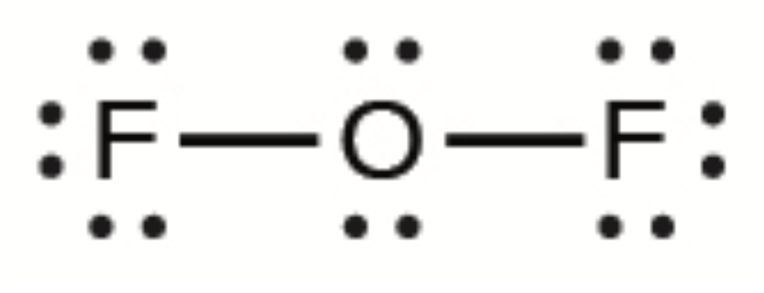
Writing Lewis Structures
For more complicated molecules
Determine the total number of valence electrons
Draw the structure, arranging electrons around a central atom (connect with a single bond)
Distribute remaining electrons on terminal atoms (not H) to complete octets
Place remaining electrons on central atom
Rearrange to make multiple bonds when possible
$OF_{2}$ has 20 valence electrons (O = 6, F = 7x2 = 14)
All 20 electrons have been used so no multiple bonds needed
Image Credit: OpenStax Chemistry - Chapter 7.3 Examples CC BY 4.0

Slide 9
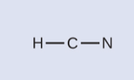
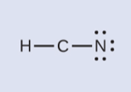
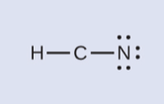
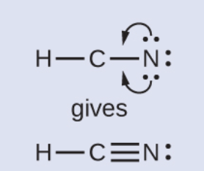
Example
What is the Lewis structure for HCN?
Calculate number of valence electrons
Draw skeleton - connect w/single bonds
Distribute electrons to terminal atoms
Place remaining electrons on central atom
Rearrange electrons to form multiple bonds
Valence electrons: (1x1) + (4x1) + (5x1) = 10
Image Credit: OpenStax Chemistry - Chapter 7.3 Examples 7.4 CC BY 4.0

Slide 10
Summary
Lewis Symbols are used to describe the valence electron structure of an atom or ion
Atoms generally follow the octet rule and want to have eight electrons in their valence shell
Hydrogen is an exception as it has only one valence electron and the transition and inner transition elements do not follow the octet rule

