Slide 1
Introduction to Physical Science
Solutions
Presented by Robert Wagner

Slide 2
Basic Properties of Solutions
Definition of a solution:
Homogeneous mixture of two or more substances
Solvent vs. Solute
Solvent - component present in a much greater concentration
Solute - component present in lesser concentration

Slide 3
Solution Examples
Sucrose (sugar)
$$C_{12}H_{22}O_{11}(s)⟶C_{12}H_{22}O_{11}(aq)$$
Sucrose molecules are solutes - spread through out the solution
Potassium dichromate ($K_{2}Cr_{2}O_{7}$)
$$K_{2}Cr_{2}O_{7}(s)⟶2K^{+}(aq)+Cr_{2}O_{7}^{2-}(aq)$$
Dissociates in water - solutes are both potassium and dichromate ions

Slide 4
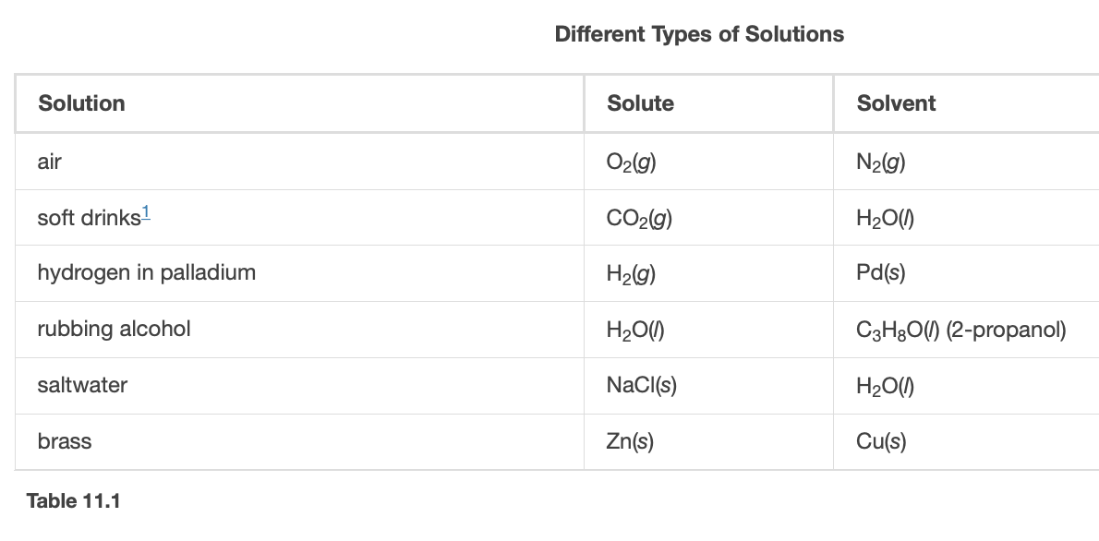
Properties & Types of Solutions
A solution can be a solid, liquid or gas.
Properties
Homogeneous
Physical state of solution is the same as that of the solvent
Components are dispersed on a molecular scale
Solvent will not settle out
Concentrations can be varied continuously
Image Credit: OpenStax Chemistry - Table 11.1 CC BY 4.0

Slide 5
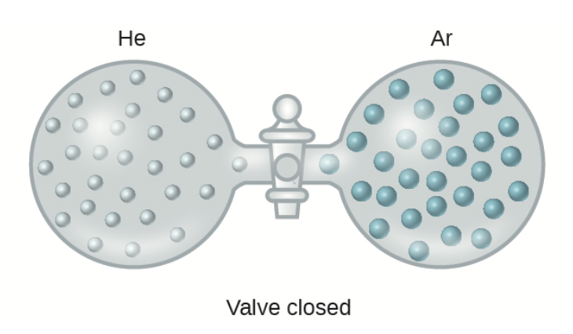
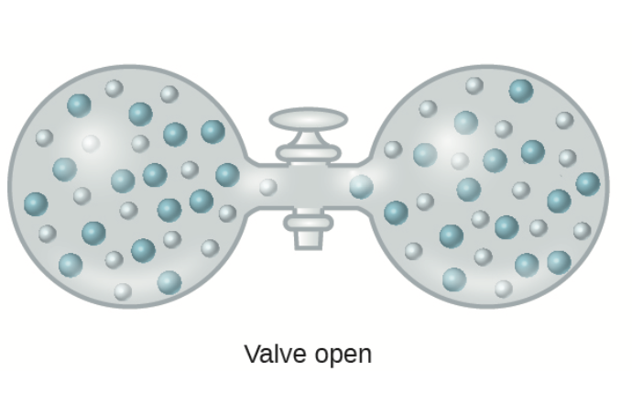
Formation of Solutions
Spontaneous process(no external energy source needed)
Decrease in internal energy
Increase in entropy
Ideal solution
No change in energy
Image Credit: OpenStax Chemistry - Figure 11.3 CC BY 4.0

Slide 6
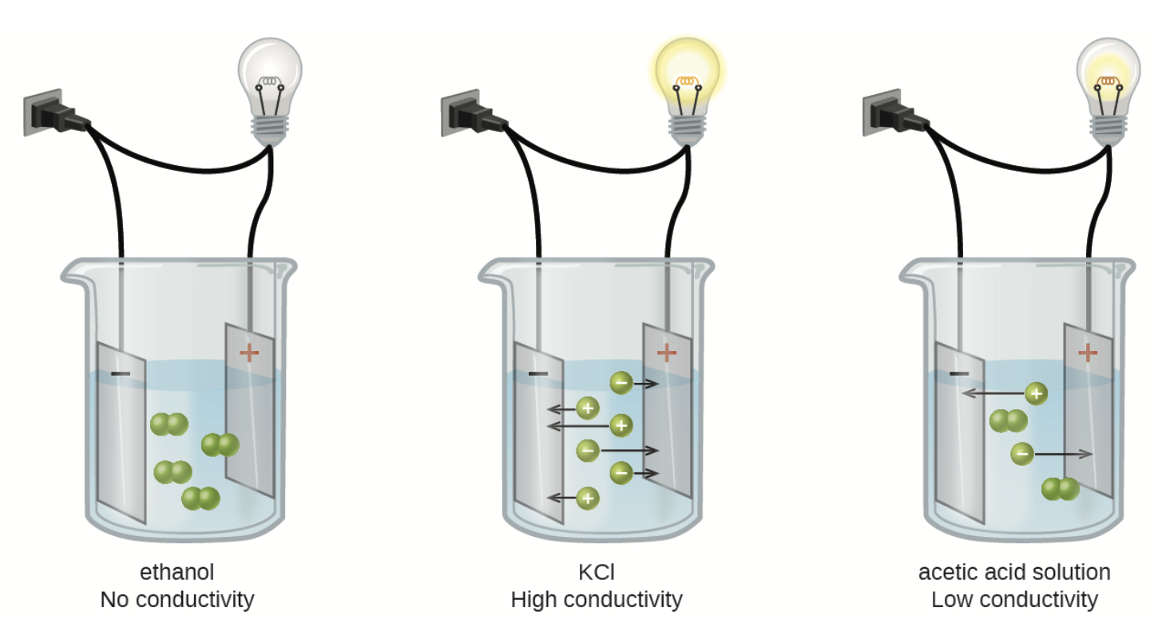
Electrolytes
Definition of electrolytes
Substances that yield ions when dissolved in a solution
Strong vs. Weak Electrolytes
Strong electrolytes - Process producing ions is essentially 100% efficient
Weak electrolytes - Process producing ions is much less than 100% efficient
Image Credit: OpenStax Chemistry - Figure 11.6 CC BY 4.0

Slide 7
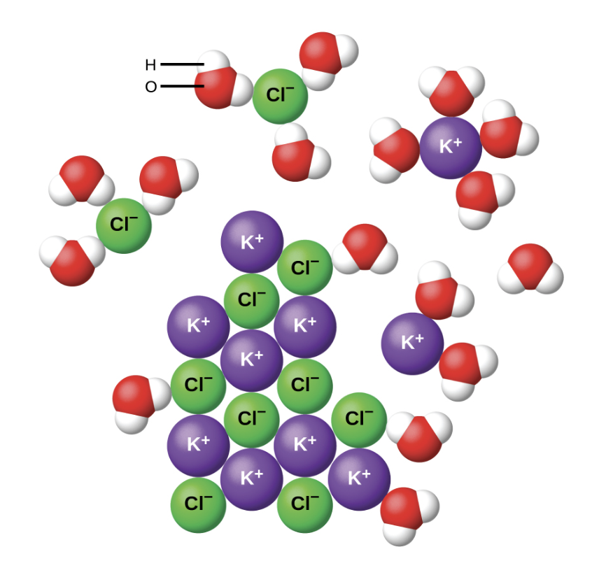
Ionic Electrolytes
Polar molecule like water are attracted to ions
Ion-dipole attraction
Dissociation - a physical process
Nearly complete dissolution => strong electrolytes
Image Credit: OpenStax Chemistry - Figure 11.7 CC BY 4.0

Slide 8
Covalent Electrolytes
Water - poor conductor of electricity - very slightly ionized
$$H_{2}O(l)+H_{2}O(l)⇌H_{3}O^{+}(aq)+OH^{-}(aq)$$
Hydrochloric Acid (HCl)
$$H_{2}O(l)+HCl(l)⟶H_{3}O^{+}(aq)+Cl^{-}(aq)$$
Strong acid - strong electrolyte
Weak acid - weak electrolyte

Slide 9
Summary
A solution is a homogeneous mixture of two or more substances - it can be a solid, liquid or gas
The spontaneous formation of a solution will generally cause a decrease in the internal energy and/or an increase in the entropy of the system
Electrolytes can be strong or weak depending on the level of dissociation of the ions in solution

