Slide 1
Introduction to Physical Science
Solubility
Presented by Robert Wagner

Slide 2
Solubility
Solubility of a solute
Maximum concentration of solute in a specific solvent under specific conditions
Saturated vs. unsaturated
Saturated - concentration of solute is equal to its solubility
Unsaturated - concentration of solute is less than the solubility
Supersaturated - concentration of solute exceeds the solubility

Slide 3
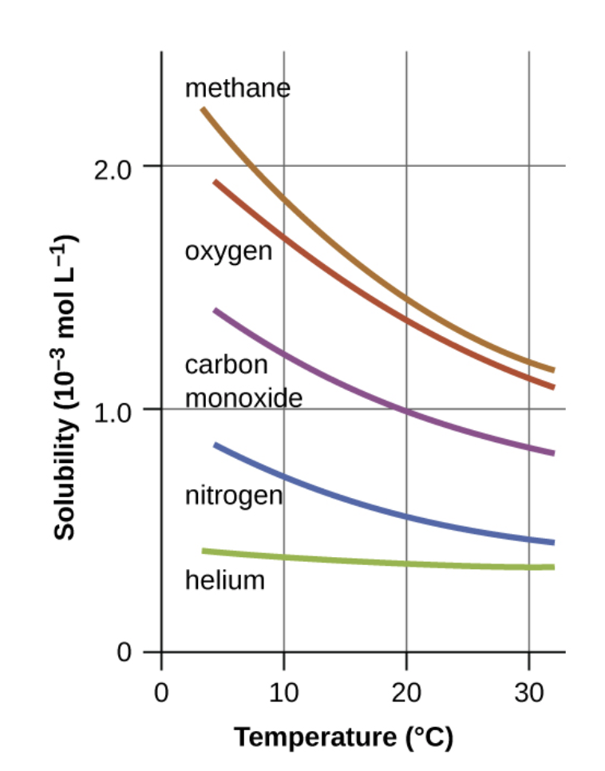
Solutions of Gases in Liquids
Gas solubility typically decreases as temperature increases
Example - increased water temperatures means decreases oxygen solubility
Henry’s Law:
$$C_{g}=kP_{g}$$
$C_{g}$ = solubility of gas
$P_{g}$ = partial pressure of gas
Image Credit: OpenStax Chemistry - Figure 11.8 CC BY 4.0

Slide 4
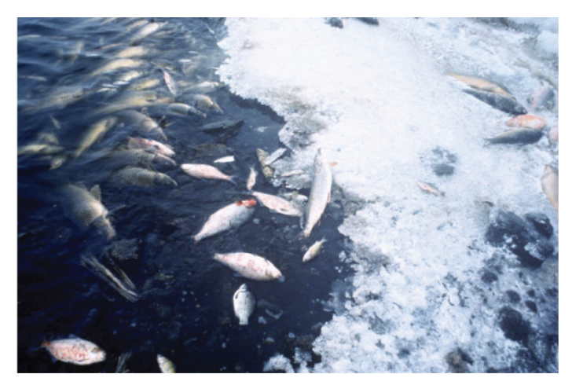
Solutions of Gases in Liquids
Gas solubility typically decreases as temperature increases
Example - increased water temperatures means decreases oxygen solubility
Henry’s Law:
$$C_{g}=kP_{g}$$
$C_{g}$ = solubility of gas
$P_{g}$ = partial pressure of gas
Image Credit: OpenStax Chemistry - Figure 11.9b (Modification of work by U.S. Fish and Wildlife Service) CC BY 4.0

Slide 5
Example
At 20ºC, the concentration of dissolved oxygen exposed to gaseous oxygen at a partial pressure of 101.3 kPa is 1.38x10⁻³ molL⁻¹. Use Henry’s Law to determine the solubility when the partial pressure is 20.7kPa.
$$C_{g}=1.38x{10}^{-3}molL^{-1};P_{g}=101.3kPa$$
$$C_{g}=kP_{g}$$
$$k=\frac{C_{g}}{P_{g}}=\frac{1.38x{10}^{-3}molL^{-1}}{101.3kPa}$$
$$k=1.36x{10}^{-5}molL^{-1}kPa^{-1}$$
$$C_{g}=kP_{g}=(1.36x{10}^{-5}molL^{-1}kPa^{-1})(20.7kPa)$$
$$C_{g}=2.82x{10}^{-4}molL^{-1}$$

Slide 6
Example
$$C_{g}=1.2x{10}^{-3}molL^{-1};P_{g}=0.17atm$$
$$C_{g}=kP_{g}$$
$$k=\frac{C_{g}}{P_{g}}=\frac{1.2x{10}^{-3}molL^{-1}}{1atm}$$
$$k=1.2x{10}^{-3}molL^{-1}atm^{-1}$$
$$C_{g}=kP_{g}=(1.2x{10}^{-3}molL^{-1}atm^{-1})(0.17atm)$$
$$C_{g}=2.0x{10}^{-4}molL^{-1}$$
$$C_{g}=(2.0x{10}^{-4}mol/L)(32.0g/mol)(1000mg/g)=6.4mg/L$$
A certain species of freshwater trout requires a dissolved oxygen concentration of 7.5 mg/L. Could these fish thrive in a polluted stream (water temp = 30.0ºC, partial pressure of oxygen = 0.17 atm)
Figure 11.8 shows that the solubility at this temperature is 1.2x10⁻³ mol/L

Slide 7
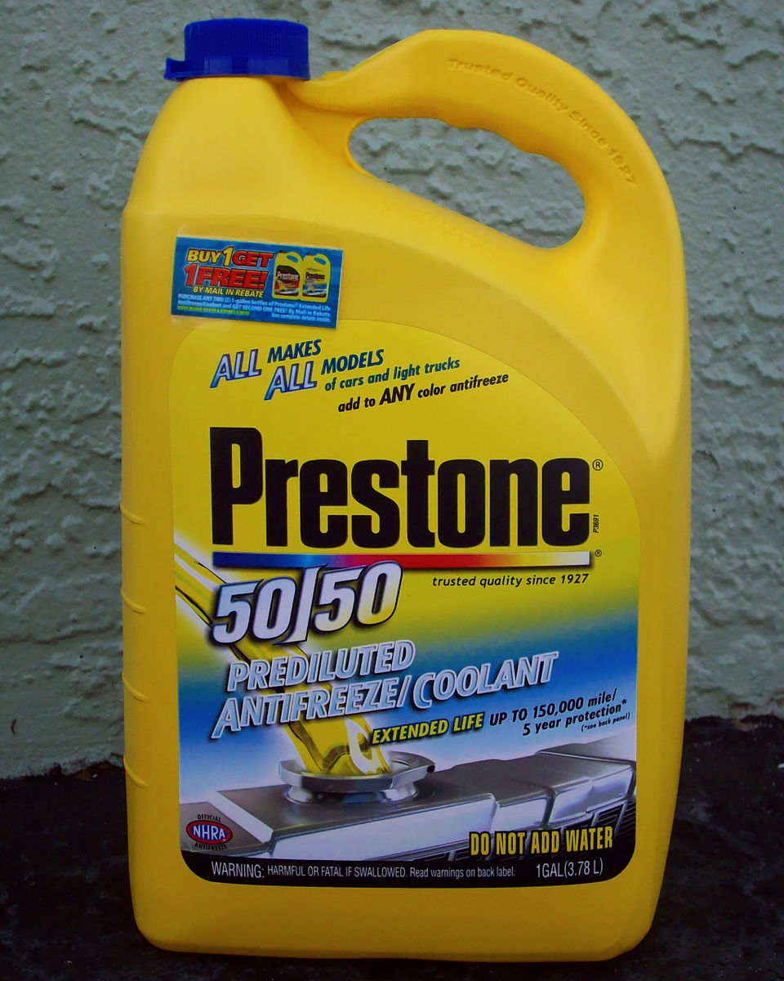
Solutions of Liquids in Liquids
Miscible - liquids that can be mixed in any proportion with each other
Ex: Ethanol, sulfuric acid, ethylene glycol
Immiscible - Liquids that do not mix significantly
Ex: Oil, gasoline, benzene
Partially miscible - Liquids that partially mix together
Image Credit: dno1967, CC BY 2.0 <https://creativecommons.org/licenses/by/2.0>, via Wikimedia Commons

Slide 8
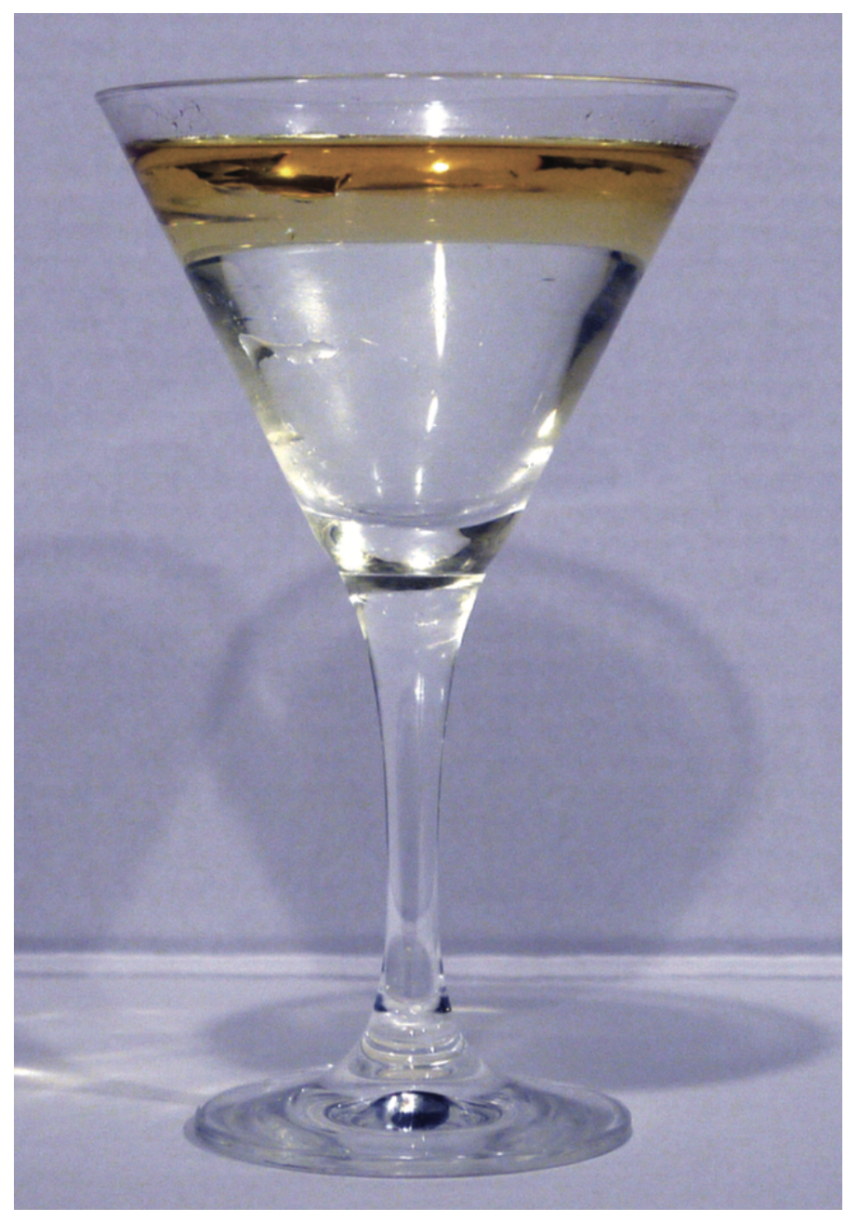
Solutions of Liquids in Liquids
Miscible - liquids that can be mixed in any proportion with each other
Ex: Ethanol, sulfuric acid, ethylene glycol
Immiscible - Liquids that do not mix significantly
Ex: Oil, gasoline, benzene
Partially miscible - Liquids that partially mix together
Image Credit: yortw, CC BY 2.0 <https://creativecommons.org/licenses/by/2.0>, via Flickr

Slide 9
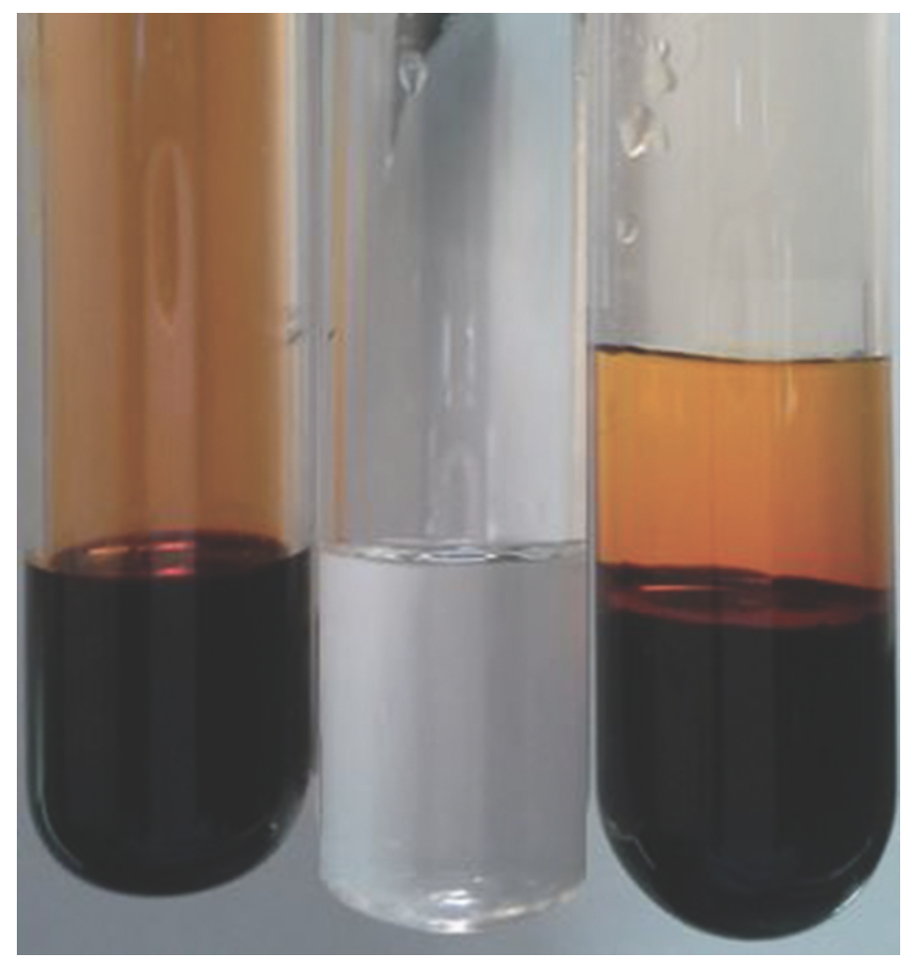
Solutions of Liquids in Liquids
Miscible - liquids that can be mixed in any proportion with each other
Ex: Ethanol, sulfuric acid, ethylene glycol
Immiscible - Liquids that do not mix significantly
Ex: Oil, gasoline, benzene
Partially miscible - Liquids that partially mix together
Image Credit: Paul Flowers, CC BY 2.0 <https://creativecommons.org/licenses/by/2.0>

Slide 10
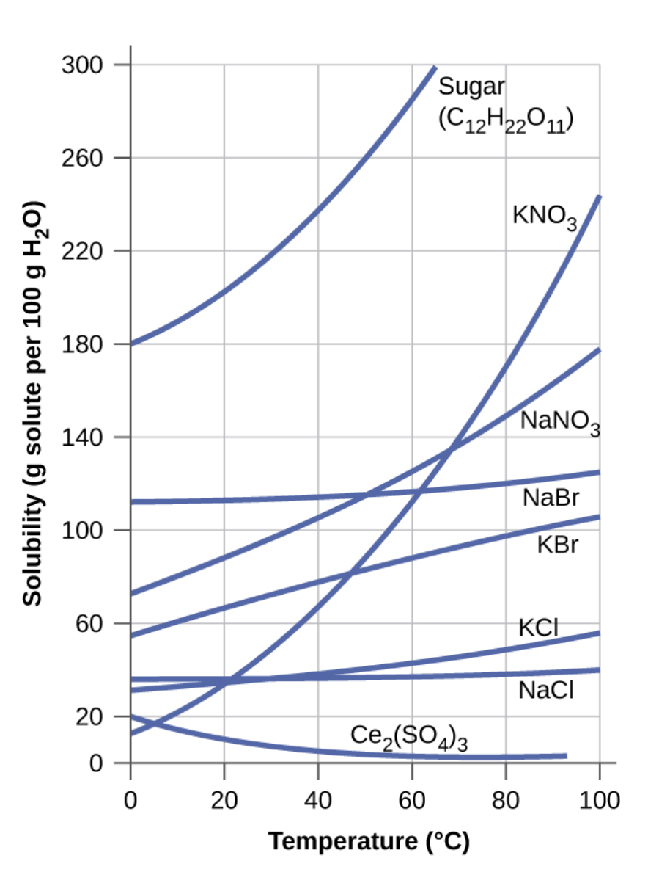
Solutions of Solids in Liquids
Solubility generally increases with temperature
Supersaturated solutions
Prepare at a higher temperature and then cool off
Remain stable until:
Seed crystal added
Mechanical agitation
Image Credit: OpenStax Chemistry - Figure 11.16 CC BY 4.0

Slide 11
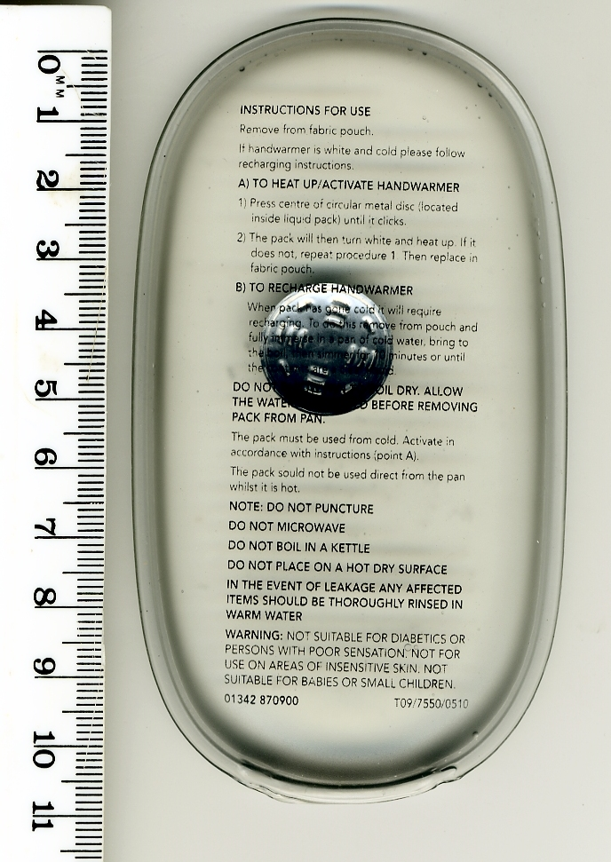
Solutions of Solids in Liquids
Solubility generally increases with temperature
Supersaturated solutions
Prepare at a higher temperature and then cool off
Remain stable until:
Seed crystal added
Mechanical agitation
Image Credit: Velela (Public Domain) via Wikimedia Commons

Slide 12
Summary
The solubility is the maximum amount of a solute that can be dissolved in a solution
Henry’s Law allows us to calculate the solubility of gases in liquids
Liquids can be miscible, immiscible or partially miscible

