Slide 1
Introduction to Physical Science
Acids & Bases, pH
Presented by Robert Wagner

Slide 2
Acids and Bases
Defined in terms of the transfer of hydrogen ions
A compound that donates a proton to another is an acid
A compound that accepts a proton from another is a base
Neutral solution - equal concentration of hydronium and hydroxide ions
Acidic solution - greater concentration of hydronium than hydroxide
Basic solution - lesser concentration of hydronium than hydroxide

Slide 3
pH and pOH
The pH of a solution is the molar concentration of the hydronium ($H_{3}O^{+}$) in the solution
$$pH=-log[H_{3}O^{+}]$$
$$[H_{3}O^{+}]={10}^{-pH}$$
The pOH of a solution is similarly defined
$$pOH=-log[OH^{-}]$$
$$[OH^{-}]={10}^{-pOH}$$

Slide 4
Example
What are the pH and pOH of pure water? The hydronium ion molarity in pure water is 1.0x10⁻⁷ at 25ºC.
$$[H_{3}O^{+}]=[OH^{-}]=1.0x{10}^{-7}M$$
$$pH=-log[H_{3}O^{+}]$$
$$pH=-log(1.0x{10}^{-7})=+7.0$$
$$pOH=-log[OH^{-}]$$
$$pOH=-log(1.0x{10}^{-7})=+7.0$$

Slide 5
Acids, Bases and Neutral Solutions
Image Credit: OpenStax Chemistry Table 14.1 CC BY 4.0

Slide 6
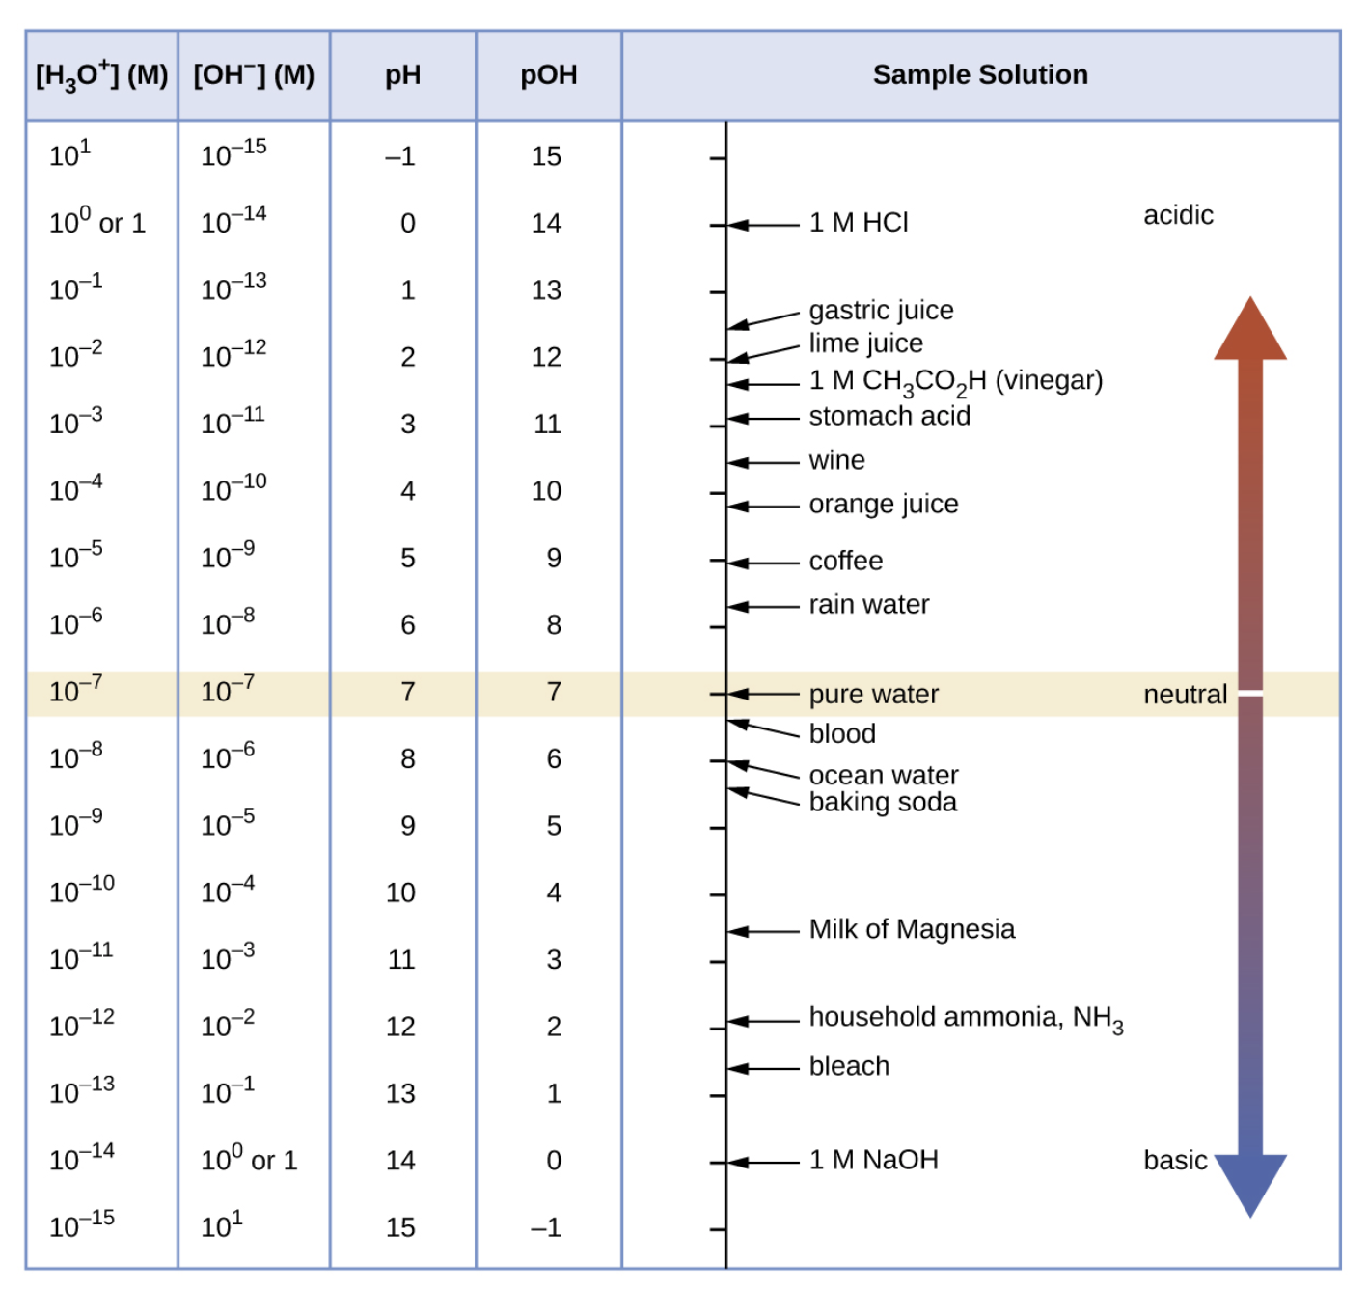
Acids, Bases and Neutral Solutions
Image Credit: OpenStax Chemistry Figure 14.2 CC BY 4.0

Slide 7
Example
What is the pH of stomach acid, a solution of HCl with a hydronium concentration of 1.2x10⁻³M?
$$[H_{3}O^{+}]=1.2x{10}^{-3}M$$
$$pH=-log[H_{3}O^{+}]$$
$$pH=-log(1.2x{10}^{-3})=+2.92$$

Slide 8
Example
Calculate the hydronium ion concentration of blood with a pH of 7.3.
$$pH=7.3$$
$$pH=-log[H_{3}O^{+}]=7.3$$
$$log[H_{3}O^{+}]=-7.3$$
$$[H_{3}O^{+}]={10}^{-7.3}$$
$$[H_{3}O^{+}]=5.0x{10}^{-8}M$$

Slide 9
Example
What are the pOH and the pH of a 0.0125 M solution of potassium hydroxide (KOH)?
$$[OH^{-}]=0.0125$$
$$pOH=-log[OH^{-}]=-log0.0125$$
$$pOH=-(-1.903)=1.903$$
$$pH+pOH=14.00$$
$$pH=14.00-pOH$$
$$pH=14.00-1.903=12.1$$

Slide 10
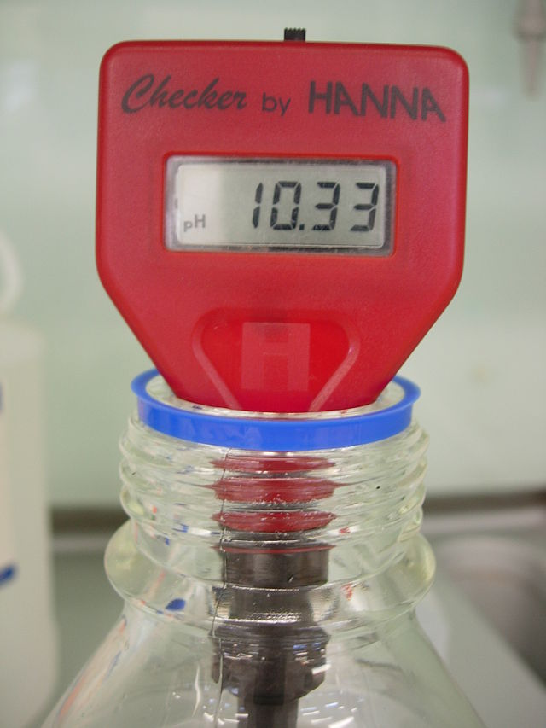
Measuring pH
pH can often be measured with devices like a pH meter
pH test strips can also be used to give a rough idea of the acid/base level of a solution
Image Credit: Laurence Livermore, CC BY 2.0 <https://creativecommons.org/licenses/by/2.0>, via Wikimedia Commons

Slide 11
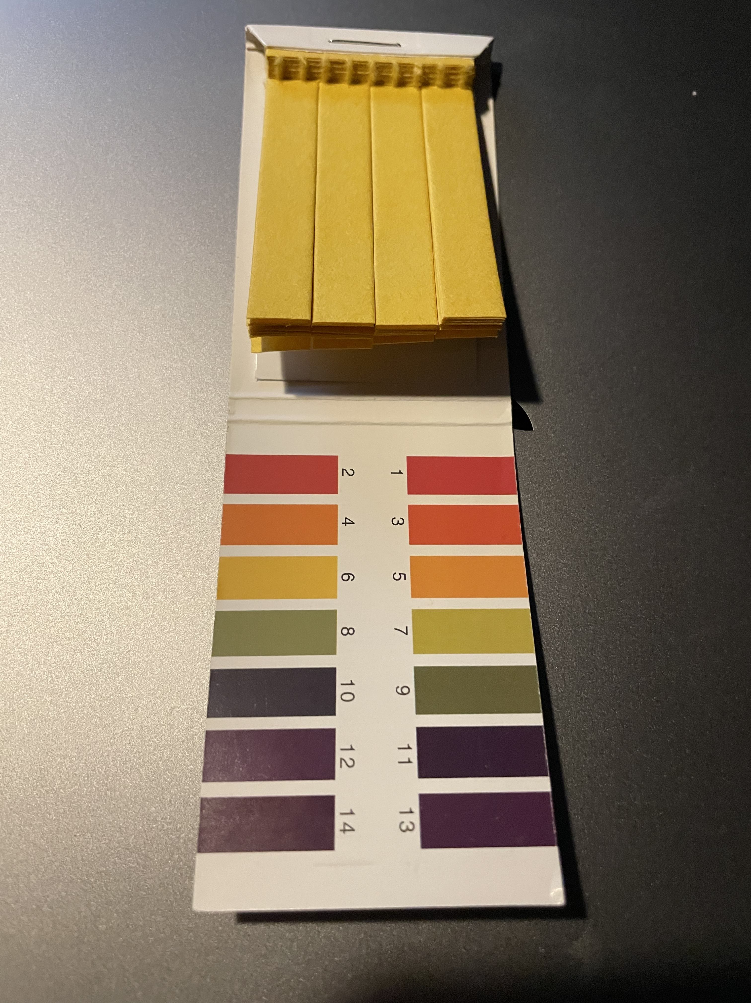
Measuring pH
pH can often be measured with devices like a pH meter
pH test strips can also be used to give a rough idea of the acid/base level of a solution
Image Credit: Robert Wagner (own work) CC-BY-4.0

Slide 12
Summary
An acid is a compound that donates a proton to another compound
The pH of a substance is a measure of the concentration of the hydronium ion
The pH and pOH of substances can be calculated and/or measured by various methods

