Slide 1
Introduction to Physical Science
Strengths of Acids & Bases
Presented by Robert Wagner

Slide 2
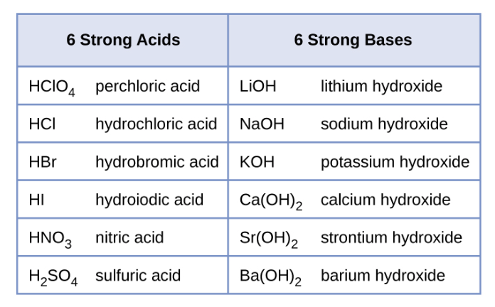
Weak and Strong Acids and Bases
Strength of acid or base depends on the level of ionization in water
Weak acid or base - little ionization
Strong acid or base - ionization essentially complete
Image Credit: OpenStax Chemistry Figure 14.6 CC BY 4.0

Slide 3
Percent Ionization
Percent ionization of a weak acid is given by
$$\%ionization=\frac{[H_{3}O^{+}]_{eq}}{[HA]_{0}}x100$$

Slide 4
Example
Calculate the percent ionization of an 0.125 M solution of nitrous acid, with a pH of 2.09.
$$pH=2.09;0.125Msolution$$
$$\%ionization=\frac{[H_{3}O^{+}]_{eq}}{[HNO_{2}]_{0}}x100$$
$$[H_{3}O^{+}]={10}^{-2.09}=0.0081M$$
$$\frac{0.0081}{0.125}x100=6.5\%$$

Slide 5
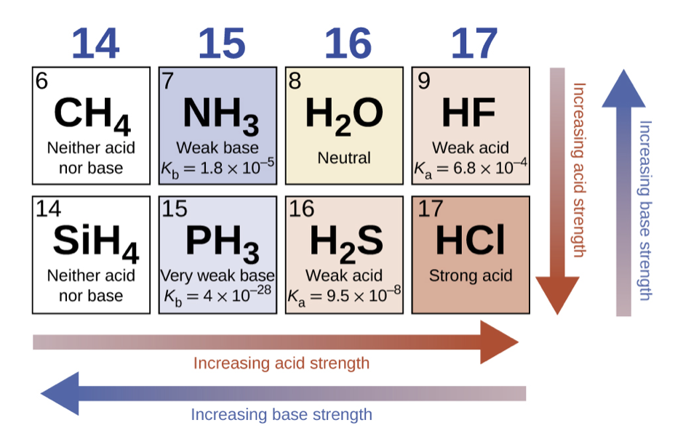
Binary Acids and Bases
Strength of acid compounds of hydrogen with nonmetals:
Increases to the right on the periodic table
Increases downward on the periodic table
Image Credit: OpenStax Chemistry Figure 14.11 CC BY 4.0

Slide 6
Summary
The strength of an acid or base depends on the level to which it is ionized in water
The percent ionization tells the amount of a weak acid that has been ionized
Binary acids - strength will increase downward and to the right in the periodic table

