Slide 1
Introduction to Physical Science
Hydrocarbons
Presented by Robert Wagner

Slide 2
Organic Compounds
Based on the chemistry of carbon atoms
Carbon can form multiple strong bonds with other atoms
Hydrocarbons
Simplest organic compounds
Composed of carbon and hydrogen
Often used as fuels and in plastics

Slide 3
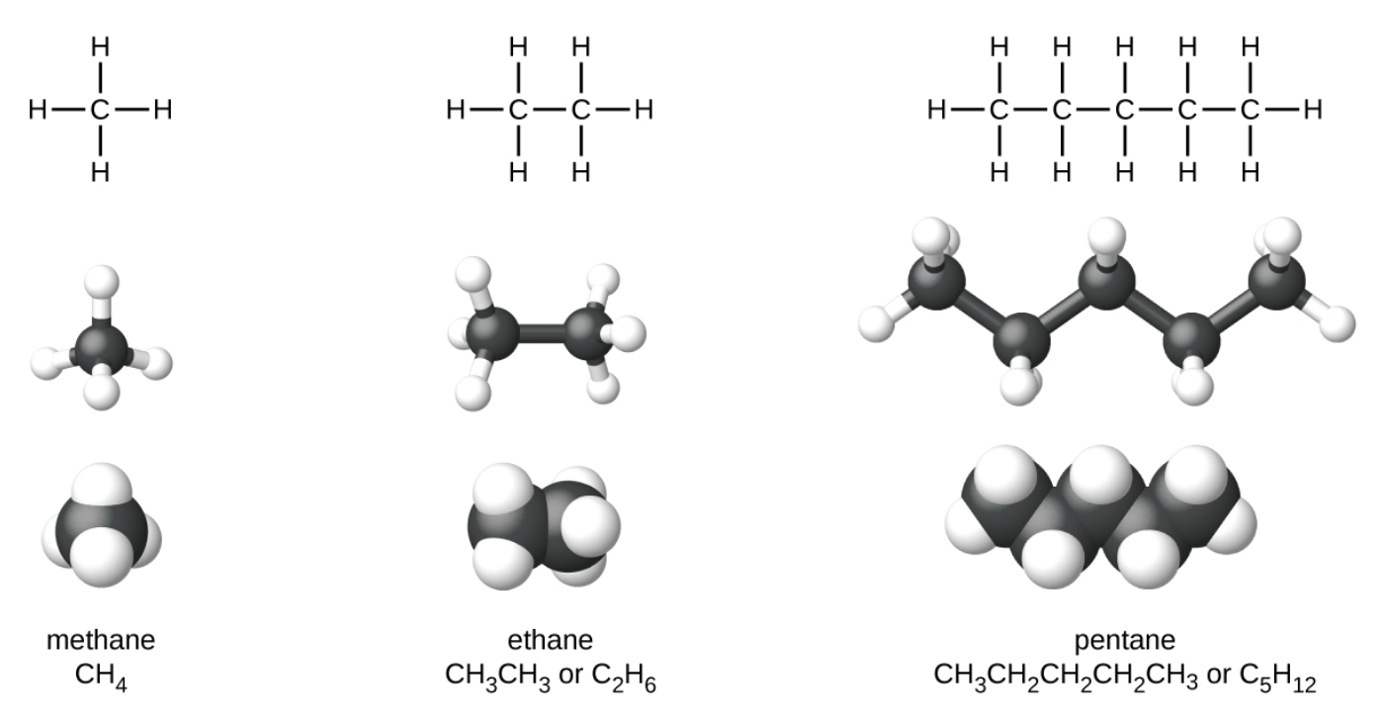
Alkanes
Alkanes are saturated hydrocarbons
Have one, single, covalent bond between each carbon atom
General formula:
$$C_{n}H_{2n+2}$$
Properties vary predictably as the number of atoms changes
Image Credit: OpenStax Chemistry Figure 20.2 CC BY 4.0

Slide 4
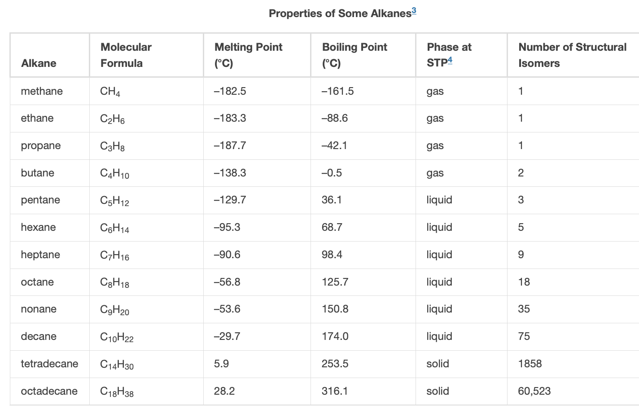
Alkanes
Alkanes are saturated hydrocarbons
Have one, single, covalent bond between each carbon atom
General formula:
$$C_{n}H_{2n+2}$$
Properties vary predictably as the number of atoms changes
Image Credit: OpenStax Chemistry Table 20.1 CC BY 4.0

Slide 5
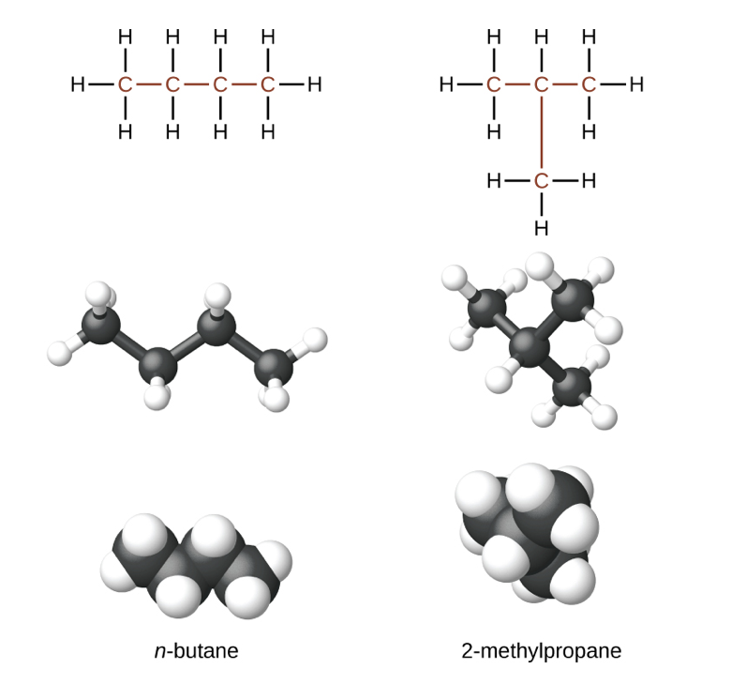
Isomers
Isomers
Hydrocarbons that have the same formula but different structures
n-Butane (normal)
Unbranched chain - no carbon atoms are bonded to more than two other carbon atoms
Isobutane (2-methylpropane) has a branched chain
Image Credit: OpenStax Chemistry Figure Chapter 20.1 CC BY 4.0

Slide 6
Naming Alkanes
Identify the longest chain of carbon atoms in the structure
2 = ethane
3 = propane
4 = butane
5 = pentane
6 = hexane ; 7 = heptane ; 8 = octane, etc.
Use a prefix to indicate the position and name of the substituent(s)

Slide 7
Naming Alkanes - Examples
Image Credit: OpenStax Chemistry Figure Chapter 20.1 CC BY 4.0

Slide 8
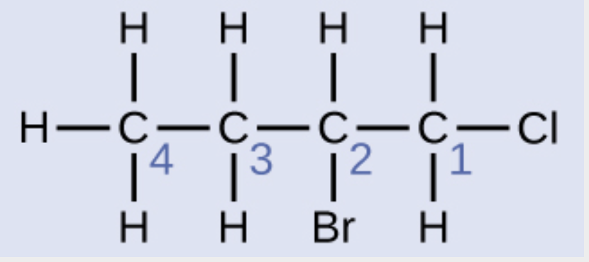
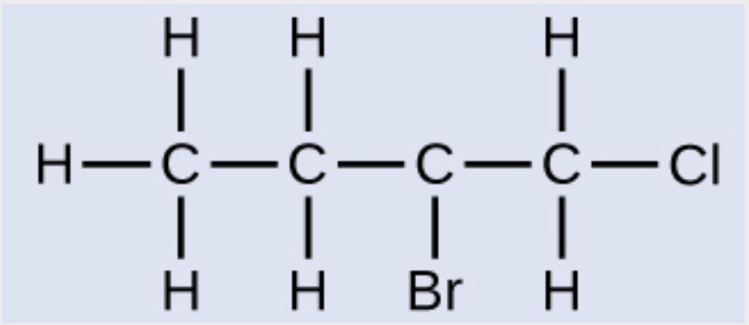
Example
Name this molecule
Chlorine attached to carbon #1
Bromine attached to carbon #2
2-bromo-1-chlorobutane
Image Credit: OpenStax Chemistry Figure Example 20.3 CC BY 4.0

Slide 9
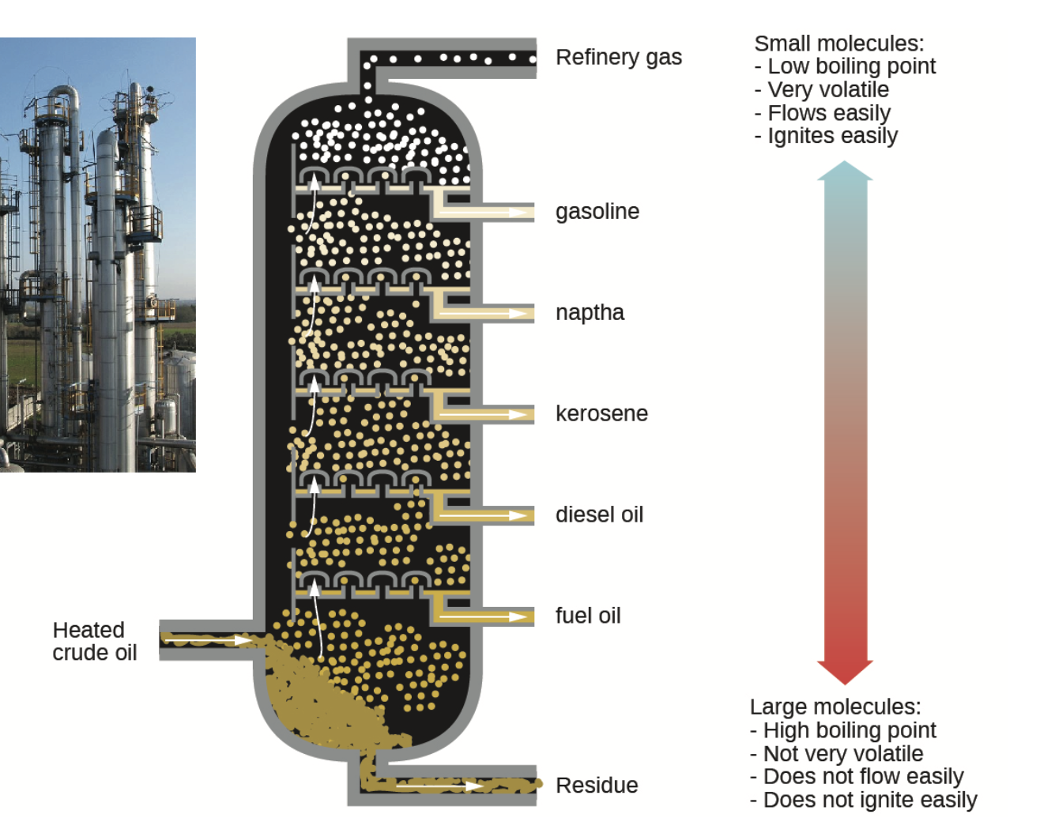
Fossil Fuels
Different liquid alkane fuels have different boiling points
Gasoline, kerosene, fuel oil
Separated by heating crude oil
Image Credit: OpenStax Chemistry Figure 20.6 CC BY 4.0

Slide 10
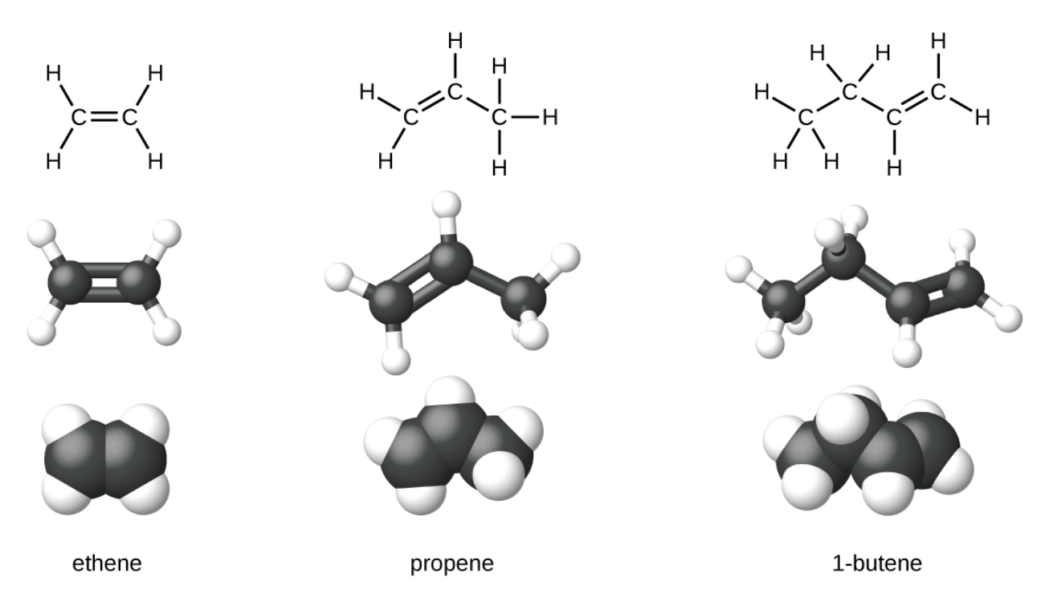
Alkenes
Alkenes are unsaturated hydrocarbons
Molecules contain one or more double bonds between carbon atoms
Ethene - simplest alkene
$$C_{2}H_{4}$$
Image Credit: OpenStax Chemistry Figure 20.7 CC BY 4.0

Slide 11
Naming Alkenes
Alkenes are named based on the name of the alkane with the same number of carbon atoms
-ane suffix is replaced by -ene
Image Credit: OpenStax Chemistry Chapter 20.1 Figure

Slide 12
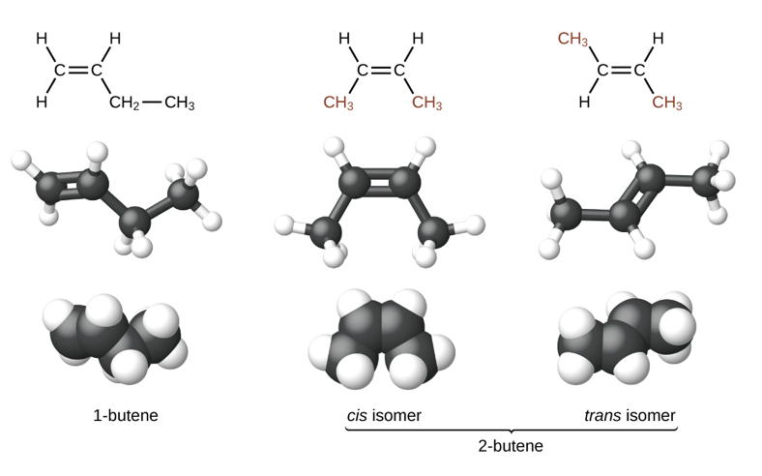
Alkene Isomers
Structural isomers
Different arrangement of atoms
Geometric isomers
Double bonds are more rigid than single bonds
Isomers can have different physical properties such as boiling points
Image Credit: OpenStax Chemistry Chapter 20.10 CC BY 4.0

Slide 13
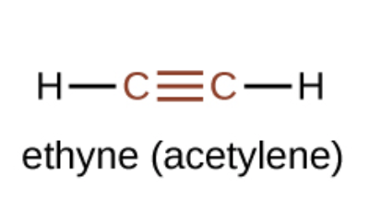
Alkynes
Alkynes are hydrocarbons with one or more triple bonds between carbon atoms
Simplest alkyne: ethyne (acetylene)
$$C_{2}H_{2}$$
-yne is used as the suffix instead of -ane or -ene
Image Credit: OpenStax Chemistry Chapter 20.1 Figure CC BY 4.0

Slide 14
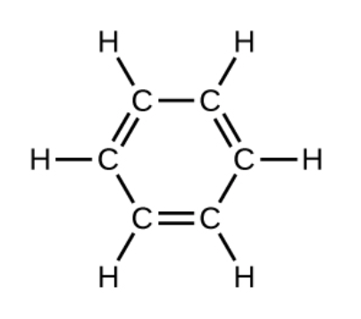
Aromatic Hydrocarbons
Hydrocarbons with a ring structure
Simplest aromatic hydrocarbon: Benzene
$$C_{6}H_{6}$$
Bonding structures are very complex and not just simple single and double bonds
Image Credit: OpenStax Chemistry Chapter 20.1 Figure CC BY 4.0

Slide 15
Summary
Alkanes are saturated hydrocarbons with only single bonds between each carbon atom
Alkenes are unsaturated hydrocarbons with one or more double bonds between carbon atoms
Alkynes are unsaturated hydrocarbons with one or more triple bonds between carbon atoms

